Slide 1



Collect data from PDF to Excel

Slide 2
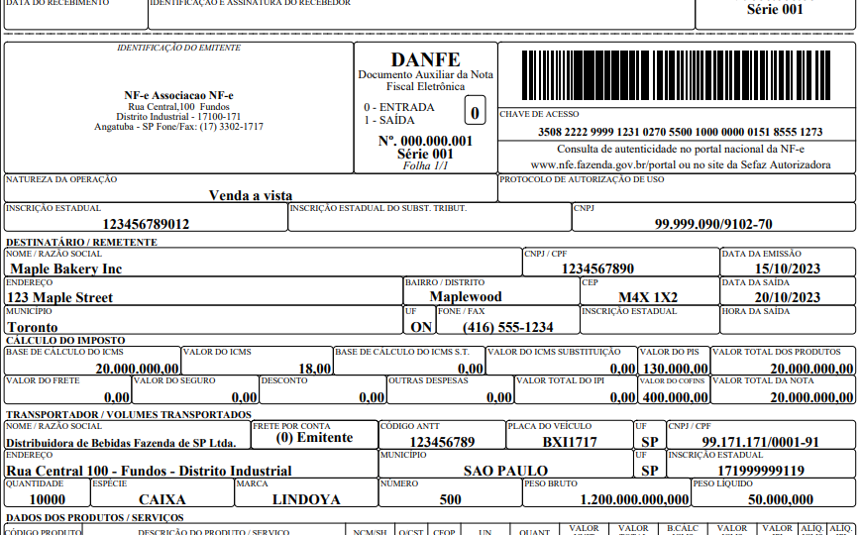
Select Data

Slide 3
Select Data

Slide 4
Create Excel

Slide 5
Collect
Data

Slide 6
For All
PDFs

