Slide 1
CSS-in-JS

Slide 2



Styled -components
A React Love Story
Patrick Ullrich
:: Software Developer
Notes:
Quick shout out about Outpost.
MedTech Start up started here in Saskatchewan. We do virtual health care, physical health care, outbreak prediction, payments, EMR, med devices, and more. We have seen a pretty rapid growth lately due to the pandemic, pushing us to just around 1000 health care providers in 6 countries. We are working with multiple governments and health institutions. And just a couple weeks ago we were selected from over a thousand applications from over a hundred countries as 1 of the top 9 innovative and production ready solutions by the UNWTO Tourism Challenge, which put us in direct communication with the UN, UNWTO, WHO, and 150+ ministers of its member states. The reason I bring this all up is, we are hiring again and we will continue to do so. I will be posting some more job postings again in the coming weeks, but, if you are a react developer, or someone with extensive web development experience, a c# backend developer, or android or ios developer and outpost sounds like a company you’d be interested in, make sure to shoot me a message on linked in or on hackregina and lets get talking!

Slide 3
CSS / SASS Where we came from
Variables
Nesting
Methodologies
Mixins
Notes:
Variables – which are now also coming to css
Nesting – Or also inheritance
Methodologies - Object Oriented CSS, Block Element Modified or BEM, Scalable and Modular Architecture for CSS or SMACCS and more
Mixing – helpful methods code snippets, really functions

Slide 4
Issues
Goals
“Safety through discipline”
Style disjointed to component
Dynamic classes are painful
“Safety through API design”
Co-locate styles with markup
Dynamic style
Support all CSS functionalities
Functions
Performance must be reasonable for our use case
Source for quote: https://twitter.com/kyleshevlin/status/925978213964066816

Slide 5
Demo – CSS App

Slide 6
Demo – Styled-Components App

Slide 7
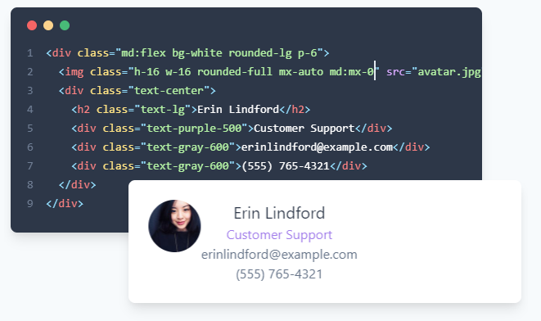
Utility frameworks

Slide 8
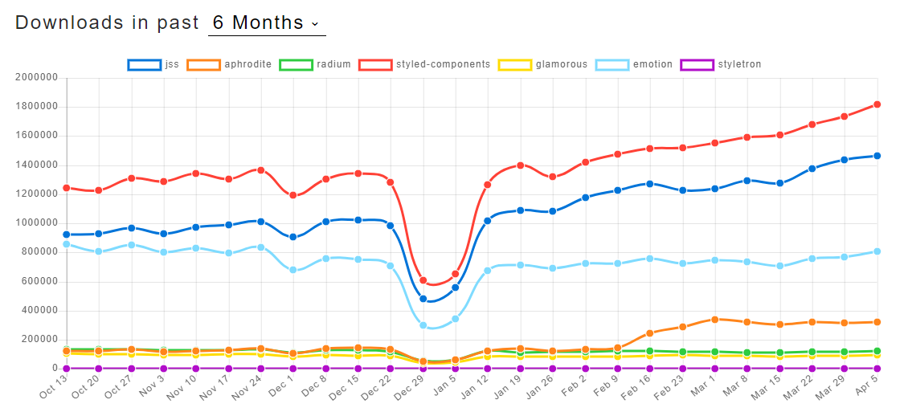
CSS-in-JS Comparison

Slide 9
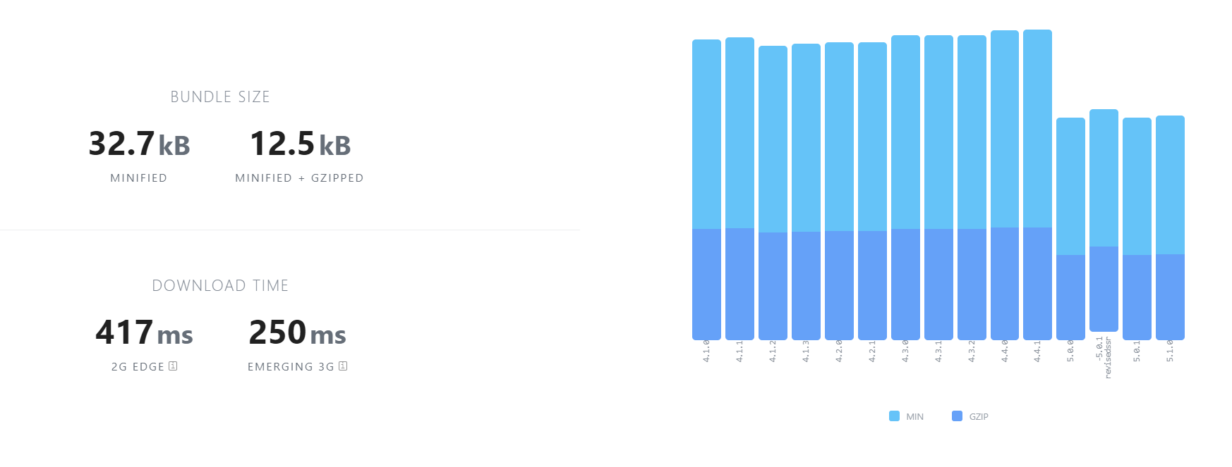
Package Size

Slide 10
Tools to check out
Babel-plugin-styled-components
Adds readable css class name to the dom
Syntax Highlighting
Official plugin for VS Code, VIM, IntelliJ products, Sublime, Atom
Testing
Jest Integration for Snapshot Testing
Linting
Stylelint-processor-styled-components
SASS to Styled-Components
Sass-extract-js to convert your Sass variables to a JS theme

Slide 11
Q&A

Slide 12
Thank You

