Slide 1

Exploring Clean Architecture & Vertical Slice Architecture
.NET Core + MediatR
Prairie Dev Con 2019 - Regina

Slide 2
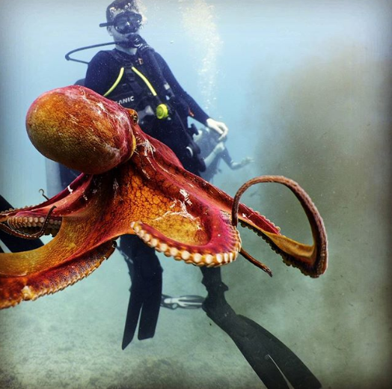
Patrick Ullrich
Senior Software Developer Outpost Health
Slack: hackregina.slack.com

Slide 3
Agenda
Stepping through time
Clean Architecture
Domain Layer
CQRS + MediatR
Application Layer
Persistence Layer
Infrastructure Layer
Presentation Layer
Tests
Vertical Slice + Clean Architecture

Slide 4


The Real Experts
Jason Taylor
Jimmy Bogard
Clean Architecture with ASP.NET Core 2.2
https://github.com/jasongt
Author of MediatR and AutoMapper, talk on Vertical Slice Architecture
https://github.com/jbogard

Slide 5
Repository – Service Pattern
Stepping through time
Reality:
Presentation Layer
Business Layer
Data Access Layer
Data Source

Slide 6
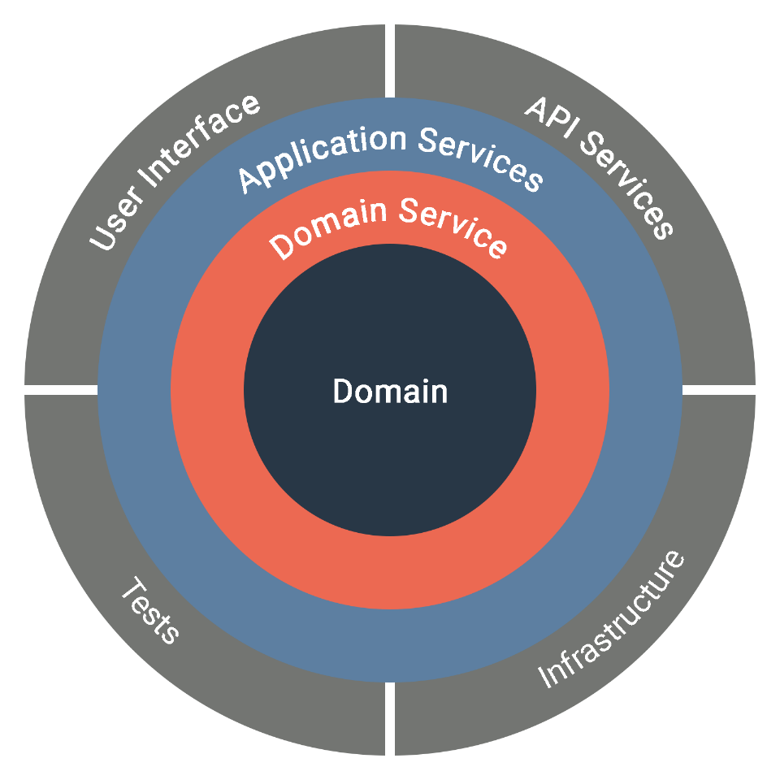
Onion Architecture
Stepping through time

Slide 7
CQRS + DDD
Stepping through time
Read Storage / Write Storage
Event Sourcing
Writes DON’T return anything
Aggregates
ValueObjects which are not real entities

Slide 8
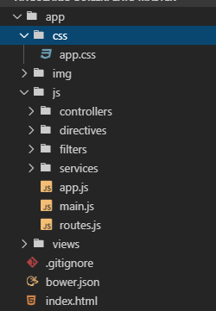
Angular 1 Era
Stepping through time
Separation:
HTML
CSS
JavaScript

Slide 9
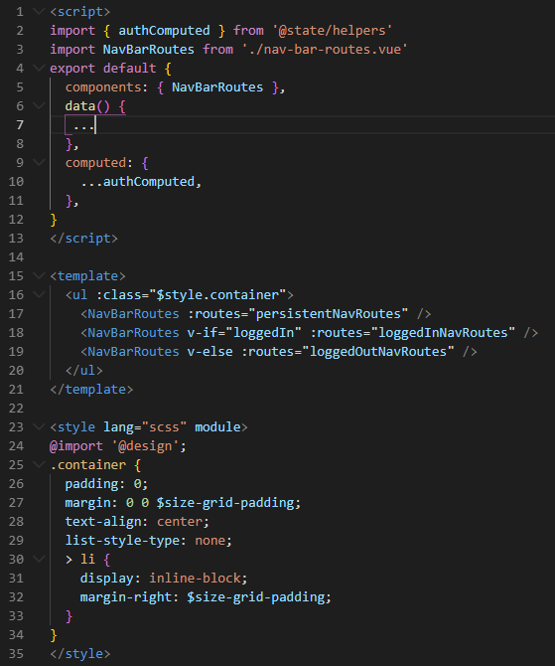
Components
Stepping through time
HTML, CSS, JavaScript in 1 file or 1 folder

Slide 10
Vertical Slice Architecture
Stepping through time
User Interface
Application Service
Slice
Domain Service
Domain
“Minimize coupling between slices and maximize coupling in a slice.” – Jimmy Bogard

Slide 11
Clean Architecture
Presentation
Persistence
Infrastructure
Application
Core
Domain

Slide 12
Domain Layer
Entities (POCO)
Enums
Exceptions
Value Objects
Presentation
Persistence
Infrastructure
Application
Domain

Slide 13

Demo & Takeaways
Avoid Data Annotations
Do use custom domain exception
Use Value Objects

Slide 14

MediatR
Intermission
Pipeline Behavior
Request
Handler
Response

Slide 15
Application Service
Interfaces
Filters
CQRS
Validators
Exceptions
Business Logic
Presentation
Persistence
Infrastructure
Application
Domain

Slide 16
Demo & Takeaways
Business Logic in Handlers
Pipeline filters for cross cutting concerns
DIP used to abstract away infrastructure and data access
MediatR, FluentValidation, and AutoMapper

Slide 17
Persistence Layer
DbContext
Migrations
Stored Procedures
Seeding
Configurations
Presentation
Persistence
Infrastructure
Application
Domain

Slide 18
Demo & Takeaways
Configurations separate from Domain
Conventions over Configuration
Fluent Configuration over Annotations

Slide 19
Infrastructure Layer
Implementations for
API Clients
File System
IoT Devices
Presentation
Persistence
Infrastructure
Application
Domain

Slide 20
Demo & Takeaways
Implementations of Application Layer Interfaces
Nothing depends on this layer

Slide 21
Presentation Layer
SPA
Angular
React
Vue
Web API
SOAP
REST
Etc.
SSR
Razor Pages
MVC
Web Forms
Presentation
Persistence
Infrastructure
Application
Domain

Slide 22

Demo & Takeaways
Controllers become thin layers
.NET Core + Open API =

Slide 23
Tests
Presentation
Persistence
Infrastructure
Easily testable
Arrange, Act, Assert
Application
Domain
Pipeline Behavior
Request
Handler
Response

Slide 24
Vertical Slice Architecture?
Slice
Move Application Logic into Presentation
Inject Infrastructure directly into Presentation
Presentation
Persistence
Infrastructure
Application
Domain

Slide 25
Thank you!
Next Steps
https://bit.ly/northwind-traders
Clean Architecture
https://github.com/jbogard/ContosoUniversityDotNetCore-Pages
Vertical Slice Architecture

