Slide 1
BSSI: Housing + Care Sync (NDIS/SRS & Aged Care)
Align new homes with trustworthy NDIS/SRS and aged-care support.
Team: PatDream — GovHack 2025 (Victoria)

Slide 2
Problem
Housing plans optimise where to add dwellings, but service planning is siloed—PT, schools, primary care and NDIS/SRS & aged‑care support are not assessed together.
Growth corridors risk “service deserts”: more homes but insufficient, reachable, quality‑assured NDIS/SRS & aged‑care support.
This hurts older people, people with disability and carers—and low transparency deters impact investment and misallocates public funds.

Slide 3
Solution — BSSI + Social Impact Layer
BSSI (Build–Service Sync Index): 0.5·Coverage + 0.3·Quality + 0.2·Access (0–100)
Coverage — NDIS/SRS & aged‑care providers per 1k residents (area‑level).
Access — PT stops ≤800 m; proximity to schools/amenities.
Quality — NDIS/SRS Social Impact Layer: proxy now (complaints/audit hints/simulated); production via partial‑audit transparency → Social Impact Score (quality‑assured support).
Outputs — risk map, ranked gap list, and a +15% permits scenario switch.

Slide 4
NDIS/SRS Social Impact Score — Quality Layer
Purpose — measure trust/quality beyond counts & access; feeds the BSSI Quality term (0–100).
Prototype → Production — today use clearly‑labelled QualityProxy; future replace with partial‑audit transparency → Social Impact Score (SIS).
Inputs (summary, privacy‑safe): audit opinion; corrective actions closed %; reportable incidents/100; substantiated complaints/100; staff screening & training %; continuity‑of‑care; cancellations/unfilled hours; participant feedback.
Example weighting: SIS = 0.40·Safety & Compliance + 0.25·Continuity & Capacity + 0.20·Workforce Quality + 0.15·Participant Experience.
Aggregation — provider‑level SIS → area‑level via participant‑weighted average; cap small‑N providers; 12‑month rolling window; case‑mix adjustment.
Governance & privacy — area‑level only; de‑identified ratios; fair‑reporting for missing/late data.
SIS (0–100) = 0.40·Safety & Compliance + 0.25·Continuity & Capacity + 0.20·Workforce + 0.15·Participant Experience

Slide 5
Victoria Datasets & Method (Prototype)
Primary VIC dataset: Building Permit Activity Monthly Summaries (VBA).
Optional VIC adds: Public Transport Lines & Stops; School Locations; Rental Report/VHR; Vicmap Features of Interest.
Other public: ABS SEIFA; NDIS Provider Register; VIC SRS register (locations).
Steps: (1) Permits→Regions→12‑mo sums → Permits_Growth_Index (0–100) (2) Coverage/Access (3) QualityProxy (4) BSSI (5) Map & Top‑10 CSV.
Privacy: area‑level metrics; no personal data.

Slide 6
Demo Outputs — Top Gap Suburbs (Prototype)
Suburb | Permits_Index | Providers_Count | Coverage/1k | Access(0–100) | QualityProxy(0–100) | BSSI(0–100)
Werribee | 100 | 6 | 22 | 60 | 38 | 34
Tarneit | 100 | 5 | 18 | 55 | 35 | 30
Craigieburn | 100 | 7 | 20 | 58 | 42 | 34
Cranbourne East | 100 | 4 | 15 | 62 | 33 | 30
Truganina | 100 | 4 | 14 | 50 | 30 | 26
Note: Permits_Index derived from VBA monthly summaries (Outer Melbourne, 12‑month
relative index). Quality is prototype proxy; will be replaced by Social Impact Score.

Slide 7
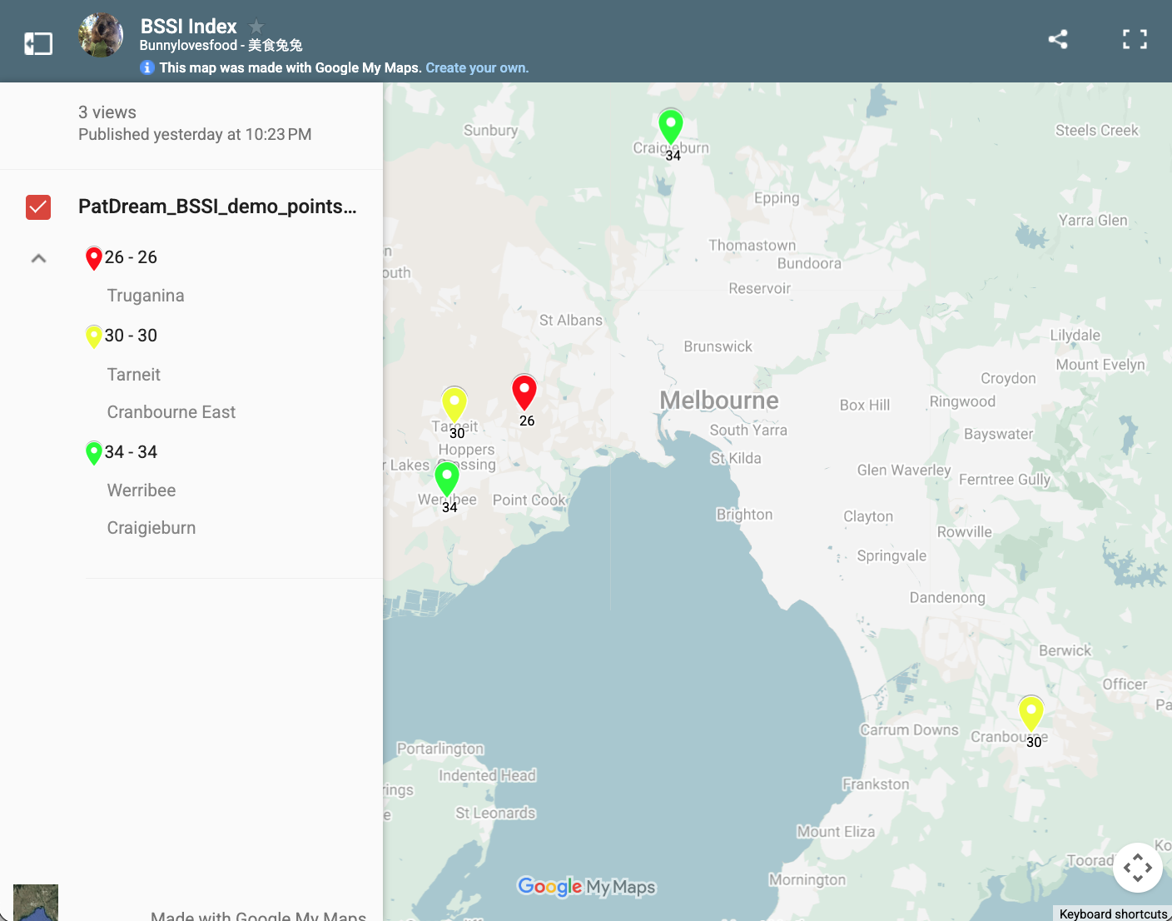
Map — Build‑Hotspot / Service‑Coldspot
Interactive My Maps link (viewer mode):
https://www.google.com/maps/d/view?mid=14MsOZWXt4HpJuAmfi9_uyfZwI-ncxNo&ll=
-37.866949053151245,144.86756012265627&z=10&hl=en

Slide 8
Impact & Roadmap
Residents — clearer choices; avoid unsafe providers; less travel burden.
Councils — plan housing WITH services; prioritise investment/oversight.
Government — reduce waste and fraud; trust & accountability via transparency.
Impact investment — de‑risk allocation; crowd‑in capital to high‑need suburbs via the measurable BSSI signal.
Roadmap: P0 prototype → P1 pilot (SRS/NDIS sample) → P2 partial‑audit transparency → P3 platform + API.

Slide 9
Challenge Fit — Enabling Better Community Housing & Infrastructure Planning
Identifies housing stress & anticipates development impacts (permits + stress lenses).
Maps gaps between housing pressure and available support services (BSSI).
Provides community/council tools: risk map, ranked list, and scenario testing.
Uses at least one VIC dataset (VBA building permits) with optional PT/schools/SEIFA.

Slide 10
Ethics, Privacy & Fairness
Privacy scope — publish only area‑level metrics (SA2/LGA); no personal data; de‑identified ratios/counts.
Small‑N protection — suppress or cap cells where N < 5; apply noise/limits to avoid re‑identification.
Fairness & bias — case‑mix adjustment; audit recency weighting; handle missing/late data with fair defaults.
Governance — open methods; public data dictionary; provider right‑of‑reply on audit summaries; versioned releases.
Security — access‑controlled raw feeds; encrypted at rest/in transit; audit logs for data access.
Ethical AI — explainable formulas (BSSI/SIS); no automated adverse actions; human‑in‑the‑loop for oversight.
Prototype note — Quality uses proxy today; path to partial‑audit transparency for Social Impact Score (SIS).

