Slide 1
Debugging Problems
Author: Patrick Farmer Supervisor: Dr. Jonathon Dukes

Slide 2
Demonstration
This will contain example code and LLM bug insertion

Slide 3
LLM’s
What LLMs are good at
Writing human-like code
What LLMs are bad at
Creating bugs intentionally
Interacting with LLM in code
Interactions with an LLM is done though an API (Ollama or OpenAI)

Slide 4
Debugging Importance
A large portion of a programmers time is spent debugging
The time spent debugging is between 35-50% (1)
The cost of debugging is between 50-75% (2)
Increased importance of debugging as LLM usage grows

Slide 5
Skills for Debugging
Domain and System Knowledge
Tool knowledge
Debugging strategies
Experience

Slide 6
Addressing Debugging
Greater exposure to python from program + practice understanding problems
Future front end should include debugging tools
A user could teach debugging strategies with the tool
More exposure to bugs particularly in LLMs

Slide 7
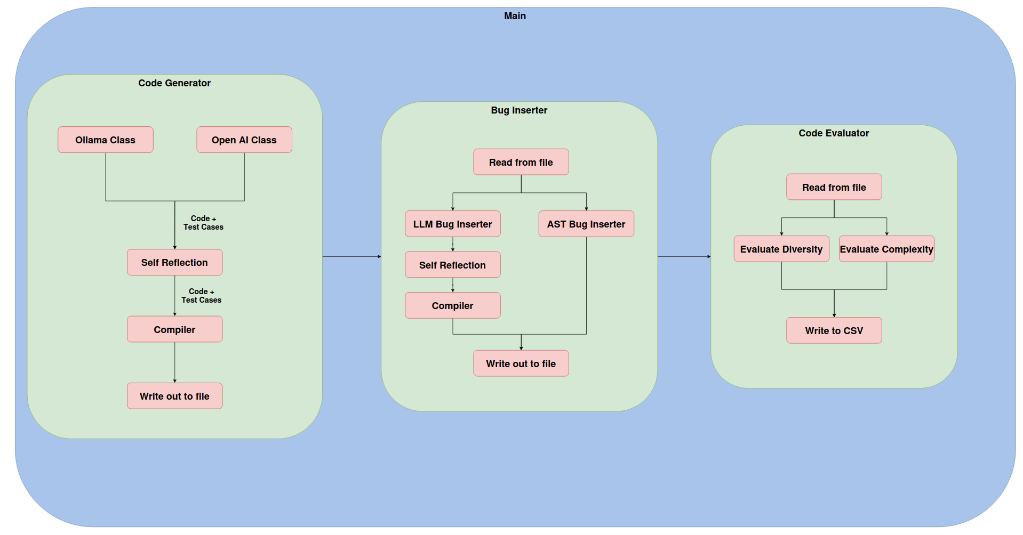
Code Architecture

Slide 8
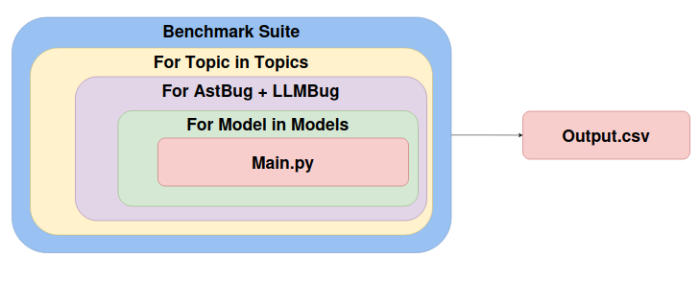
Testing Architecture

Slide 9
Bug Insertion
(Move in front of architecture diagrams?)
Two types of bug insertion
LLM bug insertion
AST bug insertion
The LLM had a lot of issues with bug insertion

Slide 10
Self Checking and Improvement
Self Checking
The code is parsed from the response
The code is fed back to the LLM along with prompt
Self Improvement
If all is ok, continue to compilation and test case checking
if not, ask LLM to improve the response and try again (up to x times)

Slide 11
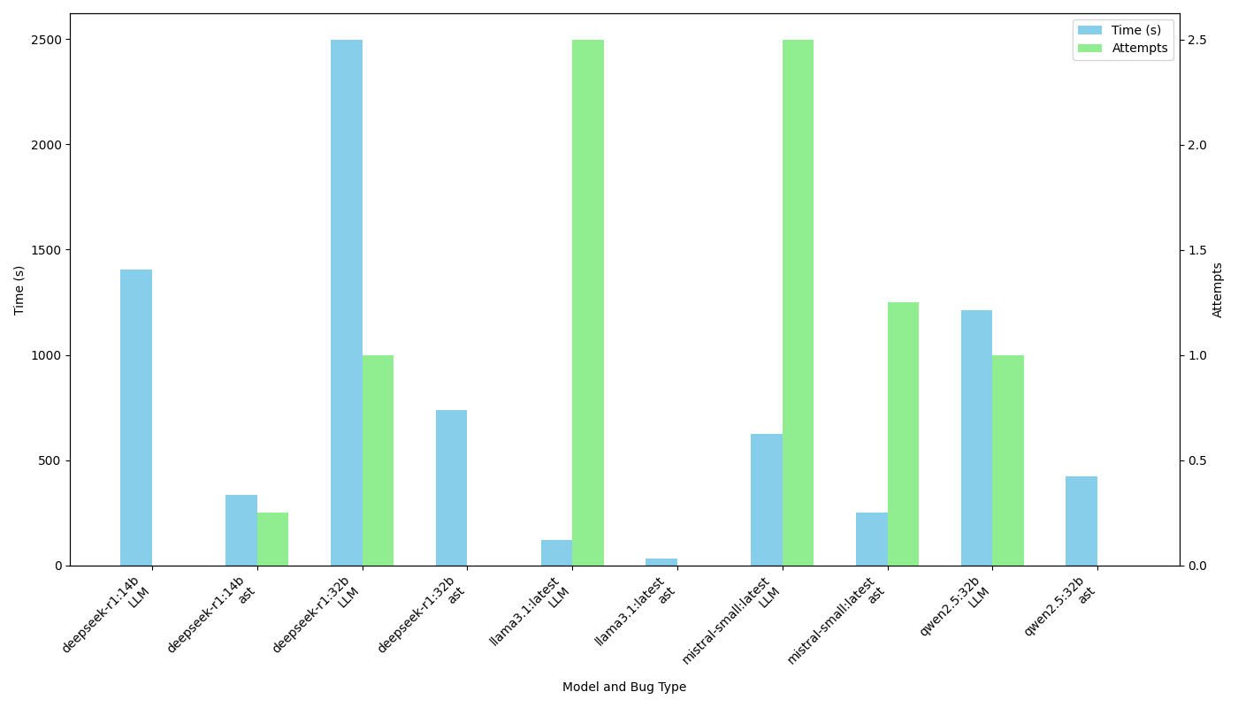
Performance across models

Slide 12
Conclusion
A tool to generate helpful problems for students to debug was created
The future work could include a front end for the tool and a study to test the usefulness of the tool
Thank you for listening

Slide 13
References
Britton, T., Jeng, L., Carver, G., Cheak, P., Katzenellenbogen, T. 2013. Reversible debugging software. Cambridge Judge Business School; http://citeseerx.ist.psu.edu/viewdoc/download?doi=10.1.1.444.9094&rep=rep1&type=pdf.
RTI. 2002. The economic impacts of inadequate infrastructure for software testing; http://www.nist.gov/director/planning/upload/report02-3.pdf. `

