Slide 1
Debugging Problems
Author: Patrick Farmer
Supervisor: Jonathan Dukes

Slide 2
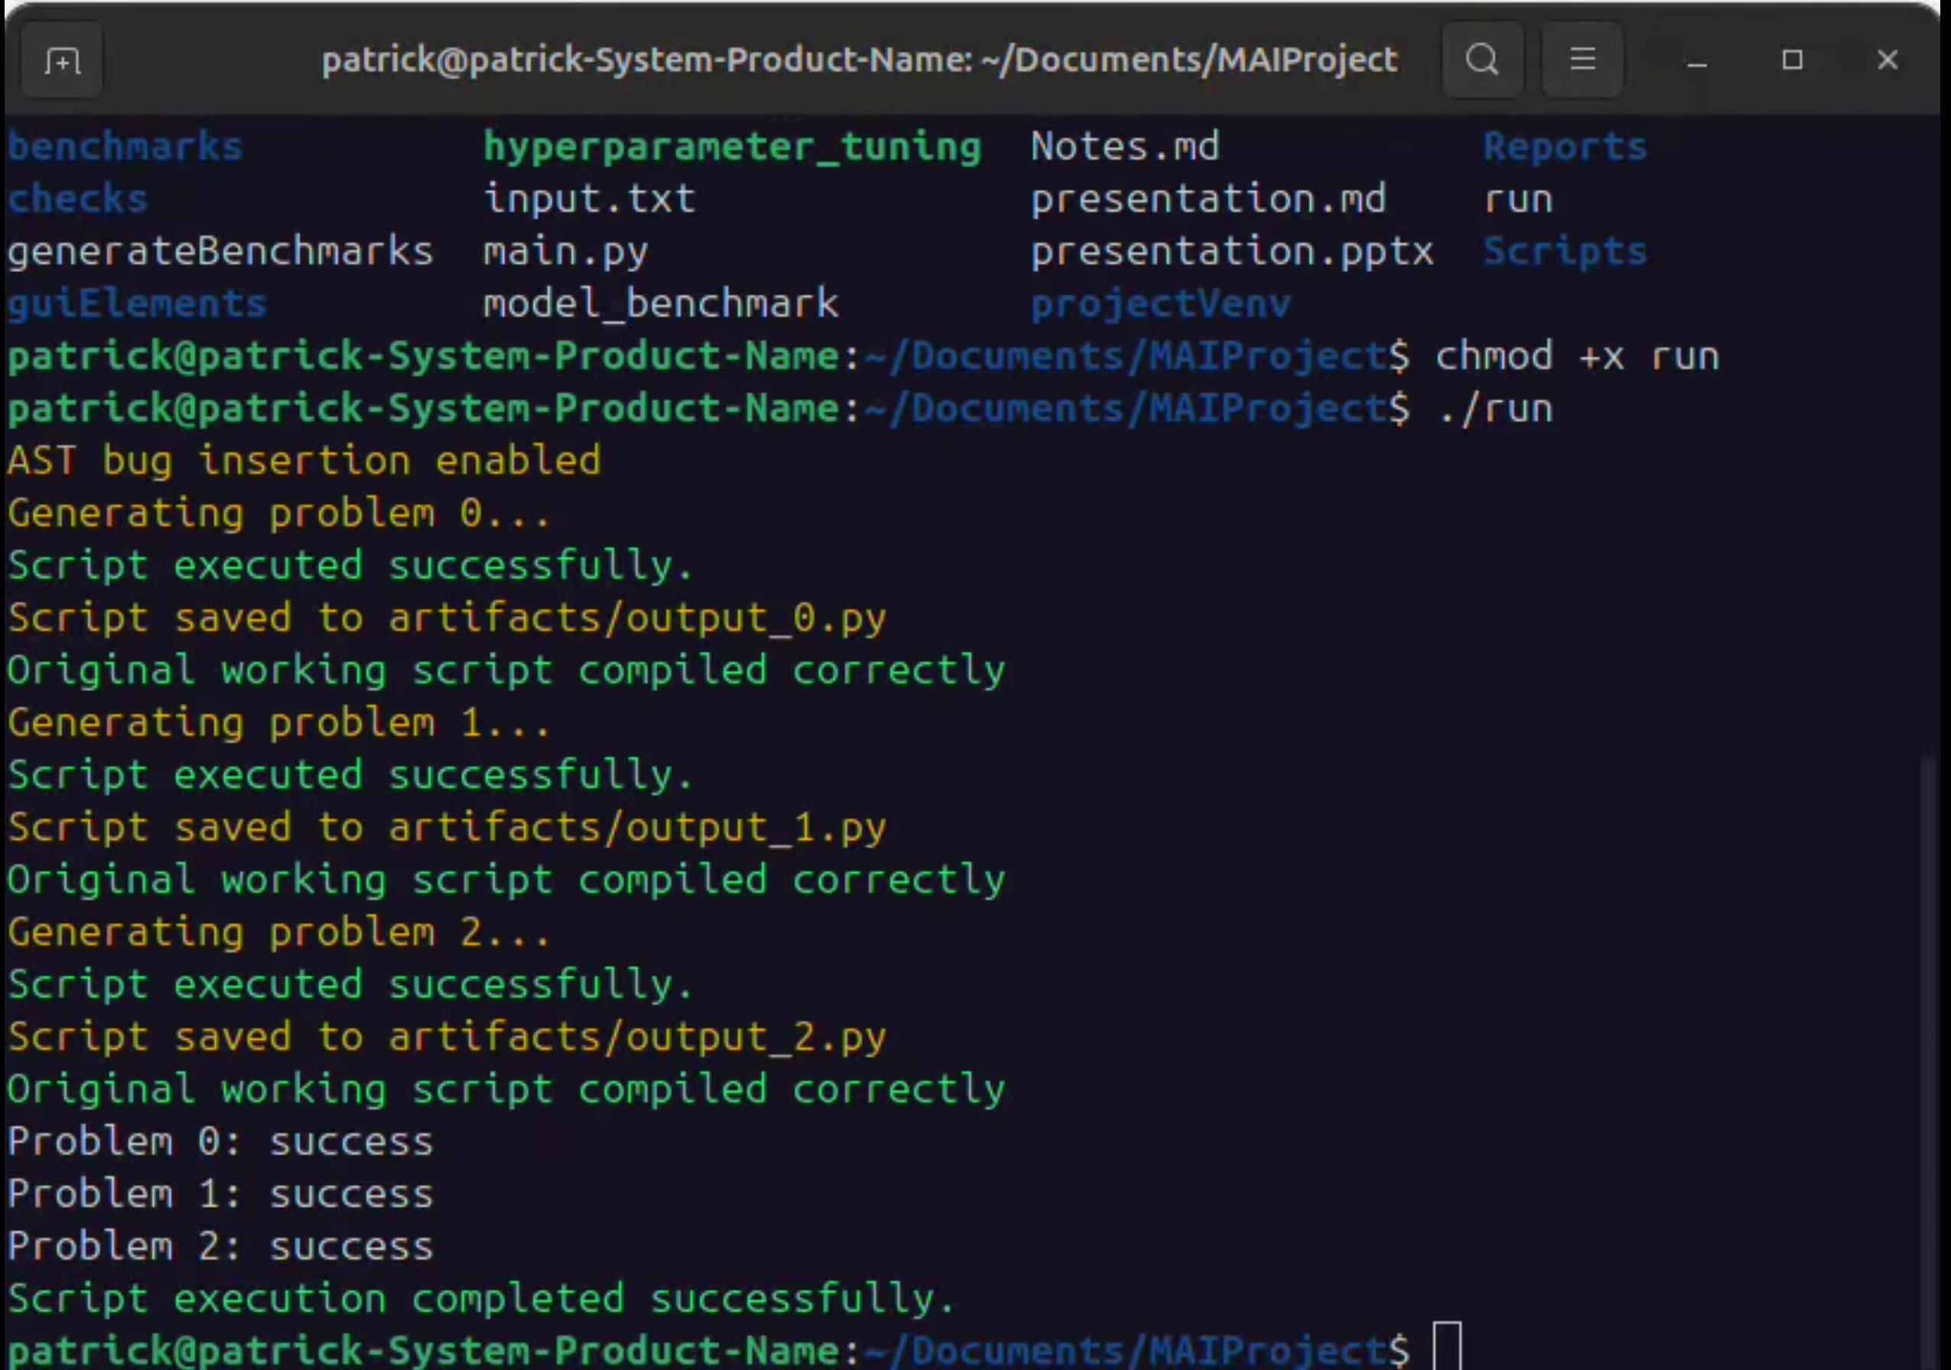
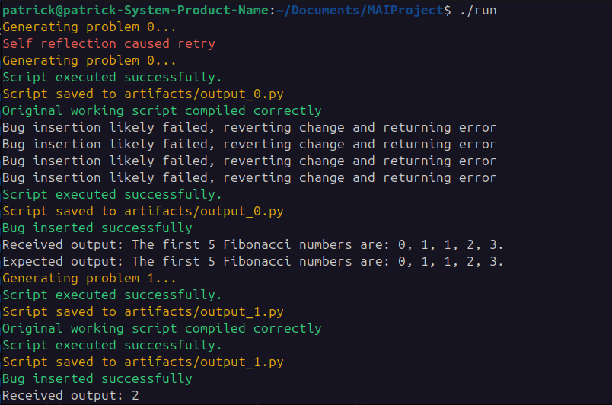
Demonstration

Slide 3
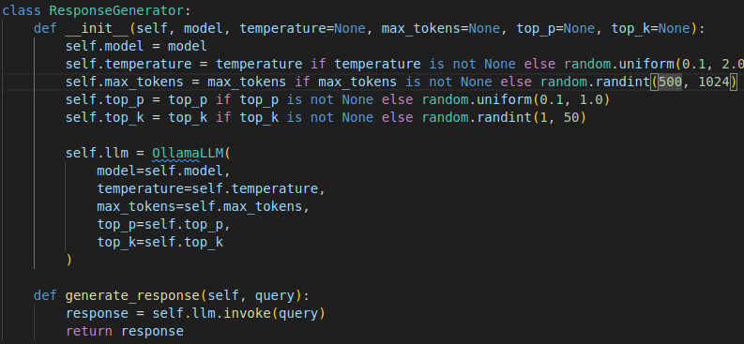
LLM’s
What LLMs are good at
  Writing human-like code
What LLMs are bad at
  Creating bugs intentionally
Interacting with LLM in code
  Interactions with an LLM is done though an API (Ollama or OpenAI)

Slide 4
Debugging Importance
A large portion of a programmers time is spent debugging
The time spent debugging is between 35-50% (1)
The cost of debugging is between 50-75% (2)
Increased importance of debugging as LLM usage grows
Britton, T., Jeng, L., Carver, G., Cheak, P., Katzenellenbogen, T. 2013. Reversible debugging software. Cambridge Judge Business School; http://citeseerx.ist.psu.edu/viewdoc/download?doi=10.1.1.444.9094&rep=rep1&type=pdf.
RTI. 2002. The economic impacts of inadequate infrastructure for software testing; http://www.nist.gov/director/planning/upload/report02-3.pdf. `

Slide 5
Skills for Debugging
Domain and System Knowledge
Tool knowledge
Debugging strategies
Experience

Slide 6
Addressing Debugging
Greater exposure to python from program + practice understanding problems
Future front end should include debugging tools
A user could teach debugging strategies with the tool
More exposure to bugs particularly in LLMs

Slide 7
Bug Insertion
Two types of bug insertion
  LLM bug insertion
  AST bug insertion
The LLM had a lot of issues with bug insertion

Slide 8
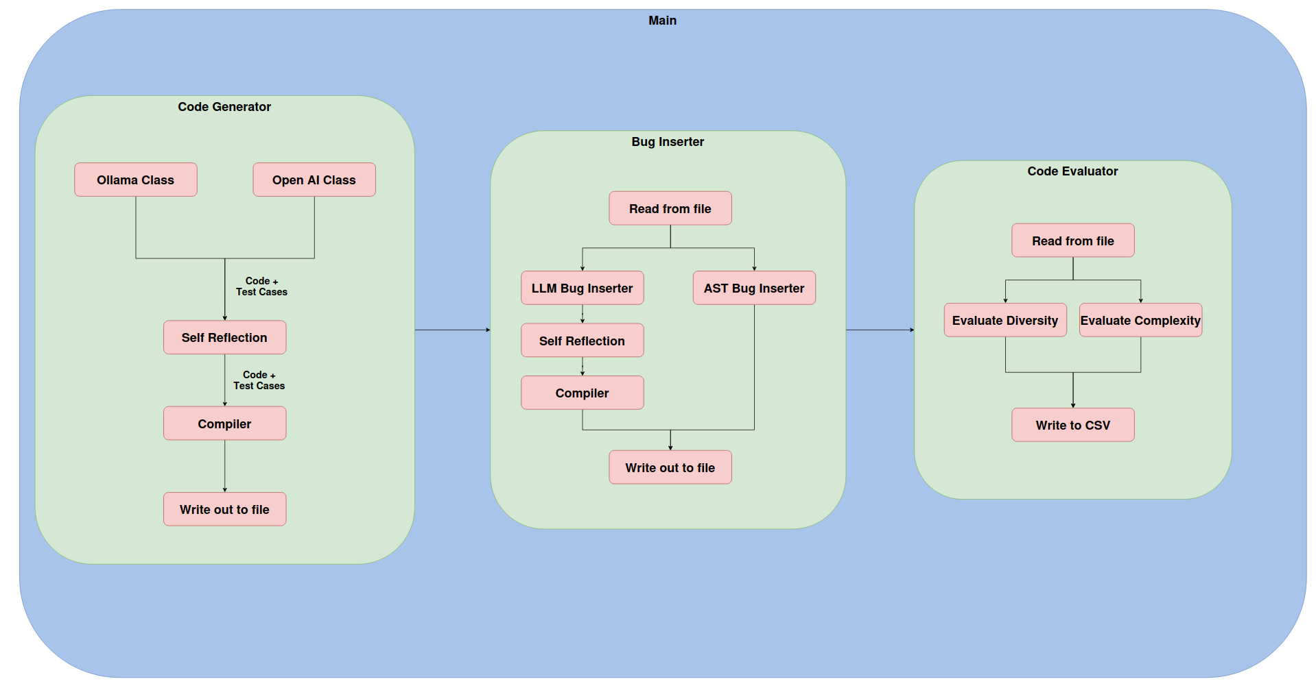
Code Architecture

Slide 9
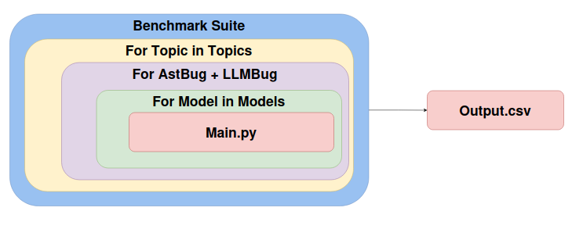
Testing Architecture

Slide 10
Self Checking and Improvement
Self Checking
  The code is parsed from the response
  The code is fed back to the LLM along with prompt
Self Improvement
  If all is ok, continue to compilation and test case checking
  If not, ask LLM to improve the response and try again (up to x times)

Slide 11
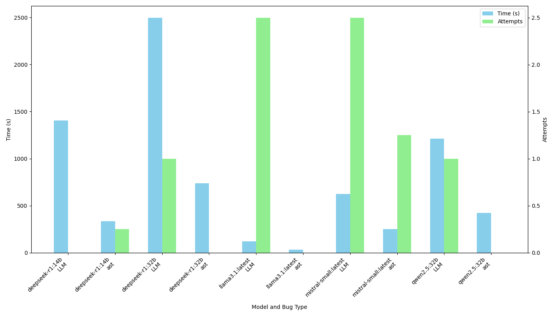
Performance across models

Slide 12
Conclusion
A tool to generate helpful problems for students to debug was created
The future work could include a front end for the tool and a study to test the usefulness of the tool
Thank you for listening

Slide 13

References
Britton, T., Jeng, L., Carver, G., Cheak, P., Katzenellenbogen, T. 2013. Reversible debugging software. Cambridge Judge Business School; http://citeseerx.ist.psu.edu/viewdoc/download?doi=10.1.1.444.9094&rep=rep1&type=pdf.
RTI. 2002. The economic impacts of inadequate infrastructure for software testing; http://www.nist.gov/director/planning/upload/report02-3.pdf. `
Trinity College Dublin, The University of Dublin

