Slide 1
Design

Slide 2

Design
X – User Experience
UI – User Interface

Slide 3

What keeps users from coming back
Not Intuitive
Hard to read
Distracting
Doesn’t work properly
Takes too long to load

Slide 4

Make sure to do this:
Use High Contrasting Colors - https://webaim.org/resources/contrastchecker/
Label all of your user interactive components – textboxes, buttons, etc.
Make sure all of your components follow the theme of your app.
Use solid or semi solid background

Slide 5
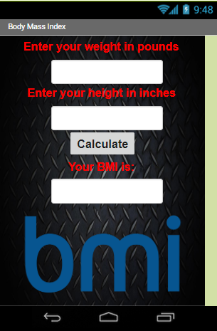
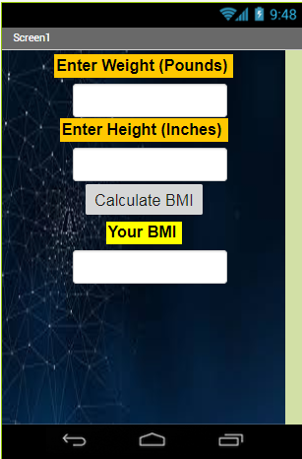
Examples

Slide 6
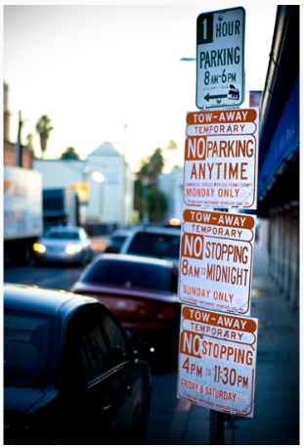
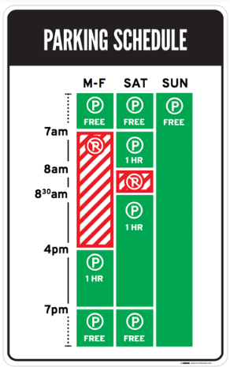
Information Overload
Best Practices:
Understand what your users need, then design based on that. This helps reduce information overload.
Have lots of information to convey to your users? Try using visuals instead of text.
Before
After

Slide 7

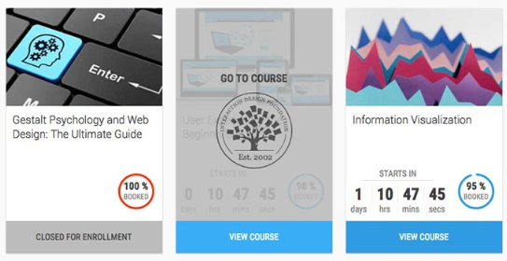
Lacking Information
Best Practices:
Always label your interactive components.

Slide 8

Typography
• Never use more than two or three different font families on a single project.
• Match the typography tone with the tone of the design and content.
• Pay attention to the thickness and contrast of a type, especially when background images are used.
• Make sure the font is easy to read.

Slide 10
Resources
https://www.interaction-design.org/literature/article/bad-design-vs-good-design-5-examples-we-can-learn-frombad-design-vs-good-design-5-examples-we-can-learn-from-130706
https://www.justinmind.com/blog/7-common-pitfalls-of-a-novice-ux-designer-and-how-to-deal-with-them/

