Slide 1
ACE
Learning for the
prediction we use
An experiment helps when its observations can
improve the model’s final prediction.
Make every experiment count.
01
Notes:
Organizing principle: choose experimental and fitting decisions to reduce error in the model we will actually use, under the actions we intend to take. This is a research objective, not an optimality theorem. Acquisition determines usable observations. Final fitting determines how the deployed predictor uses them. The tagline expresses an aspiration and guarantees no per-experiment improvement. Slides1–4 are theory,5–7 a purely illustrative example,8–10 evidence and limits. No unqualified prospective Stage B performance is included.
Sources
/Users/pat/code/ACE/docs/development/guidance/ace_theoretical_ideation_2026-10-08.md
/Users/pat/code/ACE/docs/ACE_evidence_and_public_claims_2026-10-08.md

Slide 2
Information and fitting effort
More eligible observations
More fitting on saved observations
They can reduce uncertainty about
a correctly specified mechanism.
It can reduce error left by
the online optimizer.
Posterior variance can decrease
Neural test error can still increase
The information result assumes a linear Gaussian model. Final fitting costs computation.
02
Notes:
For a correctly specified linear Gaussian mechanism with proper Gaussian prior and independent Gaussian observation noise, posterior precision equals prior precision plus the eligible design information. Adding eligible observations yields a positive semidefinite precision increment and cannot increase posterior variance for a fixed linear target. This is not monotonic realized frequentist error or a guarantee for a neural optimizer. Eligibility: clamping a node removes its natural mechanism label, although other naturally operating heads can retain usable labels under the stated assumptions. Reusing eligible observations can reduce optimization or retention deficits at additional computation cost. The existing studies do not isolate data retention from extra fitting effort.
Sources
/Users/pat/code/ACE/docs/development/guidance/ace_theoretical_ideation_2026-10-08.md
/Users/pat/code/ACE/paper/aistats_ace_2027/delivery_theory.tex

Slide 3
Error propagation through a causal model
Final error = amplified intermediate error + local error
δY = b × δM + eY
δM
Intermediate error
b
Learned slope
eY
Downstream residual
Signed errors can reinforce or cancel. A good local fit may still compose poorly.
03
Notes:
For a two-stage linear toy chain, b is the LEARNED downstream predictor slope. Define δM=Mhat−M, δY=Yhat−Y and eY=fhatY(M)−fY(M), the downstream predictor residual at the true intermediate value. Then δY=bδM+eY exactly. The true downstream slope generally does not yield this identity if learned and true slopes differ. For a differentiable nonlinear DAG the corresponding local secant/Jacobian path identity requires explicit segment assumptions. Signed residuals can reinforce or cancel, so local error magnitudes alone do not determine terminal error. This motivates inspection of composed prediction and is not evidence for the cause of the known worsening history.
Sources
/Users/pat/code/ACE/docs/development/guidance/ace_theoretical_ideation_2026-10-08.md
/Users/pat/code/ACE/paper/aistats_ace_2027/delivery_theory.tex

Slide 4
An experiment’s value depends on the target
Useful information connects an observation to the outcome we care about.
T: target. Z: measurement signal. σ²: noise variance.
ΔR = Cov(T, Z)² / (Var(Z) + σ²)
Unrelated quantity: variance 9
Target gain: 0
Target itself: variance 1
Target gain: 0.5
Example uses independent linear Gaussian parameters and noise variance 1.
04
Notes:
Conditional linear Gaussian illustration: target T=gᵀθ, candidate latent observation Z=xᵀθ, covariance Σ and additive independent Gaussian noise variance σ²>0. Target posterior variance reduction equals Cov(T,Z)²/[Var(Z)+σ²]. Example Σ=diag(9,1), T=θ2, σ²=1. Measuring θ1 has latent variance9 but target gain0. Measuring θ2 has latent variance1 but target gain1/2. Thus choosing largest observation variance can fail for a target-specific posterior objective. This exact model does not establish nonlinear ACE superiority or an optimal adaptive experimental policy. Real interventions may induce random designs, requiring expected posterior target risk rather than plugging in simulated mean features.
Sources
/Users/pat/code/ACE/docs/development/guidance/ace_theoretical_ideation_2026-10-08.md
https://papers.nips.cc/paper/1011-active-learning-with-statistical-models.pdf
https://arxiv.org/html/2411.02740v5

Slide 5
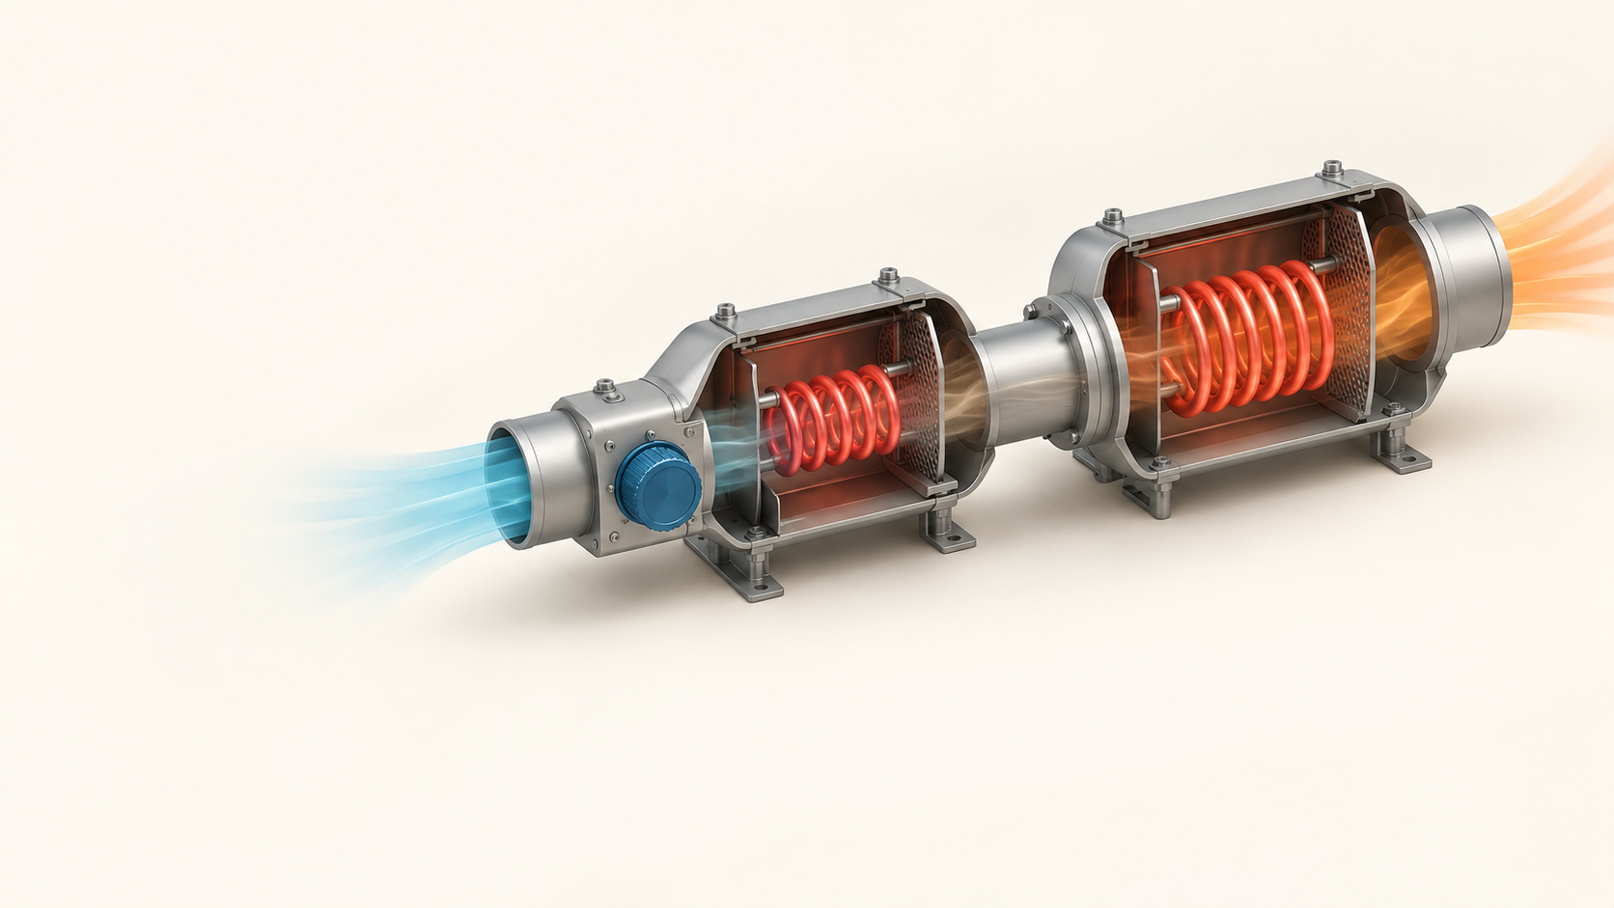
A two-stage heater
Input u = 1
M = 2u
Y = 3M
Final output
Y = 6
Illustrative model with dimensionless values
05
Notes:
Purely illustrative algebra using dimensionless response variables. This is not a physical model or an ACE laboratory result. At input u=1, first stage M=2u yields M=2, downstream Y=3M yields Y=6. Ask the audience for the output, reveal the intermediate value, then the final value. The nonlinear or physical relevance must be tested separately. Illustration: AI-generated cutaway of a fictional two-stage heater, not a photograph of a recorded apparatus. Source image /Users/pat/.codex/generated_images/01a0b23b-f609-70c3-880d-2f3eb04d9ce3/exec-8f98eb96-8f60-4728-b06e-ccb734f3f890.png.
Sources
/Users/pat/code/ACE/docs/development/guidance/ace_theoretical_ideation_2026-10-08.md

Slide 6
A small intermediate error changes the output
Quantity | True system | Predicted chain | Error
Input u | 1 | 1 | 0
Intermediate M | 2 | 2.2 | +0.2
Final output Y | 6 | 6.6 | +0.6
The downstream rule is exact. It receives a predicted intermediate value.
Checking the second stage at the measured value M = 2 hides this composed error.
06
Notes:
Keep the true rules M=2u and Y=3M. Let the learned first stage predict Mhat=2.2 at u=1, while the downstream rule remains exact. Yhat=3×2.2=6.6, intermediate error0.2 and output error0.6. A downstream head evaluated with measured M=2 predicts6 exactly, which can conceal the free-running chain error. No model was fitted to generate these values. A cancellation example, only for discussion: if the downstream residual at true M were−0.6, the same intermediate error could cancel to zero terminal error; therefore do not infer universal error ordering from local fits.
Sources
/Users/pat/code/ACE/docs/development/guidance/ace_theoretical_ideation_2026-10-08.md

Slide 7
Primary gains in two synthetic families
PEV minus systematic coverage. Negative means lower error.
Synthetic family | Mean difference | 95% interval | Holm p
Homogeneous | −0.01360 | −0.02151 to −0.00569 | 0.00384
Heterogeneous | −0.10919 | −0.18856 to −0.02981 | 0.00961
20 systems per family. 2,000 samples per arm and system.
Known graphs and one learner. Scoring ablation unresolved. External transfer remains open.
07
Notes:
Historical persistent SCM confirmationv1:40 fresh30-node systems,20 each homogeneous and heterogeneous, four policies and160 completed cells. All arms used32steps/exactly2000 environmental samples including observational refreshes, shared within-system serialized environments and zero candidate-probe samples. Primary endpoint final feasible-intervention non-root mechanism loss. PEV minus graph-matched non-leaf coverage: homogeneous−0.01360,95% paired t interval[−0.02151,−0.00569],Holm-adjustedp0.00384,20/20 favorPEV. Heterogeneous−0.10919,interval[−0.18856,−0.02981],Holm-adjustedp0.00961,16/20 favorPEV. Both primary contrasts passed. This is separate from slide9 shifted-mechanism study, whose primary coverage gate failed. Do not pool studies or select the best of them as a new scientific success rule. Known fully observed graphs, fixed learner/cost model/evaluation panel, no external-domain claim. Simpler variance scoring comparisons unresolved and observational loss similar. No new test or experiment.
Sources
/Users/pat/code/ACE/results/research_persistent_confirmation_v1/README.md
/Users/pat/code/ACE/docs/development/guidance/protocol_persistent_confirmation_v1.json
/Users/pat/code/ACE/docs/ACE_evidence_and_public_claims_2026-10-08.md

Slide 8
Final fitting improved 11 of 12 histories
Geometric exact-level error ratio
0.183
95% interval
0.102 to 0.327
One history worsened
2.015 × online error
One emulator. Exposed grid. Median of three scored refit initializations.
Fitting computation differs. Worsening history 124753321 remains included.
08
Notes:
Accepted confirmation in one deterministic emulator with12 collected histories. Geometric mean paired exact-level error ratio0.183 with95% interval[0.102,0.327], sign-flip p0.00146484. Chart normalizes unchanged online error to1 and displays the geometric delivery/online ratio, not arithmetic absolute errors. Numerator is median of three scored refit initializations, evaluation on the full exposed grid including acquired inputs, with unequal fitting computation. It supports the bundled refit procedure, not an acquisition, equal-compute, architecture or independent-world claim. Retained worsening history124753321 has online0.196339 and delivered median0.395658, ratio2.015177. All12 histories contribute to the aggregate.
Sources
/Users/pat/code/ACE/paper/aistats_ace_2027/claim_index.json
/Users/pat/code/ACE/paper/aistats_ace_2027/paper.tex
/Users/pat/code/ACE/docs/ACE_evidence_and_public_claims_2026-10-08.md

Slide 9
Lower error than a specified random policy
Mean held-out mechanism MSE. Lower is better.
64.85%
Lower group mean error
than random
19 / 20 systems
2,000 samples per
arm and system
Secondary random comparison: p = 0.00750. Primary coverage comparison failed: p = 0.05108.
The scoring ablation remains unresolved. One synthetic generator. Equal samples, unequal compute.
09
Notes:
Historical shifted-mechanism confirmation20 fresh systems and four arms,2000 environment samples per arm/system, shared within-system graph/mechanisms and persistent learner. Endpoint: final held-out noise-free feasible non-root mechanism MSE. Chart uses recorded arithmetic means0.043898 random,0.039791 coverage,0.015430 IVR PEV,0.015871 simpler variance. PEV lower than random19/20. Secondary paired difference−0.028468,95% t interval[−0.048386,−0.008550],two-sided p0.00750, not multiplicity-adjusted primary success. Descriptive group-mean reduction64.85%=1−.0154302049/.0438980071; not a paired geometric ratio, confidence bound or increased accuracy. Primary PEV minus coverage failed p0.05108, interval crosses0. PEV vs simpler variance unresolved p0.62176, not equivalence. Corrected provenance20 distinct DAGs within one fixed hierarchical generator; does not establish graph-family or external laboratory transfer. Random uses same eligible targets, random target/uniform−5…+5 values. Equal measurement budget, not equal compute. No new hypothesis test or stopped acquisition agenda restart. Other fresh primary coverage confirmations were favorable in homogeneous/heterogeneous families (40 systems), but they are different studies and are not pooled into this chart.
Sources
/Users/pat/code/ACE/results/research_pev_shift30_mean_confirmation/README.md
/Users/pat/code/ACE/docs/development/guidance/protocol_pev_shift30_mean_confirmation.json
/Users/pat/code/ACE/docs/development/guidance/erratum_shift_graph_provenance_2026-09-27.md
/Users/pat/code/ACE/docs/ACE_evidence_and_public_claims_2026-10-08.md
/Users/pat/code/ACE/results/research_persistent_confirmation_v1/README.md

Slide 10
Simple structure can be the strongest model
Delivery wins across 11 physical conditions
0 / 11
Delivery wins
against Fourier
A candidate method fits the final prediction and
compares strong simple models on reserved validation.
One apparatus. Correlated conditions. New method superiority remains open.
10
Notes:
Accepted physical prediction study: neural delivery beats rolling in7/11, physics regression3/11, Fourier0/11. All eleven evaluation conditions of one apparatus, not independent worlds. Training-only white_64 excluded from evaluation conditions. These are comparator-specific descriptive wins, not a population significance test or proved physics explanation. A suitable periodic representation plausibly reduces approximation/optimization burden; that explanation remains a hypothesis. Proposed direction: mechanism-plus-terminal fitting, structured alternative models and reserved validation against the baseline. No tested superiority, universal acceptance or automatic new experiment follows. Prospective Stage B original acceptance is complete but supplemental exact-runtime numerical replay and reporting remain unqualified, so no Stage B performance appears.
Sources
/Users/pat/code/ACE/paper/aistats_ace_2027/claim_index.json
/Users/pat/code/ACE/paper/aistats_ace_2027/paper.tex
/Users/pat/code/ACE/docs/development/guidance/ace_theoretical_ideation_2026-10-08.md

