Slide 1
Classifying Handwritten Text
Patrick Ancel

Slide 2
Motivation
Converting Handwritten Text to Documents
Preserving Stylistic Information
Defining Handwritten Fonts
  “What font do you write with?”

Slide 3
Considerations
Defining Styles is Hard
Let the Algorithm do it
No Prior Knowledge of Styles
  Unsupervised
  K-Means Clustering

Slide 4
Clustering
Each style is a cluster/class
Clusters used to train neural network
What features will be used?

Slide 5
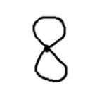
Distances
K-Means requires Distances
  Find the “distance” between 2 images
Represent Images as Vectors
  How?
  An array of pixels?
Too many coordinates
155 x 135 = 20,925

Slide 6
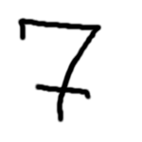
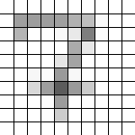
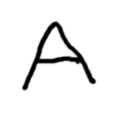
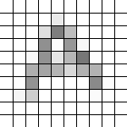
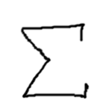
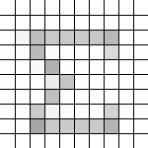
Vectors
Reduce Number of Coordinates
  Use Larger Blocks
  Divide image into Array of Squares
Each Block has Avg. Brightness
  Block Sizes Exaggerated
Individual spots of ink less relevant
  Overall picture
  Loss of detail
    Not too much, not too little
Problems
  Every Coordinate has own Dimension

Slide 7
Creating the Model
“What style?” versus “What character?”
  Two-layer Model
  Use constant symbol: 8
Image Specs
  155 x 135 pixels
  Block size = 5
K-Means (K=3)
  Unreliable
Neural Network
Create Vectors
K-Means
Neural Network

Slide 8
Related Works
Improving Handwriting Recognition
  Using an HMM for each style
  G.A. Fink and T. Plötz, “Unsupervised Estimation of Writing Style Models for Improved Unconstrained Off-line Handwriting Recognition.” in Tenth International Workshop on Frontiers in Handwriting Recognition, Université de Rennes, La Baule, France, Oct. 1, 2006. Available: https://hal.inria.fr/inria-00103797v2
Legibility
  Three classes
  36 features
  M.E. Dehkordi, N. Sherkat, and T. Allen, “Handwriting style classification,” IJDAR, 6, pp. 55-74, June 2003, doi: https://doi.org/10.1007/s10032-003-0101-4.

Slide 9
Tools Used
Python
Pillow
  Reading images
  Takes a while
    Storing temporary strings
NumPy
  Array Calculations
TensorFlow
  Neural Networks
Kaggle Dataset
  C. Zhao, “Handwritten math symbol and digit dataset.” Distributed by Kaggle. Available: https://www.kaggle.com/clarencezhao/handwritten-math-symbol-dataset (accessed Aug. 5th, 2020).

Slide 10
Datasets
Image vectors are huge
Reading images takes a while
  Especially hundreds
Reading text is faster
Lots of streaks of 0 and 255
  Run-length encoding

Slide 11
K-Means Results
Inconsistent Results
  Likely due to vector conversion
Class Labels meaningless between Runs
 | Round 1 | Round 2 | Round 3 | Round 4 | Round 5
Cluster 0 | 161 | 176 | 1 | 193 | 37
Cluster 1 | 145 | 126 | 149 | 153 | 158
Cluster 2 | 97 | 101 | 253 | 57 | 208
Iterations | 16 | 13 | 11 | 18 | 16

Slide 12
Training and Testing Data
Image Vectors + Class Labels now Associated
  Class labels arbitrary
403 Total Images
  Selected by dimension (155, 135)
20% selected for testing
  Indices randomly shuffled
  If index divisible by 5, use for testing

Slide 13
Neural Networks
Nine networks tested
  Hidden Layers: 1, 2, 3
  Nodes per Layer: 64, 128, 256
All performed well
Hidden Layers | Nodes per Layer | Mean Accuracy
3 | 128 | 93.09%
2 | 64 | 92.59%
1 | 64 | 92.35%
2 | 128 | 91.36%
1 | 128 | 90.12%

Slide 14
Results Discussion
K-Means
  Something is wrong
  Even if it were consistent…
    No prior knowledge of classes
Neural Network
  Does good with what it’s given

Slide 15
Styles
How do we evaluate the results of K-Means?
  Visual Satisfaction
    Problems down the line
    Original data might pass
  Better conversion to vectors
    Confidence that vectors represent images

Slide 16

Problems
Visualize as a Matrix
  Flattened to Vector
Square of Euclidean Distance
  ${\left(a_{1}−b_{1}\right)}^{2}+{\left(a_{2}−b_{2}\right)}^{2}+⋯+{\left(a_{N}−b_{N}\right)}^{2}$
Coordinate-by-coordinate
Location within sum is irrelevant
  Relative Positions of Squares are irrelevant

Slide 17
Problems
Consider other features
Distance between squares
Direction
  Up, down, left, right
  Inverse Tangent
Handle translations and slight rotations

Slide 18
Conclusion
The neural networks are good
Consider new clustering algorithm
Develop more complex vector representations
Storing datasets as compressed strings

