Slide 1

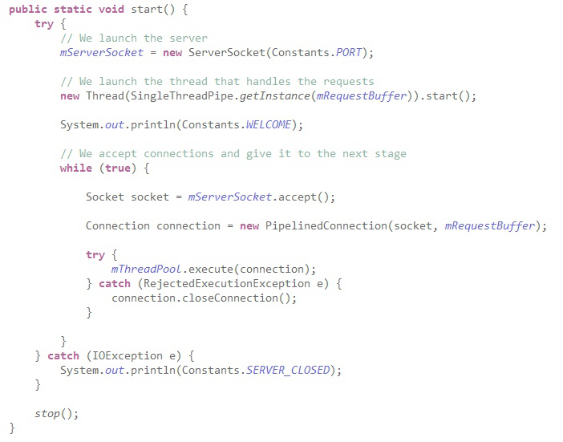
Multi-threading in In-Memory Data-Stores
Grégory Maitre & Patrick Andrade
Supervisor: André Schiper
Co-supervisor: Martin Biely
6.11.2013
Notes:
1

Slide 2

Overview
What's the project about ?
Implementation and trade-offs
  First implementation - Blocking reading
  Second implementation - Pipelined reading
What's next ?
Questions ?
Current work at : https://github.com/PatrickAndrade/top2developers.git
Notes:
2

Slide 3
What's the project about ?
Implementing a multi-threaded Key-Value data store in Java
Notes:
3

Slide 4
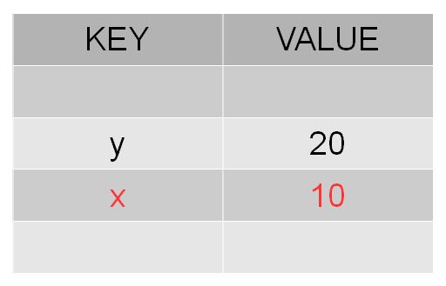
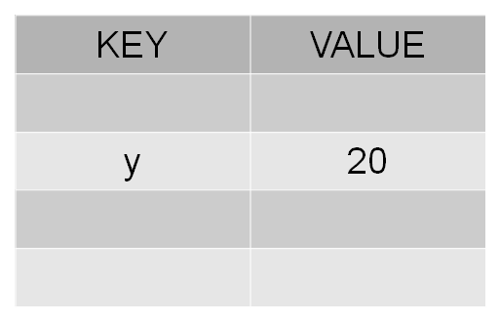
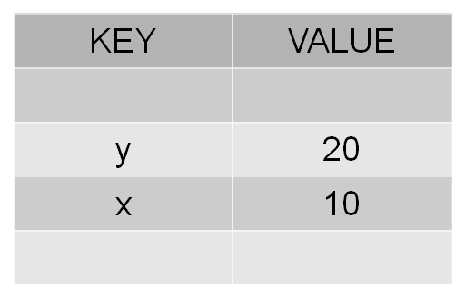
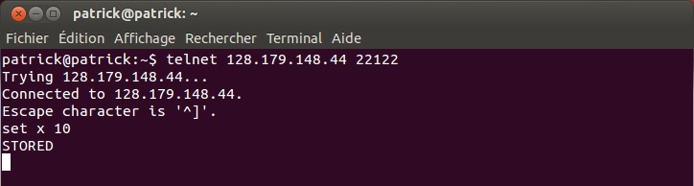
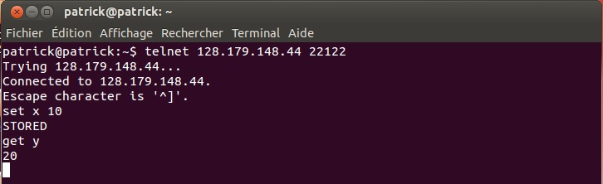
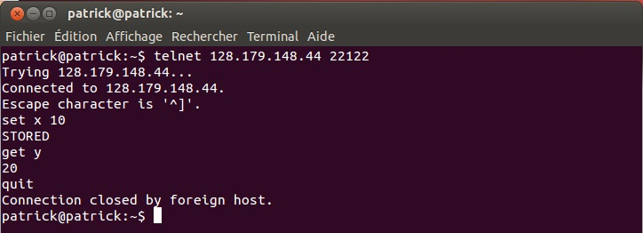
Quick example of a Key-Value store
Notes:
4

Slide 5
What's the project about ?
Implementing a multi-threaded Key-value data store in Java
Compare performances between several architectures
Inspired by Memcached and Redis
Notes:
5

Slide 6
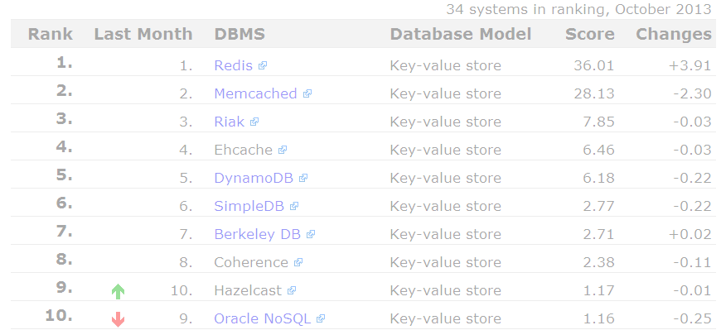
Memcached
Second most popular key-value store
Multi-threaded
Used by Facebook, Wikipedia, ...
Redis
Most popular key-value store
Single-threaded
Support Lists, Sets, Sorted Sets, ...
Used by GitHub, Stack Overflow, ...
Notes:
6

Slide 7
Implementation and trade-offs
First implementation : Blocking reading
Second implementation : Pipelined reading
These implementations use a single thread to acces the key-value store
Notes:
7

Slide 8
First implementation - Blocking reading
Internet
Server
(IP, Port)
Key-Value
Store
Request
Request
Notes:
8

Slide 9
First implementation - Blocking reading
Server
Client
Delay between two sending requests from the client
Server can’t process two requests at a time
Notes:
9

Slide 10
Second implementation - Pipelined reading
Internet
Server
(IP, Port)
Key-Value
Store
Request
Request
Notes:
10

Slide 11
Second implementation - Pipelined reading
Server
Client
Server can’t process two requests at a time
For each connection, we double the number of thread
Notes:
11

Slide 12
What's next ?
Non-Blocking IO
Implement multi-threaded architectures to access the Key-Value store
Notes:
12

Slide 13
Questions ?

Slide 14
What's next ?
Internet
Server
(IP, Port)
Key-Value
Store
Request
Request
Request
Request
Request
Request
Request

