Slide 1
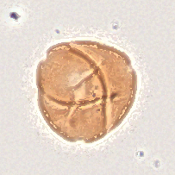
BACKGROUND
Tiny fossils help us understand ancient environments
Pollen preserves a record
of past plant life.
Smithsonian researchers study North
American vegetation from about 50 million
years ago.
Identifying thousands of specimens by hand
takes expert time.
Fossil pollen • expert-labeled specimen
SMITHSONIAN × RICE D2K / PROJECT BACKGROUND
1
Notes:
TARGET: 30 seconds
SAY:
Pollen can survive as a fossil long after the plant itself is gone. By identifying it, researchers can work out what kinds of plants lived in an area and learn about past environments. Our project focuses on North American vegetation from about fifty million years ago. The challenge is that microscope slides contain lots of tiny specimens, and identifying them by hand takes expert time. We want to use machine learning to help with that process.
SOURCE / PRESENTER CONTEXT (not spoken):
Scientific motivation from the supplied sponsor presentation and initial report. Image: expert-labeled Platycarya platycarioides focus-stacked crop from the project dataset; not a model prediction.

