Slide 1
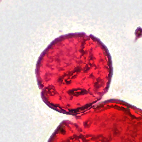
01 / WELCOME
Identifying Fossil Pollen
with Machine Learning
Help researchers identify fossil pollen
categories more efficiently.
Patrick Batsell · Yun Ying Tsai · Yeonju Kim · Yunfan Bao · Alan Yang
SMITHSONIAN × RICE D2K
1
Notes:
TARGET: 10 seconds | PRESENTER 1
SAY:
Hi everyone. We’re the Rice D2K Smithsonian team. We’re using machine learning to help researchers identify fossil pollen.

Slide 2
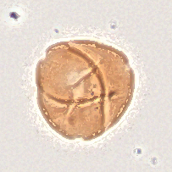
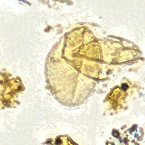
02 / WHY IT MATTERS
What grew in North America during a warmer past?
Fossil pollen preserves clues from about 50 million years ago.
→
→
Fossil pollen
Identify plant groups
Reconstruct vegetation
The bottleneck: identifying thousands of specimens by hand.
SMITHSONIAN × RICE D2K
2
Notes:
TARGET: 30 seconds | PRESENTER 1
SAY:
Our scientific question is: what grew in North America when the climate was warmer, about fifty million years ago? Fossil pollen gives researchers clues about the plants that lived there. But identifying thousands of tiny specimens by hand takes expert time. We want to help with that identification step so researchers can study more of the collection.

Slide 3
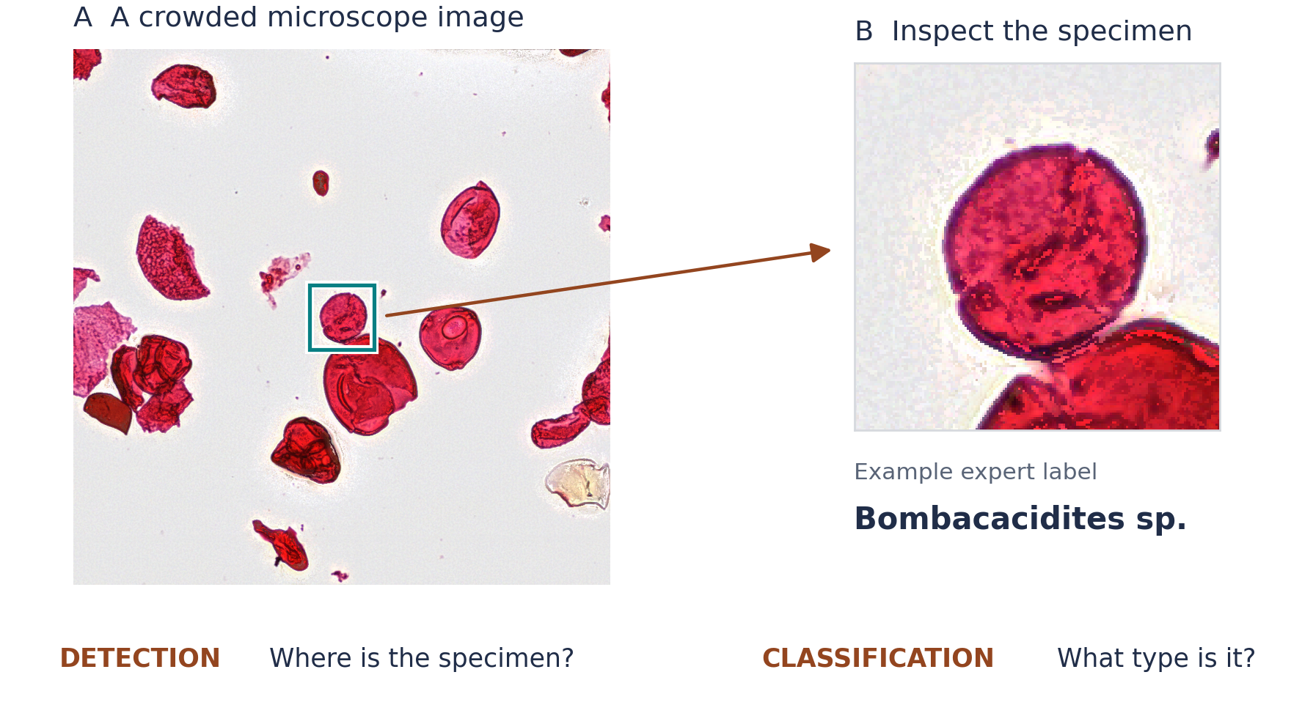
03 / THE PROBLEM
Finding pollen is only the first step
Our goal: assign a category to each detected specimen.
SMITHSONIAN × RICE D2K
3
Notes:
TARGET: 25 seconds | PRESENTER 2
SAY:
This image shows the gap we’re addressing. The previous team developed a detector to find specimens, like the one inside this box. But a location alone doesn’t tell researchers what kind of pollen it is. Our goal is to add that category identification, using details of the specimen’s shape and surface.

Slide 4
04 / PRIOR WORK
What earlier studies suggest
01
02
03
Punyasena et al.
Martinsen et al.
Abbas Shaikh et al.
Locate pollen
↓
Crop specimens
↓
Identify categories
Locate specimens
↓
Crop specimens
↓
Identify categories
Multifocal slides
↓
Image tiles
↓
Detect specimens
Build on whole-slide detection; add category identification.
SMITHSONIAN × RICE D2K
4
Notes:
TARGET: 25 seconds | PRESENTER 2
SAY:
These three studies give us our starting point. Punyasena and Martinsen locate specimens and then classify individual crops. Abbas Shaikh and colleagues developed a pipeline for detecting specimens across large, multifocal slides. We’ll build on whole-slide detection and compare two ways to add category identification.

Slide 5
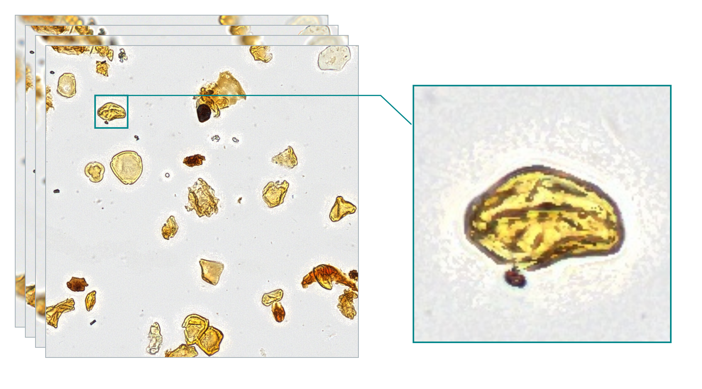
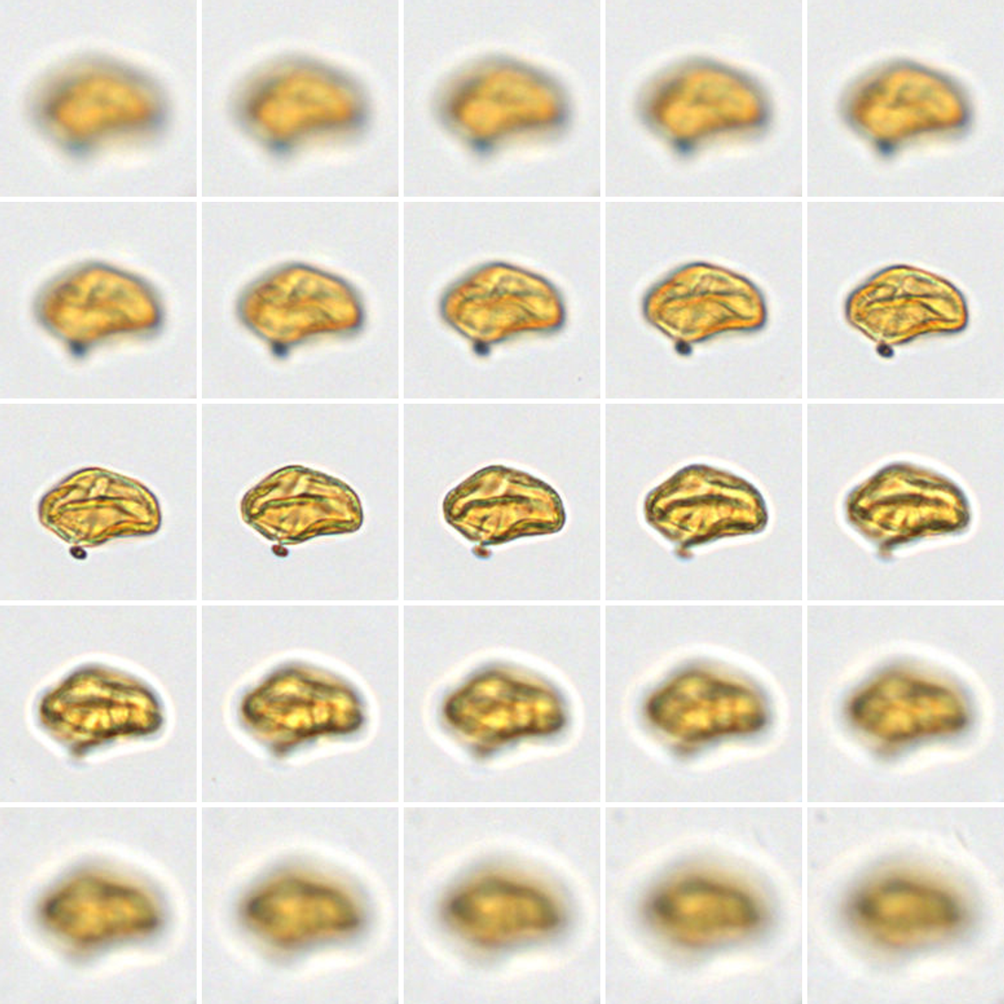
05 / MICROSCOPY DATA
One specimen, multiple focal views
This example: 25 focal planes
About 30 GB for the full scan
An expert-annotated pollen grain
SMITHSONIAN × RICE D2K
5
Notes:
TARGET: 20 seconds | PRESENTER 3
SAY:
Each scan captures different focal depths, so different details become clear in different views. This example has twenty-five focal planes, and the full scan is about thirty gigabytes. We’ll extract smaller regions so we can work with individual specimens.

Slide 6
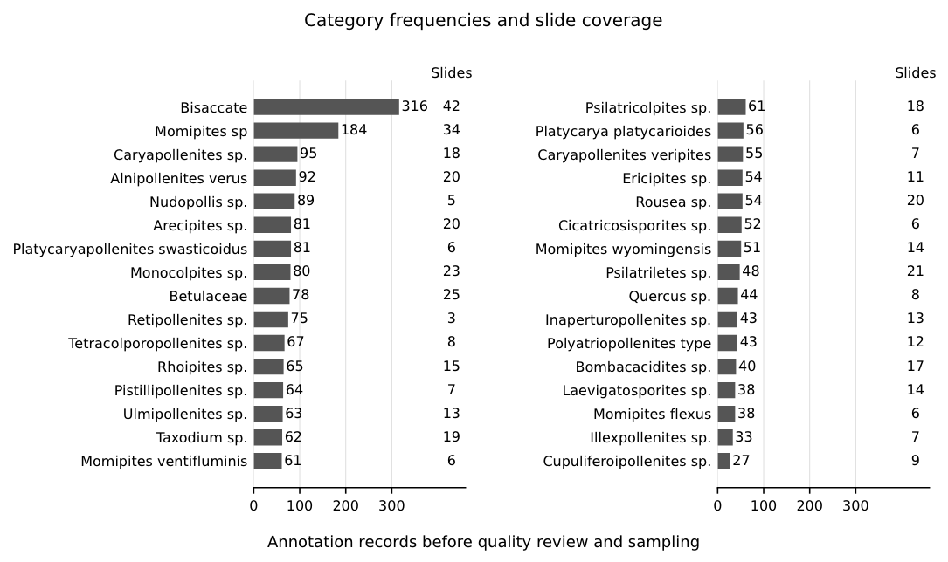
06 / OUR DATA
Some categories have far fewer examples
83
32
2,290
image–annotation pairs
priority categories
priority annotations
LABELED EXAMPLES · FOUR SELECTED CATEGORIES
Bisaccate
316
Arecipites sp.
81
Bombacacidites sp.
40
Cupuliferoipollenites sp.
27
Fewer examples can make a category harder to learn.
SMITHSONIAN × RICE D2K
6
Notes:
TARGET: 25 seconds | PRESENTER 3
SAY:
We have eighty-three image and annotation pairs. Our starting selection includes thirty-two priority categories and two thousand two hundred ninety annotations. These four categories illustrate the imbalance: some have hundreds of examples, while others have only a few dozen. That can make the less common categories harder to learn.

Slide 7
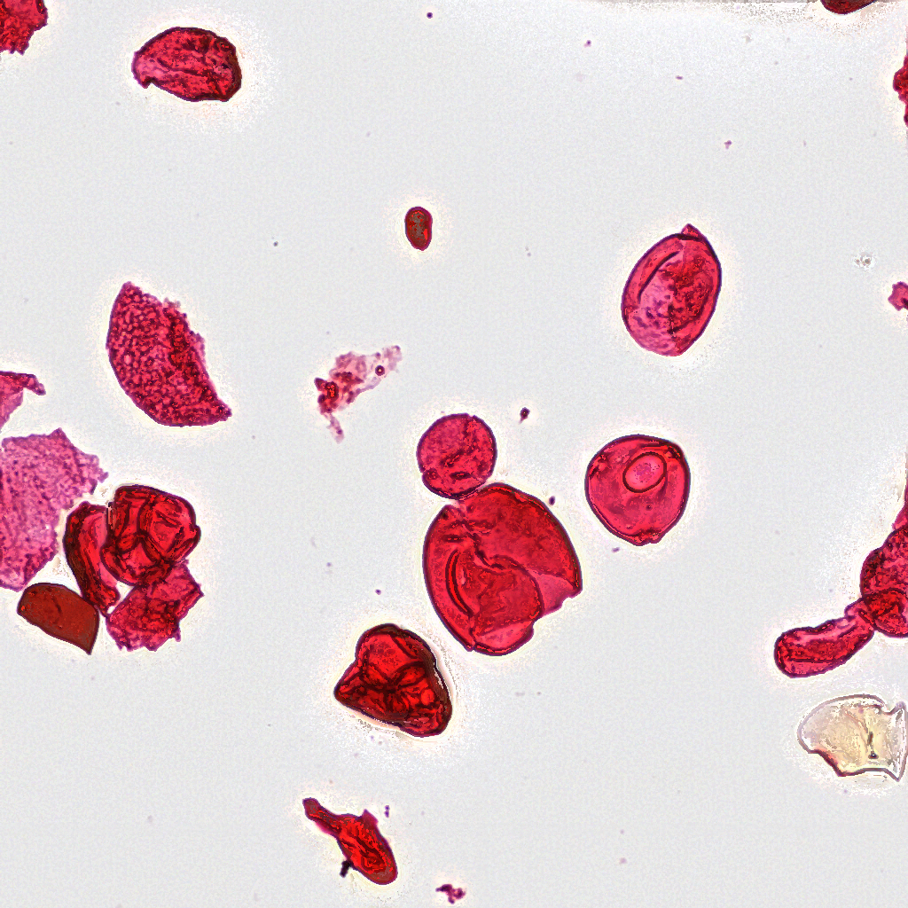
07 / PREPARE LABELED EXAMPLES
Turn expert annotations into learning examples
1 Locate the specimen
2 Read its expert label
3 Extract a labeled crop
ANNOTATION TITLE
→
Tiliapollenites sp.
→
Expert category map
Bombacacidites sp.
Check that the crop is clear and contains the marked specimen.
SMITHSONIAN × RICE D2K
7
Notes:
TARGET: 30 seconds | PRESENTER 4
SAY:
Here’s how we turn the annotations into learning examples. First, we locate the marked specimen in the image. We read its expert label and use the supplied mapping to connect it to a target category. Then we extract a small image around it and check that it’s clear and properly positioned. The result is a specimen image paired with its category.

Slide 8
08 / TRAINING AND TESTING
Learn from some slides; test on unseen slides
Mix up the microscope slides, then separate them into three groups.
Training
Validation
Testing
✓
✓
✓
Learn from examples
Make adjustments
Check new slides
All examples from one microscope slide stay in the same group.
SMITHSONIAN × RICE D2K
8
Notes:
TARGET: 30 seconds | PRESENTER 4
SAY:
Next, we mix up the microscope slides and divide them into training, validation, and testing groups. The model learns from training examples, validation helps us make adjustments, and testing checks how well it works on new slides. All examples from one slide stay together. We can also balance the training examples so the most common categories don’t dominate.

Slide 9
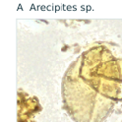
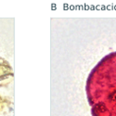
09 / OUR COMPARISON
Does a dedicated classifier improve identification?
A ONE MODEL DOES BOTH JOBS
Find + identify
→
Specimen locations + categories
RF-DETR
B TWO MODELS SHARE THE WORK
Find specimens
→
→
Identify each crop
Detector · RF-DETR
Classifier · Swin-Tiny
Compare correct locations and labels on the same held-out slides.
SMITHSONIAN × RICE D2K
9
Notes:
TARGET: 50 seconds | PRESENTER 5
SAY:
We’ll compare two ways to do the job. In the first, one model finds each specimen and identifies its category at the same time. In the second, a detector finds the specimens, and a separate classifier identifies each crop. The question is whether giving identification its own model improves the results. We don’t know yet which will work better. We’ll compare them on the same held-out slides, checking both the locations and the categories, including less common categories.

Slide 10
10 / TAKE-HOME MESSAGE
Make fossil pollen collections easier to study
INTENDED OUTPUT: LOCATED, LABELED SPECIMENS FOR EXPERT REVIEW
A suggested category
for the expert to review
→
Example: Bombacacidites sp.
Illustration uses an expert label, not a model prediction.
Less manual identification. More evidence about past vegetation.
NEXT: prepare crops → train both approaches → compare their errors
SMITHSONIAN × RICE D2K
10
Notes:
TARGET: 25 seconds | PRESENTER 5
SAY:
Our intended result is a set of located, labeled specimens that experts can review. The aim is to reduce repetitive identification work and help researchers study past vegetation. Next, we’ll prepare the crops, train both approaches, and compare their mistakes. Thank you.

