Slide 1
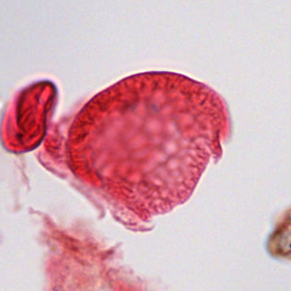
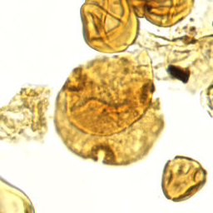
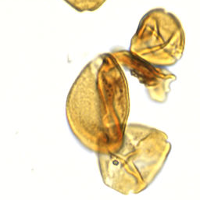
01 / PROJECT UPDATE
Two approaches to identifying fossil pollen
RF-DETR method first · classifier backbones second
01
RF-DETR
Find specimens and identify categories.
02
Classifier backbones
Identify categories from specimen crops.
Bisaccate
Bombacacidites sp.
Arecipites sp.
Classification dataset: 2,283 specimens · 32 priority categories
SMITHSONIAN × RICE D2K · CLASSIFICATION UPDATE
1
Notes:
TARGET: 25 seconds
We’ve organized this update into two parts. First is the RF-DETR method, which aims to locate specimens and identify their categories together. Then we’ll cover the classifier backbones, which identify categories from prepared specimen crops. That classification experiment uses 2,283 specimens across 32 priority categories. The images here are real examples with expert labels.

Slide 2
02 / SECTION 01 · RF-DETR
RF-DETR: detection and category identification
RF-DETR team update
Placeholder · content to be added
SMITHSONIAN × RICE D2K · CLASSIFICATION UPDATE
2
Notes:
TARGET: 0 seconds
PLACEHOLDER — not a spoken script. RF-DETR team to add its method, progress and results. Allow approximately 60 seconds if the full presentation should stay near five minutes. No RF-DETR results are supplied or implied here.

Slide 3
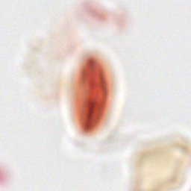
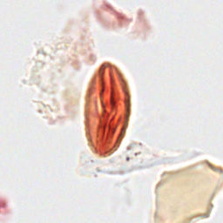
03 / SECTION 02 · CLASSIFIER BACKBONES / FOCUS
A clearer view helps the model identify pollen
Original focal plane
Selected sharper plane
Unseen-slide accuracy
32% → 38%
Same Swin model settings.
Only the selected focal
plane changed.
Same specimen and crop · expert label: Quercus sp.
SMITHSONIAN × RICE D2K · CLASSIFICATION UPDATE
3
Notes:
TARGET: 45 seconds
The microscope scans show each specimen at several focal depths. On the left is the original view; on the right is a sharper view of the same specimen. We used a sharpness score to choose one plane for each crop. With the same Swin training settings, validation accuracy on unfamiliar slides increased from about 32 to 38 percent. This example illustrates the focus change; it doesn’t mean this particular specimen caused that improvement. We’d also like to know when identification requires features visible across several depths, rather than just one sharp image.

Slide 4
04 / CLASSIFIER BACKBONES / EVALUATION
Two questions, two ways to check performance
Unseen slides
Shared slides
Can it work on a different slide?
Can it identify more grains on familiar slides?
LEARN FROM
CHECK ON
LEARN FROM
CHECK ON
Slide A
Slide C
A · grain 1
A · grain 2
Slide B
Slide D
B · grain 1
B · grain 2
Different specimens in every set. Final test slides remain reserved.
SMITHSONIAN × RICE D2K · CLASSIFICATION UPDATE
4
Notes:
TARGET: 50 seconds
We checked performance in two situations. In the unseen-slide experiment, all specimens from a slide stay together, so the model is checked on slides it hasn’t learned from. In the shared-slide experiment, it learns from some grains and is checked on other grains from the same slides. We never reuse the exact same specimen in both sets. Shared slides can have familiar staining and imaging conditions, so that is an easier situation. Both experiments have the same number of training and validation examples, but the actual examples differ. A separate final test set remains unused.

Slide 5
05 / CLASSIFIER BACKBONES / RESULTS
Adapting DINO gives our strongest results so far
Validation accuracy · identifying categories in prepared specimen crops
Unseen slides
Shared slides
Swin
38%
66%
DINO · frozen
30%
59%
DINO · adapted
44%
70%
Adapted = trained the final two DINO blocks and its category classifier.
Single-run validation comparisons; final test untouched. These are not whole-slide detection results.
SMITHSONIAN × RICE D2K · CLASSIFICATION UPDATE
5
Notes:
TARGET: 55 seconds
Here are the classification results. Swin reached 38 percent on unseen slides and 66 percent with shared slides. DINO initially did worse when we kept its image-processing backbone fixed and trained only a small classifier. We then allowed the final part of DINO to adapt to our specimens. That reached about 44 percent on unseen slides and 70 percent with shared slides. Its category-averaged F1 score also improved. These are promising initial results, but they are single-run validation comparisons, not final test results. They measure identification of prepared crops, rather than the complete process of finding and classifying everything on a slide.

Slide 6
06 / CLASSIFIER BACKBONES / ERRORS
Where identification still struggles
Adapted DINO · unseen-slide validation
EXPERT CATEGORY
CORRECTLY IDENTIFIED
CORRECT / TOTAL
Momipites wyomingensis
0%
0 / 21
Polyatriopollenites type
11%
1 / 9
Bombacacidites sp.
12%
2 / 17
Ulmipollenites sp.
16%
5 / 32
Psilatricolpites sp.
17%
3 / 18
Arecipites sp.
18%
2 / 11
18 of 21 Momipites wyomingensis were predicted as Momipites sp.
Lowest category recall among categories with ≥5 validation examples; small samples remain uncertain.
SMITHSONIAN × RICE D2K · CLASSIFICATION UPDATE
6
Notes:
TARGET: 45 seconds
This shows the categories the adapted DINO model struggled with most on unfamiliar slides. Momipites wyomingensis was the clearest problem: none of its 21 validation specimens were identified correctly, and 18 were called Momipites instead. Polyatriopollenites, Bombacacidites, Ulmipollenites, Psilatricolpites and Arecipites also had low recovery. The counts on the right show how many examples each result is based on. We’ve limited this ranking to categories with at least five examples, since a result based on one or two specimens would be especially unreliable. These are the main categories to investigate next.

