Slide 1
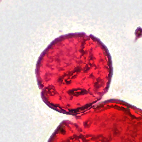
01 / WELCOME
Identifying Fossil Pollen
with Machine Learning
Help researchers identify fossil pollen
categories more efficiently.
Patrick Batsell · Yun Ying Tsai · Yeonju Kim · Yunfan Bao · Alan Yang
SMITHSONIAN × RICE D2K
1
Notes:
TARGET: 10 seconds | PRESENTER 1
SAY:
Hi everyone. We’re the Rice D2K Smithsonian team. Our project is about helping researchers identify fossil pollen using machine learning.

Slide 2
02 / BACKGROUND
Why fossil pollen matters
01
02
03
Why it matters
The challenge
Our starting point
Pollen survives in sediment.
It records ancient plant life.
We study vegetation about 50 million years ago.
Microscope images contain many specimens and debris.
Identifying each specimen takes expert time.
The previous Rice team developed a detector.
Our next step is identifying the category of each specimen.
SMITHSONIAN × RICE D2K
2
Notes:
TARGET: 30 seconds | PRESENTER 1
SAY:
Fossil pollen gives us clues about which plants lived in the past. Smithsonian researchers use it to understand North American vegetation about fifty million years ago. The challenge is that identifying these tiny specimens takes expert time. The previous Rice team developed a detector that finds specimens. We want to build on that by identifying their categories.

Slide 3
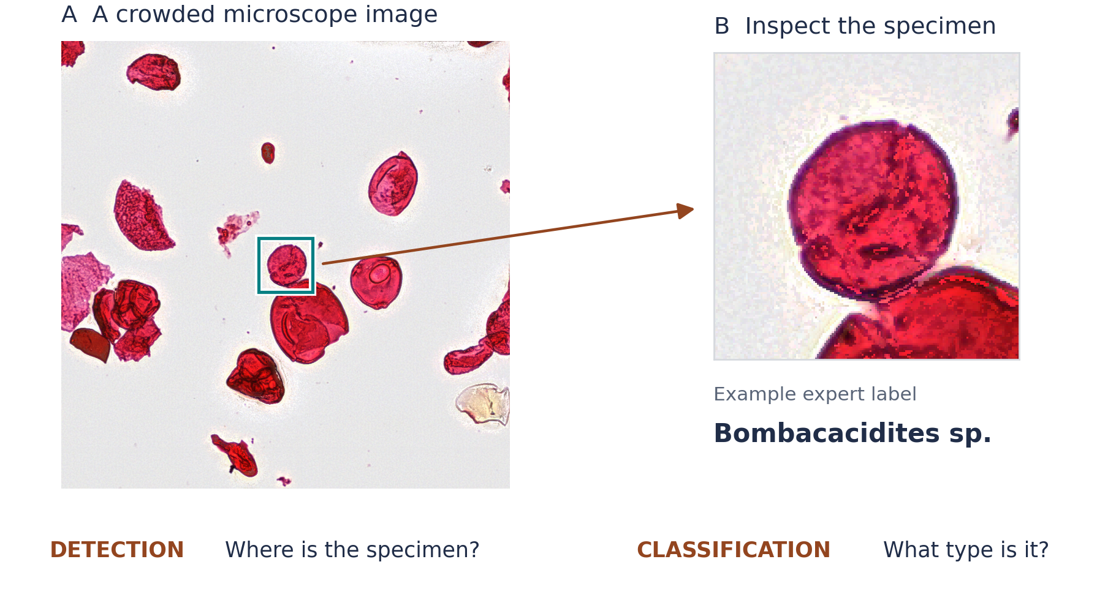
03 / THE PROBLEM
One slide, thousands of specimens
SMITHSONIAN × RICE D2K
3
Notes:
TARGET: 25 seconds | PRESENTER 2
SAY:
This shows the difference between finding a specimen and identifying it. On the left, the box marks one pollen grain in a crowded microscope image. On the right, we can inspect its shape and surface details. Detection asks, where is it? Classification asks, what kind is it? Our project connects those two tasks.

Slide 4
04 / PRIOR WORK
What earlier studies suggest
01
02
03
Punyasena et al.
Martinsen et al.
Abbas Shaikh et al.
Locate pollen
↓
Crop specimens
↓
Identify categories
Locate specimens
↓
Crop specimens
↓
Identify categories
Multifocal slides
↓
Image tiles
↓
Detect specimens
Build on whole-slide detection; add category identification.
SMITHSONIAN × RICE D2K
4
Notes:
TARGET: 25 seconds | PRESENTER 2
SAY:
These studies give us two foundations. Punyasena and Martinsen locate specimens and then classify individual crops. Abbas Shaikh and colleagues developed a pipeline for detecting specimens across large, multifocal slides. We want to build on that detection work and add category identification, comparing separate and combined approaches.

Slide 5
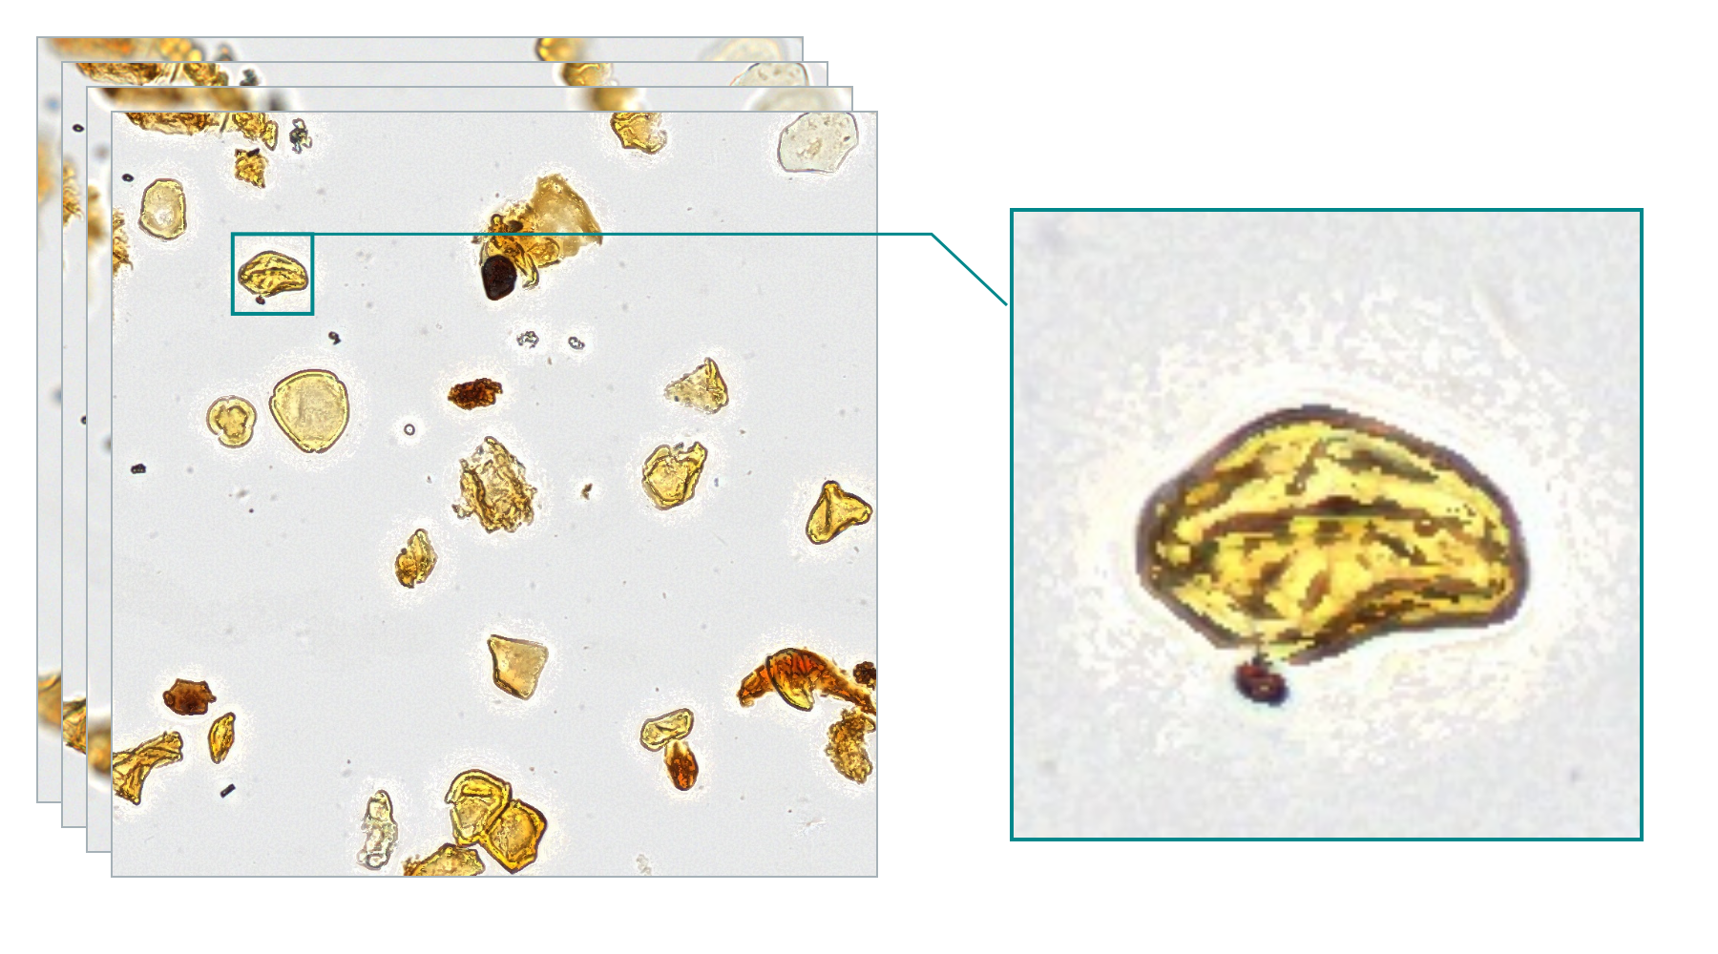
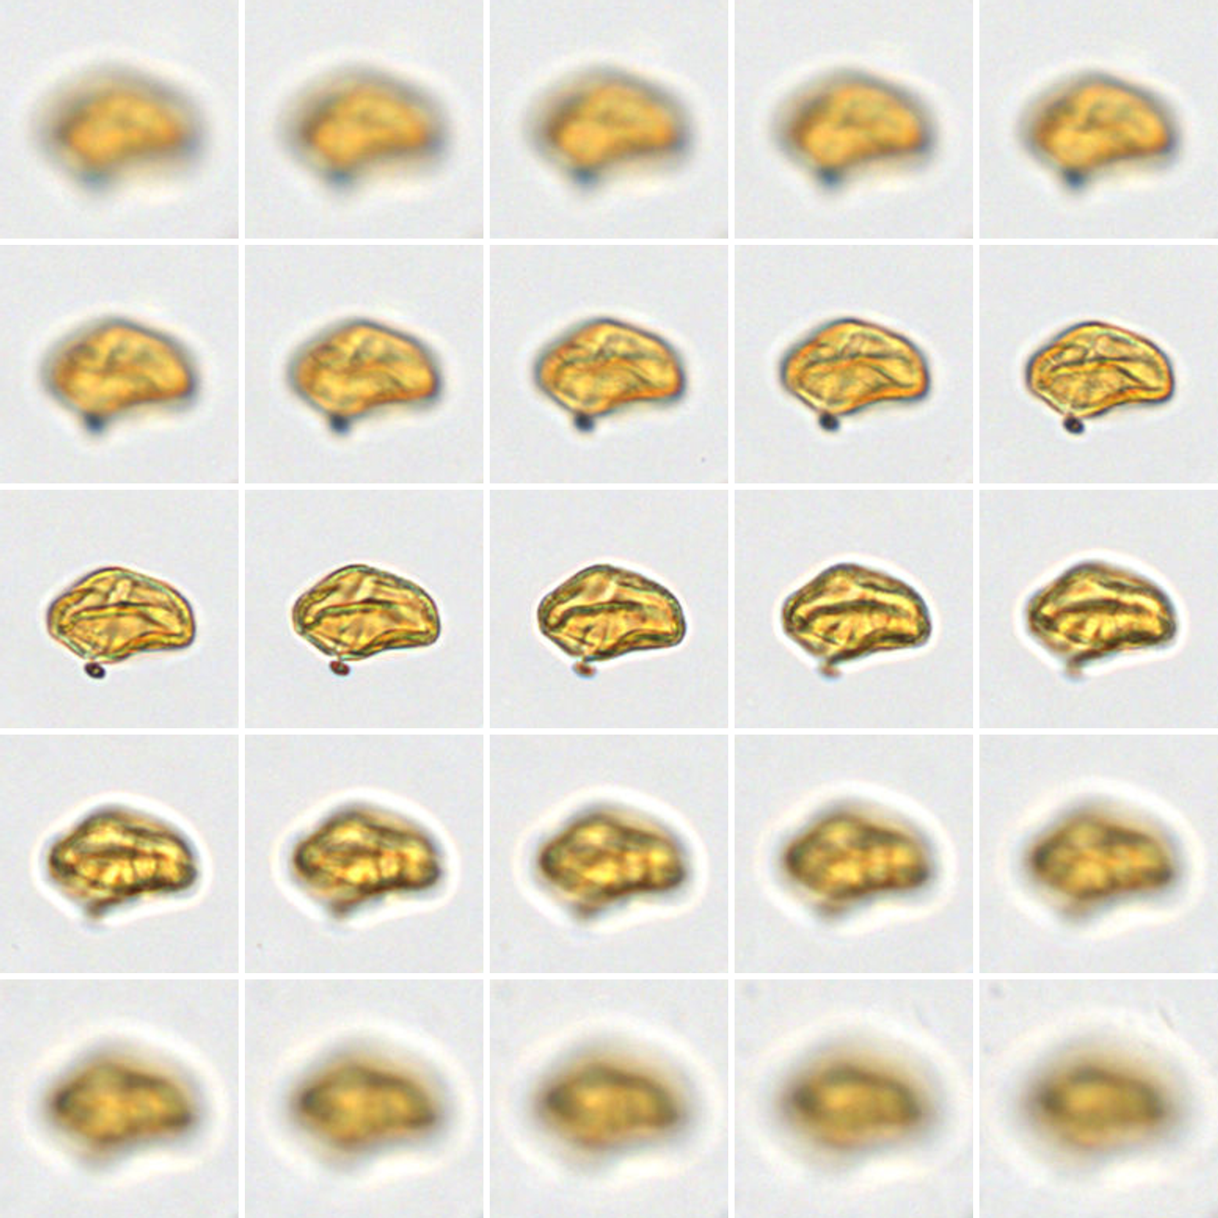
05 / MICROSCOPY DATA
One specimen, multiple focal views
This example: 25 focal planes
About 30 GB for the full scan
An expert-annotated pollen grain
SMITHSONIAN × RICE D2K
5
Notes:
TARGET: 20 seconds | PRESENTER 3
SAY:
The images also capture different focal depths. Here, the same specimen appears across twenty-five focal planes, and this example’s full scan is about thirty gigabytes. We’ll work with smaller image regions and use the focal views to make the specimen’s details easier to see.

Slide 6
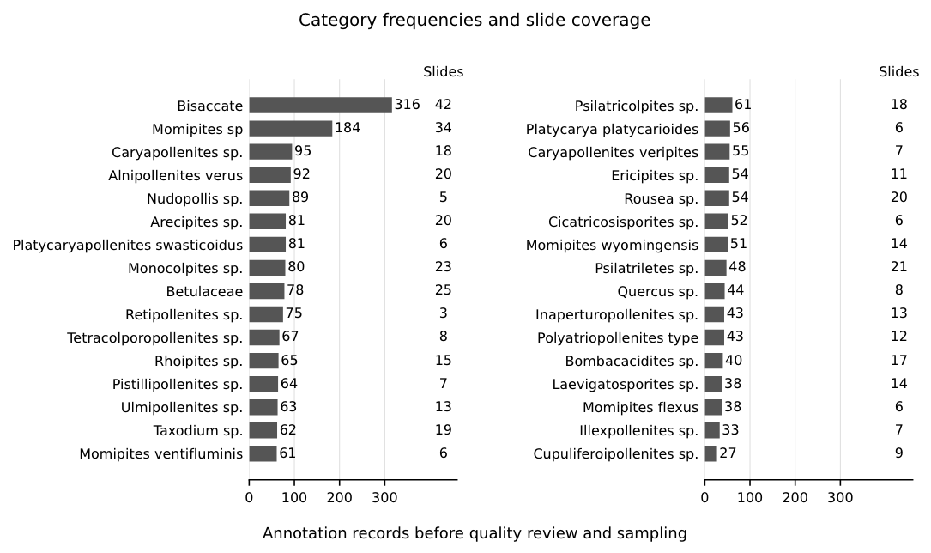
06 / ANNOTATION INVENTORY
Annotation inventory
83
image–annotation pairs
32
priority categories
2,290
annotations
Some categories have
far fewer examples.
SMITHSONIAN × RICE D2K
6
Notes:
TARGET: 30 seconds | PRESENTER 3
SAY:
Our collection has eighty-three microscope images paired with expert annotations. We’re starting with thirty-two priority categories containing two thousand two hundred ninety annotations. The chart shows that some categories have many more examples than others. That matters because categories with fewer examples can be harder to learn. We’ll account for that when training and evaluating the models.

Slide 7
07 / DATA PIPELINE
Connect images, locations, and expert labels
01
02
03
Match the files
Map expert labels
Check the examples
→
→
Pair each microscope image
with its annotation file.
Link original annotation titles
to the target categories.
Check positions, missing
labels, and duplicates.
OUTPUT
Each specimen linked to its image, location, and category
SMITHSONIAN × RICE D2K
7
Notes:
TARGET: 30 seconds | PRESENTER 4
SAY:
First, we organize the examples. Each microscope image is matched with its annotation file, which gives us specimen locations and expert labels. We connect those labels to the categories we want to recognize. Then we check that the marks point to the right specimens and look for missing labels or duplicates. This keeps each example linked to its source.

Slide 8
08 / DATA PIPELINE
Prepare examples for a fair test
01
02
03
Group and split
Extract and inspect
Build model inputs
→
→
Keep related slides and every
view of a specimen together.
Extract small image regions;
check position and focus.
Regions for detection;
specimen crops for
classification.
TRAINING ONLY
Vary training examples and balance categories.
SMITHSONIAN × RICE D2K
8
Notes:
TARGET: 35 seconds | PRESENTER 4
SAY:
Next, we separate the data for training, validation, and testing. Examples from the same microscope slide stay together, so the test checks performance on unfamiliar slides. We then extract smaller regions and check their position and focus. Larger regions help the detector find specimens, while individual crops help the classifier identify them. Any extra image variations or category balancing are applied only to training examples.

Slide 9
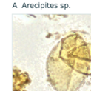
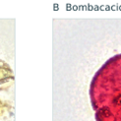
09 / PROPOSED METHODS
Two ways to identify specimens
1 FIND AND IDENTIFY TOGETHER
RF-DETR
→
Location + category
2 FIND FIRST, IDENTIFY SECOND
RF-DETR
Specimen crops
Swin-Tiny
→
→
Find specimens
Isolate each example
Identify its category
Compare location accuracy and category identification.
SMITHSONIAN × RICE D2K
9
Notes:
TARGET: 50 seconds | PRESENTER 5
SAY:
We’ll compare two approaches. The first uses RF-DETR to find each specimen and predict its category at the same time. The second uses RF-DETR just to find specimens. We then crop each specimen and pass it to Swin-Tiny, a separate classifier. This comparison helps us see whether identifying specimens separately works better than doing both tasks together. We’ll check whether the models find the right locations and assign the right categories, including categories with fewer examples. These are our proposed approaches; training and evaluation are the next steps.

Slide 10
10 / CONCLUSION
From finding pollen to identifying it
Compare two approaches to automated identification.
01
02
03
Prepare specimen images
Train initial models
Evaluate mistakes
Help experts study past vegetation more efficiently.
SMITHSONIAN × RICE D2K
10
Notes:
TARGET: 25 seconds | PRESENTER 5
SAY:
The main idea is to move from finding pollen to identifying it. Next, we’ll prepare the specimen images, train the initial models, and look closely at their mistakes. The goal is to give experts a useful starting point for identification, so they can study past vegetation more efficiently. Thank you.

