Slide 1
By Ali
Phone no: 9032704090
Email Id:yawarali17@hotmail.com
DataTypes and Variable in C#

Slide 2
Agenda
What is DotNet Framework
Various DotNet Framework
Architecture of DotNet Framework
Compilation in Dotnet

Slide 3

Father Of C# .Net
Anders Hejlsberg

Slide 4
NET Framework
NET Framework is a software framework developed by Microsoft that runs primarily on Microsoft Windows.
Class Library
Common Language Runtime Engine

Slide 5
NET Framework (Continue)
It includes a large class library named Framework Class Library (FCL) and provides language interoperability (each language can use code written in other languages) across several programming languages.
Programs written for .NET Framework execute in a software environment named Common Language Runtime(CLR), an application virtual machine that provides services such as security, memory management, and exception handling. (As such, computer code written using .NET Framework is called "managed code".)
FCL and CLR together constitute .NET Framework.

Slide 6
Cont..
FCL provides user interface, data access, database connectivity, cryptography, web application development, numeric algorithms, and network communications.
Programmers produce software by combining their source code with .NET Framework and other libraries.

Slide 7
Cont…
.NET Framework led to a family of .NET platforms targeting mobile computing, embedded devices, alternative operating systems, and web browser plug-ins.
A reduced version of the framework, .NET Compact Framework, is available on Windows CE platforms, including Windows Mobile devices such as smartphones.
.NET Micro Framework is targeted at very resource-constrained embedded devices.
Silverlight was available as a web browser plugin.
Mono is available for many operating systems and is customized into popular Smartphone operating systems (Android and iOS) and game engines.
.NET Core targets the Universal Windows Platform (UWP), and cross-platform and cloud computing workloads.

Slide 8
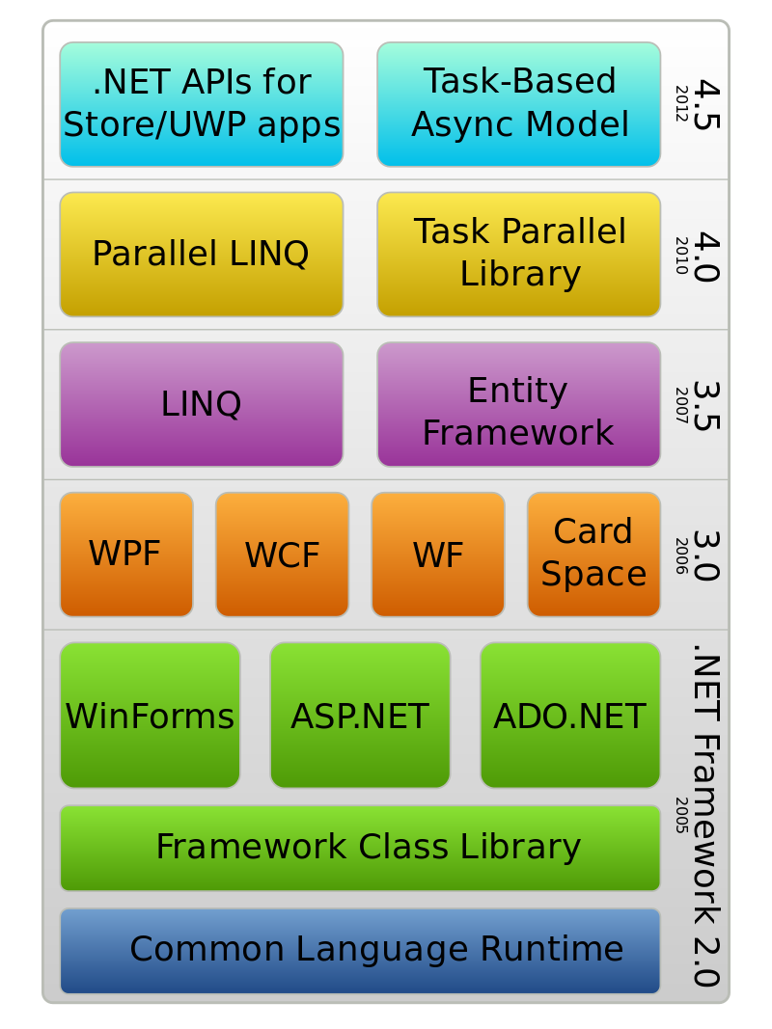
.Net framework Architecture

Slide 9
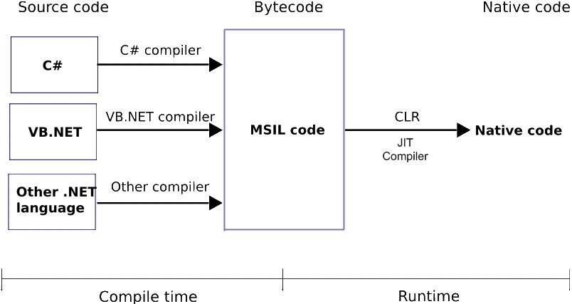
Dotnet code Compilation

