Slide 1

FELICIA HARRIS
MODULE 2
SLP

Slide 2
Introduction
Importance of Employee Voice
Increases engagement and job satisfaction
Enhances innovation and problem-solving
Reduces turnover and absenteeism
Objective of the Program
To create a structured and inclusive platform for employees to express their ideas, concerns, and feedback
Notes:
Employee voice is crucial in creating an engaged and satisfied workforce. It encourages employees to share their ideas, which can lead to increased innovation and problem-solving. Moreover, when employees feel heard, it reduces turnover and absenteeism. The objective of the Voice Empowerment Initiative (VEI) is to establish a comprehensive platform for employees to express their ideas, concerns, and feedback effectively.

Slide 3
Current Challenges
Lack of communication channels
Low employee engagement
Unaddressed grievances
Notes:
Currently, our organization faces several challenges in terms of employee voice. There is a noticeable lack of effective communication channels, which has led to low employee engagement. Additionally, many grievances remain unaddressed, contributing to dissatisfaction and a potential increase in turnover. Addressing these issues is essential for fostering a positive work environment

Slide 4
Program Overview
Name of the Program: Voice Empowerment Initiative (VEI)
Key Components:
Regular feedback sessions
Anonymous suggestion boxes
Employee committees
Notes:
The Voice Empowerment Initiative (VEI) aims to tackle these challenges head-on. The key components of VEI include regular feedback sessions, anonymous suggestion boxes, and the formation of employee committees. These elements will ensure that every employee has multiple avenues to voice their opinions and concerns

Slide 5
Action plan
Phase 1: Establish Communication Channels
Monthly town hall meetings
Online forums and suggestion boxes
Phase 2: Encourage Participation
Training sessions on effective communication
Incentive programs for active participation
Phase 3: Monitor and Improve
Regular surveys to assess program effectiveness
Continuous improvement based on feedback
Notes:
The implementation of VEI will occur in three phases.
In Phase 1, we will establish new communication channels such as monthly town hall meetings and online forums.
In Phase 2, we will encourage participation through training sessions on effective communication and incentives for active participation.
Finally, in Phase 3, we will monitor the program's effectiveness through regular surveys and continuously improve it based on feedback.

Slide 6
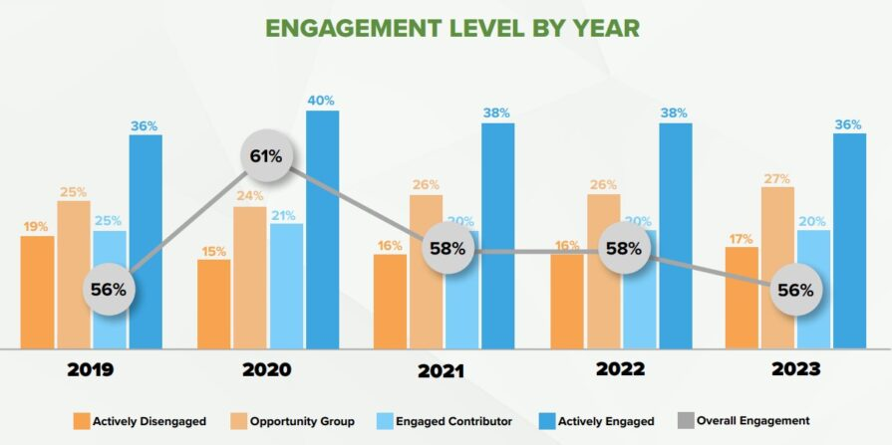
Visual 1: Employee Engagement Data
Notes:
This graph illustrates the current levels of employee engagement per year.

Slide 7
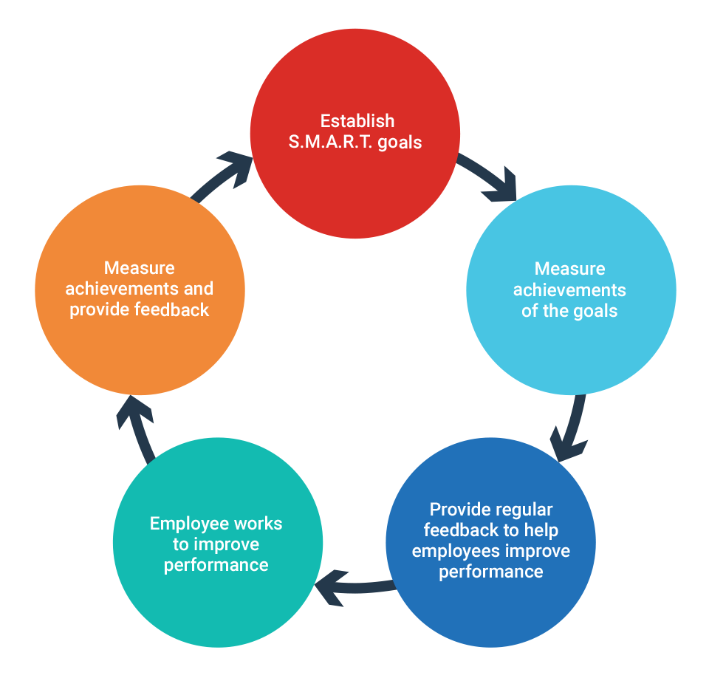
Visual 2: Feedback Loop Diagram
Notes:
This diagram shows how the feedback process will work.

Slide 8
Benefits of the program
For Employees:
Improved morale and job satisfaction
Greater sense of ownership and responsibility
For the Company:
Enhanced productivity and innovation
Better employee retention
Notes:
The benefits of the VEI program are substantial. For employees, it will lead to improved morale and job satisfaction by giving them a voice in the organization. For the company, we can expect enhanced productivity, greater innovation, and better employee retention rates. The program creates a win-win situation for both employees and the organization

Slide 9
Conclusion
Recap of the program and its importance
Call to Action:
Implement the VEI to create a more inclusive and innovative workplace
Foster a culture of open communication and continuous improvement
Notes:
In conclusion, the Voice Empowerment Initiative (VEI) is a strategic approach to creating a more inclusive and innovative workplace. By implementing this program, we will foster a culture of open communication and continuous improvement. I strongly encourage you to support this initiative and help us build a more engaged and productive workforce

Slide 10
References
Morrison, E. W. (2014). Employee voice and silence. Annu. Rev. Organ. Psychol. Organ. Behav., 1(1), 173-197.
Wilkinson, A., & Fay, C. (2011). New times for employee voice?. Human Resource Management, 50(1), 65-74.
Mowbray, P. K., Wilkinson, A., & Tse, H. H. (2015). An integrative review of employee voice: Identifying a common conceptualization and research agenda. International Journal of Management Reviews, 17(3), 382-400.
Dundon, T., Wilkinson*, A., Marchington, M., & Ackers, P. (2004). The meanings and purpose of employee voice. The International Journal of Human Resource Management, 15(6), 1149-1170.

