Slide 1
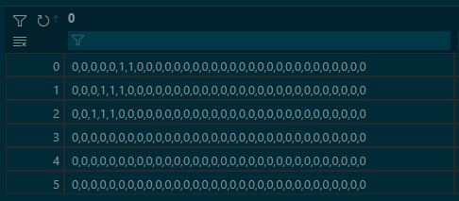
<- Event Number
RPCs
Number of hits in each eta strip during event
Triplet Low
Triple Mid
Triple Top
Singlet
Doublet Low
Doublet Top

Slide 2
