Slide 1
Angular distributions

Slide 2
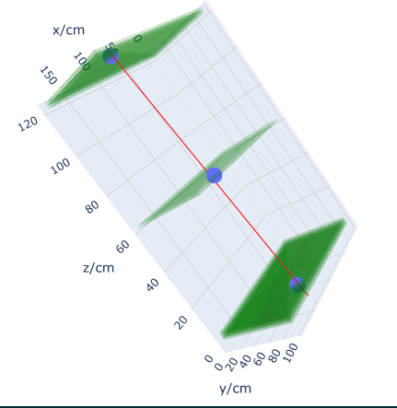
Angle calculations
Project reconstructed trajectory on to faces of Cuboid formed by RPC.
Dot with unit vector perpendicular to RPC surfaces to find angles.

Slide 3
Cosmic muon data from 04/03
Using 15ns time window and max cluster size 3 throughout.

Slide 4
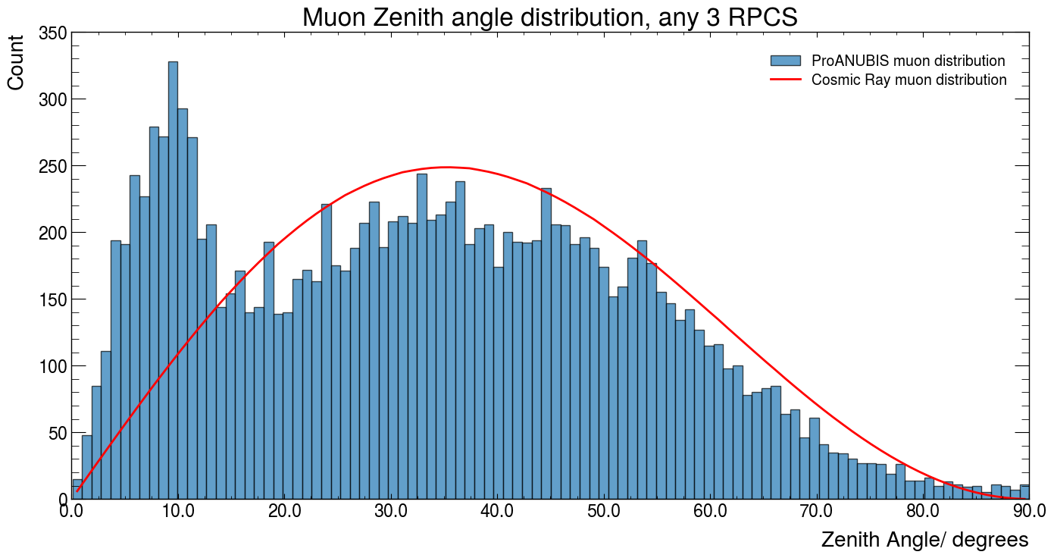

Slide 5
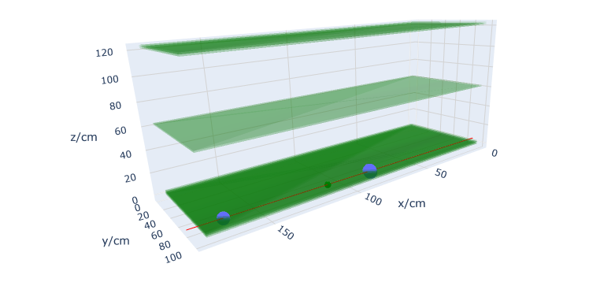

Slide 6
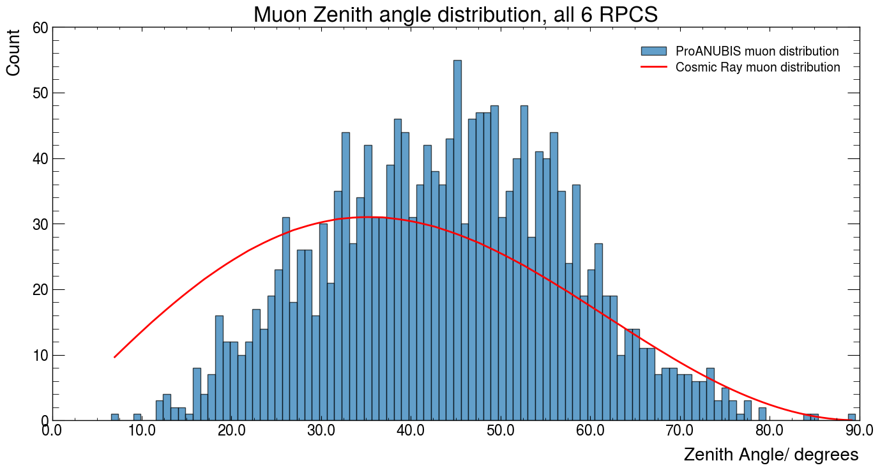

Slide 7
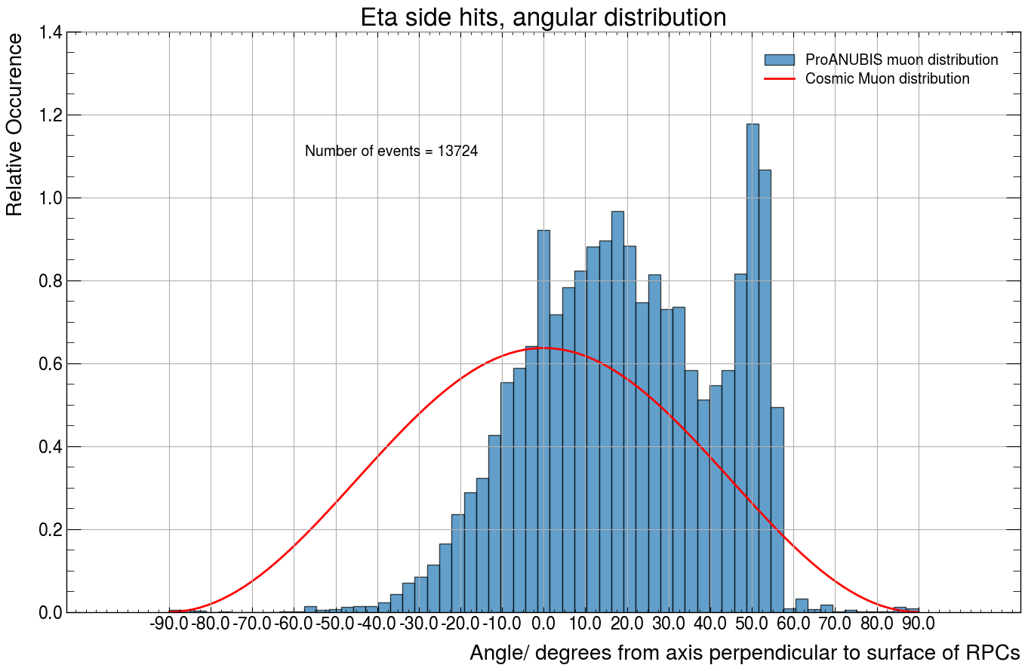
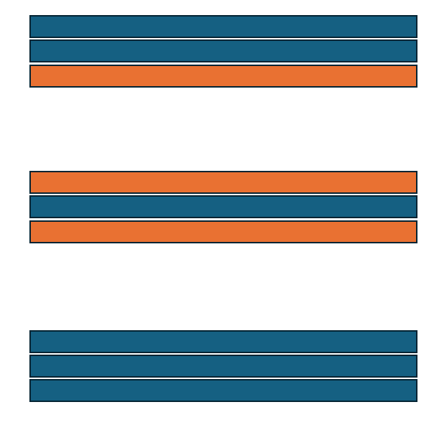
Eta Direction
5⁰
50⁰
X-axis Direction
45⁰
Phi Direction

Slide 8
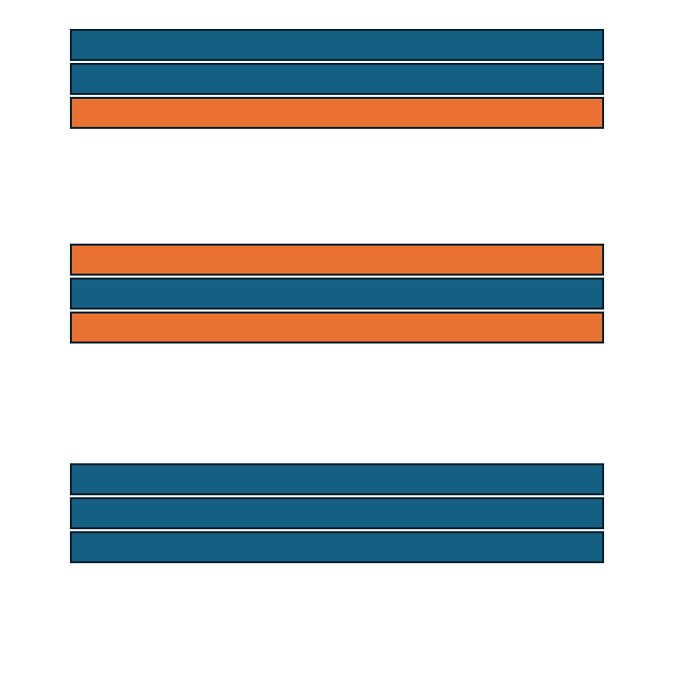
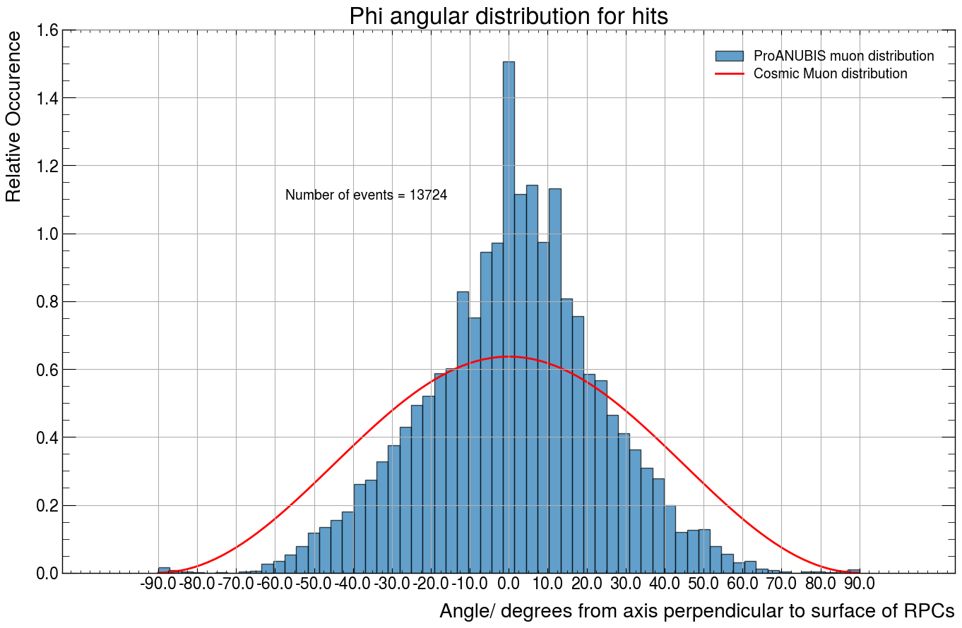
Y-axis Direction
θ
Eta Direction
Phi Direction

Slide 9
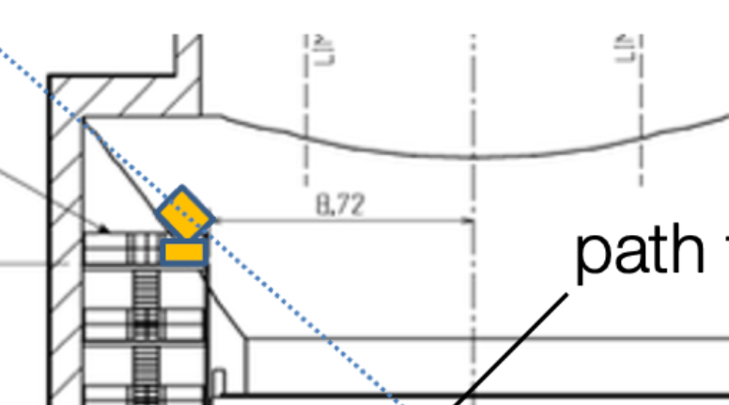
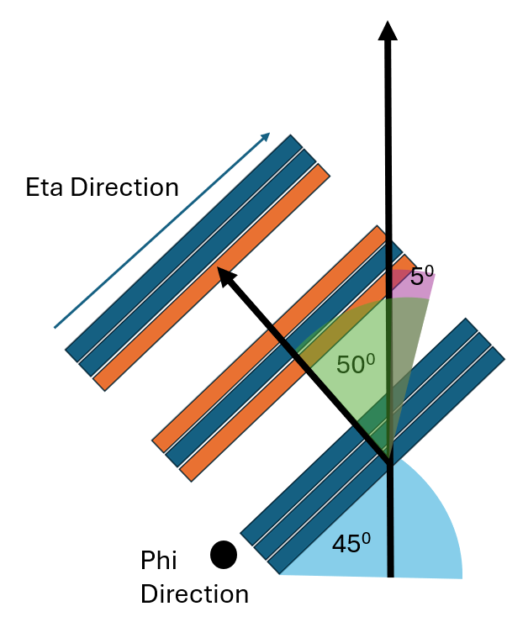
4.84m

Slide 10
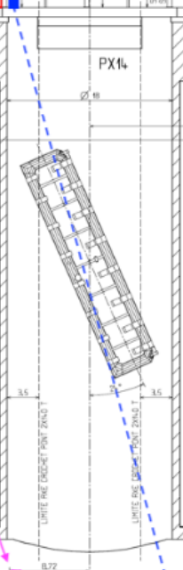
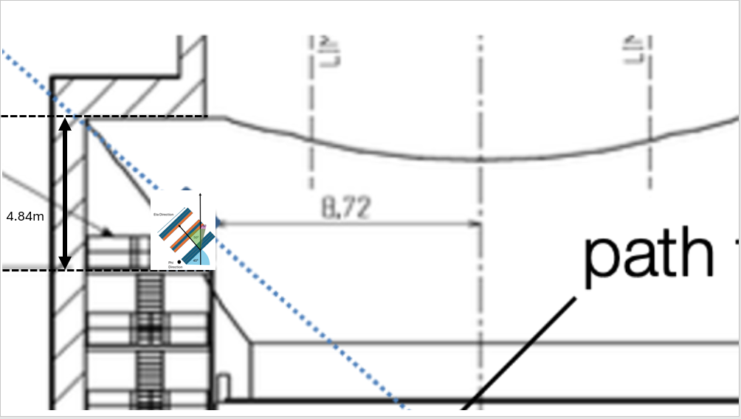
56m

Slide 11
Eta Direction
Y-axis Direction
θ
θ
Eta Direction
45⁰
Phi Direction
Phi Direction

Slide 12
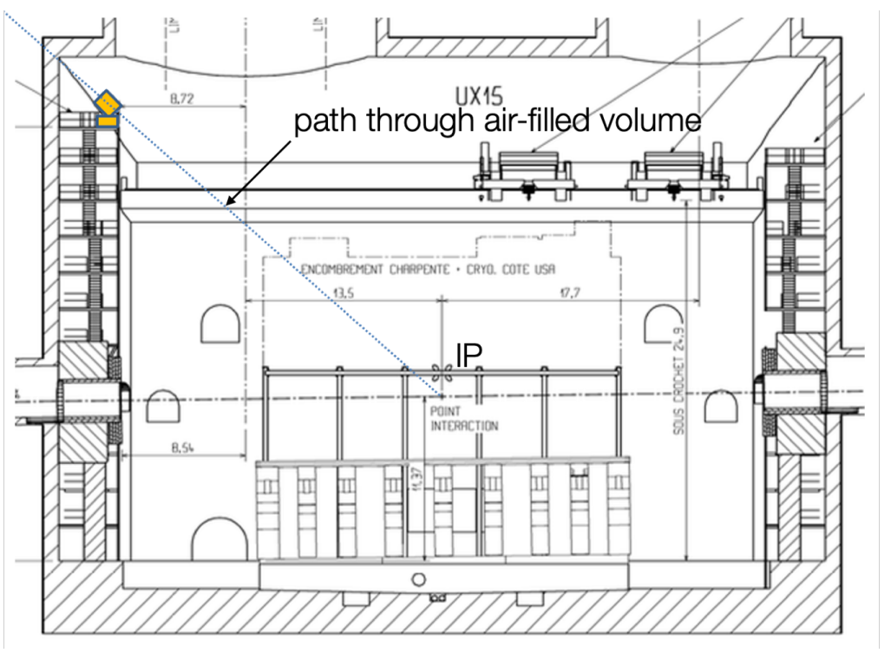
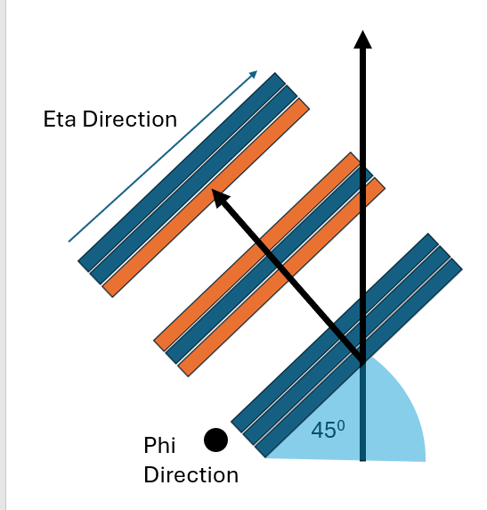

Slide 13
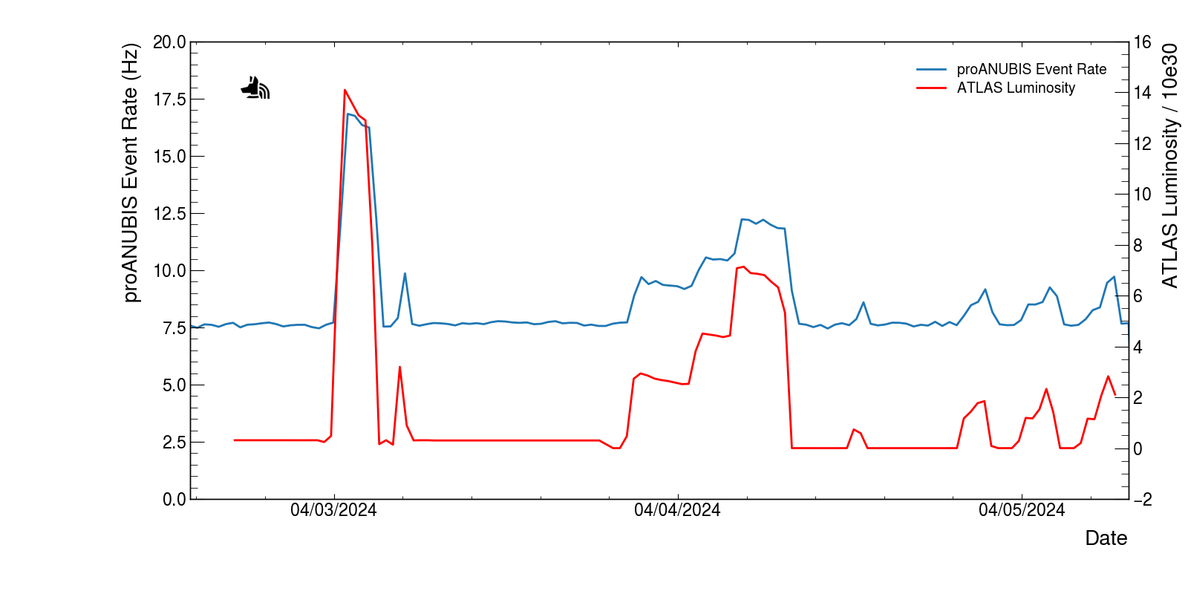
ProANUBIS during ATLAS luminosity event 03/04/24
American Date system

Slide 14
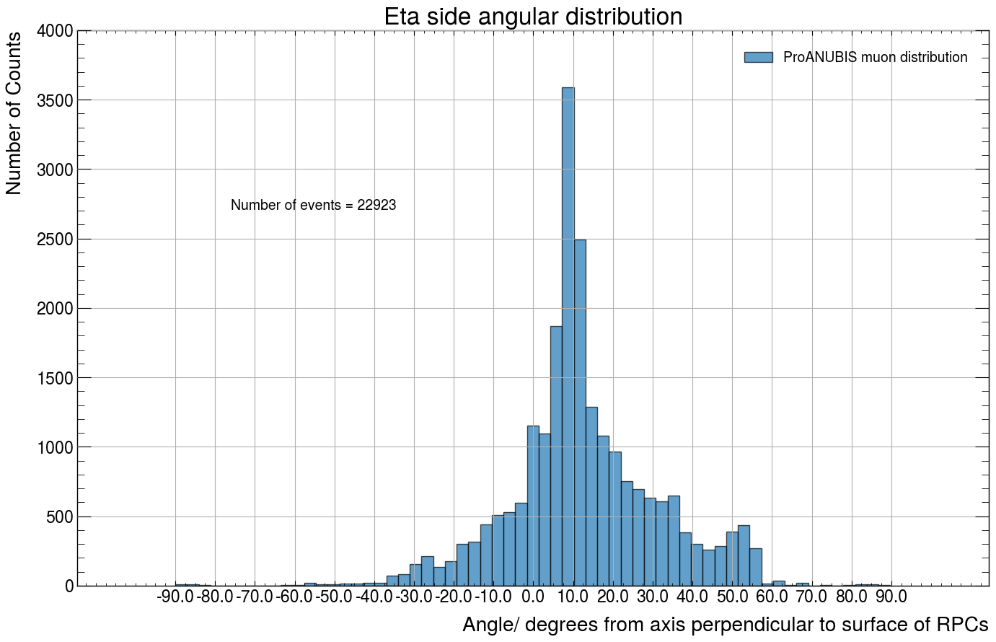

Slide 15
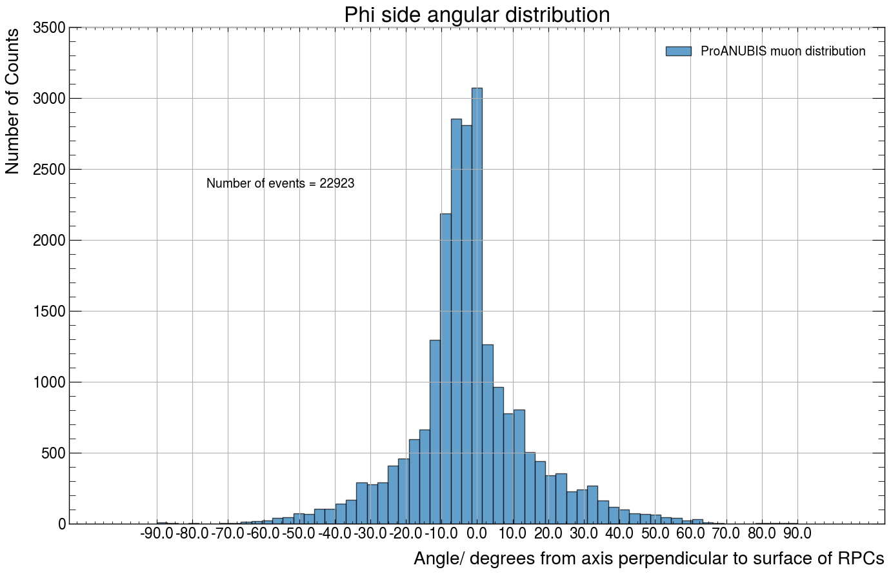

Slide 16
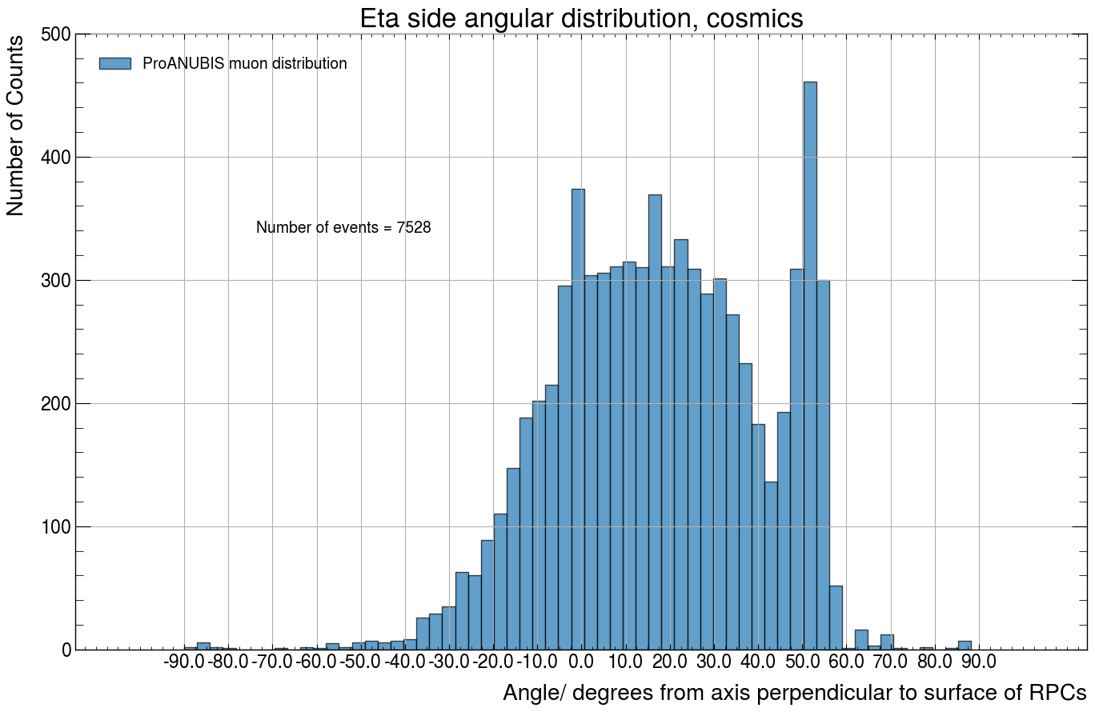

Slide 17
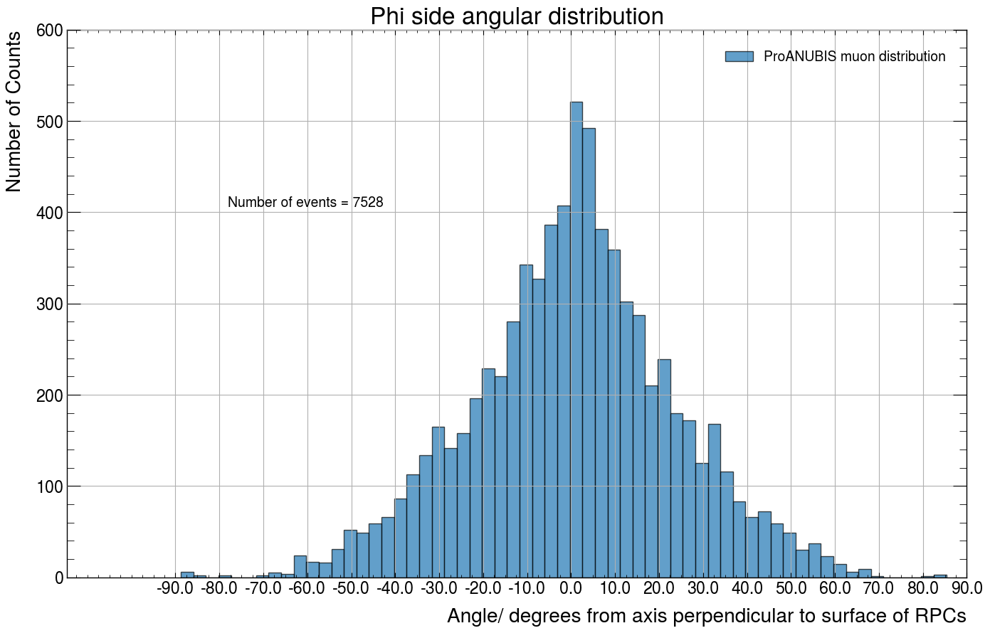

Slide 18
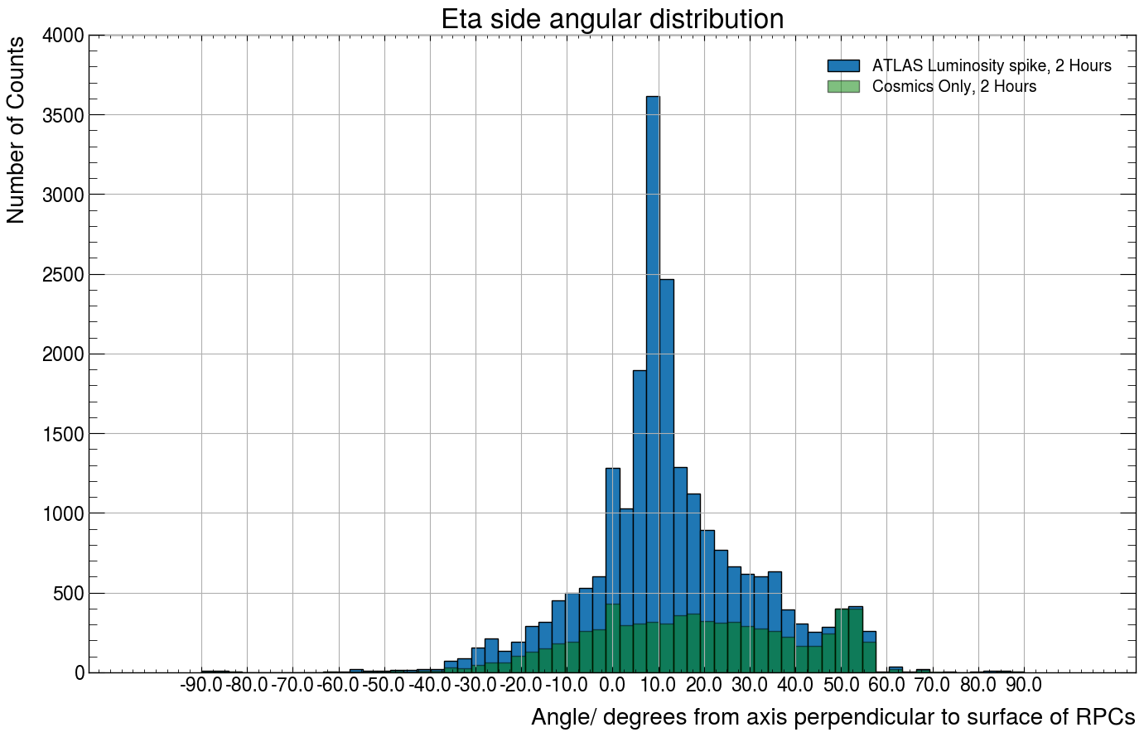

Slide 19
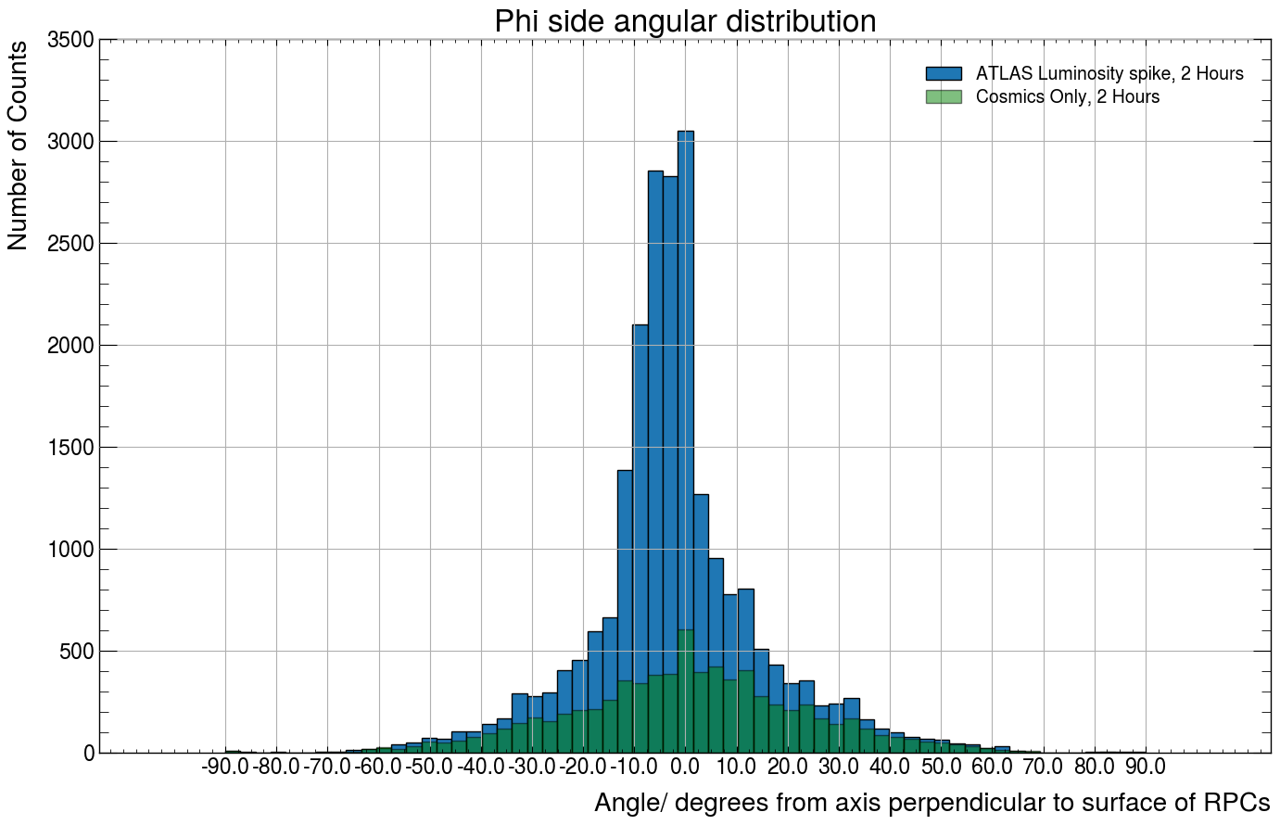

Slide 20
Introducing timing information
Using timing of top RPC hit – bottom RPC hit to determine if a trajectory is traversing vertically upwards or downwards.
dT >0 implies the top RPC hit was hit last and therefore the particle was travelling upwards. Vice-versa for dT <0.

Slide 21
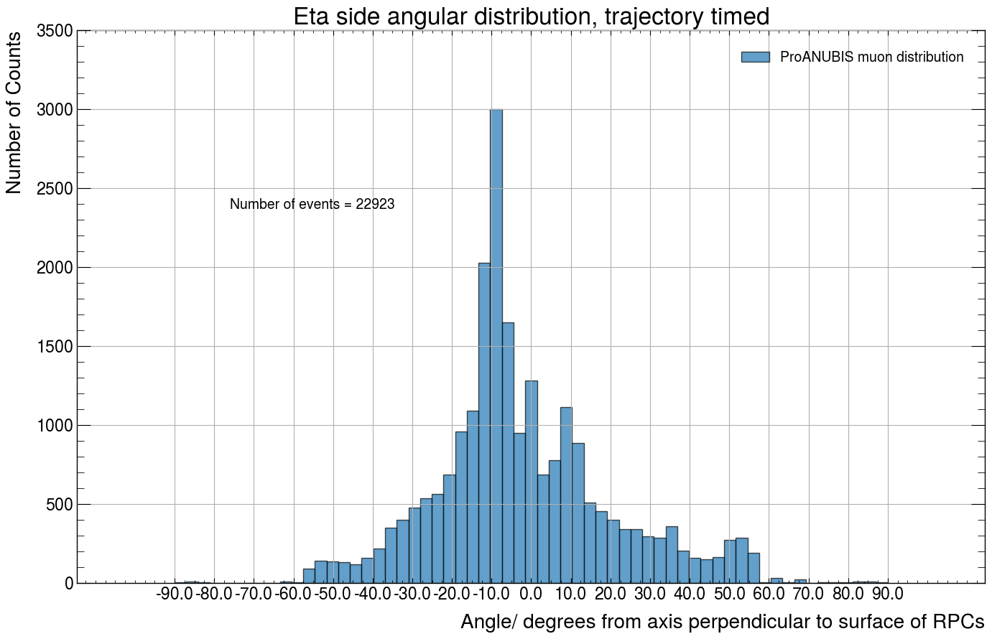
ProANUBIS during ATLAS luminosity event 03/04/24

Slide 22
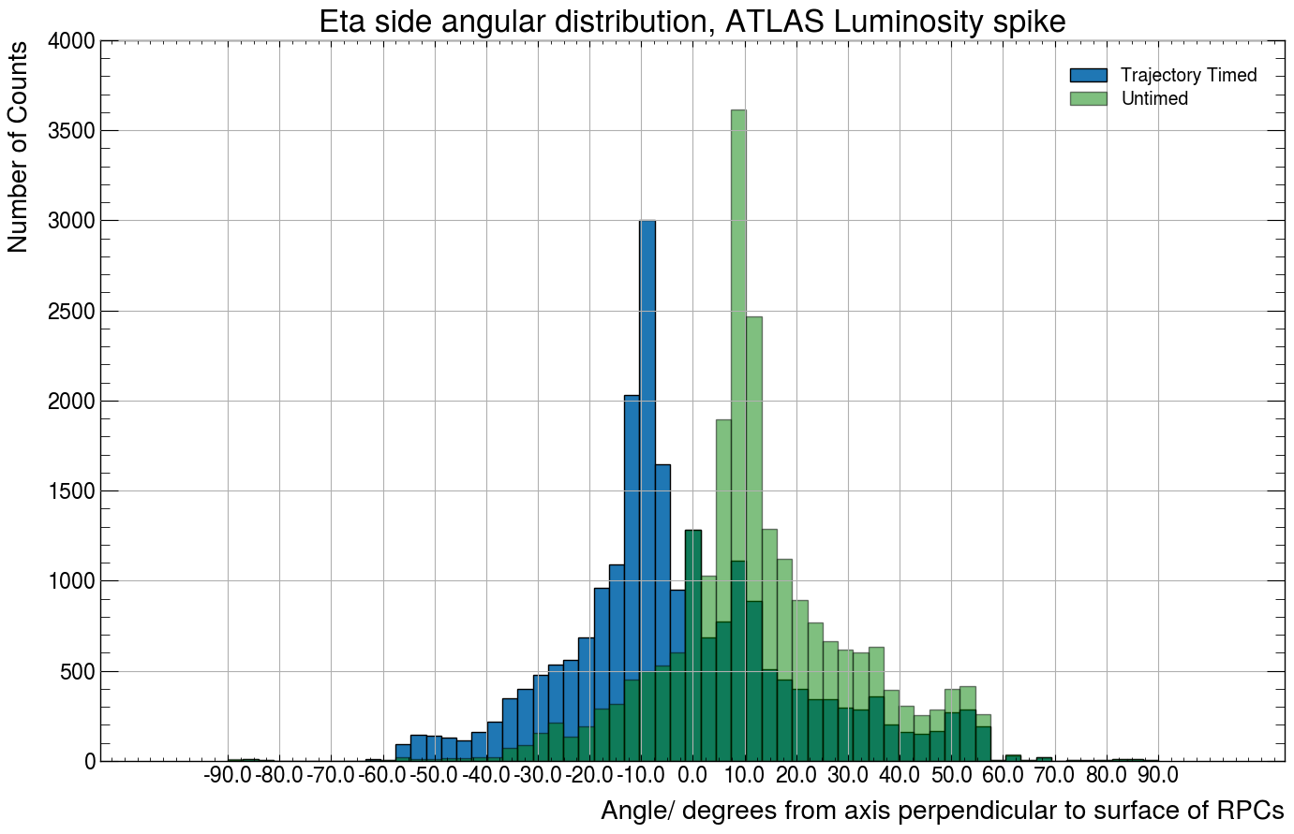
Trajectory with RPC timing is blue

Slide 23
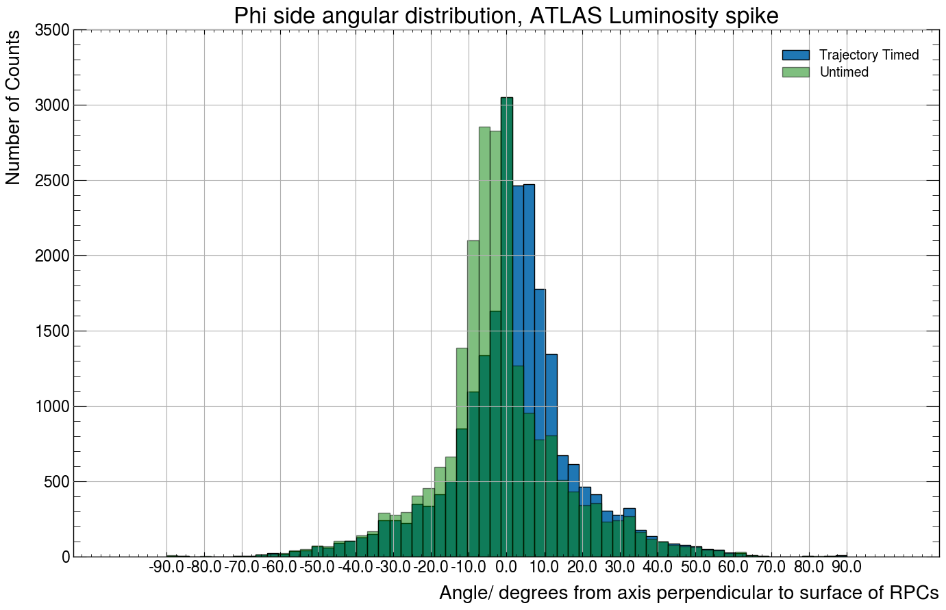

Slide 24
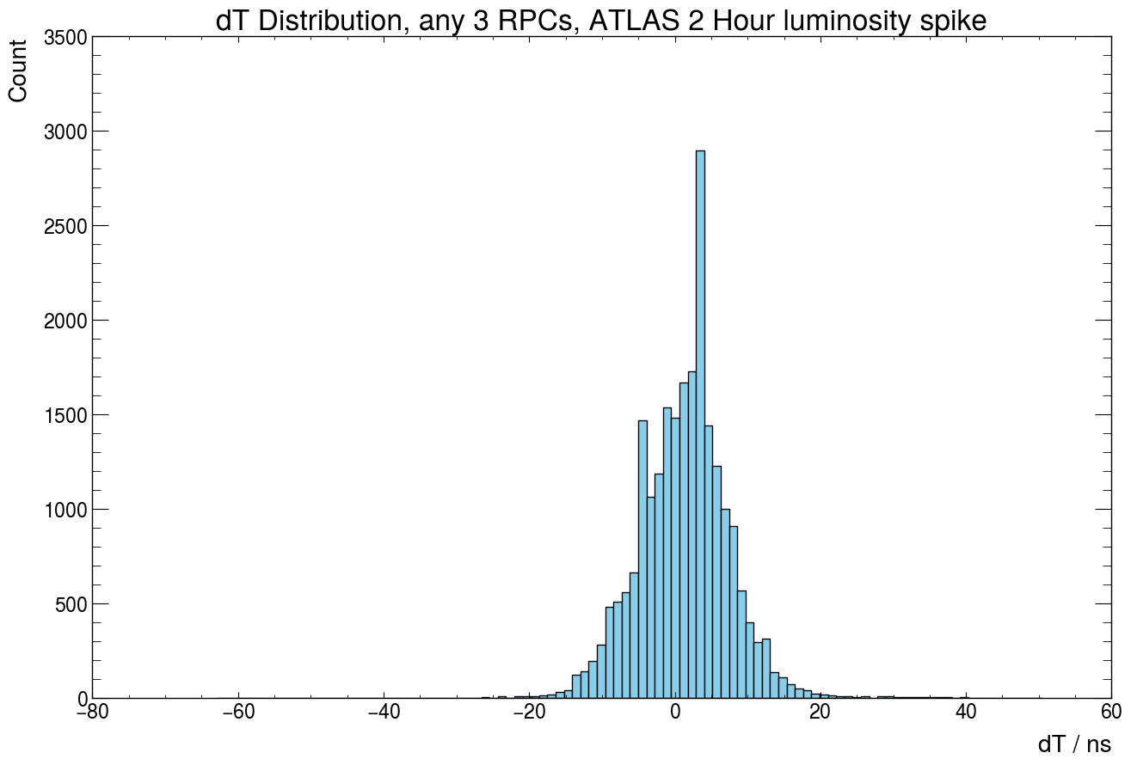
dT distribution for events (Any 3 RPCs)
Tails at high and large negative dT due to events running over 50-80 ns. This is an artifact of the time window used. Reducing the time window would potentially miss out on particle events, so instead a dT filter could be used to remove these tails.

Slide 25
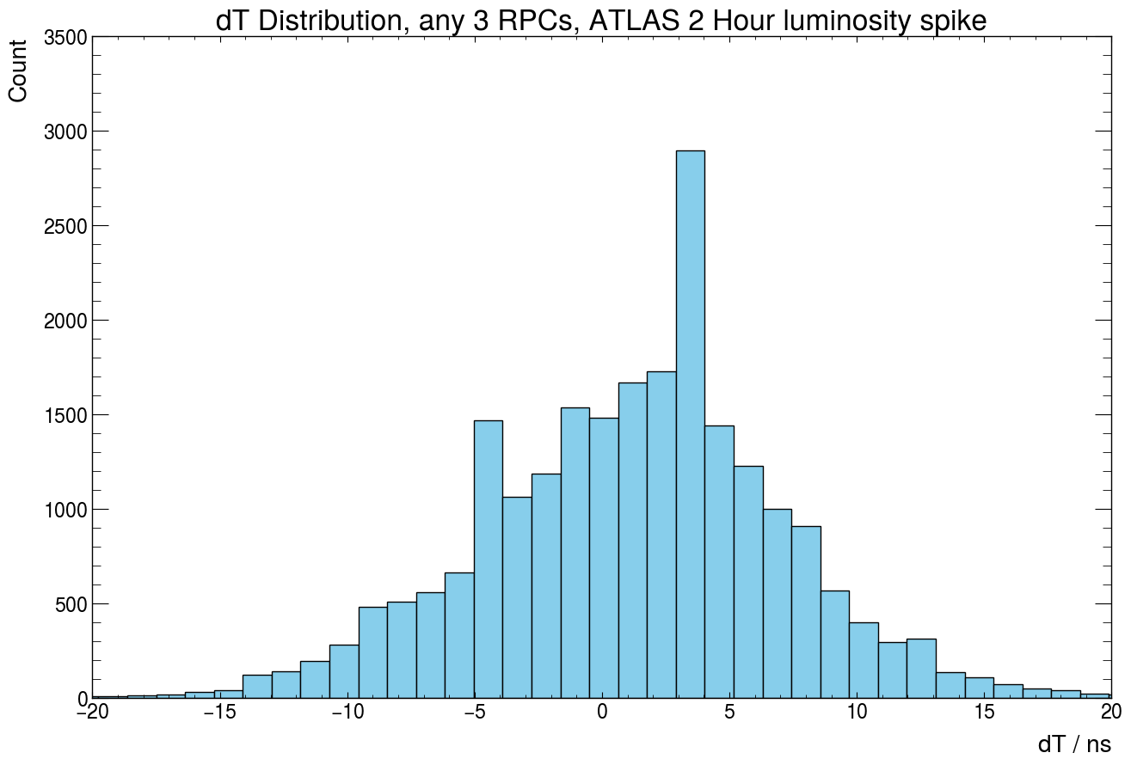
Peak at around 4ns.
1ns = 30cm.
4ns corresponds to crossing all 3 chambers.

Slide 26
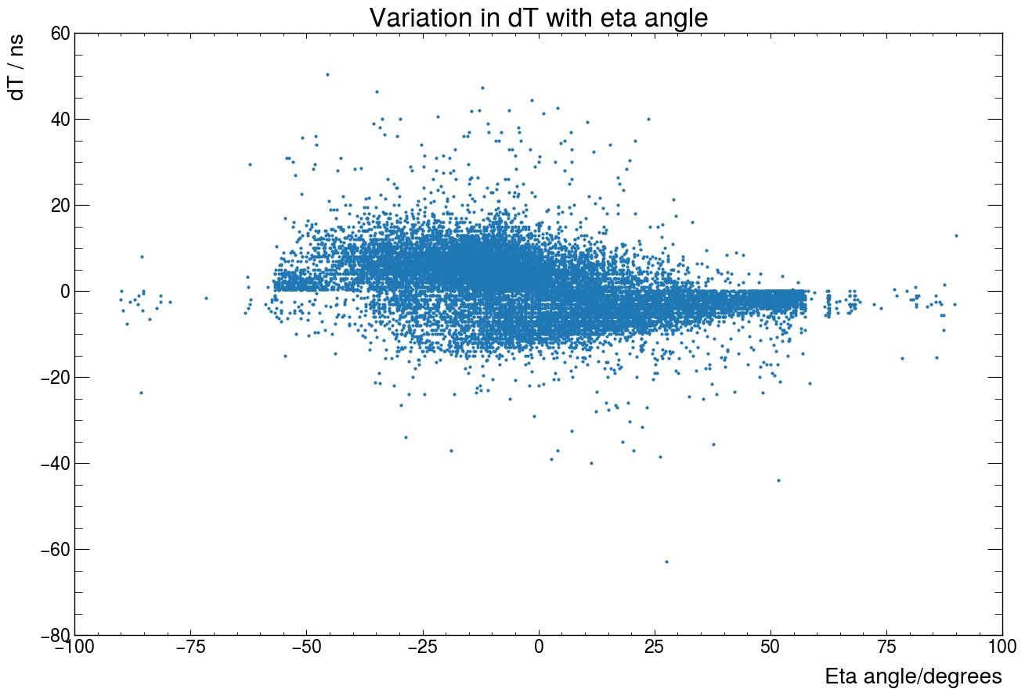
Likely cosmic muons whose angles have been flipped since dT<0 for them.
dT < 0 tends to occur at more positive eta angles. As suggested by the plot!
dT < 0 implies particle travelling downwards through RPC (e.g. cosmic ray muon)

Slide 27
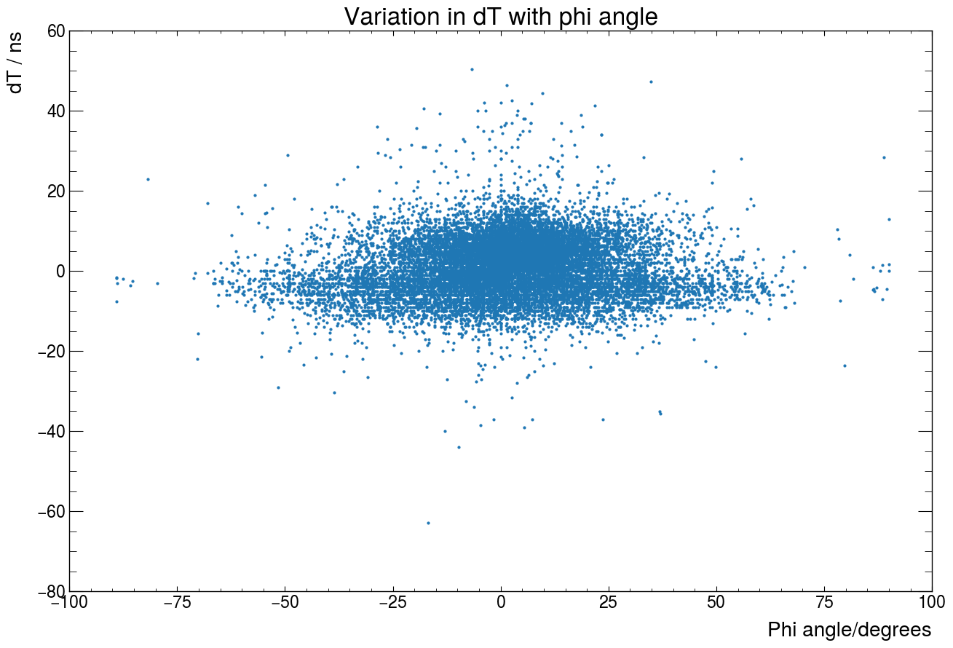
More Phi spread for negative dT. Positive dT more peaked around 0

Slide 28
Cosmic ray distributions, trajectory timed. (03/04/24, outside luminosity spike).

Slide 29
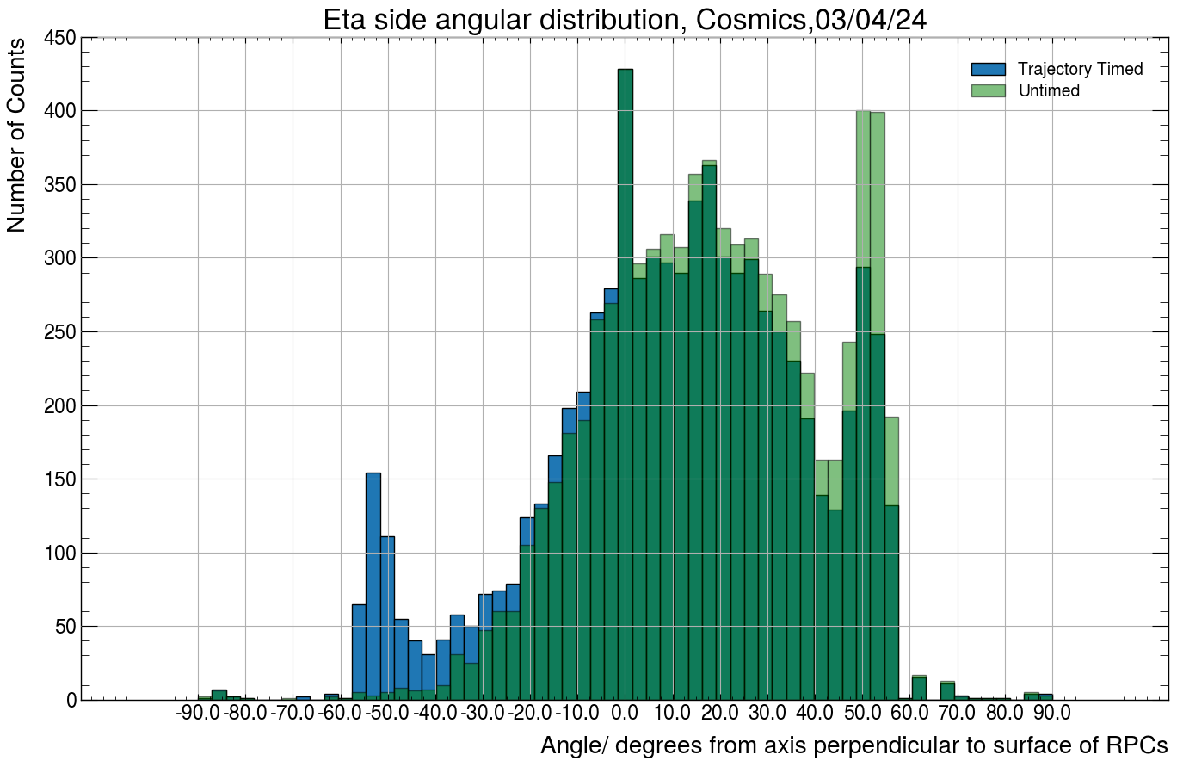
Likely cosmic muons whose angles have been flipped since dT<0 for them.

Slide 30
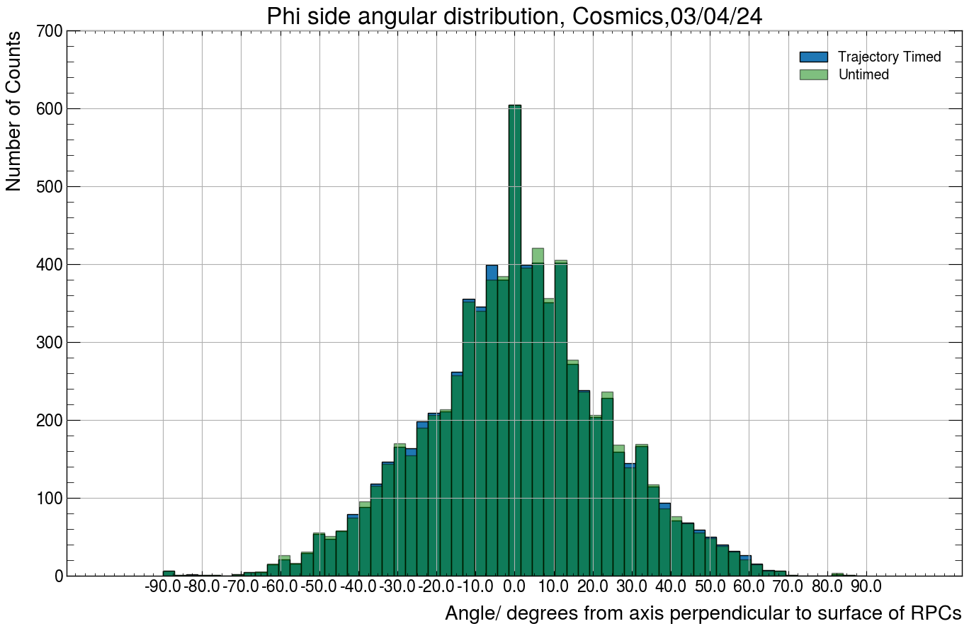

Slide 31
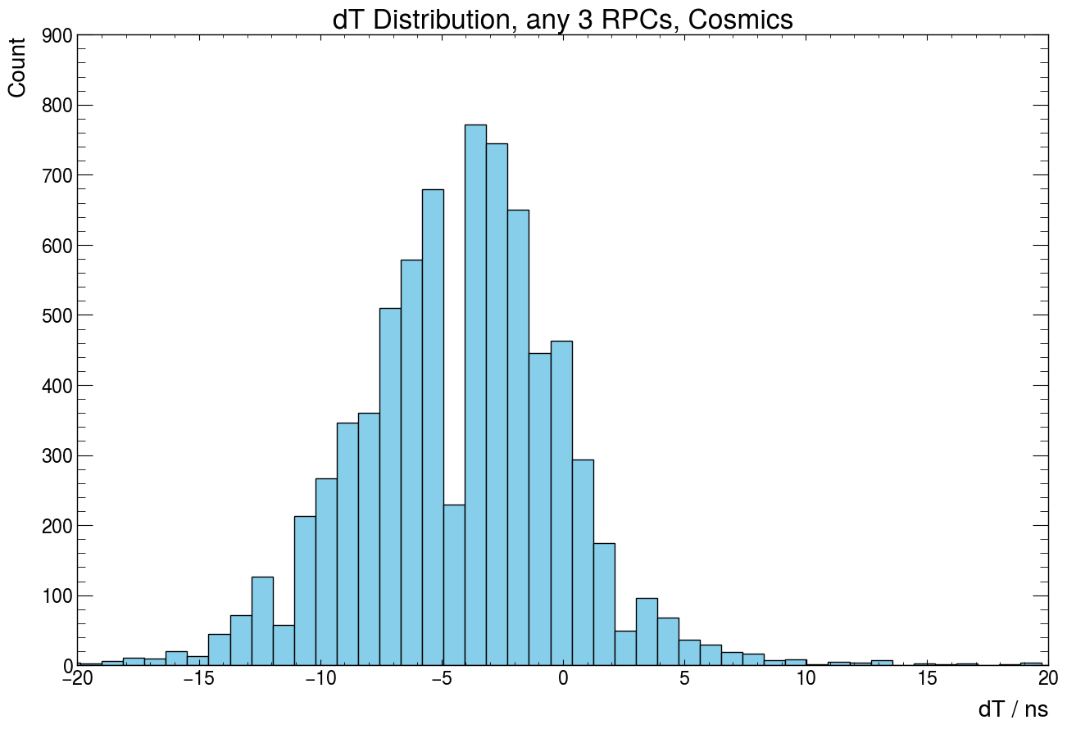
Check expected dT for RPC distances. 1 ns = 30cm

Slide 32
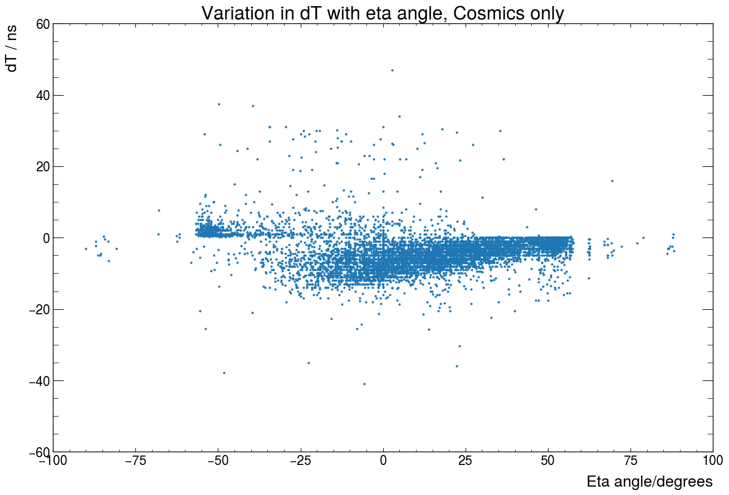

Slide 33
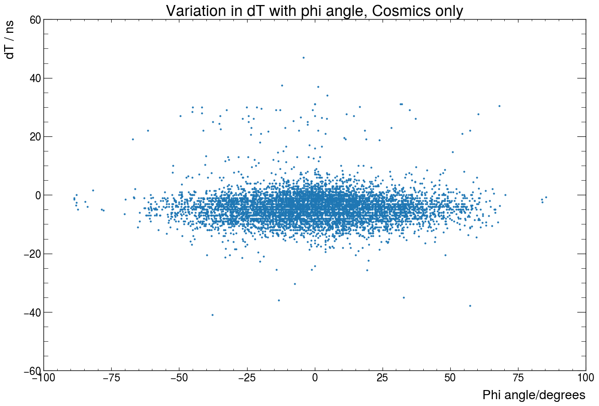

Slide 34
Combined Cosmics + Particle event plots.

Slide 35
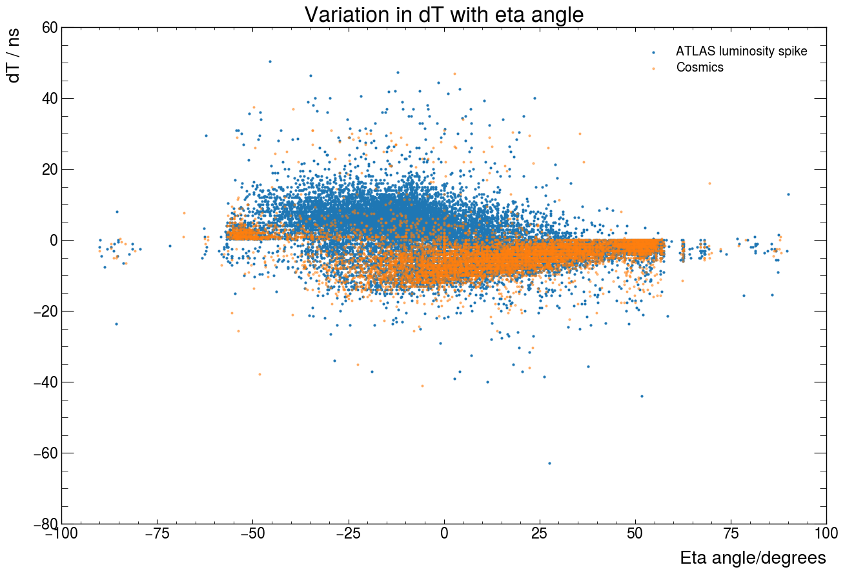

Slide 36
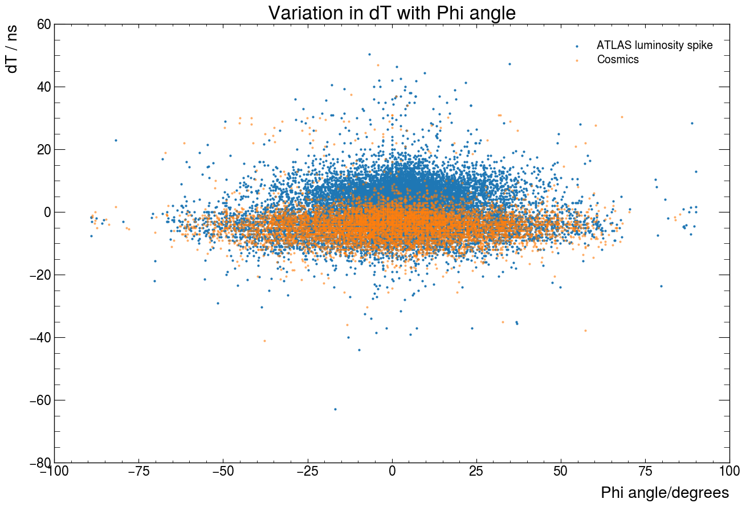

Slide 37
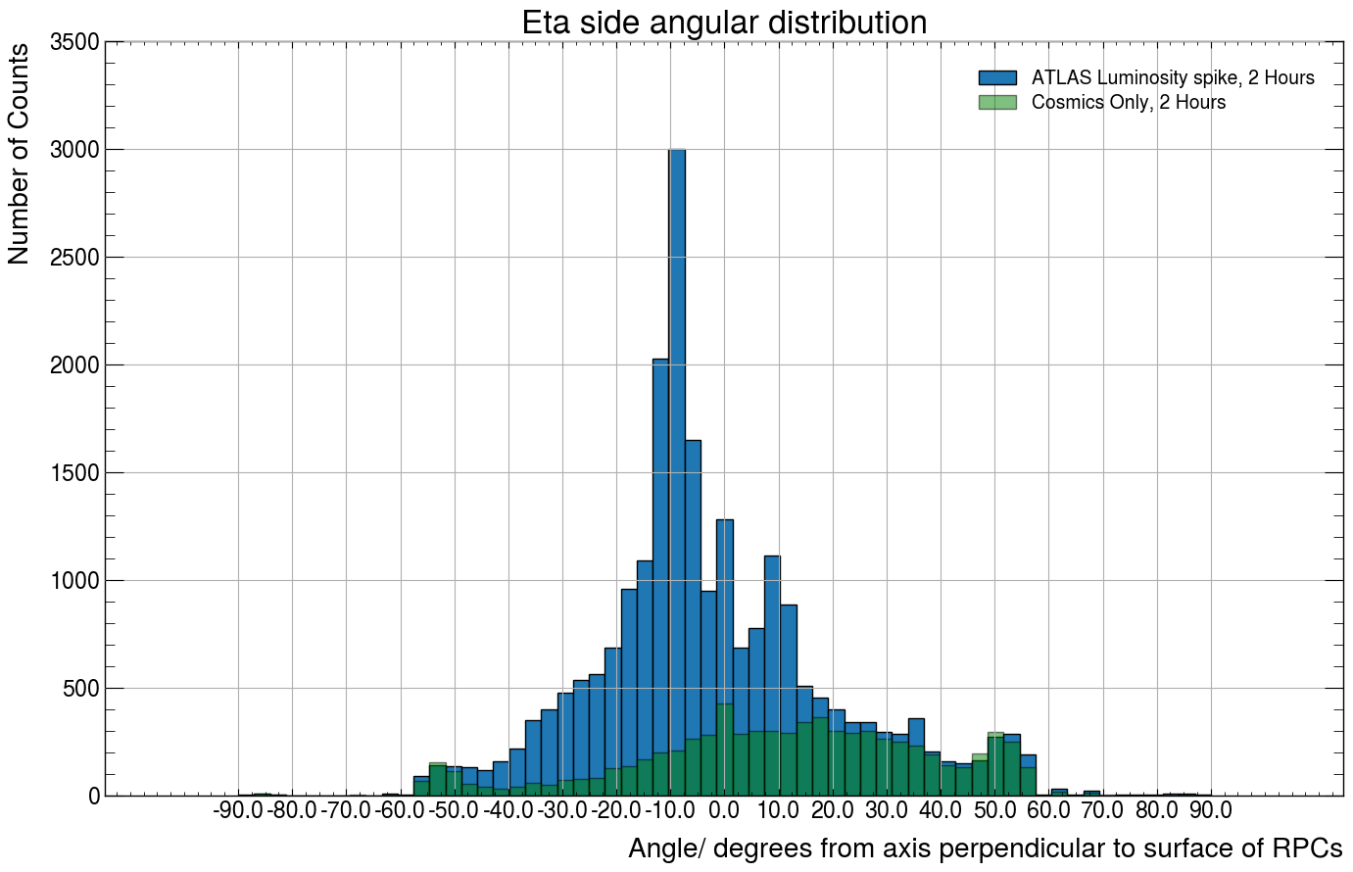

Slide 38
