Slide 1
Angular distributions

Slide 2
Cosmic muon data from 04/03

Slide 3
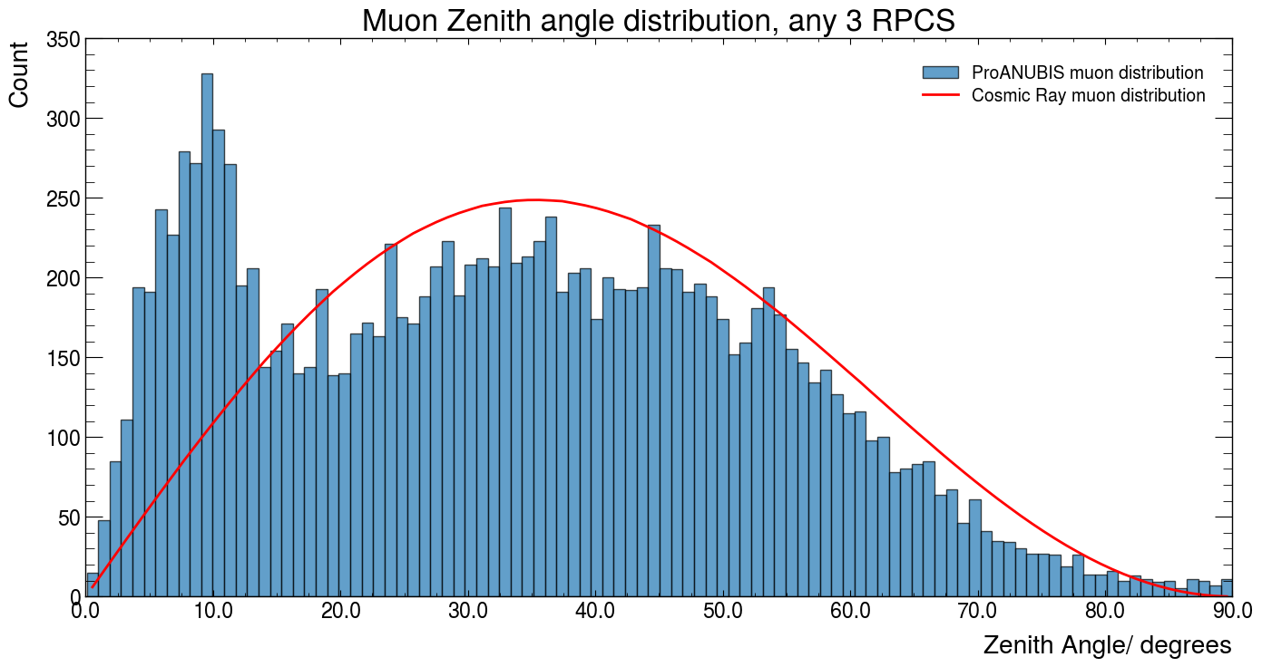

Slide 4
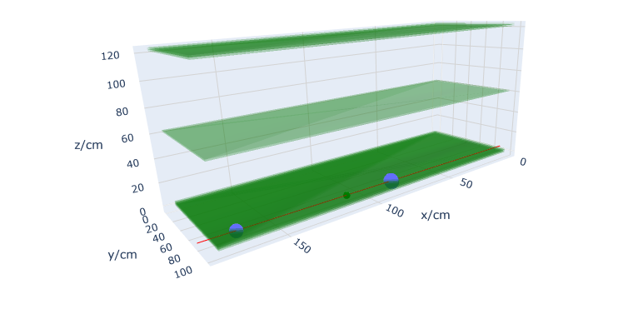

Slide 5
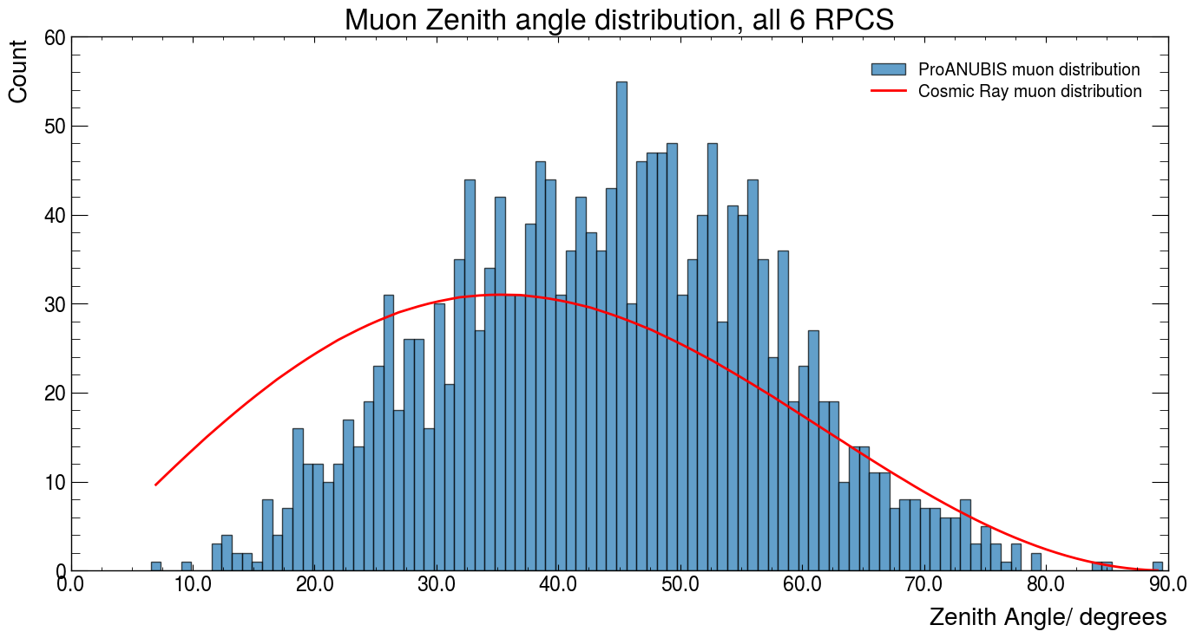

Slide 6
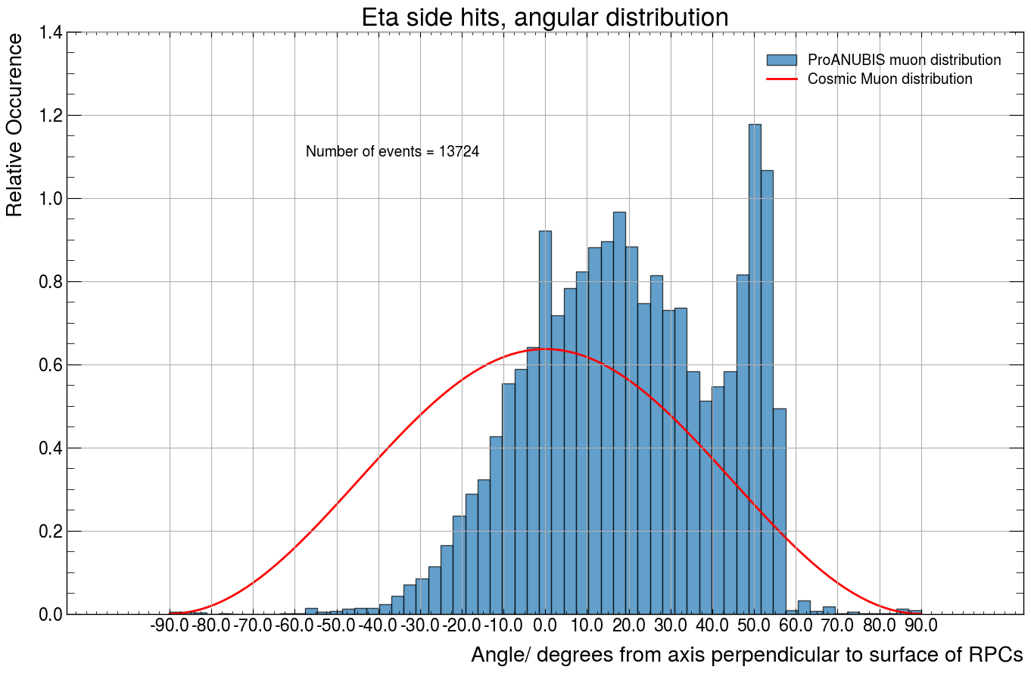

Eta Direction
5⁰
50⁰
X-axis Direction
45⁰
Phi Direction

Slide 7

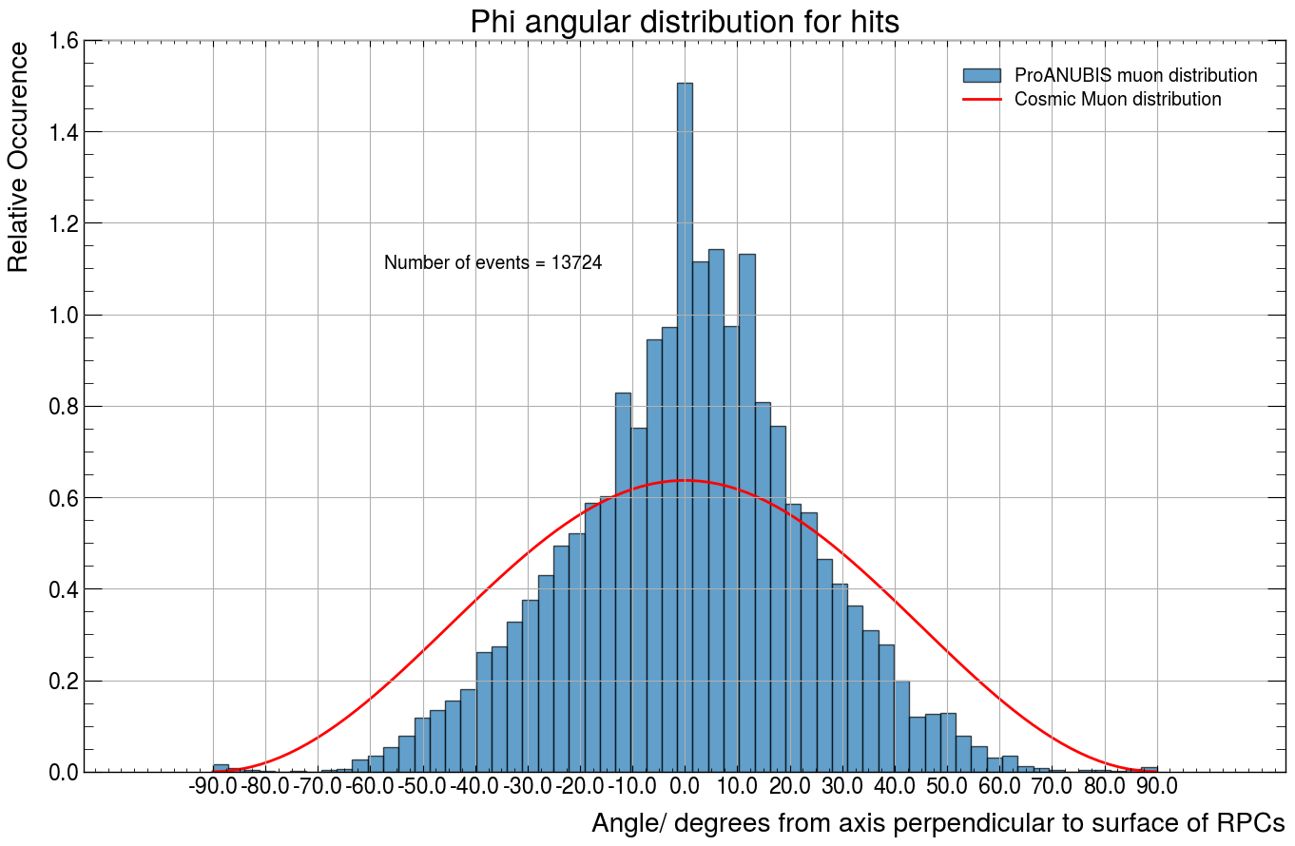
Y-axis Direction
θ
Eta Direction
Phi Direction

Slide 8
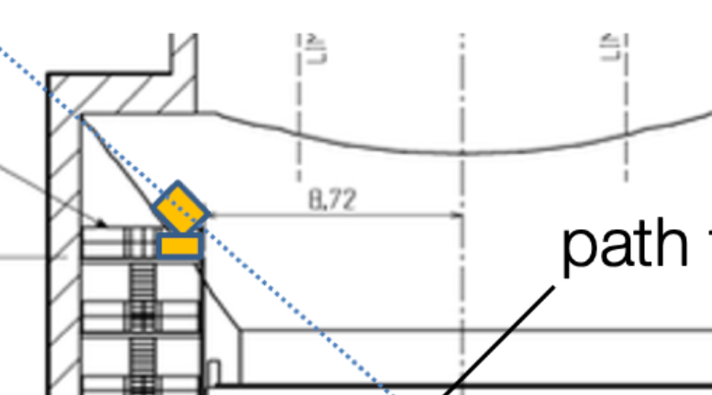
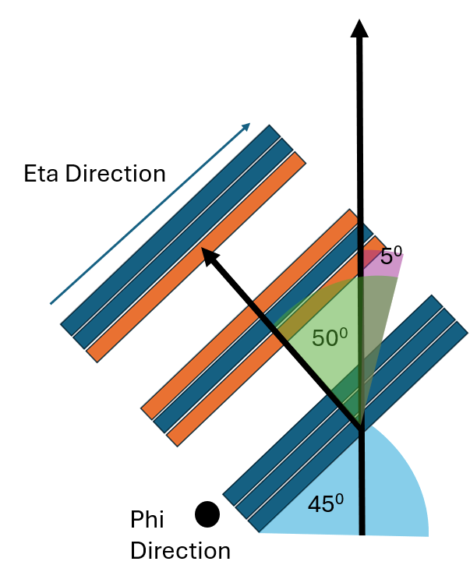
4.84m

Slide 9
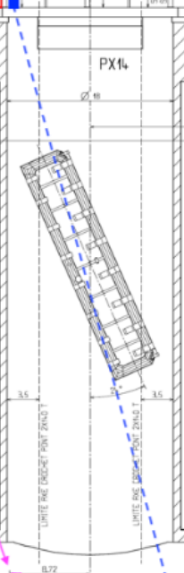
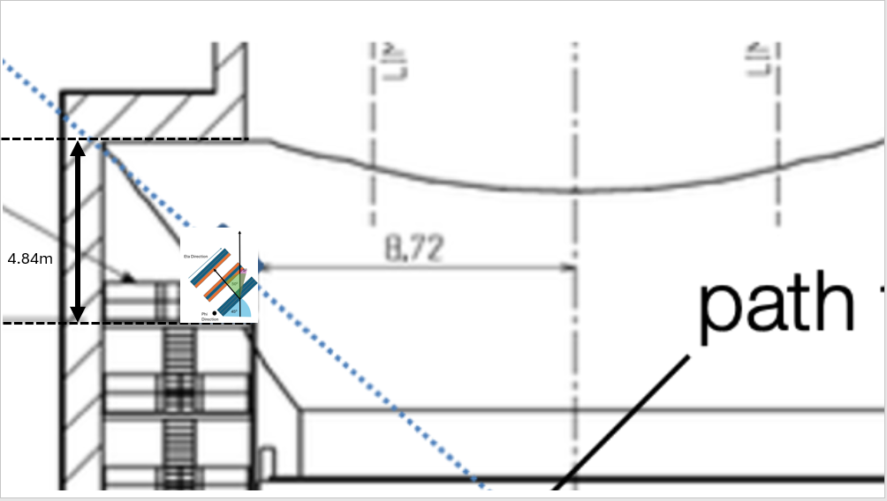
56m

Slide 10
Eta Direction
Y-axis Direction
θ
θ
Eta Direction
45⁰
Phi Direction
Phi Direction

Slide 11
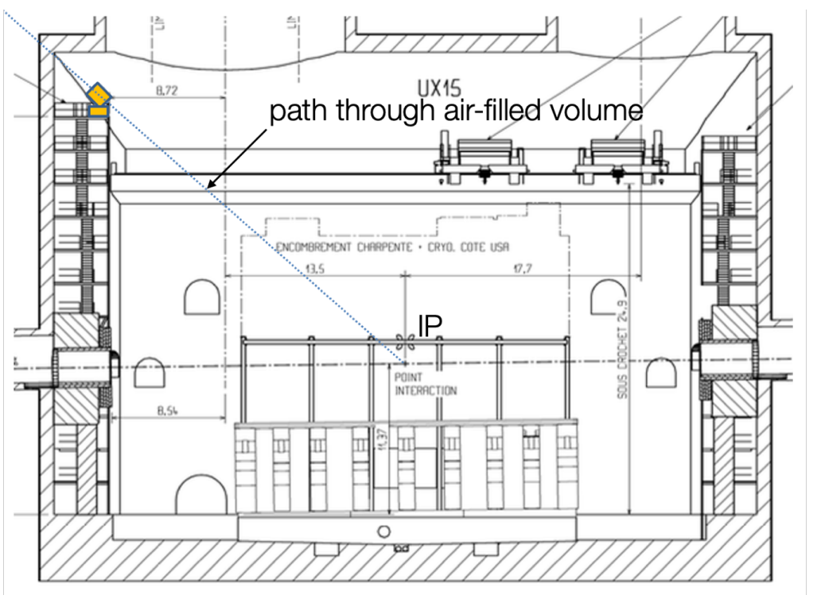
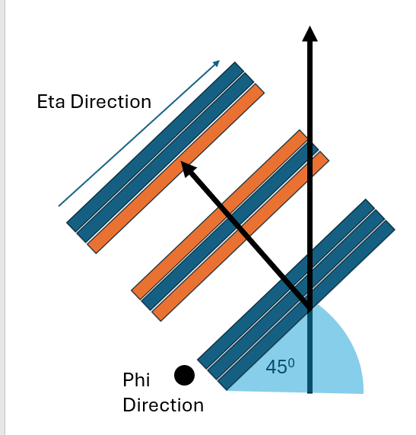

Slide 12
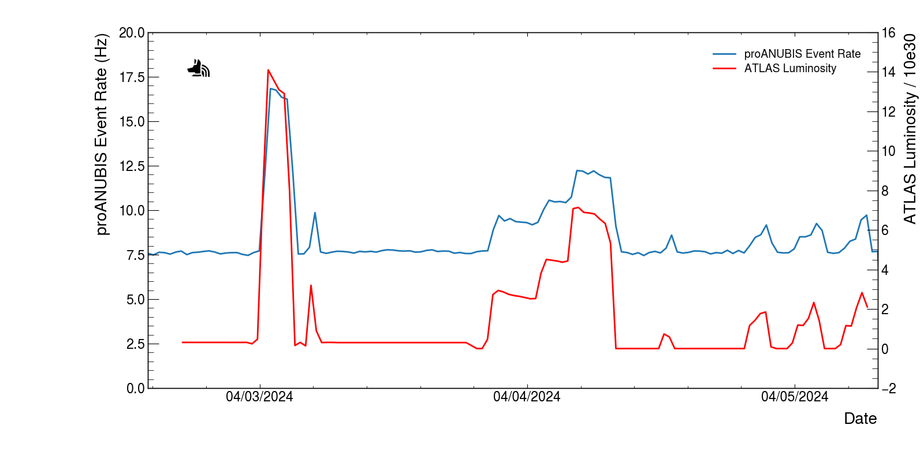
ProANUBIS during ATLAS luminosity event 03/04/24
American Date system

Slide 13
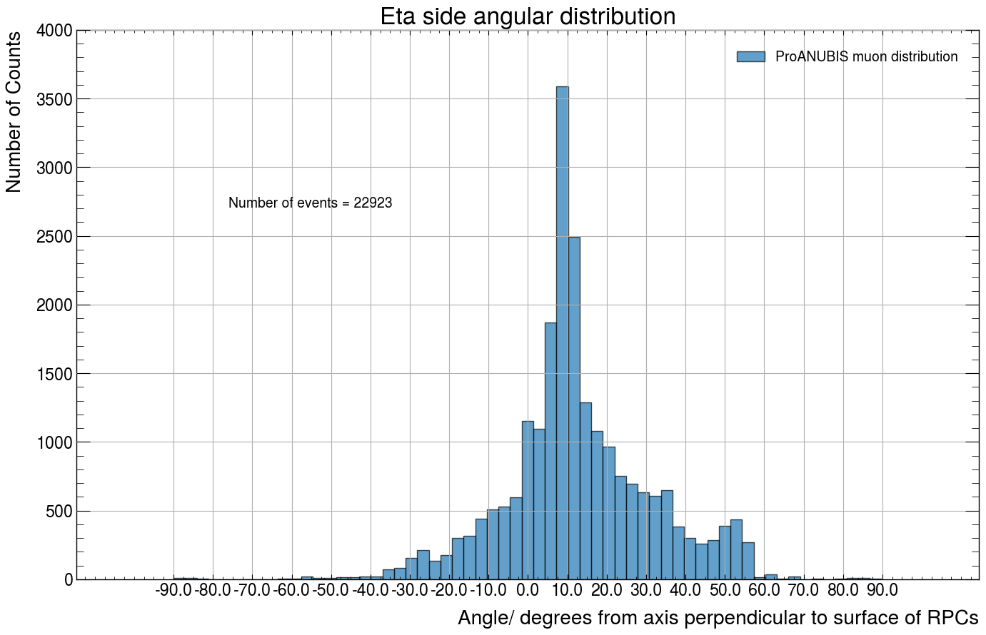

Slide 14
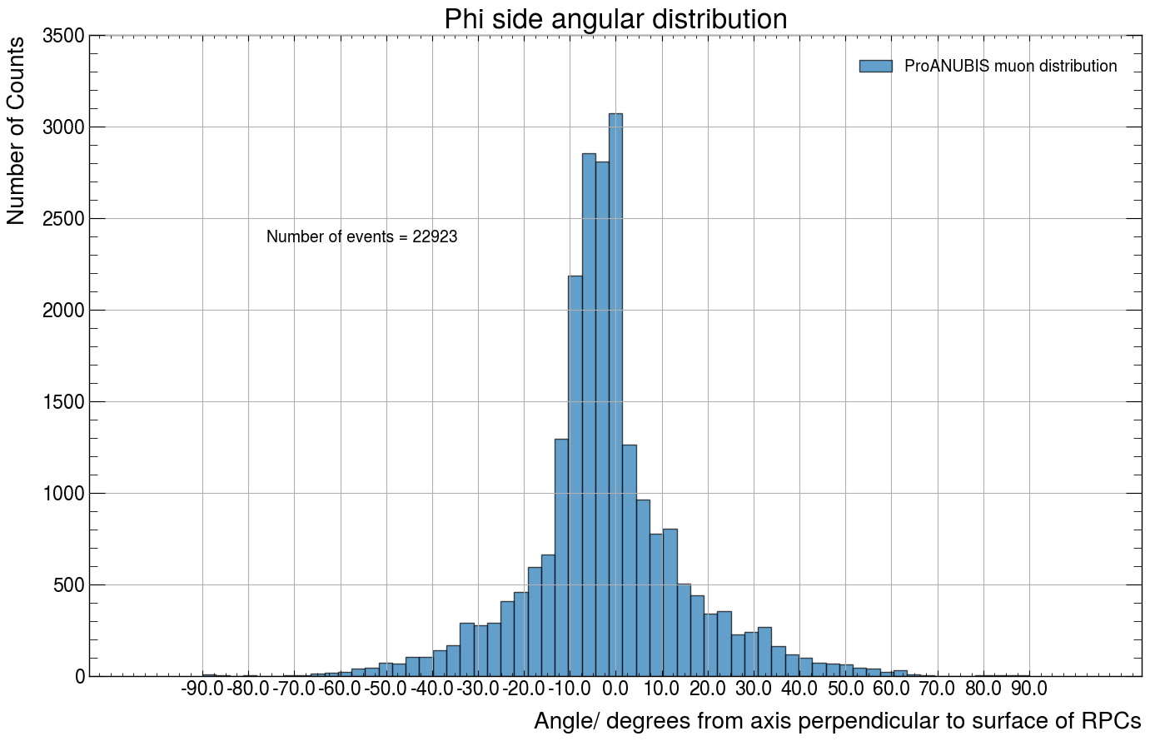

Slide 15
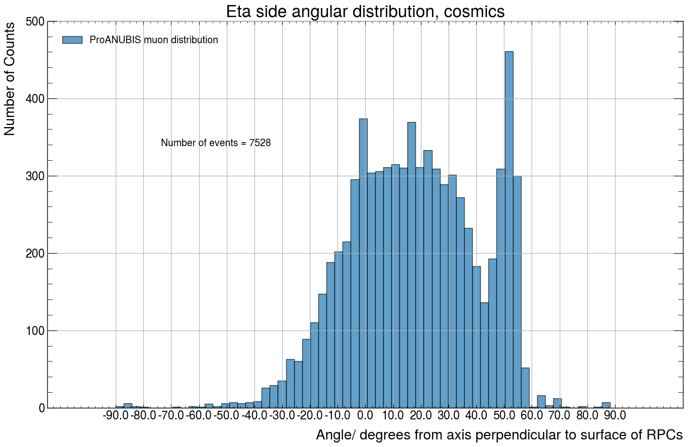

Slide 16
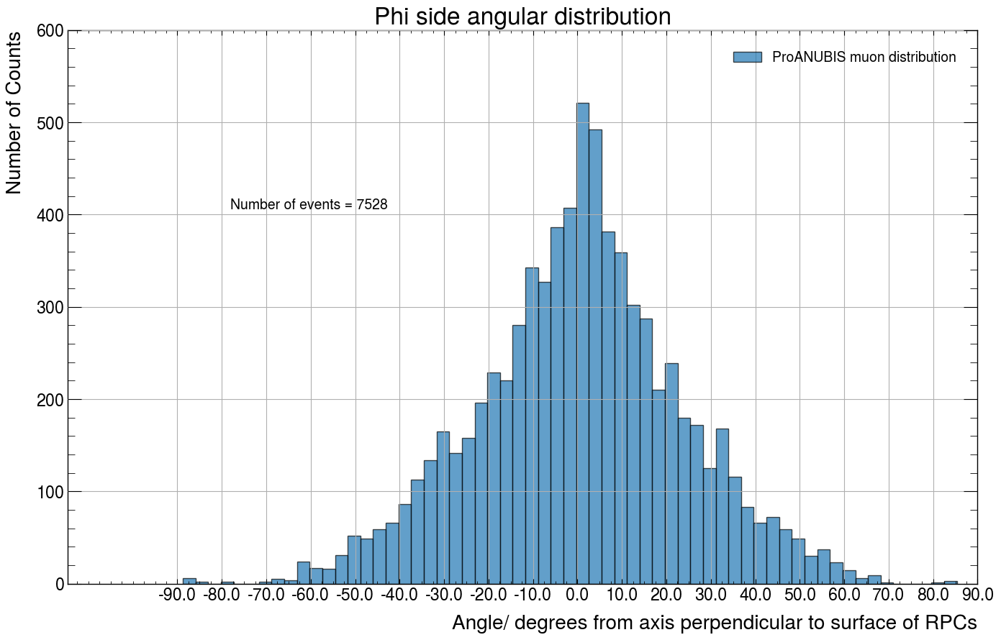

Slide 17
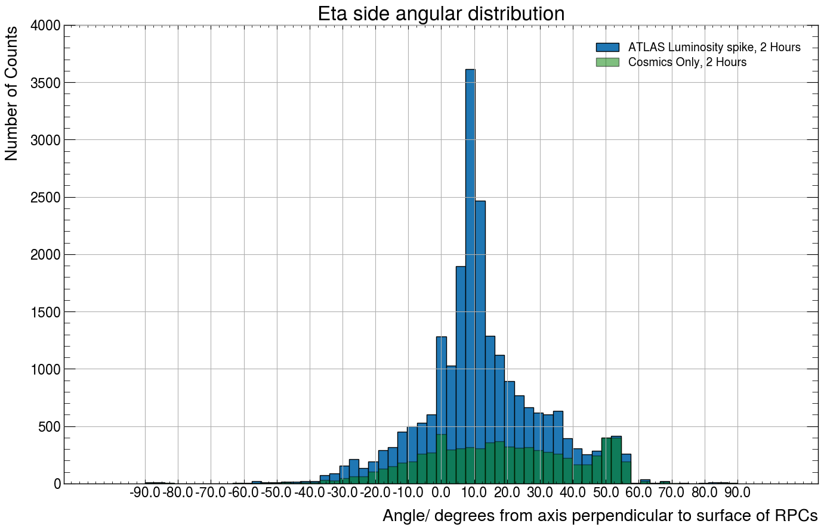

Slide 18
