Slide 1
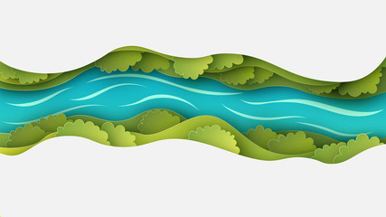
Coordinated Operation of Flaming Gorge Reservoir With Lake Powell

Slide 2
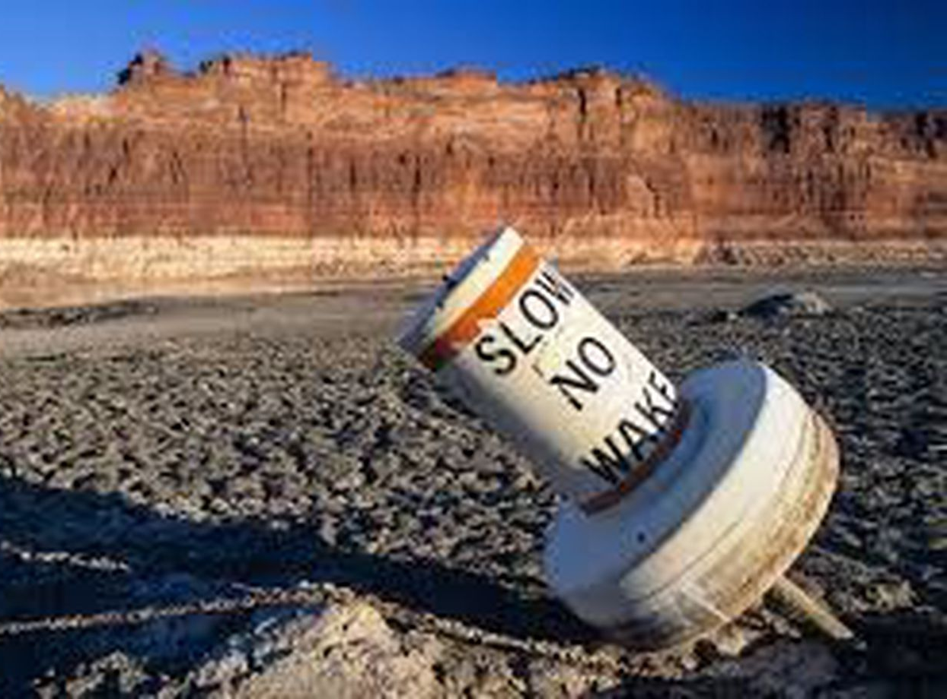
Notes:
As we all know the intermountain west is experiencing severe ongoing drought. One potential benefit of a coordinated operation of Flaming Gorge and Lake Powell is increased water stored in Lake Powell which would give Glen Canyon Dam operators more flexibility in meeting downstream water demands and environmental release flows during this severe drought.
Therefore, the objective of this project is to design a simplified, yet representative model of the Upper Colorado River Basin (UCRB) in regard to the coordinated operation of these two reservoirs.

Slide 3
Model Formulation
Objective Function(s)?
Maximize Additional Flows Sent To Lake Powel (Maximize Sum of Flows)
Minimize Unmet Environmental Flow Performance Indicator?
Decision Variables (Location, Time)
Reservoir Storage
Release schedule and volume: Hydropower, Baseflow, and Environmental Release Volumes
Constraints
Too many, further model simplification is likely required.
Notes:
Currently my model has 1 objective function which is to maximize release to lake Powell. My line of reasoning is that by maximizing release to lake Powell but still satisfying all the operational and environmental flow requirements, plus mass balance and a conservative minimum reservoir elevation in Flaming Gorge, I would essentially be identifying a Flaming Gorge operational strategy that is maximally beneficial to lake Powell with out having to include Lake Powell in my model which simplifies things quiet a lot. I am also still considering a multi objective model that would allow more flexibility in the model regarding meeting environmental flow releases.

Slide 4
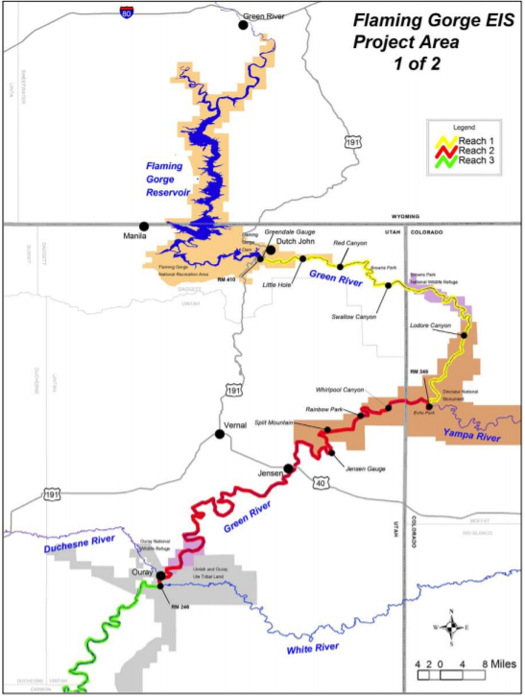
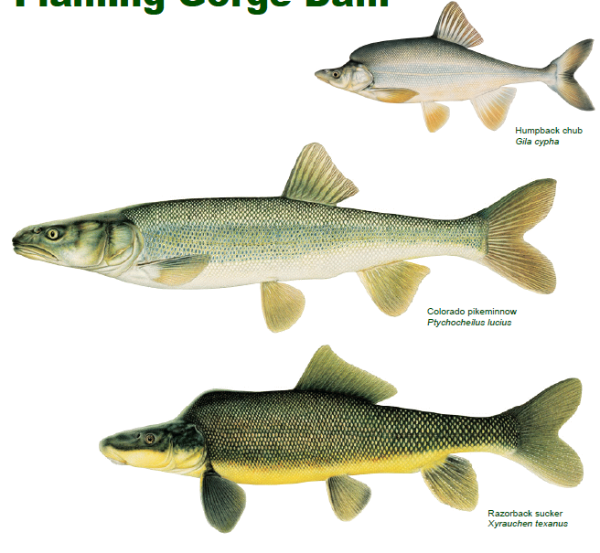
Constraints: Management Objectives
ENDANGERED!
Notes:
Flaming Gorge is currently operated in accordance to the 2006 decision of record. Basically, in addition to meeting all the previous hydropower, baseflow, and consumptive use demands, reservoir operations are now required to include environmental flow releases for several weeks two times year. The volume of these releases is determined in a tiered manner based on hydrologic inputs. The timing of the releases are designed correspond to major reproductive or lifecycle events endangered fish species. Therefore the exact timing of these releases vary each year but generally occur within predictable time intervals. The environmental flow targets for these fish are different for each of the 3 different reaches of the green river. I’ve simplified this in my model to only trying to meet demands in Reach 2 because in general if the environmental flow targets for reach 2 are met the flow targets for reach 1 and 3 are almost always met. However reach 2 flow rates are not solely dependent on releases from flaming gorge. Reach 2 flow rates also depend on unregulated inflows from the Yampa River. This brings me to my last slide

Slide 5
Major Modeling Challenges: Uncertain Inputs
Random nature of hydrologic inputs to Flaming Gorge reservoir and Yampa River
Environmental Releases that can occur at random within specified time intervals
Hydropower demands that fluctuate hourly or daily.
Notes:
I am trying to deal with several rather uncertain model inputs and flow constraints. I have the random nature of the hydrologic inputs to flaming gorge and the Yampa river which I am going to try to deal with using several different hydrologic scenarios based on historical data or predefined USBR hydrologic scenarios for flaming gorge/
I have the some what random nature of the environmental flow releases. The volumes of which are dependent on hydrologic inputs and in reality, the timing varies over about the span of a month. Because the time step of my model is in months I will assign the flow the demands of the environmental flow releases to the month or months that they fall in.
Finally I have hydropower demands that are always fluctuating. Currently my plan is to use historic hydropower release data to come up with total monthly minimum, average, or maximum hydropower releases
In conclusion I still have a lot of work to do.

