Slide 1


Booking system
Harry’s Salon
Single user booking system for barbershops
Group 6: Isak, Nick, Patrick
https://github.com/PatrickClemmensen/AP_CS_SEM1_HARRYS
April 8, 2026
EK
Erhvervsakademi København
Notes:
Isak
---
Kort intro-hej-hej

Slide 2
Agenda
A
B
C
D
EK
Erhvervsakademi København
Notes:
Isak
---
Vi har fået til opgave at hjælpe TechLab med at lave The Ultimate Loan Tracker
Vi har efter bedste evne forsøgt at tænke som udviklere
Vi vil I løbet af præsentationen argumentere for, hvordan vi har taget højde for og/eller inkorporeret ovenstående punkter I vores løsning

Slide 3
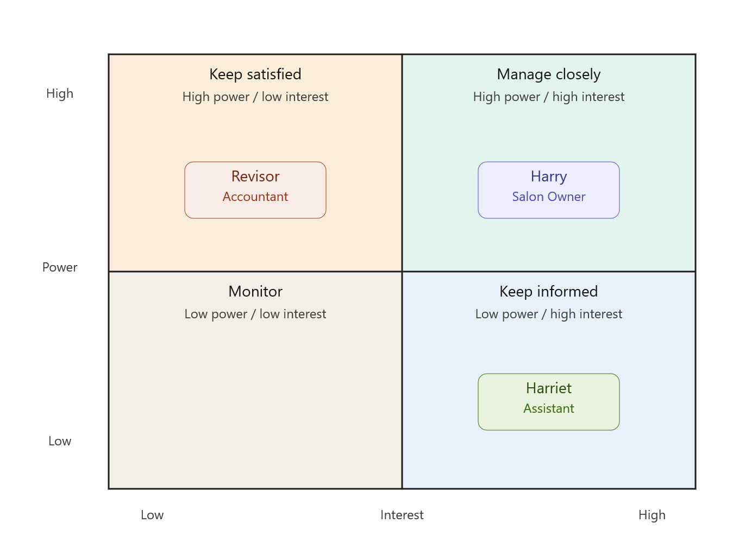
Stakeholder analysis
Power-Interest Matrix – Harry’s
Harry – Involve in Sprint review, primary decision-maker on scope
Revisor – deliver financial view cleanly, keep interface simple
Harriet – demo each sprint, ensure booking flow works for daily use
Harriet handles the majority of incoming booking calls after school hours — UI clarity in the booking flow is critical to her daily efficiency."
Notes:
Obs: Er customers stakeholders?

Slide 4
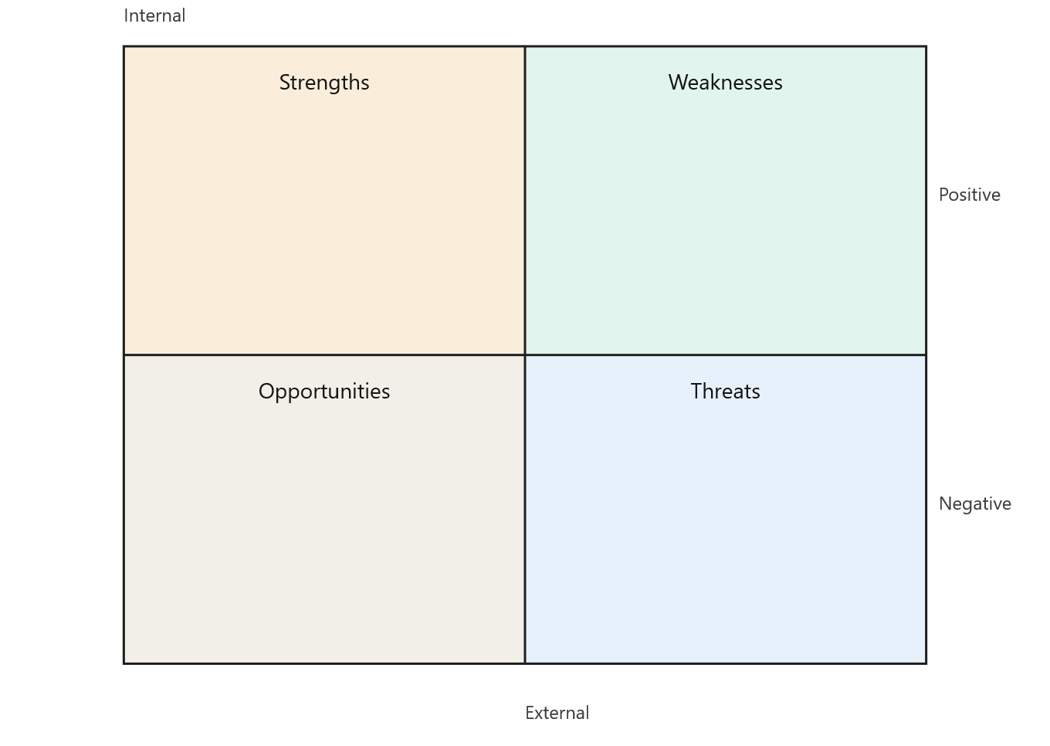
SWOT analysis
Harry’s Salon
— Console-based / low technical barrier
— Revisor gets direct access to financial records, no manual cross-checking
— Both Harry/Harriet can manage bookings
— File persistence
— Low technical literacy of users
— No existing digital data to migrate
— Single laptop, no backup system
— Manual calendar as fallback risk
— No network, offline only
— Digital records enable statistics — Foundation for future online booking — Payment history improves forecasting — Closed-day logic reduces errors
— Adoption resistance if UI is confusing — Data loss if file persistence fails — Scope creep from nice-to-haves
Notes:
Obs. Skal ”closed-day logic” være i opportunities?

Slide 5
Questions?
Thank you.
Group 6: Isak, Nick, Patrick
[· github.com/your-org/your-repo ]
EK
Erhvervsakademi København
16 / 16
Notes:
Isak, Nick & Patrick <3

