Slide 1
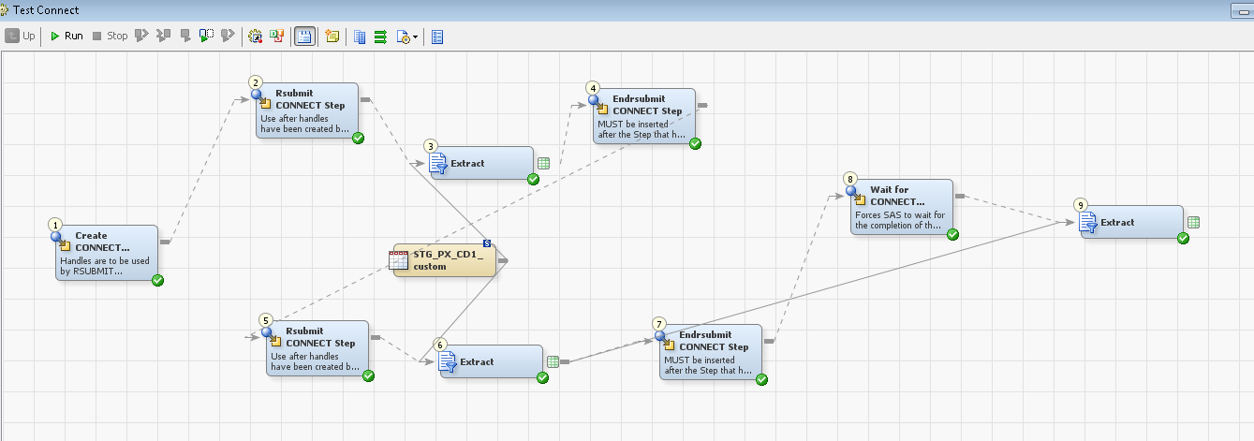
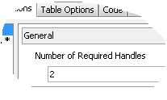
These two extracts will run at the same time
This extract will run after the SAS has completed waiting
Creates handles for your Connect sessions, you specify how many you need. Here we need 2
Rsubmit will use first available handle
Enclose the code you want to run within a subsession with an endrsubmit
Tells SAS to wait for the parallel sessions to complete

