Slide 1


Refactoring Pre-compiler
Turning Water into Wine
Refactoring Rotten Code

Slide 2
Turning Water into Wine
Intro Slide
Patrick Delancy
Corey House
Ryan Langton

Slide 3
Turning Water into Wine
Workshop Schedule
Time | Section
8am-8:45am | Intro
8:45am-9:45am | Identify Code Smells – areas of code that need refactoring.
9:45am-10am | Break
10:00am-12pm | Introduce Sample Application - Code Challenges and Group Code discussion.
12pm-1pm | Lunch
1pm-1:45pm | Writing Clean Code
1:45pm-2:45pm | Refactoring practice and assistance
2:45pm-3pm | Break
3pm-4pm | Share refactored code, challenges
4pm-5pm | Conclusions – final thoughts

Slide 4
Quotes
"Refactoring changes the program in small steps. If you make a mistake, it is easy to find the bug." - Martin Fowler, Refactoring: Improving the Design of Existing Code
"When you feel the need to write a comment, first try to refactor the code so that any comment becomes superfluous." - Martin Fowler, Refactoring: Improving the Design of Existing Code
Uncle Bob quote
Broken windows quote (Pragmatic programmer?)
“Red, Green, Refactor”
Source Unknown, about TDD

Slide 5
Refactoring – Why?
Why You Should Refactor
You don’t write perfect code the first time, ever.
As a code base grows, it should evolve to meet needs.
Excess code is removed.
So you (and others) can understand it.
To move high risk to isolated areas.
Keep technical debt low.
To improve coding skills.
You are coding as opposed to researching.
Learn to recognize bad code (rigid, inflexible, fragile)

Slide 6
Refactoring – Why
Why You Shouldn’t Refactor
Approach code as if it’s a minefield, every change to code should be handled very carefully.
Churn code for no tangible benefit.
When producing no identifiable feature or improvement for users.

Slide 7
A Case Study
Developer A | Developer B
Does not refactor. | Refactors often.
Studies existing code diligently until he learns it well enough to make the necessary change. | Uses non destructive refactoring to learn code (renames often, extracts methods, classes)
Strict about changing the minimum amount of code. | Large portions of code changed with each enhancement or fix.
Spends 90% of his time researching (charting, etc), 10% coding. | Spends 90% of his time coding, 10% researching.
Never causes regressive bugs. | Often causes regressive bugs.
Not a great coder. | Is the better coder (gives talks at KCDC)
Spends X amount of time on a bug fix. | Takes 150% time as Developer A on a bug fix.
Seen as a good employee. | Seen as a Risk.

Slide 8
Refactoring vs. Hacking
Refactoring is a balancing act
When is it appropriate to refactor?
How much risk is involved?
How can I mitigate the risk?
Refactoring is not immediately profitable
Benefits are long term.
Refactoring is easier with code that has followed good principals of testing and separation of responsibilities.
Most code written does not follow these rules.
Most code written is difficult to refactor safely.

Slide 9
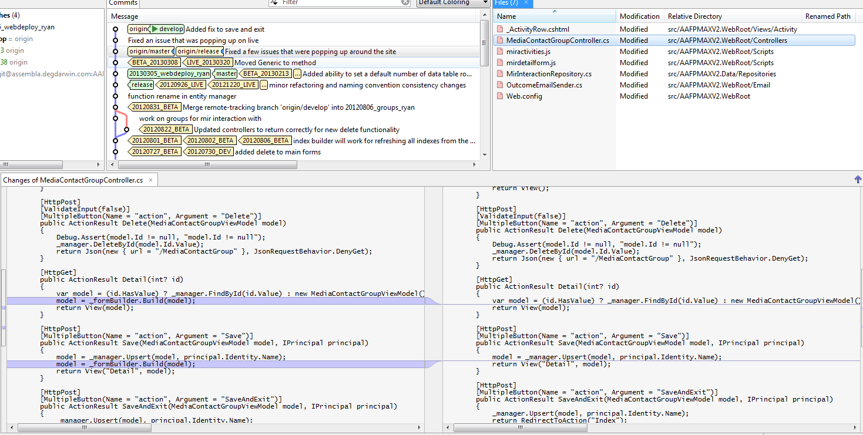

Slide 10
Unintentional Effects of Refactoring
Why the code change
Performance refactoring made in another area of code, assumed modelbuilder call was no longer needed.
Actual affects
Saving of this form caused all MediaContacts within the group to be wiped out.
Because the code was changed in an area other than the original enhancement, the code made it through QA and client testing.
Users took 3 weeks before they noticed the bug.
31k of 36k records deleted over this 3 week span.
1 week of developer and QA time to craft and test a fix, loss of income.
98-99% of data recovered.
Users confidence level drops in the development team.
Other projects in process suffer.

