Slide 1
J. Patrick Desbrow, MSTM
The Perceptions of Marketing Executives
in California-based
Financial Services Organizations
with Regard to
Customer Relationship Management

Slide 2
Overview of Dissertation
Chapter One: Introduction, Problem and Purpose
Chapter Two: Literature Review
Chapter Three: Research Methodology
Chapter Four: Findings
Chapter Five: Discussion
Notes:
Chapter One - Introduction, Problem and Purpose of the Study.
Chapter Two - Literature Review on the evolution of Internet-based learning, continuing education programs, and the role of Marriage Family Therapists. These three themes of research are the basis for this study.
Chapter Three - Research methodology and design for study based on the information collected in the literature review. The methodology is designed to determine the effectiveness of the Internet-based learning continuing education courses as an alternative to traditional home study courses.
Chapter Four - Presents the results of the finding from the experiment. The results will be in the form of summary and detailed data collected from comprehensive tests conducted at the end of each course; and a Likert scale questionnaire.
Chapter Five - Discusses the findings of the experiment, limitations of the study, conclusions, and recommendations for future studies.

Slide 3
Chapter One: Introduction
There was a time in the United States when merchants knew their customers
The country was organized into small businesses that served the community and fueled the local economy
Today, we refer to this collection of small-scale loosely organized businesses as cottage industries

Slide 4
Chapter One: Introduction
During the Industrial Revolution, companies focused their efforts on developing mass produced products and mass marketing advertisement
As a result, small proprietor’s influence over customer’s purchases began to decline
One of the casualties of moving from the
customer-centered small business to the larger
modern corporation is the loss of personal touch
with the customers

Slide 5
The Problem
There is a growing distance between large corporations and their customers
Many corporations have lost focus while dealing with the increasing complexity of business and the strong competitive forces in the marketing place
This loss of focus has resulted in a greater loss of business

Slide 6
The Problem
This provides the perfect opportunity for new companies to quickly take customers away
Many are now beginning to recognize the need to improve their customer relations
The problem is that there is little literature from objective researchers to capture the results of CRM initiatives
It is not clear whether executive’s perceptions are understood with regards to the planning and implementation of CRM initiatives

Slide 7
The Purpose
The purpose of this study was to investigate the perceptions of marketing executives with regard to the effective planning and implementation of customer relationship management (CRM)
The study bridges the gap between the theory of CRM and it’s application within the Financial Services Industry
The researcher determined the factors that lead to both successful and failed CRM initiatives.

Slide 8
Research Questions
What are the perceptions of California-based financial services marketing executives with regard to the planning and implementation of CRM initiatives?
What characteristics are essential for the successful planning and implementation of CRM initiatives in California-based financial services companies?
What are the common mistakes, with respect to planning and implementation, for failed CRM initiatives within California-based financial services companies?

Slide 9
Limitations of Study
The study was limited to companies based in California, so comparisons can be made among organizations that share a common tax structure
Data was gathered from companies established prior to 1997 as a way to eliminate the problems associated with new businesses
The focus was on companies, which have been implementing CRM software for at least the
previous two years

Slide 10
Chapter Two: Literature Review
Challenging the old paradigm of Mass Marketing
Developing Strategies for Relationship Management
Effecting the Profitability of the Organization
Creating the Technology Infrastructure
Determining Characteristics for Projects that Both Succeed and Fail

Slide 11
Challenging the old paradigm
Peppers and Rogers (1993, 1995) are one of the first authors that challenge the old paradigm of mass production, mass media, and mass marketing
This future is a reality today due to the advent of the Internet, and very large database technologies.
The Meta Group (2001) presents a broader definition of CRM. They suggest that CRM is more than a marketing philosophy. It is a strategy to improve sales, customer service, and operations.

Slide 12
Relationship Management
Dolan (1991) offers an extensive explanation of a strategic marketing department’s function. One clear theme is the importance of centering all strategies on the customer
As an industry matures, the individual companies evolve their strategic objectives from a product driven focus toward a customer driven focus
McKenna (1997) emphasized the use of technology in relationship marketing

Slide 13
Effecting the Profitability
Two dissertations examine the different aspects of the customer relationship process.
The first dissertation reviews the organizational processes that led to customer profitability. Huntley (1999) suggests that organizations who focus their effort on their customers are more likely to be profitable
The second dissertation explores the differences between customer satisfaction and customer value. Boentiz (2001) states that measuring customer satisfaction is not a true indication of loyalty.

Slide 14
Creating the Technology
Hughes (1994) described how to use business knowledge and database technology to implement a customer centric direct marketing operation inside an organization
Hughes presented a framework that instructs the reader on the issues that must be addressed while building a marketing database
  Behind the marketing database
  Blend between customers and prospects
  Understanding the potential uses of the marketing database
  Why marketing databases fail?

Slide 15
Chapter Three: Methodology
Research Design
  Develop an online survey instrument
  Select California marketing executives
  Collect, organize, and present the data
  Perform statistical procedures to answer the research questions
Analysis Unit / Population
  A California-based financial services marketing executive
Sample
  Goal - 300 marketing executives
  Used - 113 marketing executives

Slide 16
Validity
The researcher employed a Delphi committee to create the online survey instrument
  Consisted of experts in the field of financial services and
  customer relationship management
  Offered their comments and suggestions to ensure that the
  survey is valid and appropriate to the research questions
The researcher updated the survey instrument based on the comments from the expert panel

Slide 17
Reliability
The researcher employed an agreement reliability estimate to demonstrate the instrument’s level of reliability
  Selected 7 marketing executives to participate in the reliability test
  Sent the proposed paper-based invitation letter to the sample
  Three days later, contacted the 7 marketing executives and
  asked them to complete a short telephone interview

Slide 18
Chapter Four: Findings
Survey Items 1 to 20
  Developed an online survey instrument
  Selected California marketing executives
  Collected, organized, and presented the data
  Performed statistical procedures to answer the research questions
Research Questions 1, 2, & 3

Slide 19
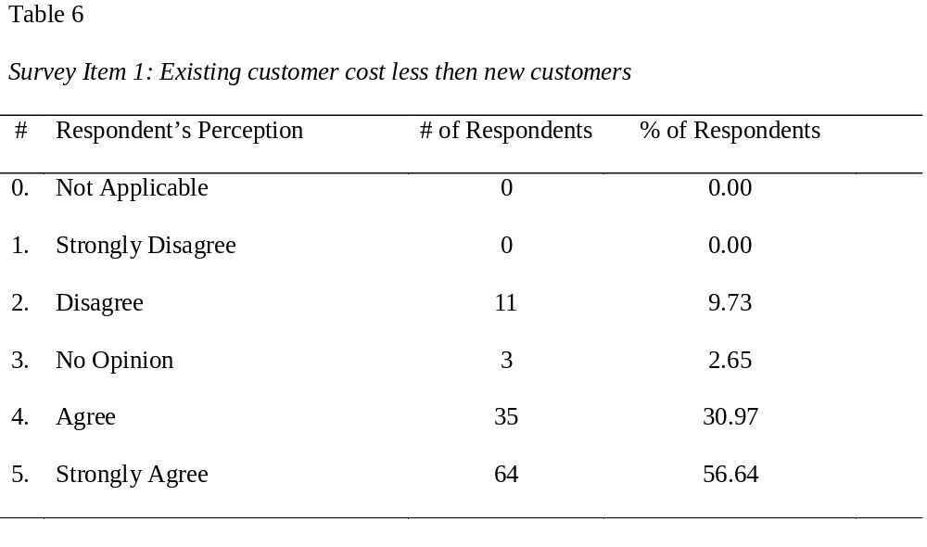
Findings - Survey Item 1
None of the responses were NA or SD; Most were A or SA
This is a strong positive perception to this statement

Slide 20
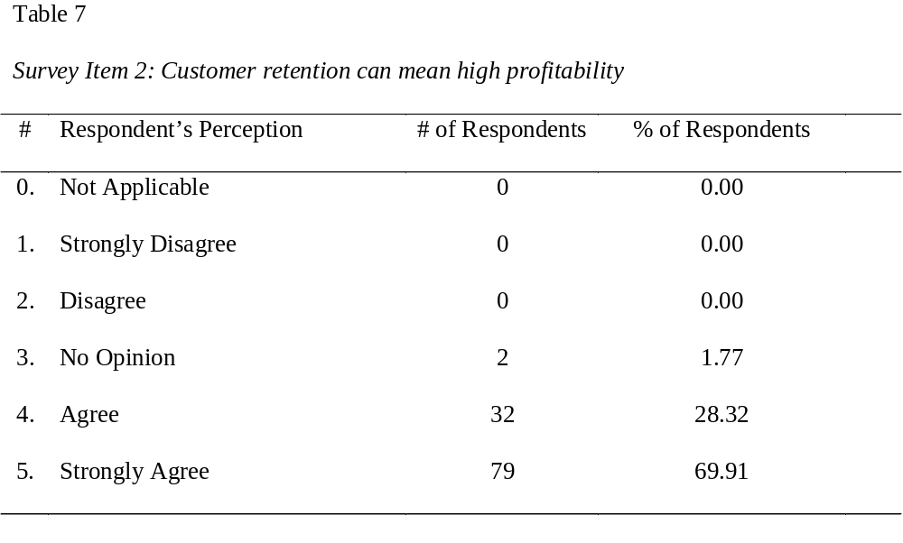
Findings - Survey Item 2
None of the responses were NA, SD, D; Most were A or SA
This is a strong positive perception to this statement

Slide 21
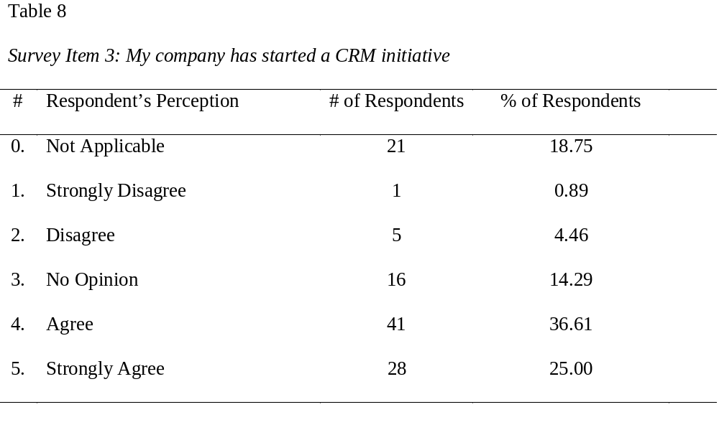
Findings - Survey Item 3
Few strong negative opinions such as SD, D
This is a strong positive perception to this statement

Slide 22
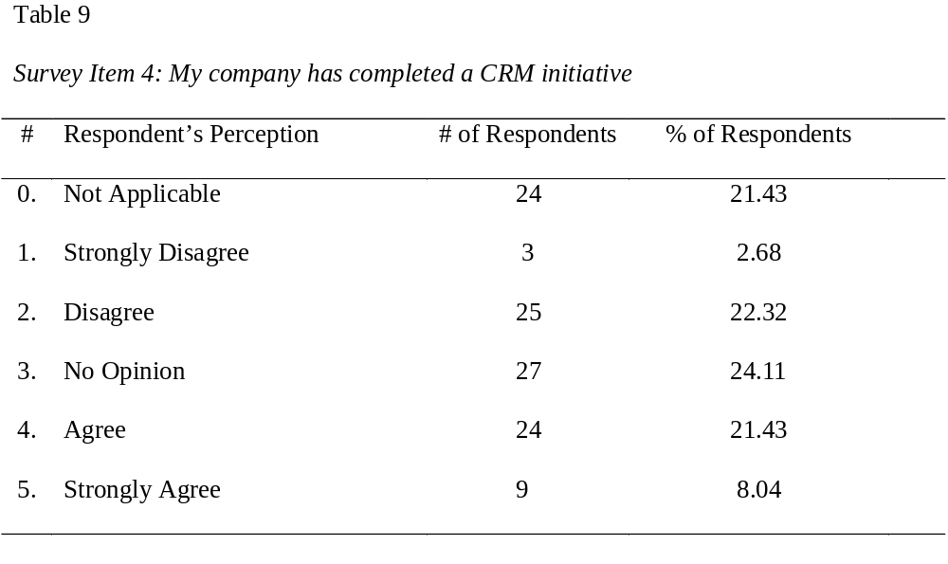
Findings - Survey Item 4
Few responses were SD or SA; Even distribution in the middle
There is no agreement on this statement

Slide 23
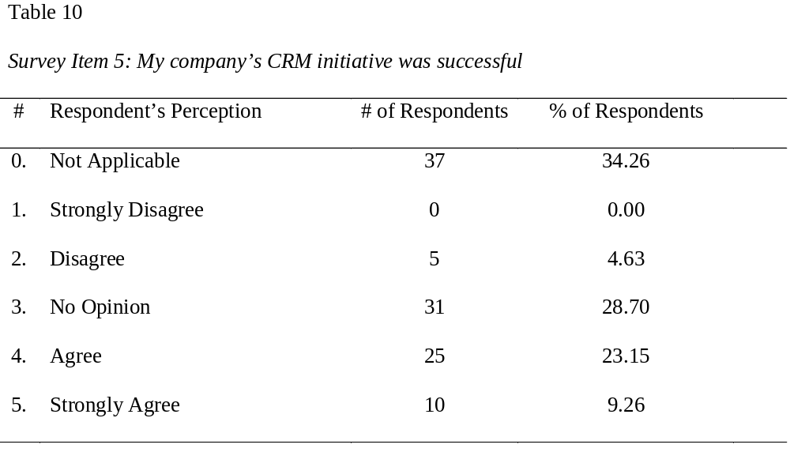
Findings - Survey Item 5
Few responses were SD or D; Most responses were NA or NO
Perceptions are uncertain about their company’s CRM success

Slide 24
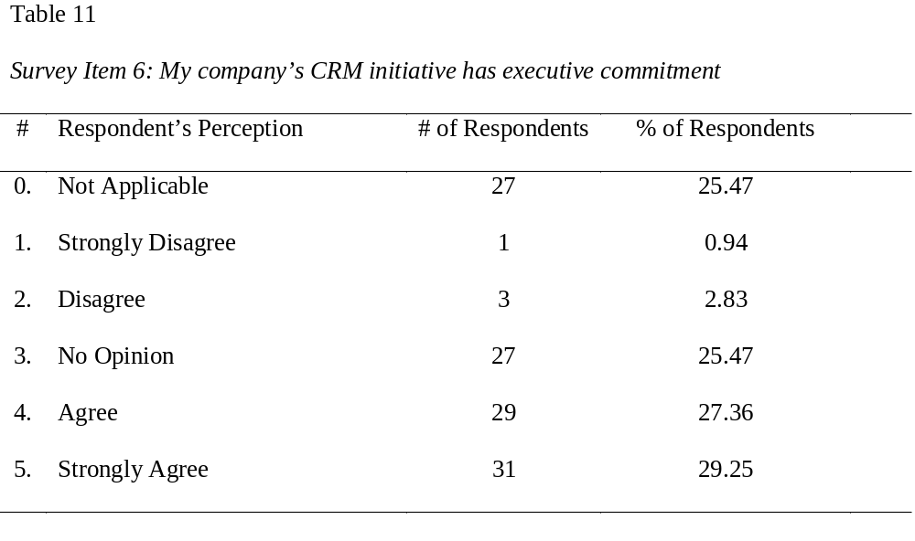
Findings - Survey Item 6
Many responses were NA or NO; and A or SA
There is more agreement than NA/NO on this statement

Slide 25
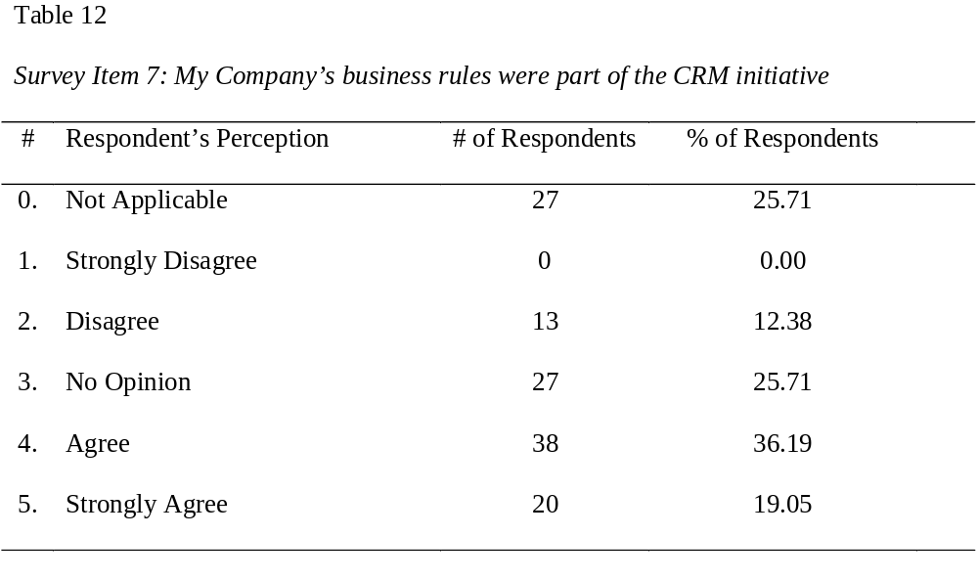
Findings - Survey Item 7
No responses were SD; Few were D; Many were NA or NO
This is a strong positive perception to this statement

Slide 26
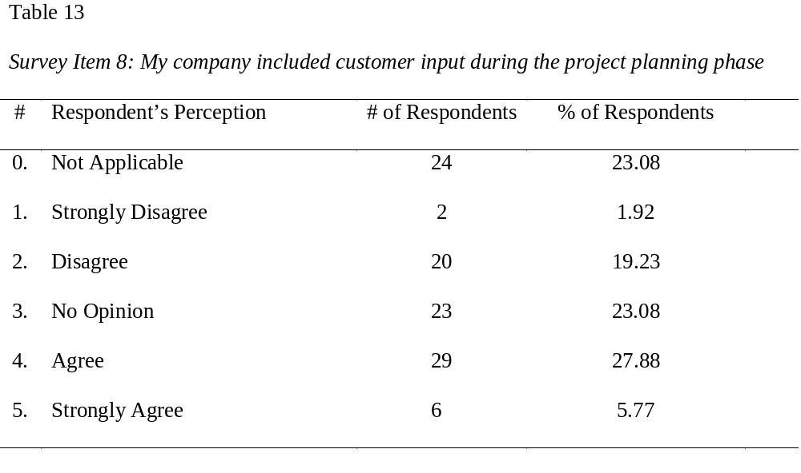
Findings - Survey Item 8
Few responses were SD or SA; Even distribution through middle
This is no agreement on this statement

Slide 27
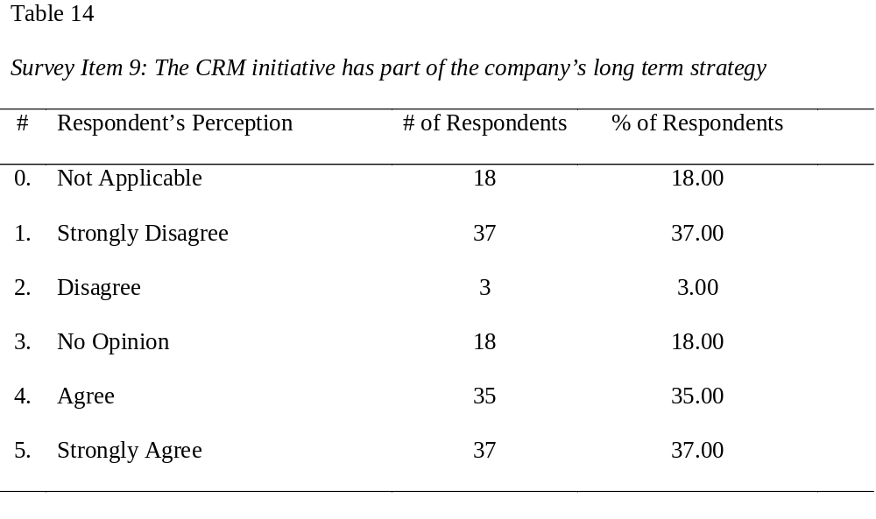
Findings - Survey Item 9
Few response were D; Even distribution through perceptions
This is no agreement on this statement

Slide 28

Findings - Survey Item 10
Few responses were SD or D; Most responses were NA or NO
Perceptions are uncertain but few are willing to claim failure

Slide 29
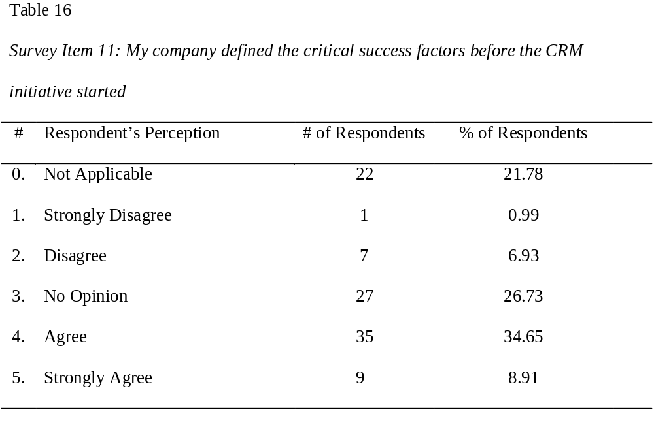
Findings - Survey Item 11
Few responses were SD or D; Most responses were NA or NO
Perceptions are uncertain but few are willing to claim failure

Slide 30
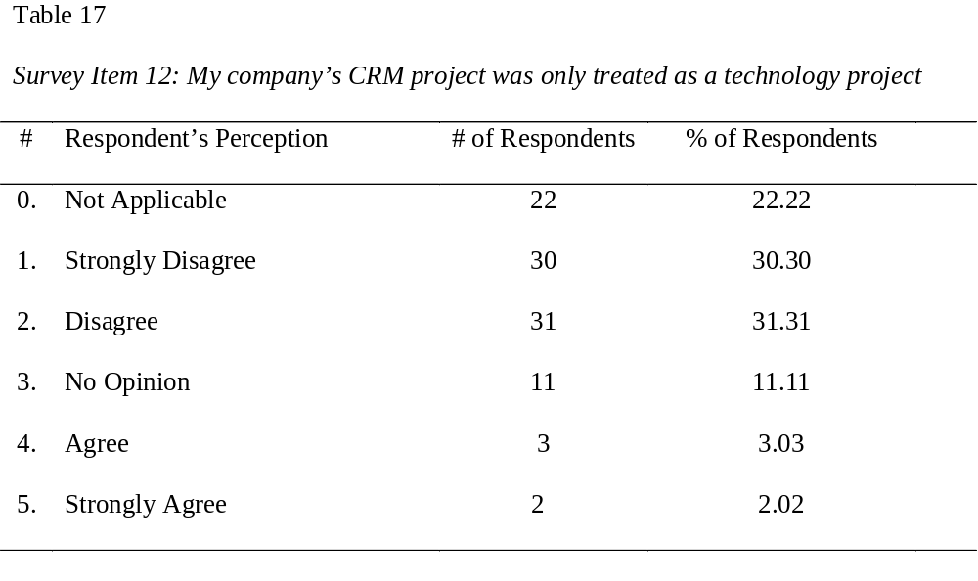
Findings - Survey Item 12
Few responses were A or SA; Many responses were SD or D
Respondents do not agreement with this statement

Slide 31
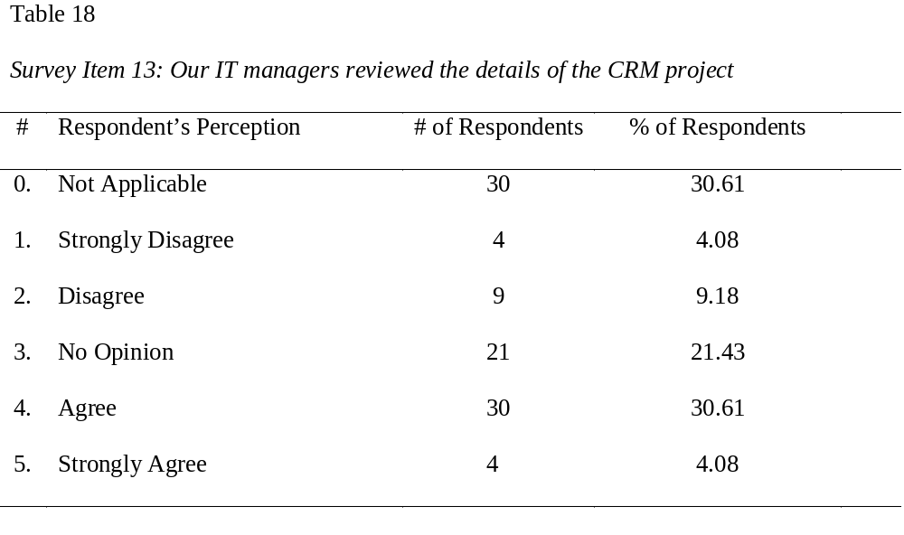
Findings - Survey Item 13
Few responses were SD or SA; Most responses were NA or NO
The remaining responses where positive to this statement

Slide 32
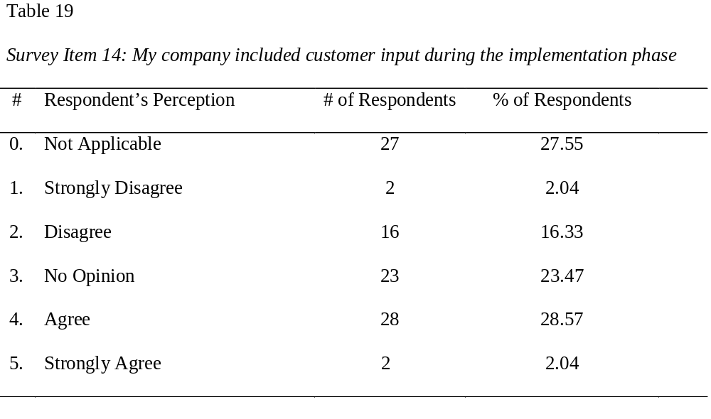
Findings - Survey Item 14
Few responses were SD or SA; Even distribution through middle
This is no agreement on this statement

Slide 33
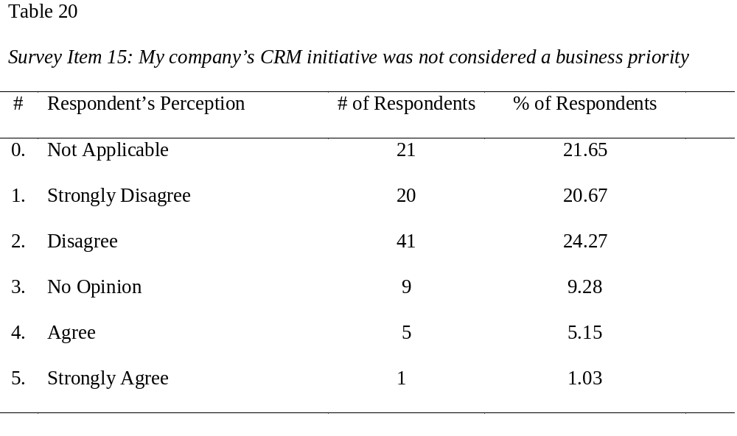
Findings - Survey Item 15
Few responses were A or SA; Many responses were SD or D
Respondents do not agreement with this statement

Slide 34
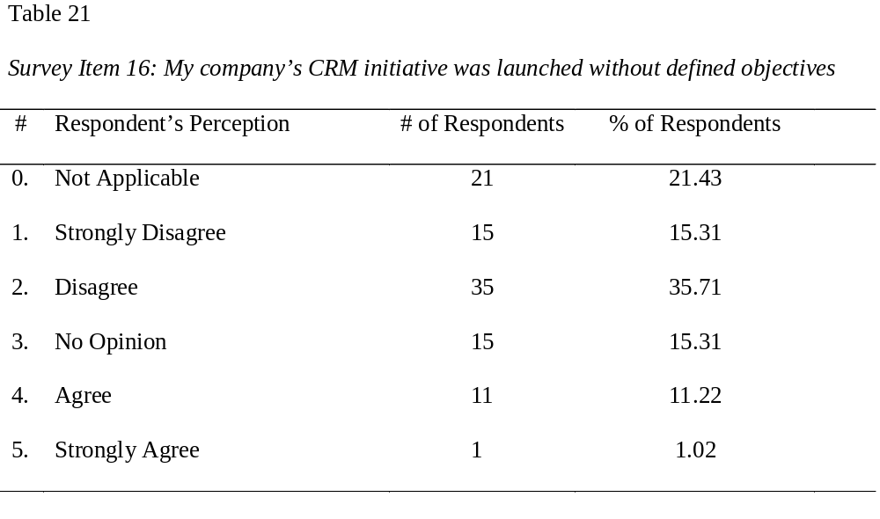
Findings - Survey Item 16
Few response were SA; Even distribution through perceptions
This is no agreement on this statement

Slide 35
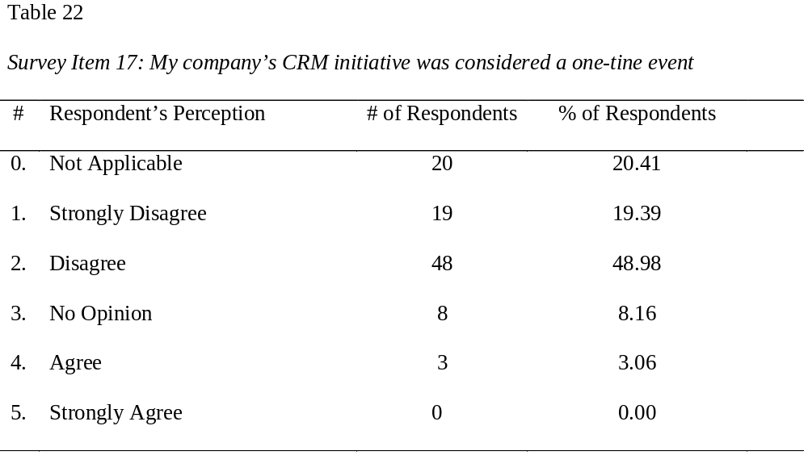
Findings - Survey Item 17
Few responses were A or SA; Many responses were SD or D
Respondents do not agreement with this statement

Slide 36
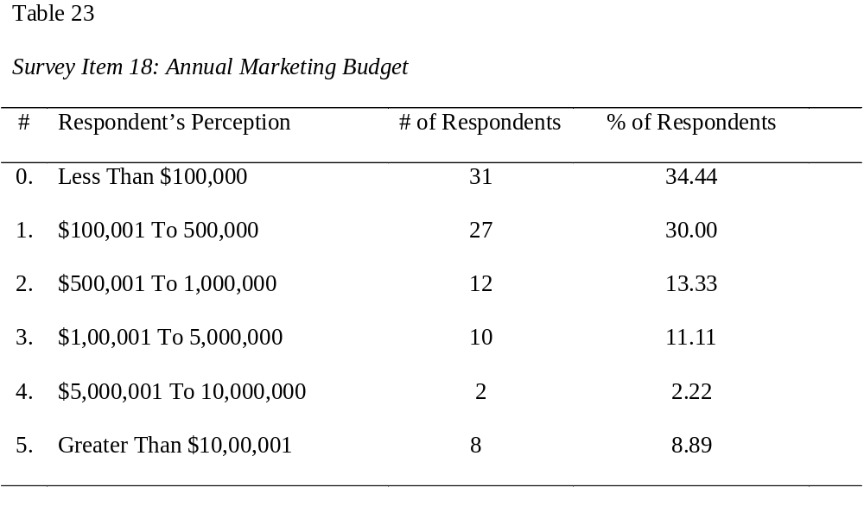
Findings - Survey Item 18
Most responses were 500,000 or less

Slide 37
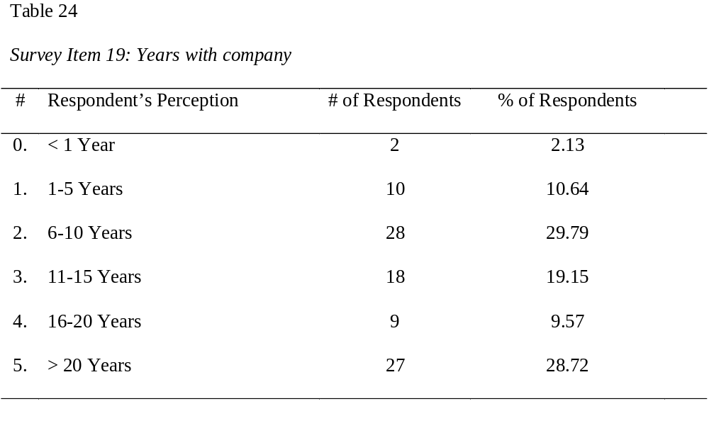
Findings - Survey Item 19
Most responses 6 to 10 year or greater than 20 years

Slide 38
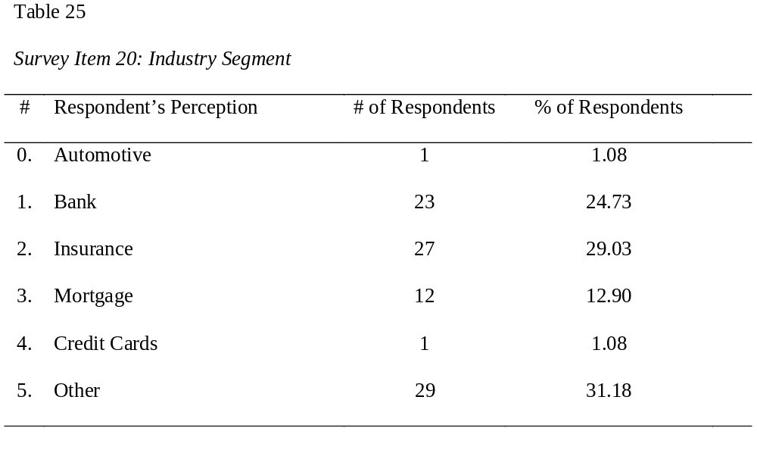
Findings - Survey Item 20
Most responses were from Insurance, Bank, and Other

Slide 39
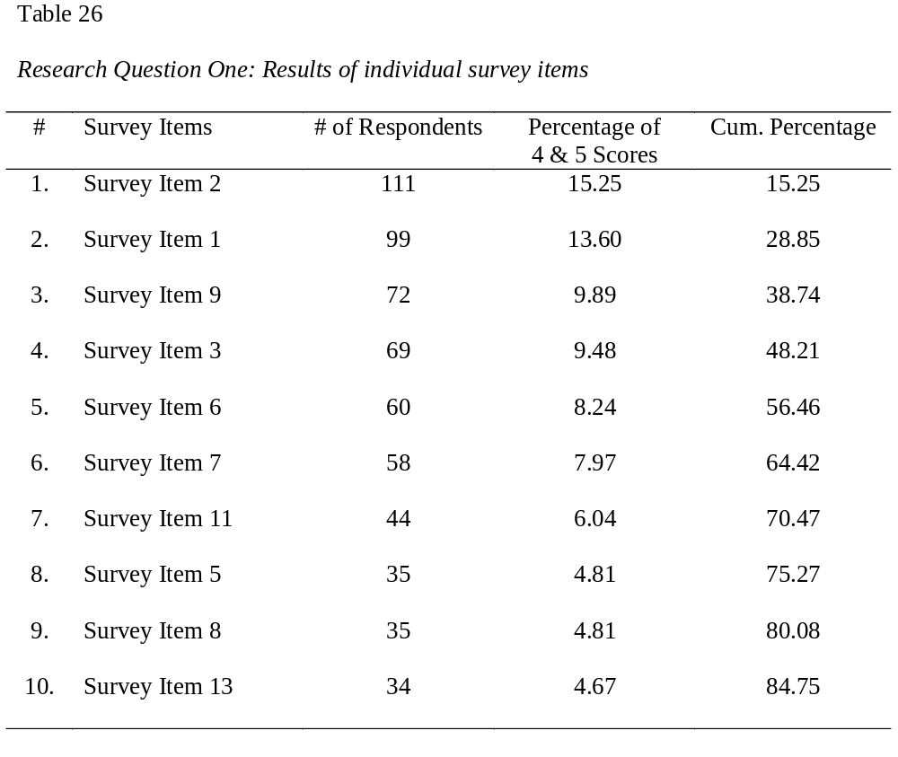
Conclusions – Research Question 1

Slide 40
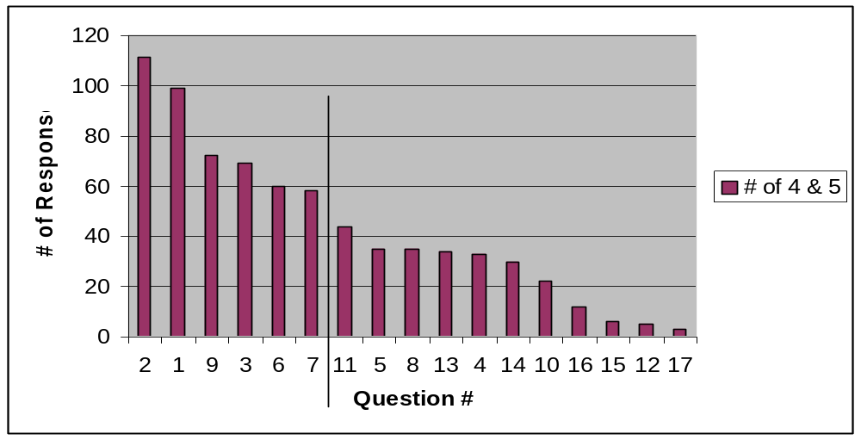
Conclusions – Research Question 1
Survey items 2, 1, 9, 3, 6, & 7 represent the strongest perceptions

Slide 41
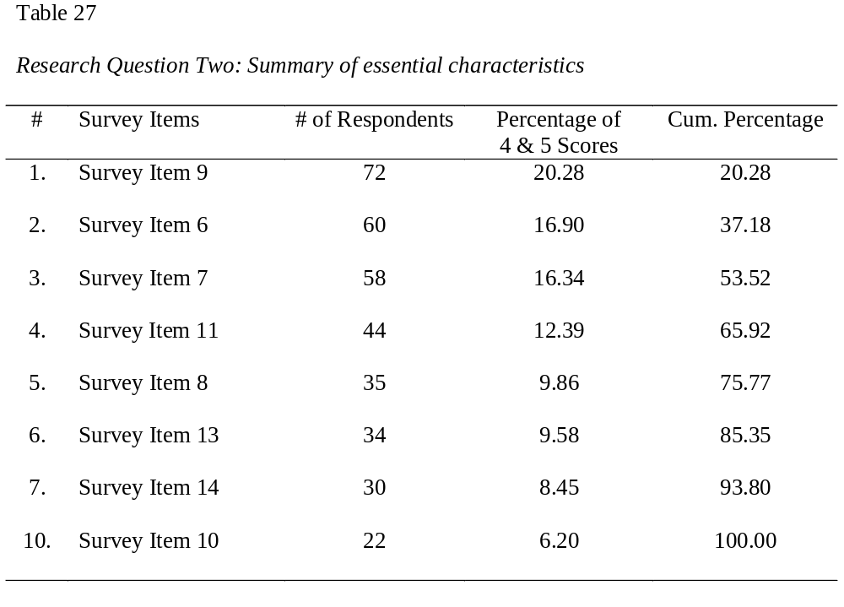
Conclusions – Research Question 2
Survey items 9, 6, & 7 represent the essential characteristics

Slide 42
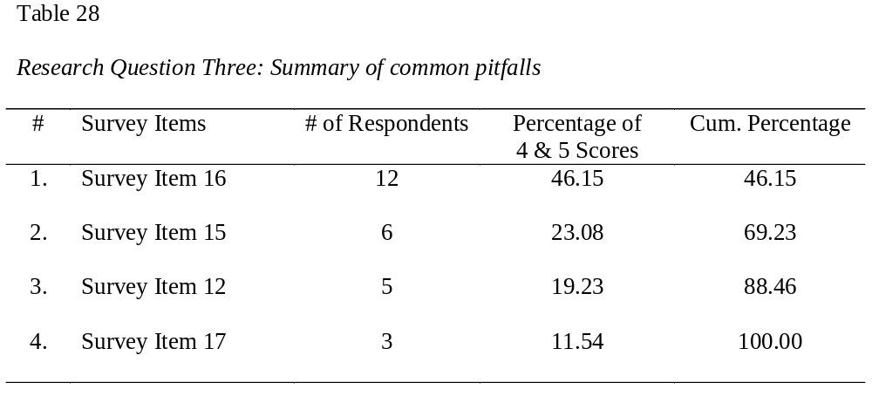
Conclusions – Research Question 3
Survey items 16, 15, & 12 represent the common pitfalls

Slide 43
Chapter Five: Conclusion
Summary of Factors
Generalizability of Findings

Slide 44
Discussion - Summary of Factors
Formulate a solid vision for the project
Focus on gaining and maintaining executive commitment
Allow business processes to drive the CRM implementation
Never begin a project without a strategy
Ensure the project is integral to the business strategy

Slide 45
Discussion - Summary of Factors
Do not rely on someone else’s success as your blueprint
Ensure the project begins with a clear set of objectives and defined metrics
Prepare a recovery plan as soon as the business may be impacted by project issues
Choose your list of vendors wisely but consider using outside experts in the planning and implementation

Slide 46
Discussion – Generalizability of findings
Did not collect 300 participates for the sample
  Only able to collection 113 participates
  Conducted 25 telephone interviews
  These two groups were compared to ensure the non-responding
  population is similar in their demographic characteristics
  Performed a Chi-Square Goodness of Fit test comparing these
  demographics using a significance level of 0.05
  18 out of the 20 survey items showed no difference in response
  patterns between the groups
  Some level of bias and any generalizations should be limited to
  groups with similar demographic characteristics

Slide 47
Questions

