Slide 1
Voice Controlled RoboCar
By Bao Phuc Duong, Cody Ells, and Austin Rowland

Slide 2

Summary of Functionality
Ultrasonic sensors allows the car to autonomously navigate an area by stopping movement when it is going to hit an obstacle.
Voice commands allow the user to move the robot in several directions
Ultrasonic sensors also allow the turn the robot without the use of voice commands
The robot has facial expressions that change based off specific action

Slide 3
Functionality of Components
ARM Mbed LPC1768:
Controls entire system logic by running a program on boot
EasyVR 3 Plus:
Allows the robot to listen to voice commands and react to them
DC Motors:
Moves the left and right wheels on the vehicle
H-Bridge Motor Driver:
Allows for easy control of multiple motors using digital signals, as well as switching a motor’s polarity

Slide 4
Functionality of Components
LEDs
Act as the vehicle's headlights and taillights when in motion
PCB-Mount Speaker
Plays sound while vehicle in forward motion
LCD Screen
Displays robot facial expressions depending on action
Battery Holder w/ Switch
Allows for a device hard reset option
Shadow Chassis
Body that holds all the electronic components for the vehicle

Slide 5
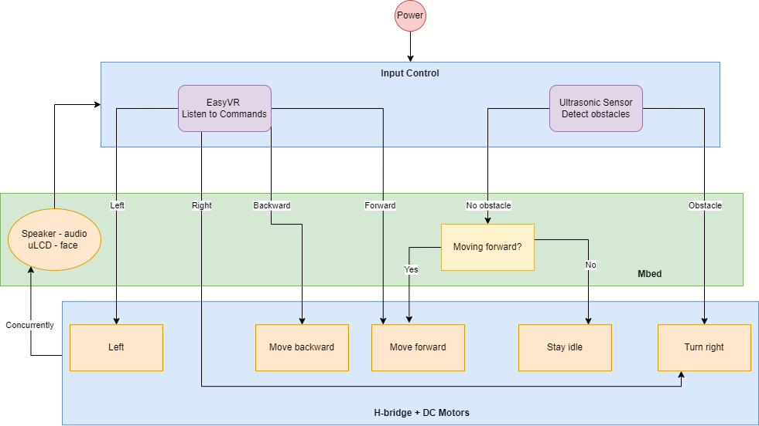
Functional Block Diagram

Slide 6
Functionality Explained
When powered on, the RoboCar actively waiting for voice commands (with EasyVR) and looking for obstacles (with Ultrasonic sensor) in front of it
If the voice command is "Forward", the RoboCar moves forward until it detects an obstacle on its path. To avoid collisions, the RoboCar turns right and waits for the next command
If the voice command is "Backward", the RoboCar moves backward for 3 seconds, then stops and waits for the next command
If the voice command is "Left", the RoboCar turns left. If the voice command is "Right", the RoboCar turns right. After the turn, it waits for the next command

Slide 7
Functionality Explained
Whenever there's an object within 300mm of the sensing range, no matter what the robot is doing (moving forward or idling), it immediately stops and turns right to avoid collisions
When the RoboCar moves forward, it plays the "Barbie Girl" song with the speaker. When the RoboCar moves backward or turns left/right, it plays a suitable beeping sound
When the robot idles, the uLCD displays an idling animation. When the RoboCar moves or turns, the uLCD displays a happy animation
The robot can be powered on and off with a slide switch on its battery case

Slide 8
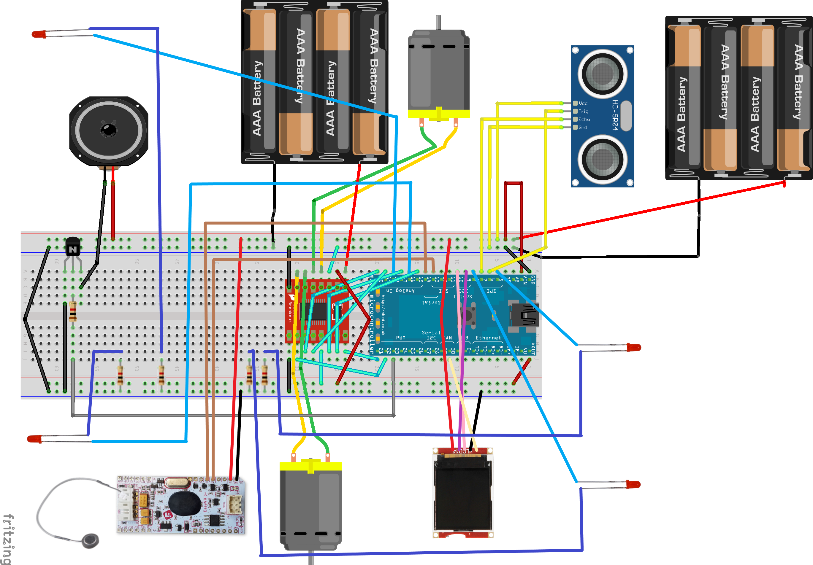
System Schematic
This is a wiring schematic between the Mbed and its peripherals
Represents all the connections between the system components

Slide 9
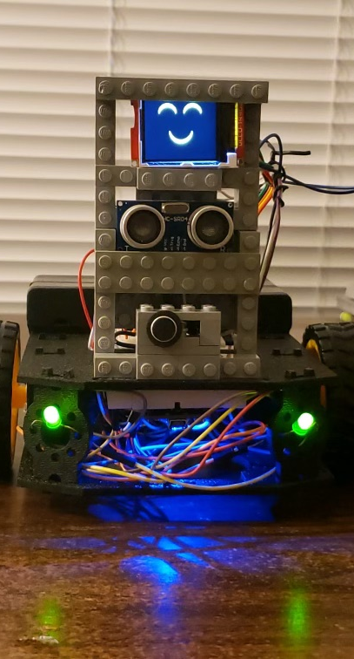
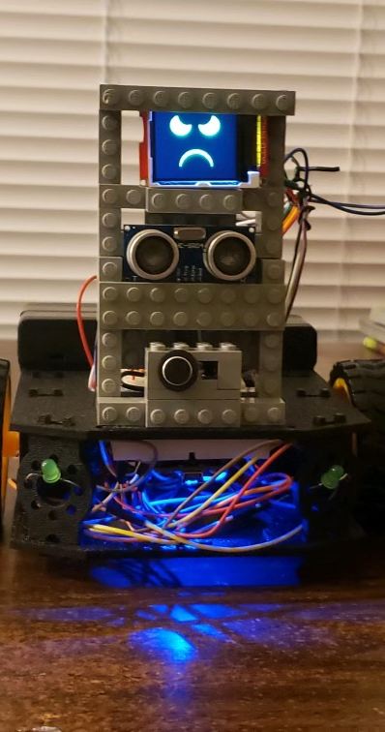
RoboCar Visual Aids
Here we can see two different facial expressions, both happy and angry
Happy robot is associated with forward movement, which we see represented with the headlights both turned on
Angry robot is associated with backward movement, which is represented with the taillights both turned on

Slide 10
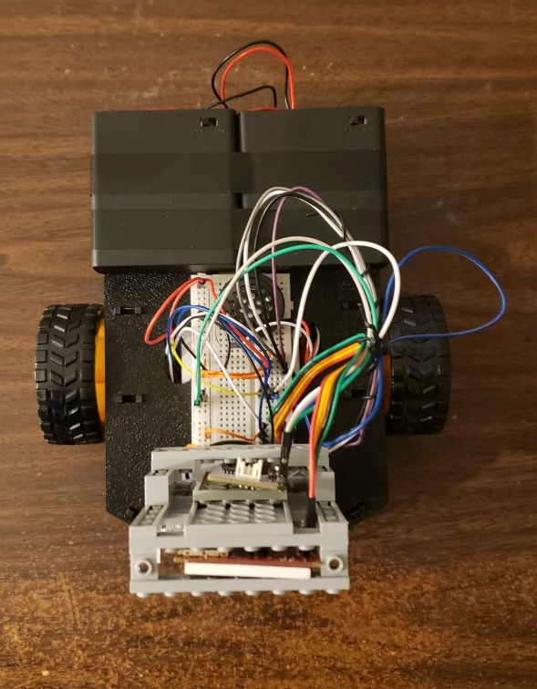
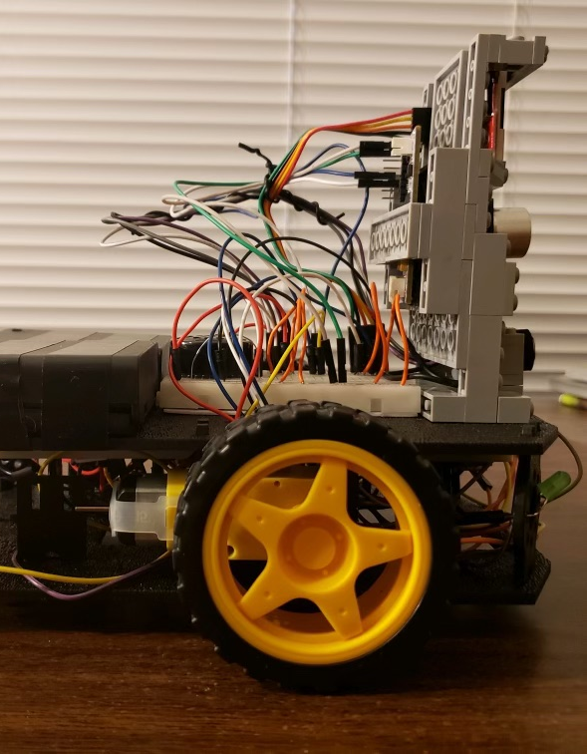
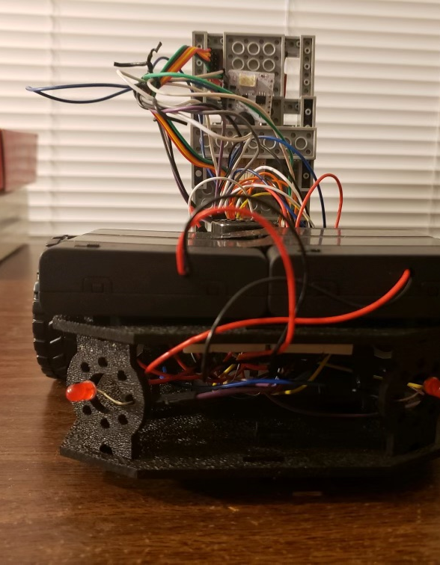
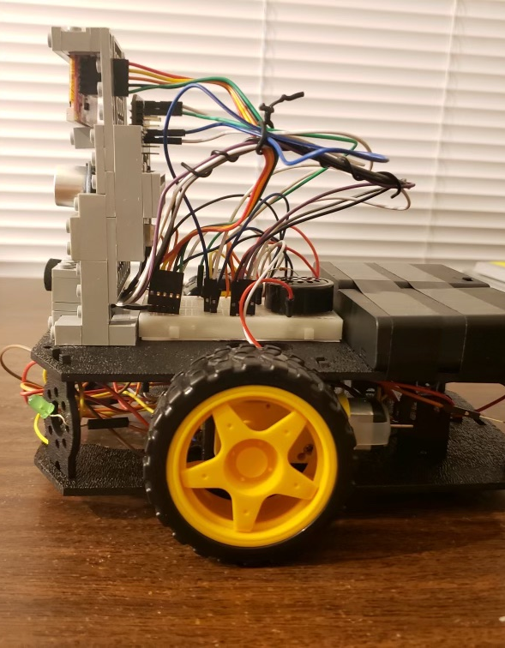
RoboCar Visual Aids
Here we can see different views of the chassis design and the electrical wiring of system components

Slide 11
Future Improvements
We can add another Ultrasonic sensor at the back of the RoboCar so that it can detect obstacles when moving backward
In addition to "Forward", "Backward", "Left", "Right", we can teach the RoboCar to recognize more voice commands
We can redesign the power source so that the Mbed and the DC Motors can share the same power source instead of using two separate sources
We will redraw the facial expressions for the RoboCar to make it more colorful and lively

