Slide 1
Version control with git/github

Slide 2
Why use version control?
Track changes to code over time
Back up each version of the code
Annotate each change
Share code with others
Formal framework for working collaboratively with others

Slide 3
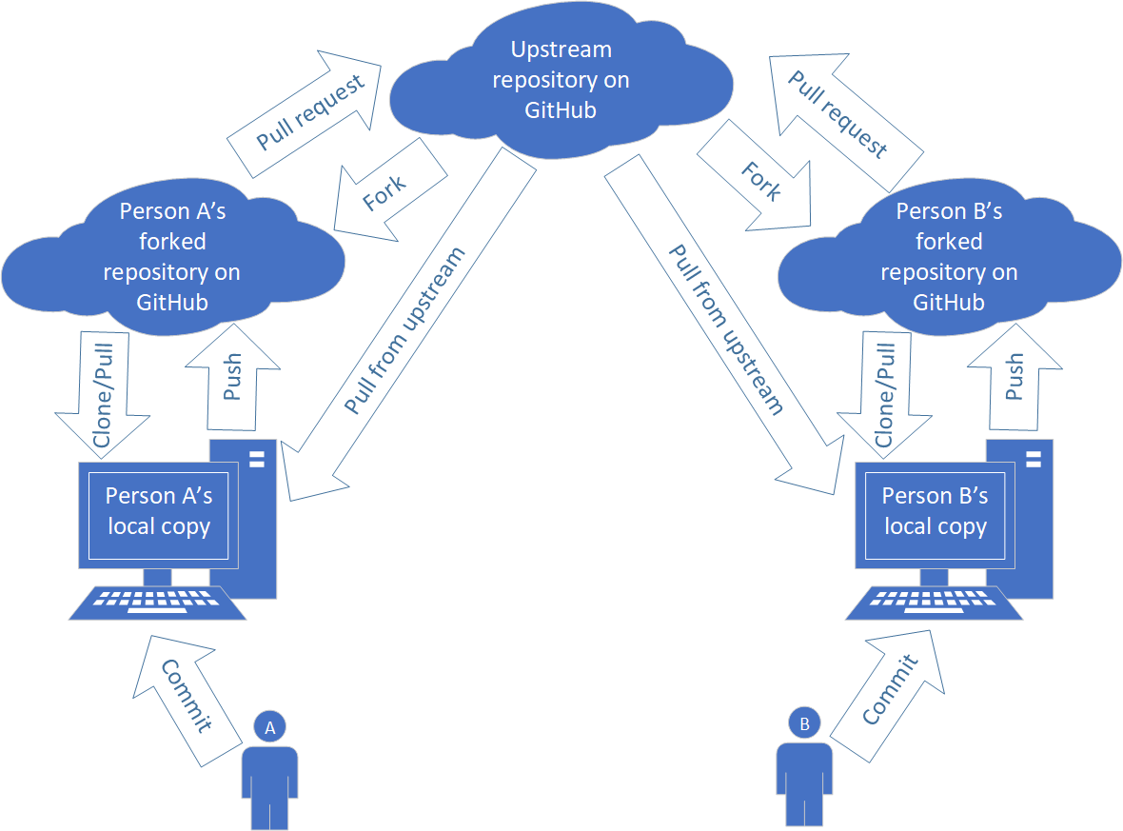
An example Git/GitHub workflow

Slide 4
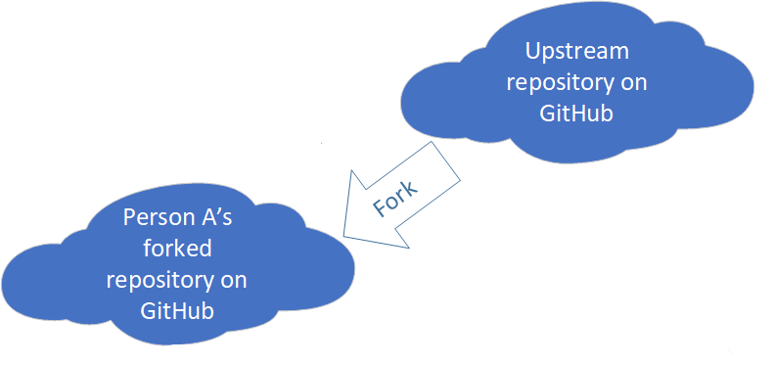
Fork
Create our own remote copy of the upstream repository to make changes to.
We don’t want to make changes directly on the main repository, so we make a copy to work on. Our changes can be reconciled with the upstream version later.
Go to the upstream repository on GitHub, and click the “Fork” button.
repository – the set of files that make up the project and are tracked by Git
remote – a version of the repository stored on the web
upstream repository – the “main” version of the repository everyone will work from and submit changes to

Slide 5
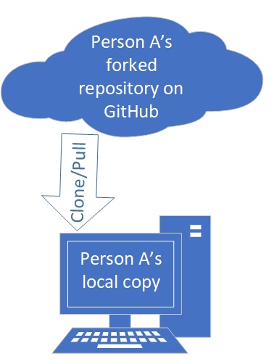
Clone/Pull
Copy our forked repository onto our computer so we can work on it in RStudio.
Go to our forked repository on GitHub, click the “Clone or download” button and copy the URL.
In RStudio, make a new project (File > New project). Select “Version Control”. Select “Git”. Copy the URL into the box. Browse to a folder where we’ll keep the repository. Click “Create project”

Slide 6
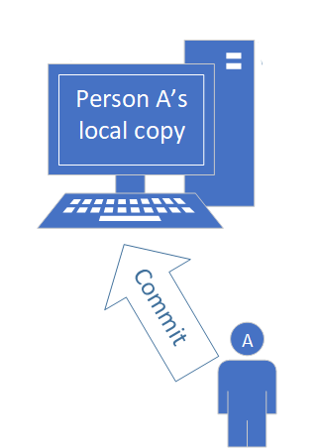
Commit
Make changes to our local version, annotate, and save them to be tracked by Git.
In RStudio, make a change to our local version. In the “Git” tab, click “Commit”. Stage files for the commit by checking the corresponding box. Enter a brief commit message in the box describing the changes. Click the “Commit” button.
commit – a set of changes made to a repository
stage – indicate which files should be included in the commit
commit message – a brief (one sentence) message describing the changes included in the commit

Slide 7
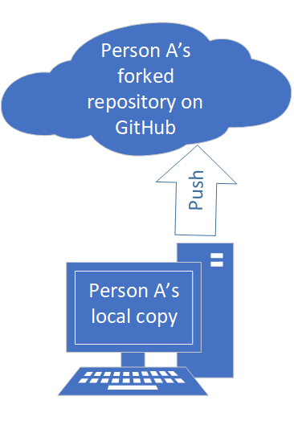
Push
Save one or more commits to our forked repository on the web.
In RStudio, click the “Push” button. We may have to type our GitHub login information.

Slide 8
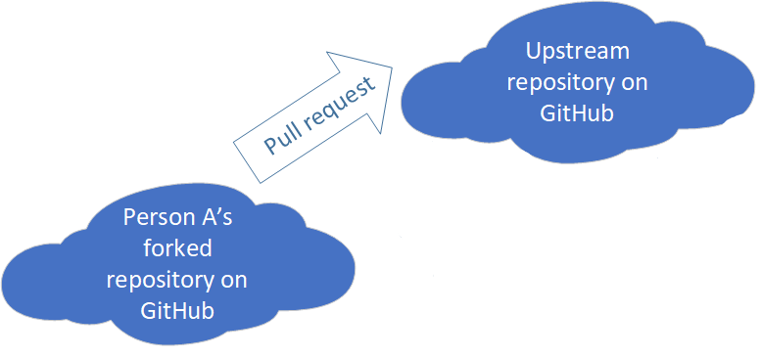
Pull request
Request to have the changes we made to our local repository included in the upstream repository.
Go to our forked repository on the web and click “New pull request.” Click “Create pull request.” Enter a message describing our changes. Submit pull request. The owner of the upstream repository will review the changes and complete the pull request if the changes look good.

Slide 9
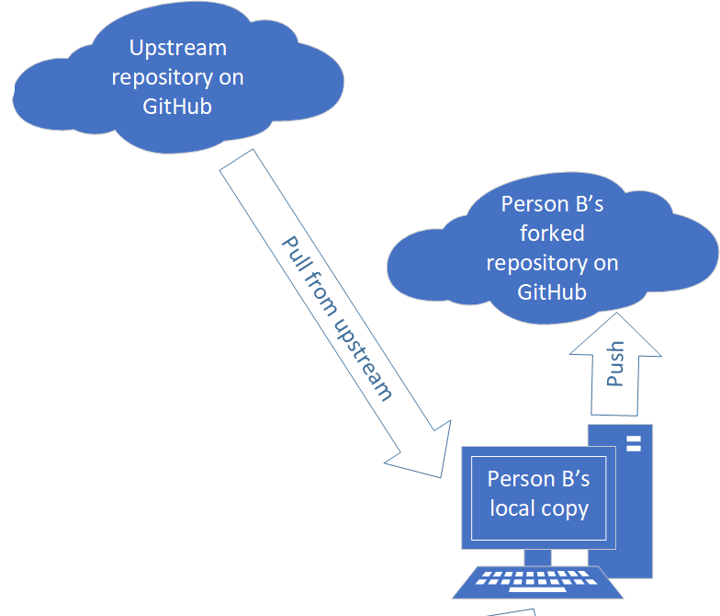
Pull from upstream
After our pull request is accepted in the upstream repository, a colleague may want to pull those changes into their version.
They could set up the upstream repository in Git and pull from the upstream. To save to their forked copy, they would push the changes to the forked repository.

