Slide 1
R Package Basics

Slide 2
R Packages
The most complete, systematic way of sharing R code (with strict rules!)
Bundles of code, documentation, data, and tests
Installed with install.packages(), loaded with library(), and provide help with ?.
Allow for transparent, reproducible workflows
Require a lot of work up front, and continuing work to maintain

Slide 3
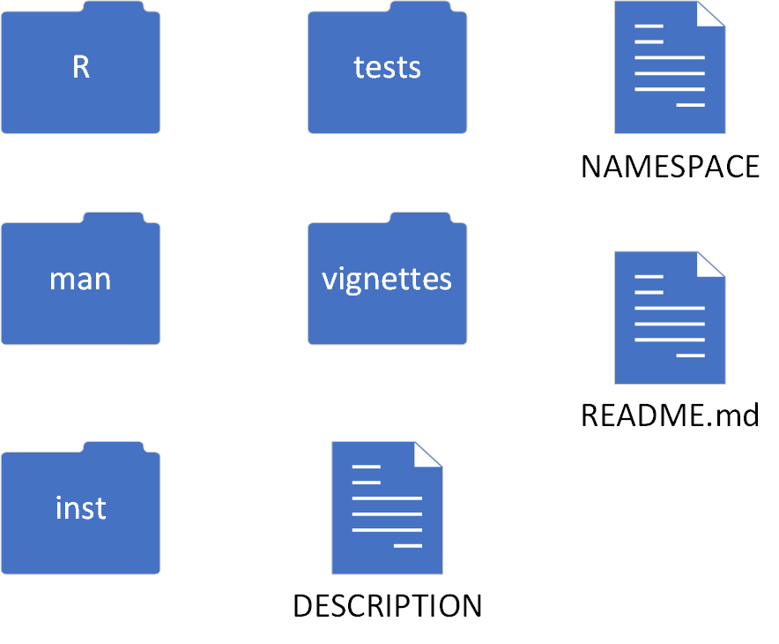
R Package Structure

Slide 4


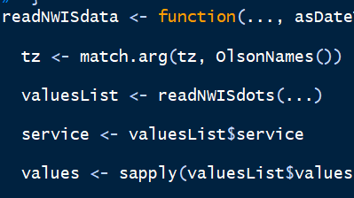
R/: R code
The R folder is where all R code (in the form of functions) is stored.
Related functions are organized into scripts with descriptive file names. Each script can contain one or more functions.
When the package is built and loaded with library(), the scripts in the R folder are run, which creates the functions.

Slide 5

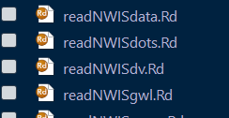
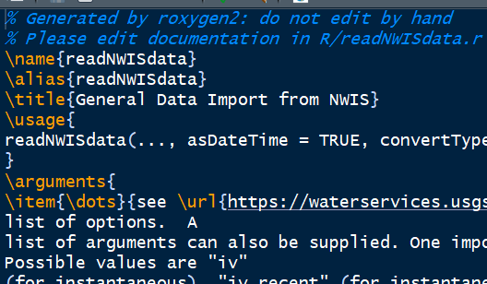
man/: code documentation
The man (short for manual) folder is where the documentation for the functions is stored.
These files produce the help pages you see when you use ? or help()
Each function documentation
Says what the function does
Explains what the arguments are
Explains what the function returns
Provides additional details if needed
The roxygen2 package makes writing function documentation easy. Don’t write your documentation manually.

Slide 6

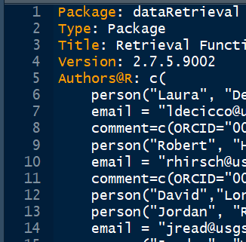
DESCRIPTION
The DESCRIPTION file gives information about the package:
The author(s) and maintainers of the package
The version number
A description of what the package does
Package dependencies (other packages it needs to function)

Slide 7

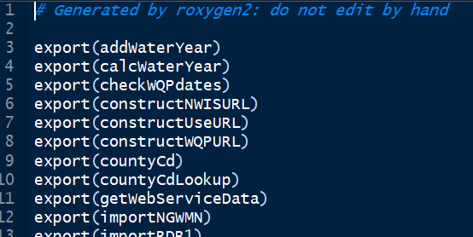
NAMESPACE
The NAMESPACE file describes what’s exported from your package and what’s imported
Exported functions are the functions in your package that are available to the user.
Imported functions are functions from other packages that your package uses.
Don’t write your NAMESPACE file manually. The roxygen2 package does this for you.

Slide 8

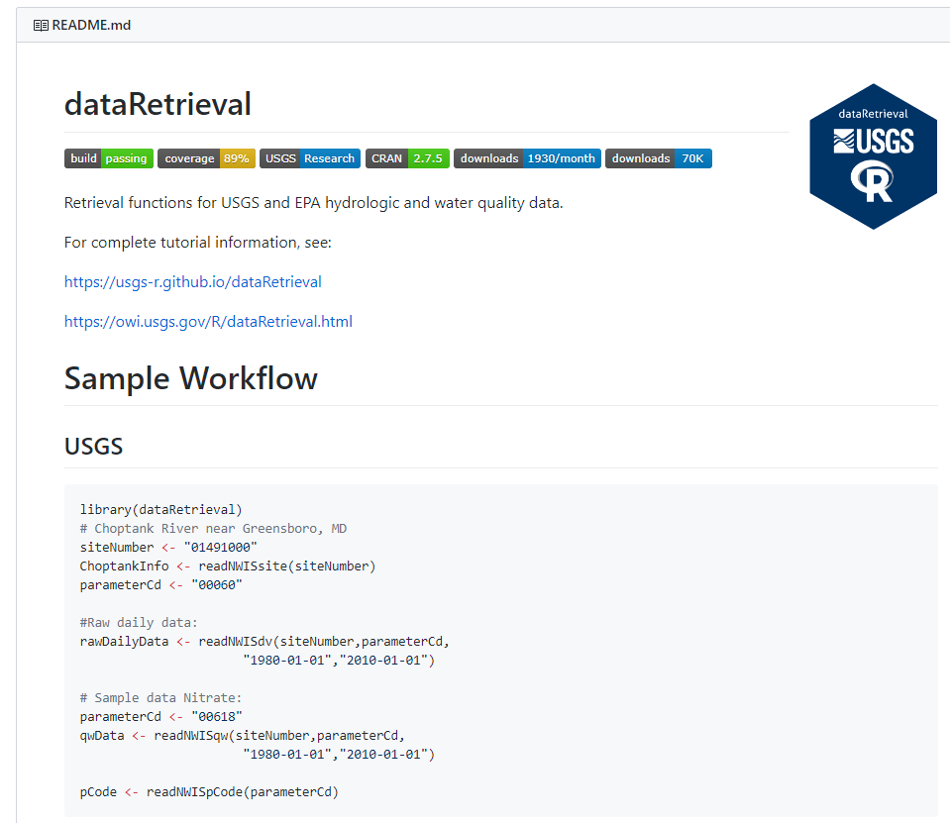
README.md
The README file is an informal markdown file that gives you a chance to tell users or potential users what you want them to know about the package such as:
Installation instructions
Recommended workflow
The README file is especially useful for packages on GitHub. The README file is rendered on the main page of the repository.

Slide 9
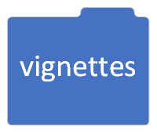
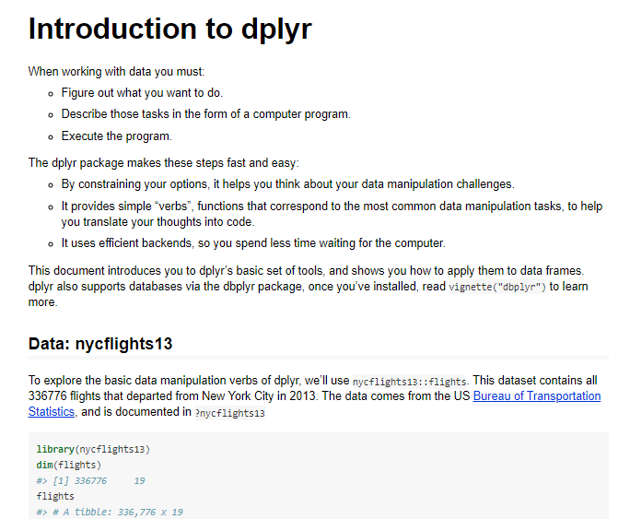
vignettes/: long form documentation
Vignettes are long form documentation that mixes text and code in a markdown document.
They explain specific aspects of a package and explain how the package is to be used.
You can browse vignettes for a specific package by using, for example: browseVignettes(“dplyr”)

Slide 10
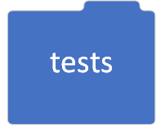
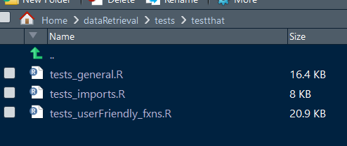
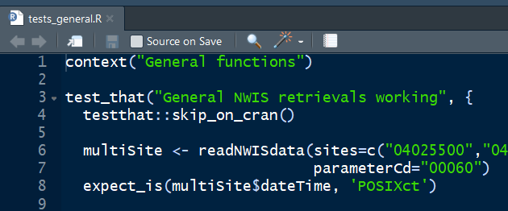
tests/: automated tests
The test folder contains tests that automatically run each time your code is built.
Tests help make sure the package works the way you think does, and make sure you don’t break the package while you’re working on it.
Write tests using the testthat package in R.
It’s a good idea to write a test for any new functions you write.

Slide 11

inst/: additional files
The inst folder is used for any files you need your user to have access to.
Sample data where the file format is important (xml, csv)
Shiny web applications
There are other places to store sample data if the format is not important such as example data or lookup tables

Slide 12
A package workflow
Write a new function, including documentation with roxygen2.
Write tests for that function to verify to yourself and others that it works the way you want it to (and doesn’t break in the future).
Build and load the package.
Commit or merge your code on GitHub (if applicable).
Look out for bug reports, issues, and feature requests.
As the package maintainer, clearly communicate expectations and lines of communication to users. (How will they report bugs? What level of support can they expect?

Slide 13
Tools and references for package development
R Packages, by Hadley Wickham
USGS Package Devlopment
Packages
devtools: everything you need for creating package directories and building and testing your package
roxygen2: package documentation made easy. Allows the user to write R functions and documentation all in one file
testthat: a framework for writing tests in your R pacakge

