Slide 1
Growth and Change in a Population
Patrick Farley
MATLAB Final Project

Slide 2
Setup:
Create two simulations:
Change in population number with limited resources:
Start with a number of “animals”, with the ability to reproduce over time.
Start with a finite amount of “food” that replenishes over time.
Goal: accurately model the relationship between population number and available food.
Change in population gene pool with limited resources:
Start with similar parameters, but give each member of the population “genes” which affect its appearance.
Goal: create a model of natural selection.
Assume only two species: “animals” and “food”.
Assume animals stay in one area
Assume all other needs are met: shelter, water, space, etc.

Slide 3
Code:
For part 1:
Use one loop to represent time. With each iteration, food grows, animals age, and some die.
Within this loop is a second loop which looks through each member of the population and checks if they meet the requirements to reproduce.
At end of each cycle, plot population vs time.
For part 2:
Similar to Part 1.
More specific rules for reproduction:
Genes for color and size are passed from parents to offspring with some random variation.
Rule that larger animals need more food to survive.
Plot the members of the population at specific time intervals to see how the gene pool has changed.

Slide 4
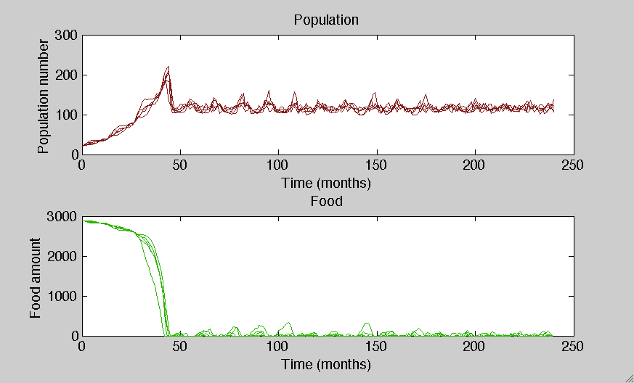
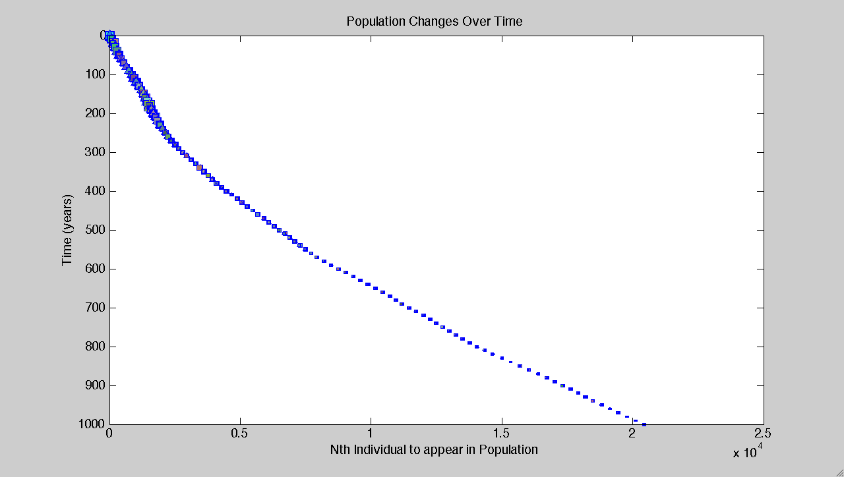
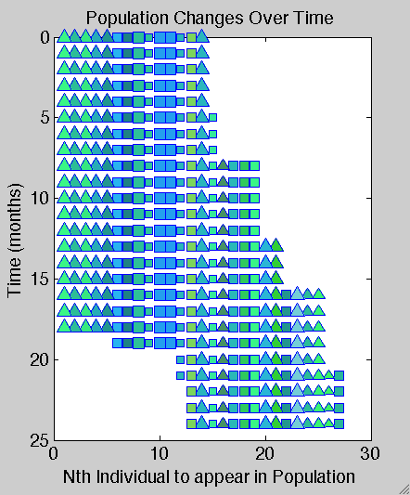

Plots:

Slide 5
Looking Back:
Challenges:
Giving the right amount of strength to the pressure of natural selection
Conclusions:
The traits expressed in a population will naturally change over time as a result of external pressures.
Future extensions:
A “predator” rule which favors the survival of a certain color (simulates the way camouflage works).
Competition among individuals for mates and food (favoring larger size).
Run two different environments with the same starting population: see how they become more different over time.

