Slide 1
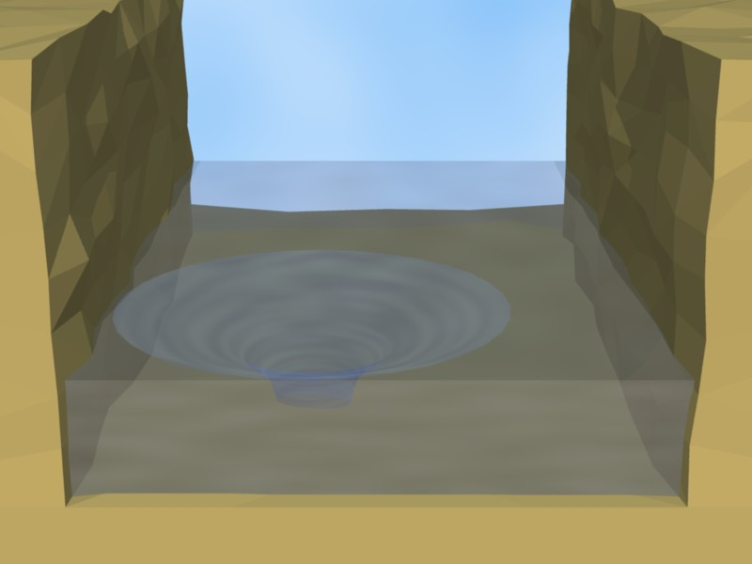
initial current
150m
50m
75m
50m
200m

Slide 2
