Slide 1

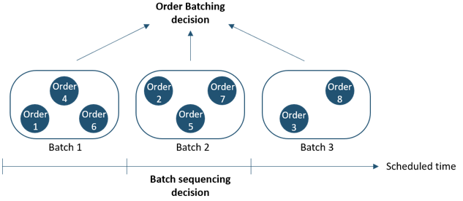
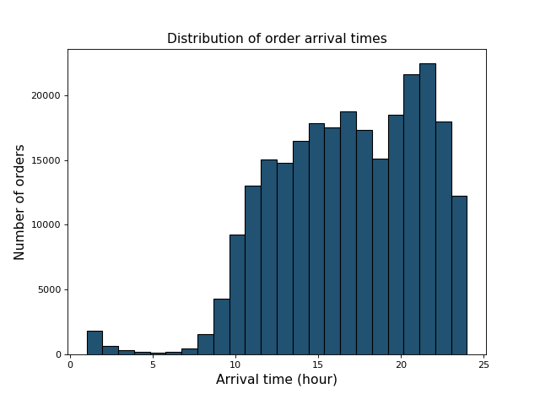
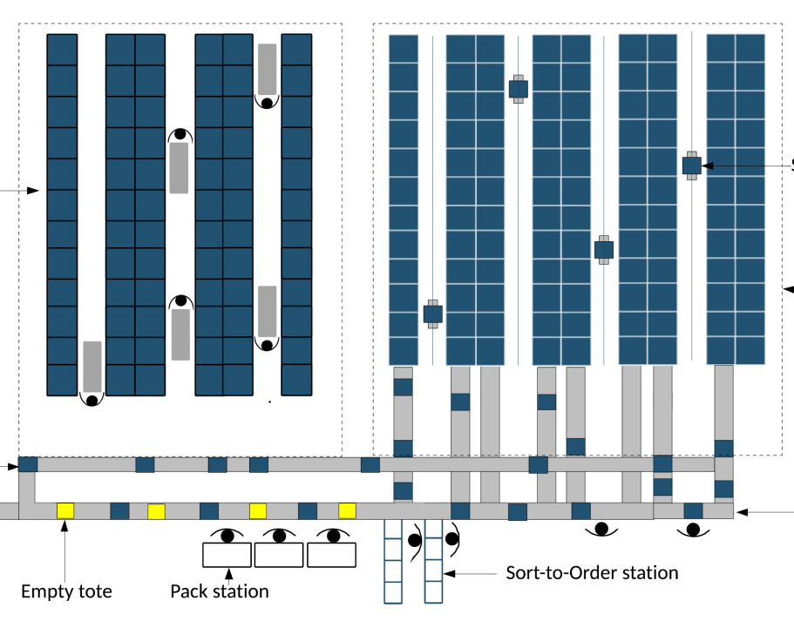
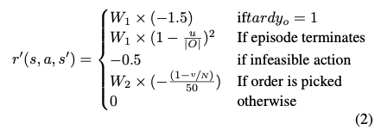
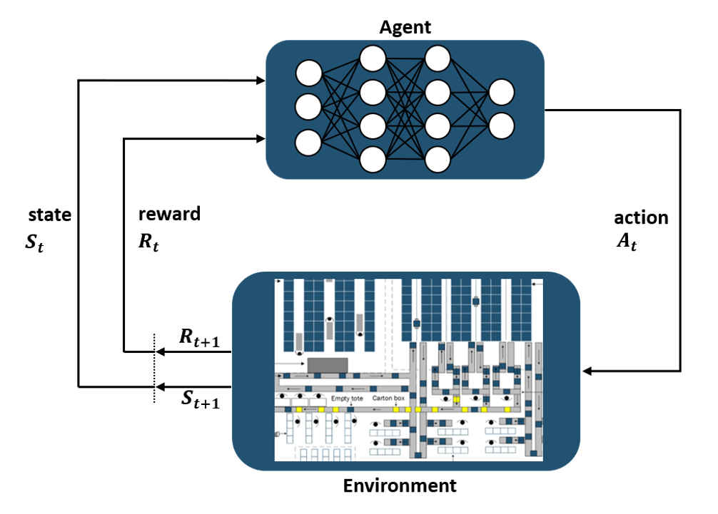
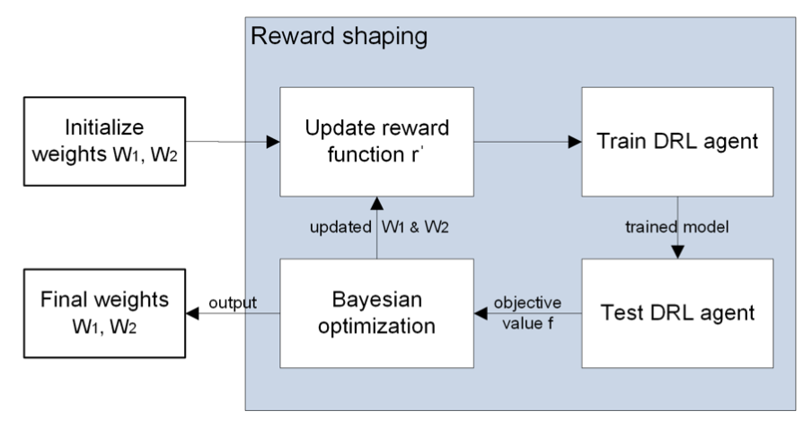
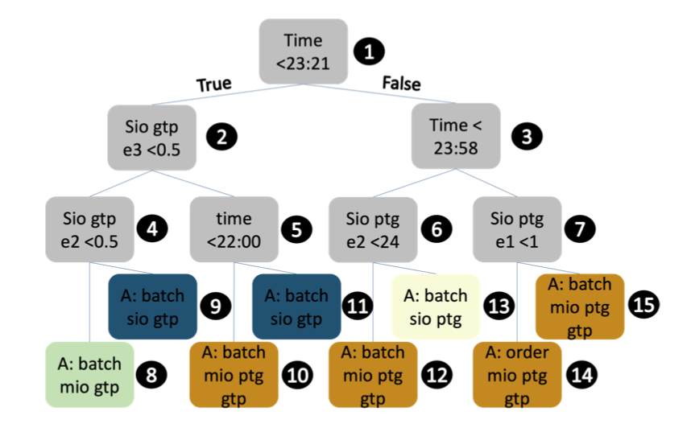
Deep Reinforcement Learning for a Multi-Objective Online Order Batching Problem
Martijn Beeks, Reza Refaei Afshar, Yingqian Zhang, Remco Dijkman (TU/e)
Claudy van Dorst, Stijn de Looijer (Vanderlande)
Problem description
Challenges
Multi-objective problem
Large instance size
Dynamic environments
Online variant of the order batching problem
Online order batching problem with two objectives:
Minimize late orders
Minimize order picking costs
Real time allocating orders to batches
Methodology
1. Deep Reinforcement Learning
Actions: pick-by-order / pick-by-batch
State information: orders, time
Reward function →
Literature review
Exact methods are computational too complex
Most heuristic methods consider single objective
Deep Reinforcement Learning demonstrates interesting behavior (Cals et al., 2020)
2. Deep Reinforcement Learning with reward shaping (RS)
Reward shaping is a difficult process in multi-objective DRL
Finding a reward function is presented as a Hyper-optimization problem
This is solved using a Bayesian Optimization problem
Results and Discussion
BOC heuristic: batches based on similarity of orders (Huang et al., 2017).
DRL + Reward Shaping (RS) outperformed other methods significantly (p=0.05)
Analysis of learned policy
Using a Decision Tree, logic from the DRL approach is derived
During a day, focus on minimizing order picking costs
End of a day, focus on minimizing tardy orders
Conclusion
“DRL with RS has found to be well capable to learn to address the multi-objective online order batching and sequencing problem
Future work
Automate state reward action formulation
Do we need deep NN’s?

