Slide 1
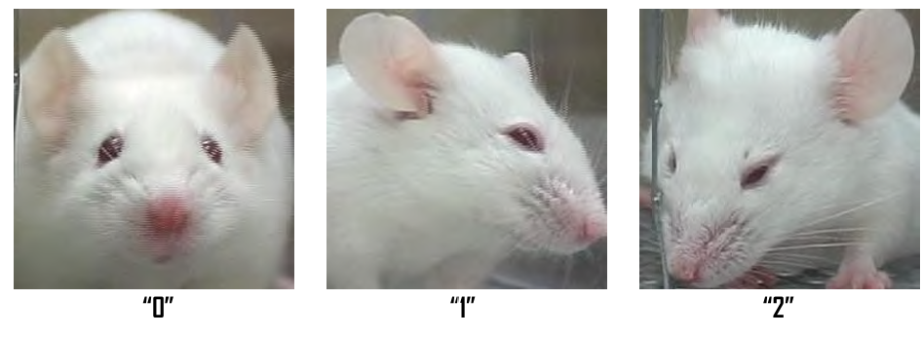
Image Data
Mouse Grimace Scale (MGS)
facial action untis (AU) are divided into 3 level
AU is not present = 0
AU is moderatly visable = 1
AU is severe = 2
Action Untis
Orbital Tightening (Augenform)
eyeslid is tightly closed or squeezed
„2“ if the eye closure reduces eye size by more than half
sleeping doen‘t count
https://www.utep.edu/research/laboratory-animal-resources-center/_files/docs/mgs-manual---mouse-grimace-scale.pdf

Slide 2
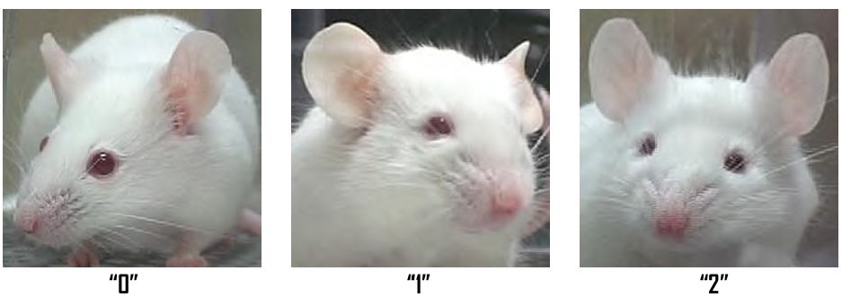
Image Data
Mouse Grimace Scale (MGS)
facial action untis (AU) are divided into 3 level
AU is not present = 0
AU is moderatly visable = 1
AU is severe = 2
Action Untis
Orbital Tightening (Augenform)
Nose Bulge (Nasenform)
muscles around the nose contract so that a bulge on top of the nose is displayed
vertical wrinkels may appear
V-form connecting the eyes and nose
https://www.utep.edu/research/laboratory-animal-resources-center/_files/docs/mgs-manual---mouse-grimace-scale.pdf

Slide 3
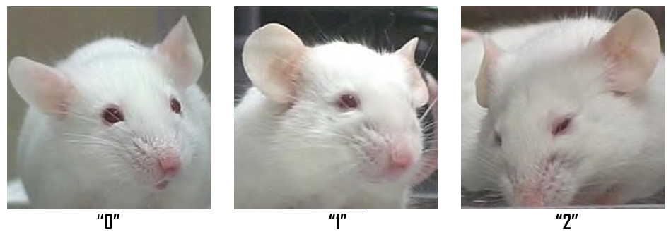
Image Data
Mouse Grimace Scale (MGS)
facial action untis (AU) are divided into 3 level
AU is not present = 0
AU is moderatly visable = 1
AU is severe = 2
Action Untis
Orbital Tightening (Augenform)
Nose Bulge (Nasenform)
Cheek Bulge (Wangenform)
cheek muscles are contracted and extend the check outward to the baseline position
distance between eyes and whiskers may appear shorter
https://www.utep.edu/research/laboratory-animal-resources-center/_files/docs/mgs-manual---mouse-grimace-scale.pdf

Slide 4
Image Data
Mouse Grimace Scale (MGS)
facial action untis (AU) are divided into 3 level
AU is not present = 0
AU is moderatly visable = 1
AU is severe = 2
Action Untis
Orbital Tightening (Augenform)
Nose Bulge (Nasenform)
Cheek Bulge (Wangenform)
cheek muscles are contracted and extend the check outward to the baseline position
distance between eyes and whiskers may appear shorter
https://www.utep.edu/research/laboratory-animal-resources-center/_files/docs/mgs-manual---mouse-grimace-scale.pdf

Slide 5
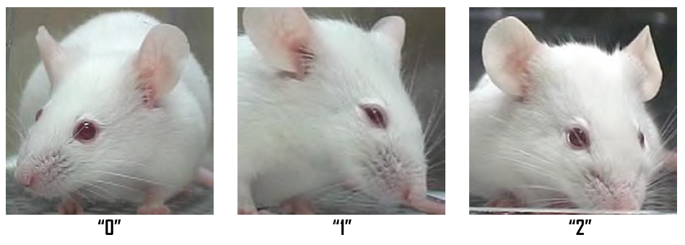
Image Data
Mouse Grimace Scale (MGS)
facial action untis (AU) are divided into 3 level
AU is not present = 0
AU is moderatly visable = 1
AU is severe = 2
Action Untis
Orbital Tightening (Augenform)
Nose Bulge (Nasenform)
Cheek Bulge (Wangenform)
Ear Position (Ohrenstellung)
Whisker Change (Schnurrhaarenveränderung)
whiskers either pulled back against the cheek or tensely stretched forward
https://www.utep.edu/research/laboratory-animal-resources-center/_files/docs/mgs-manual---mouse-grimace-scale.pdf

Slide 6
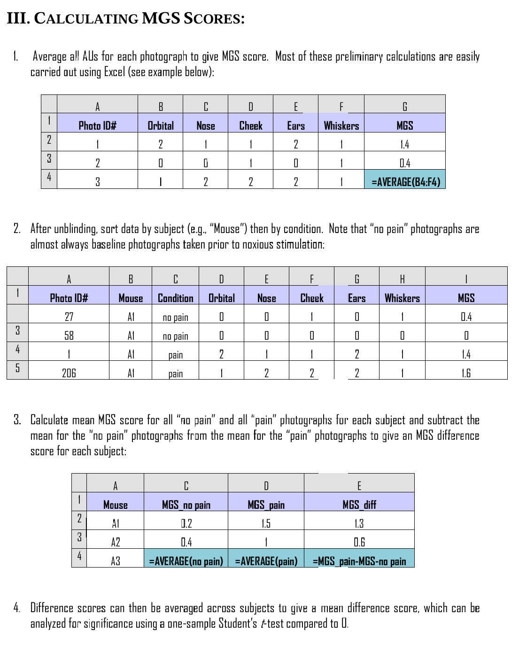
Image Data
Mouse Grimace Scale (MGS)
https://www.utep.edu/research/laboratory-animal-resources-center/_files/docs/mgs-manual---mouse-grimace-scale.pdf

Slide 7
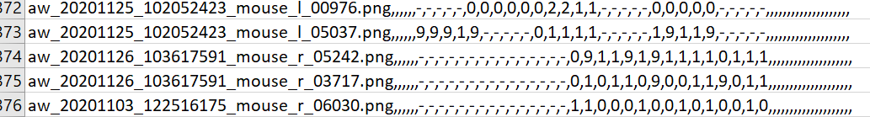
Image Data
Other Problem
On what label do we train?
MGS?
Pain/ No-Pain?
How do we calculate Pain/No-Pain or MGS Label from csv-file?
Ear Position (ep) – Reviewer3 = ep3
0,1,2 = normal intensity values
- = Reviewer couldn‘t review that image
,, = Reviewer hasn‘t ever seen that image
9 = Corresponding AU couldn‘t be measured
https://www.utep.edu/research/laboratory-animal-resources-center/_files/docs/mgs-manual---mouse-grimace-scale.pdf

Slide 8
Model Training
Successfull training -> Optimizing the hyperparameter
Optimizing Strategies
GridSearch
RandomSearch
Bayesian Search
Evolutionary Search
…
Optimizing Frameworks
Optuna
GridSampler
RandomSampler
Tree-structured Parzen Estimator - TPESampler (a form of bayesian search)
CmaEsSampler (a form of evolutionary search)
…
Hyperparameter:
Learning Rate (lr)
Learning Rate Scheduling
StepLR
Cosine Annealing
Optimizer
SGD
Adam
AdamW
Batchsize
Weigth Decay (when supported by optimizer)
Initilization Schems (Random, He-Initialisation (Kaiming), …)
….
https://www.utep.edu/research/laboratory-animal-resources-center/_files/docs/mgs-manual---mouse-grimace-scale.pdf

Slide 9
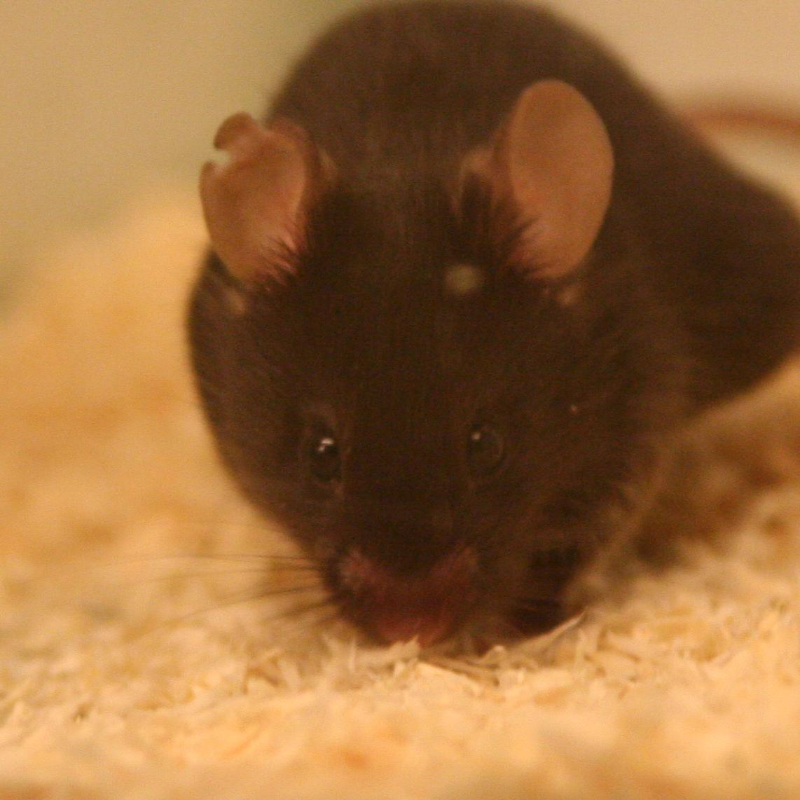
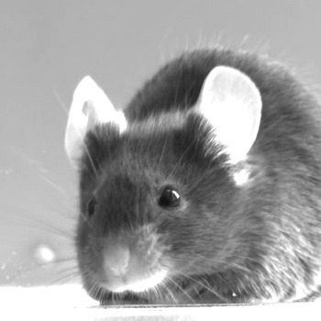
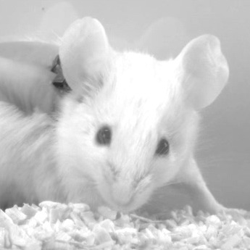
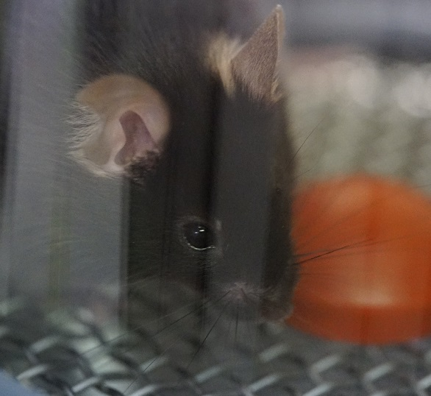
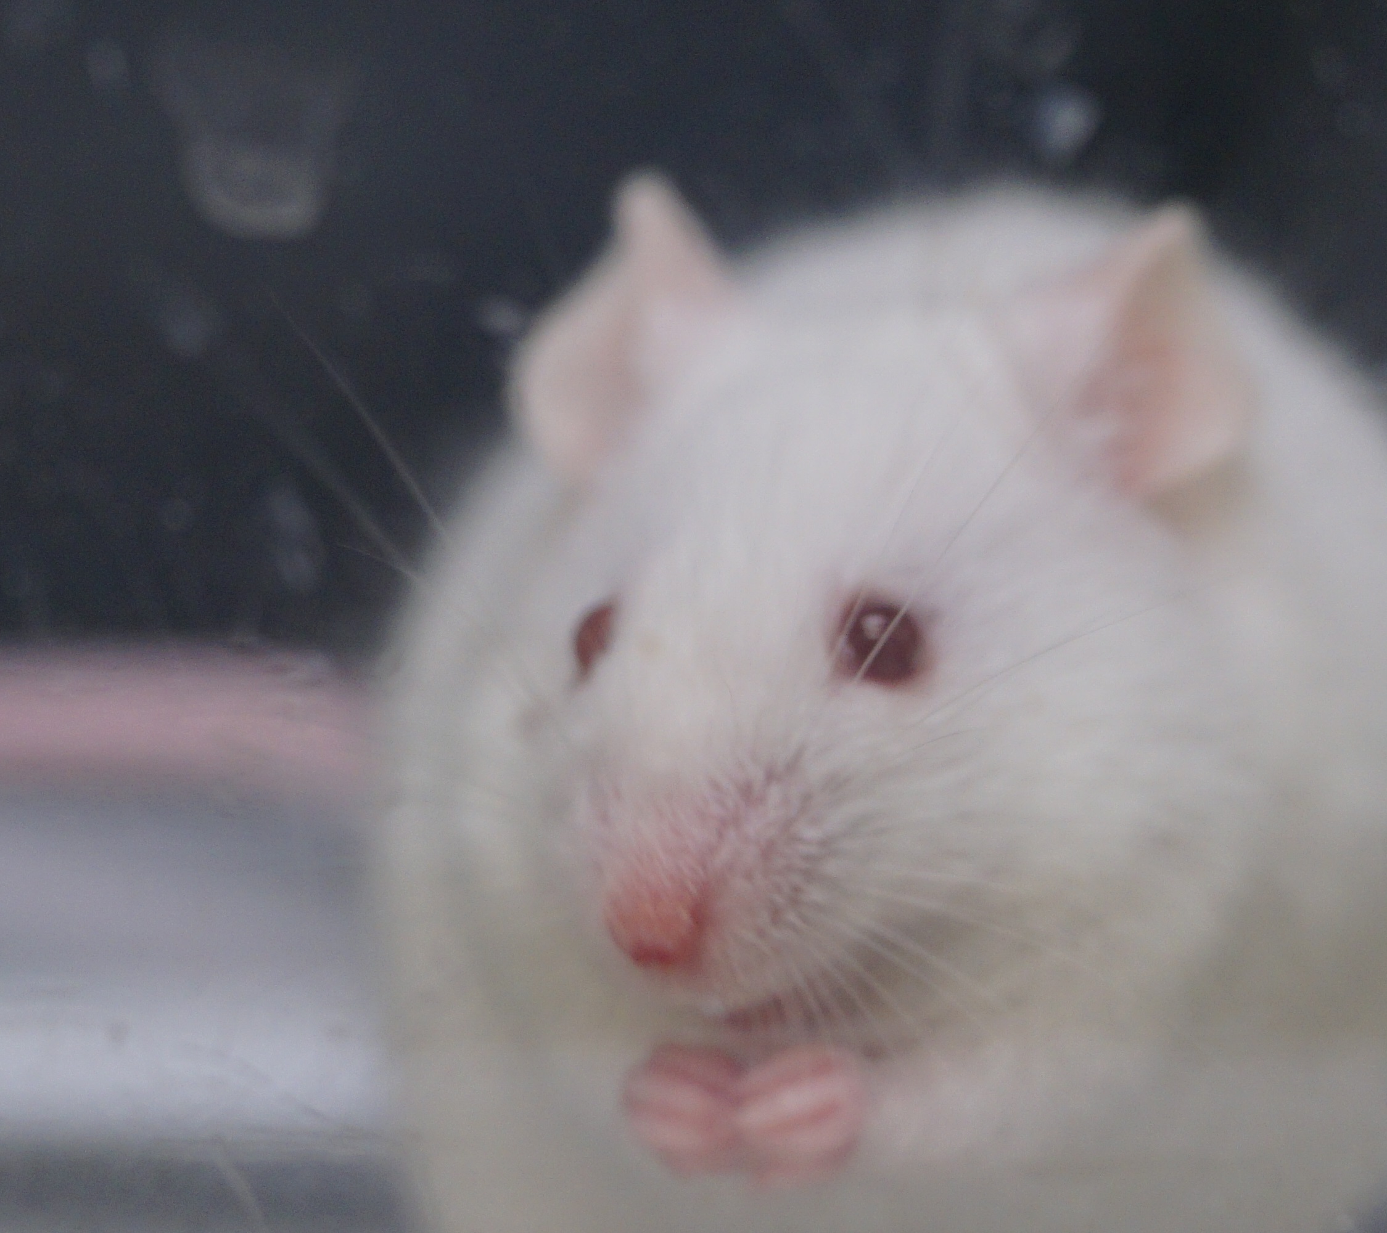
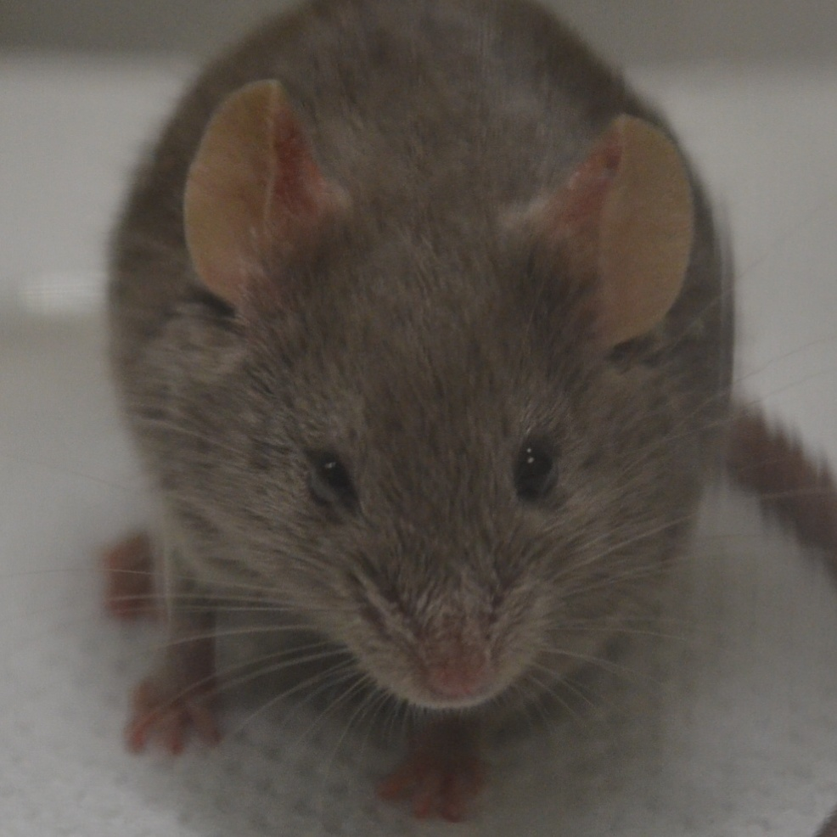
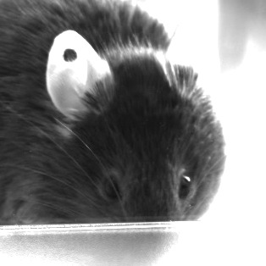
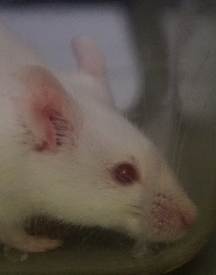
Image Data
Problems for ML
Color vs. No-Color
Different ground structures
different color of mice
artifacts in the images
AU not visible
colorshifts in the images
https://www.utep.edu/research/laboratory-animal-resources-center/_files/docs/mgs-manual---mouse-grimace-scale.pdf

Slide 10
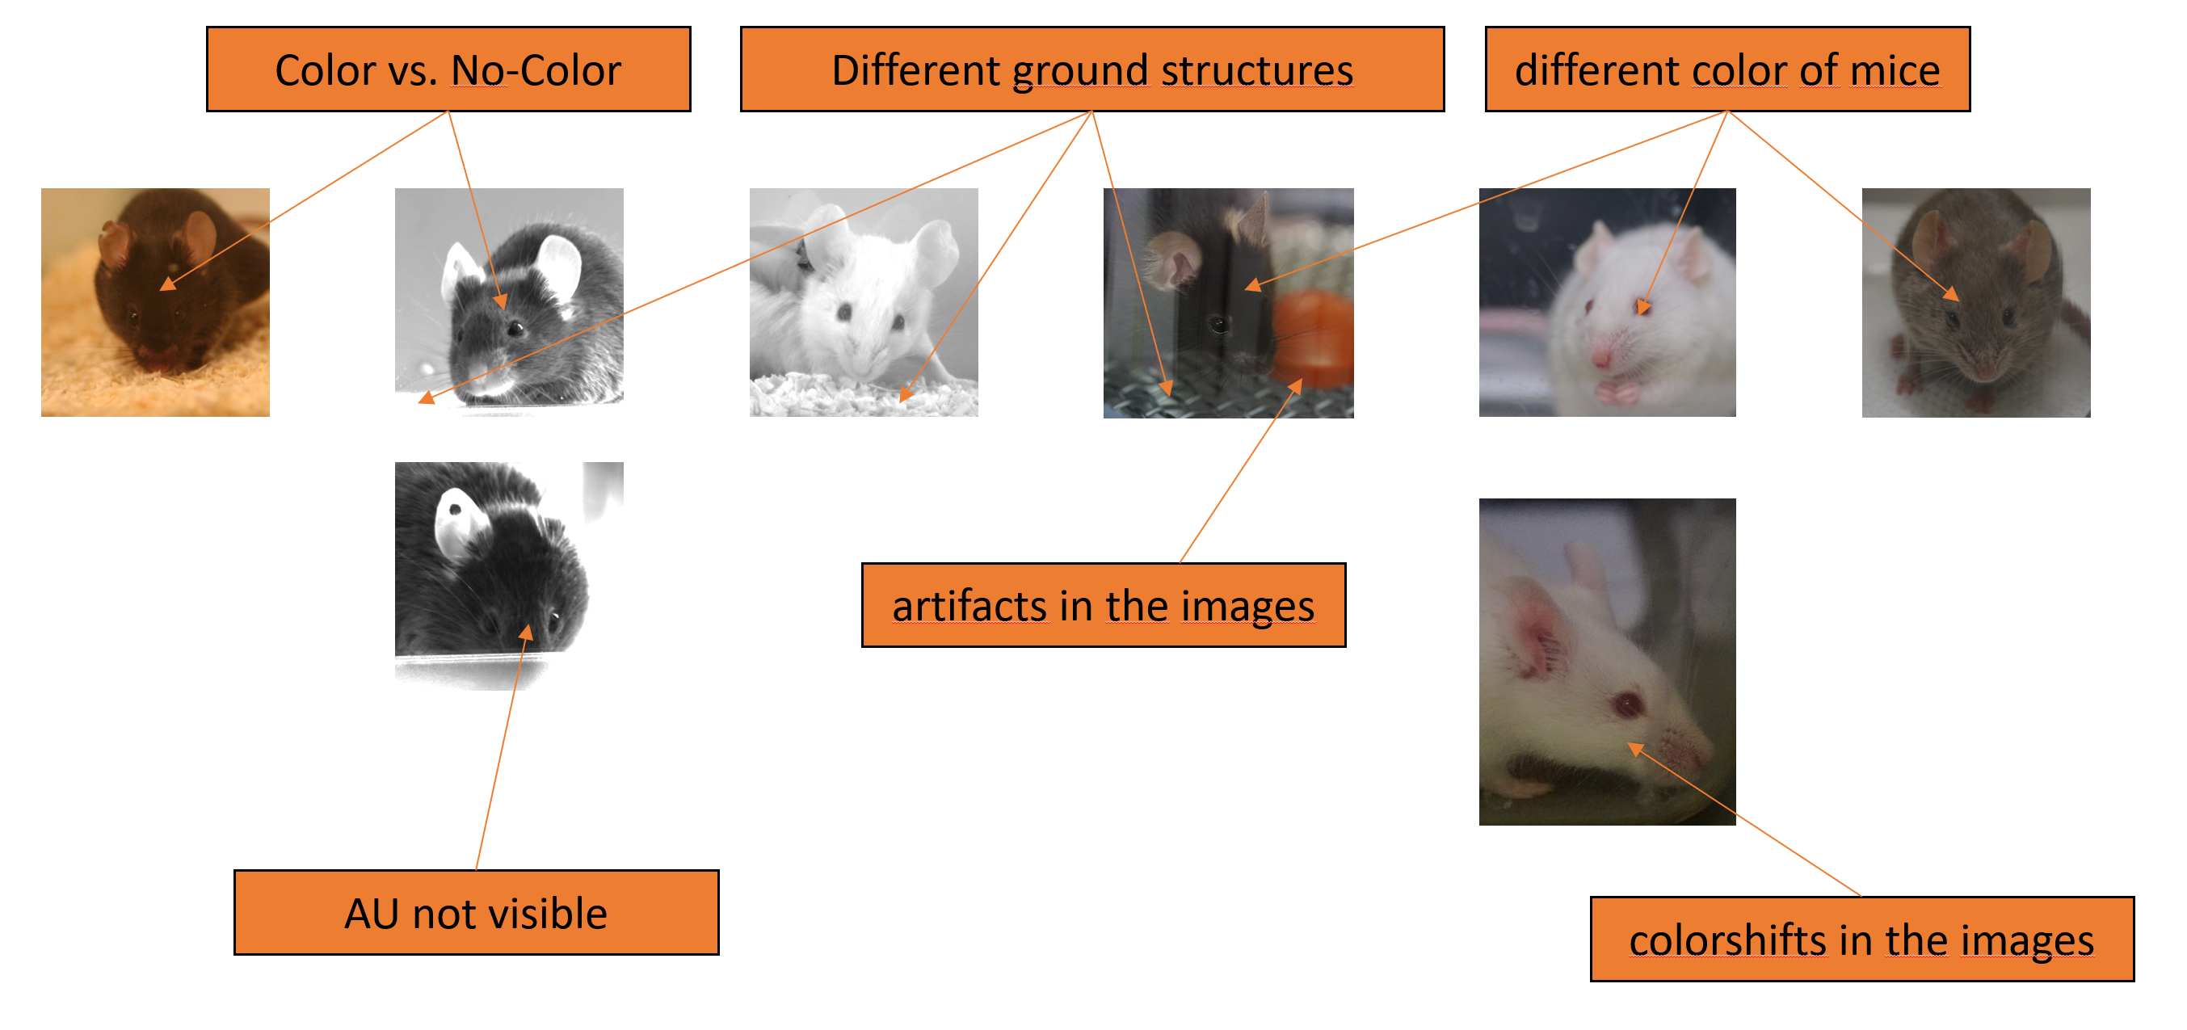
Image Data
Problems for ML
Probably the different images came from different experiments (either we only train on one experiment or find a way to reduce the effect of the distribution shifts between the data -> Datapreprocessing / Dataaugmentation)
Datapreprocessing / Dataaugmentation
Color vs. No-Color & Colorshifts:
RandomGrayscale(p=0.4) – convert 40% of the images into grayscale images and therefore reduce the chance of the model to take color as a shortcut to predict MGS
transforms.Grayscale(num_output_channels=1) – convert all images to grayscale works even better if color has no effect on AU / MGS prediction
Different ground structures:
Cropping or Background-Masking are not really an option
Different fell color:
Gamma Correction or Equalize Histograms are also not really an option
Shadows, artifacts, …:
transforms.GaussianBlur(kernel_size=3, sigma=(0.1, 1.0)) – blurres the images a little making it harder for the model to see the artefacts and use them for the prediction (could be bad for the whiskers so)
Futher techniques:
transforms.RandomRotation(degrees=5) – rotate the images a little for more robustness of the pose by the mice
transforms.Resize((224, 224)) – resize images to the input size of ResNet18
transforms.Normalize(mean=[0.5, 0.5, 0.5], std=[0.5, 0.5, 0.5]) – normalization increases the stability and speed of the training since all channels are equaliy distributed (must be calculated for the dataset)
https://www.utep.edu/research/laboratory-animal-resources-center/_files/docs/mgs-manual---mouse-grimace-scale.pdf

