Slide 1
Manual vs Automated Parking Ventilation Systems: A Long-Term Cost Comparison

Slide 2
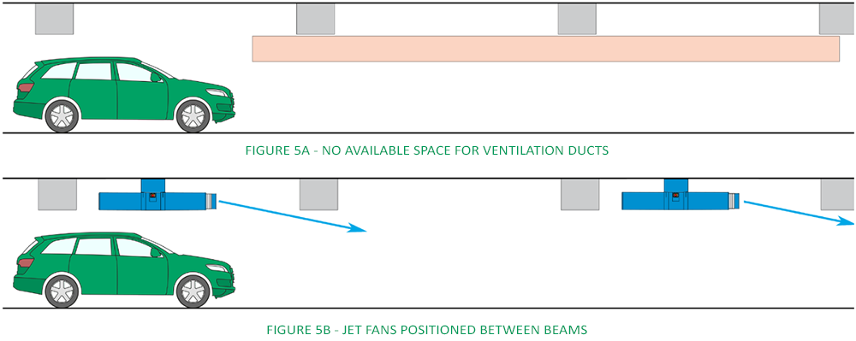
Parking Basement Ventilation System:

Slide 3

Importance of Basement Ventilation
Prevention of Carbon Monoxide Accumulation

Slide 4

Importance of Basement Ventilation
Prevention of Carbon Monoxide Accumulation
Compliance to OSHA standards

Slide 5
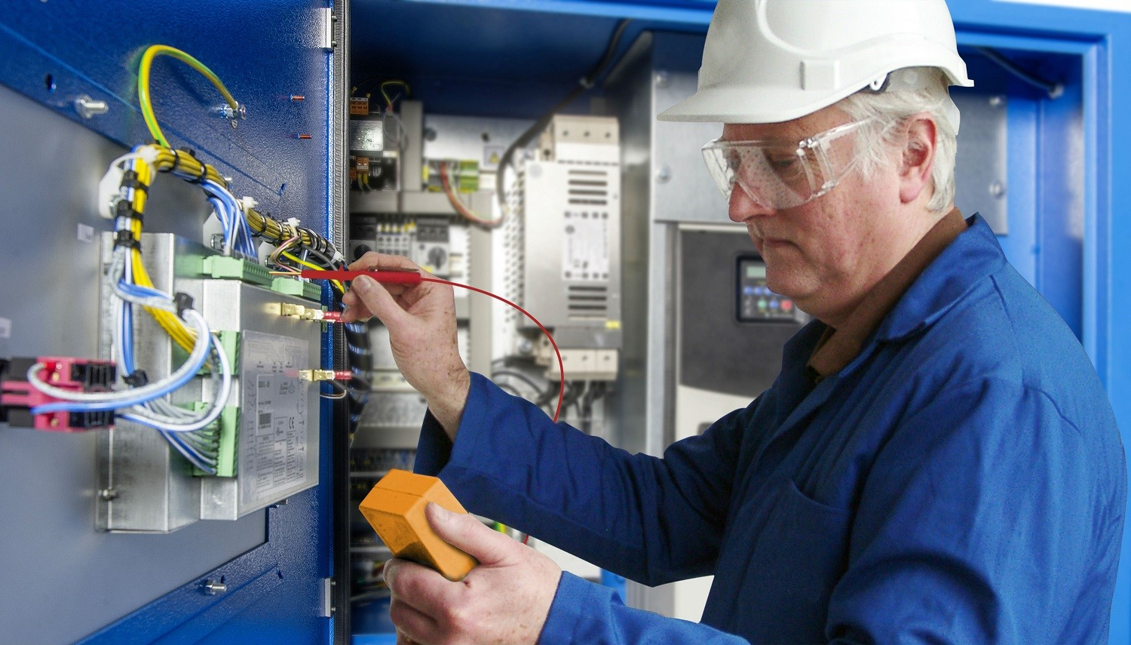
Options of Installation
Manually Operated

Slide 6

Options of Installation
Manually Operated
Automated Operation

Slide 7
Factors That Contribute to Installation Costs
Material and Labor cost as initial cost

Slide 8
Factors That Contribute to Installation Costs
Material and Labor cost as initial cost
Monthly Operational and Maintenance Cost

Slide 9
Factors That Contribute to Installation Costs
Material and Labor cost as initial cost
Monthly Operational and Maintenance Cost
BENECO monthly PHP/KW-hr rate

Slide 10
BENECO KW-hr rate trend from Oct-2021 to Oct-2022
The Computed CMGR is 0.92%

Slide 11
Costs for Manual Installation
Initial Material and Labor Cost: PHP 580,000

Slide 12
Costs for Manual Installation
Initial Material and Labor Cost: PHP 580,000
O & M Cost/month: PHP 70,000

Slide 13
Costs for Manual Installation
Initial Material and Labor Cost: PHP 580,000
O & M Cost/month: PHP 70,000
Operational hours: 6 hours/day

Slide 14
Costs for Automated Operation Installation
Initial Material and Labor Cost: PHP 3,200,000

Slide 15
Costs for Automated Operation Installation
Initial Material and Labor Cost: PHP 3,200,000
O & M Cost/month: PHP 5000

Slide 16
Costs for Automated Operation Installation
Initial Material and Labor Cost: PHP 3,200,000
O & M Cost/month: PHP 5000
Operational hours: 6 hours/day

Slide 17
Cost Differences and Similarities
Both have the same Operational hours and Total Power Rating.

Slide 18
Cost Differences and Similarities
Both have the same Operational hours and Total Power Rating.
Hence, Both will have the same Utility Bill Costs

Slide 19
Cost Differences and Similarities
Both have the same Operational hours and Total Power Rating.
Hence, Both will have the same Utility Bill Costs.
The initial cost of the Automated Operation installation is 550% more than the Manual Operation installation.

Slide 20
Cost Differences and Similarities
Both have the same Operational hours and Total Power Rating.
Hence, Both will have the same Utility Bill Costs.
The initial cost of the Automated Operation installation is 550% more than the Manual Operation installation.
The monthly Operation and maintenance cost of the Manual Operation installation is 1400% higher than the Automated Operation installation.

Slide 21
Cost Differences and Similarities
Both have the same Operational hours and Total Power Rating.
Hence, Both will have the same Utility Bill Costs.
The initial cost of the Automated Operation installation is 550% more than the Manual Operation installation.
The monthly Operation and maintenance cost of the Manual Operation installation is 1400% higher than the Automated Operation installation.
CMGR of BENECO KW-hr rate is 0.92%

Slide 22
Cost Differences and Similarities
Both have the same Operational hours and Total Power Rating.
Hence, Both will have the same Utility Bill Costs.
The initial cost of the Automated Operation installation is 550% more than the Manual Operation installation.
The monthly Operation and maintenance cost of the Manual Operation installation is 1400% higher than the Automated Operation installation.
CMGR of BENECO KW-hr rate is 0.92%
Budget for Manual and Automated Operation installation compounds by 5% annually.

Slide 23
What will the comparison of expenses of the 2 installation modes look like in a span of 10 years?

Slide 25
Pros and Cons of Manual Operation Installation
Pros:
Assigned technicians may be able to provide support for technical problems outside of Ventilation maintenance.

Slide 26
Pros and Cons of Manual Operation Installation
Pros:
Assigned technicians may be able to provide support for technical problems outside of Ventilation maintenance.
Low starting cost.

Slide 27
Pros and Cons of Manual Operation Installation
Pros:
Assigned technicians may be able to provide support for technical problems outside of Ventilation maintenance.
Low starting cost.
Technicians can provide immediate support for ventilation systems.

Slide 28
Pros and Cons of Manual Operation Installation
Pros:
Assigned technicians may be able to provide support for technical problems outside of Ventilation maintenance.
Low starting cost.
Technicians can provide immediate support for ventilation systems.
Cons:
Total incurred costs will eventually be more than the Automated Operation Installation after a period of 4 years.

Slide 29
Pros and Cons of Manual Operation Installation
Pros:
Assigned technicians may be able to provide support for technical problems outside of Ventilation maintenance.
Low starting cost.
Technicians can provide immediate support for ventilation systems.
Cons:
Total incurred costs will eventually be more than the Automated Operation Installation after a period of 4 years.
Total incurred costs after 10 years will be more than 300% after 10 years.

Slide 30
Pros and Cons of Automated Operation Installation
Pros:
Reduction of the need for skilled personnel due to automation.

Slide 31
Pros and Cons of Automated Operation Installation
Pros:
Reduction of the need for skilled personnel due to automation.
Total incurred costs in a span of ten years is 300% less compared to a manually operated system.

Slide 32
Pros and Cons of Automated Operation Installation
Pros:
Reduction of the need for skilled personnel due to automation.
Total incurred costs in a span of ten years is 300% less compared to a manually operated system.
Cons:
Technician deployment in case of problems will not be conducted immediately.

Slide 33
Pros and Cons of Automated Operation Installation
Pros:
Reduction of the need for skilled personnel due to automation.
Total incurred costs in a span of ten years is 300% less compared to a manually operated system.
Cons:
Technician deployment in case of problems will not be conducted immediately.
High initial cost for Material and labour costs.

Slide 34
Recommendations:
Choose the Automated Operation Installation and negotiate with a billing method that lasts for 2-3 months. Billing method is to be based on progress, conducted every 2 weeks with a qualified QA/QC Engineer monitoring project progress and authorizing billing requests from the subcontractor.

Slide 35
Recommendations:
Choose the Automated Operation Installation and negotiate with a billing method that lasts for 2-3 months. Billing method is to be based on progress, conducted every 2 weeks with a qualified QA/QC Engineer monitoring project progress and authorizing billing requests from the subcontractor.
Install a manually operated Parking Ventilation system using admin electricians then invest for automation before building facilities are operational. The admin personnel who conducted the installation shall be assigned as on call tech support.

Slide 36
THAT ENDS OUR ANALYSIS. THANK YOU FOR THE TIME!

