Slide 1
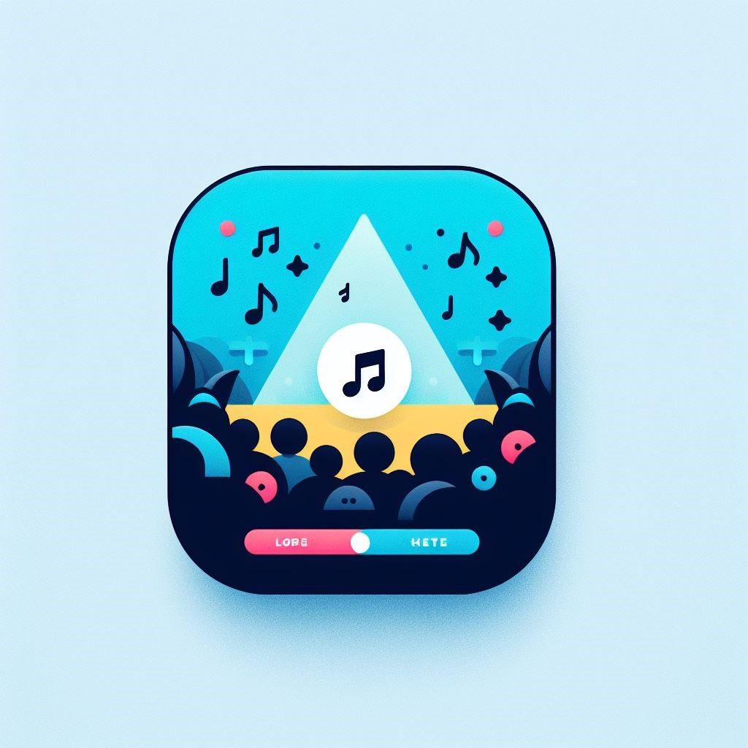
Gig-Guide
By Patrick Hession

Slide 2

What is it?
App to help you ensure you don’t miss concerts by artists you love.
Spotify Account integration
Push Notifications for your favourite Gigs
Tailored AI concert Suggestions
Guides you to venues
Easily purchase tickets

Slide 3
Research
Expo and react native.
Node express.
API docs.
UI Design.
Expo Notifications.
Compatibility on various devices.
Firebase.
AI prompt engineering
AWS with nginx and PM2

Slide 4
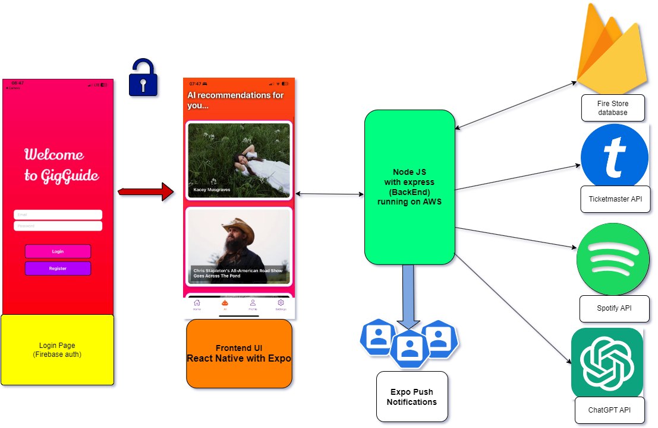
Architecture Diagram

Slide 5
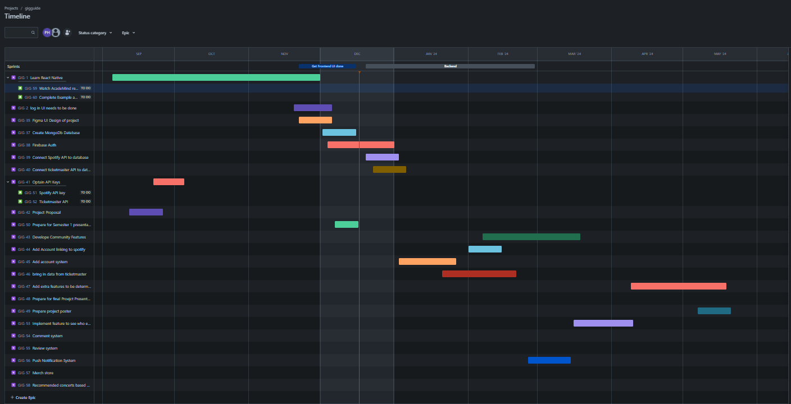
Organisation
Kept Teams logs up to date with progress
Had weekly standup discussions with fellow classmates
Used Jira heavily to plan and adjust timeline as problems arose

Slide 6
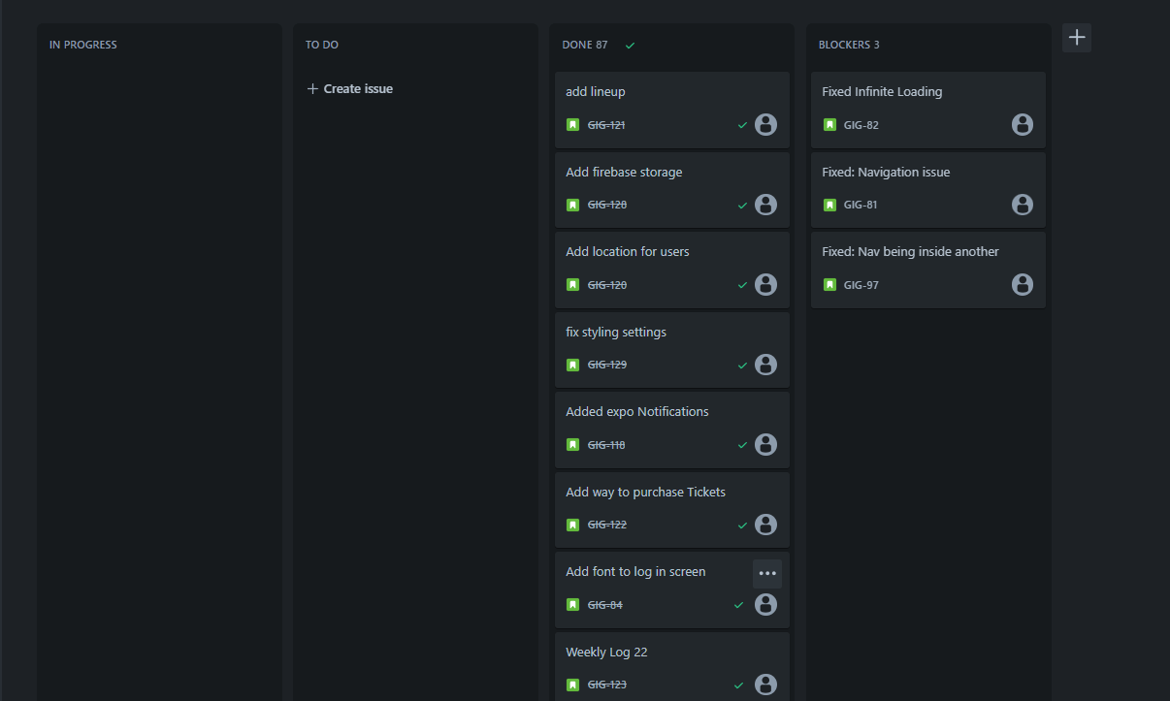
Agile Board

Slide 7
Thanks For Listening!

