Slide 1
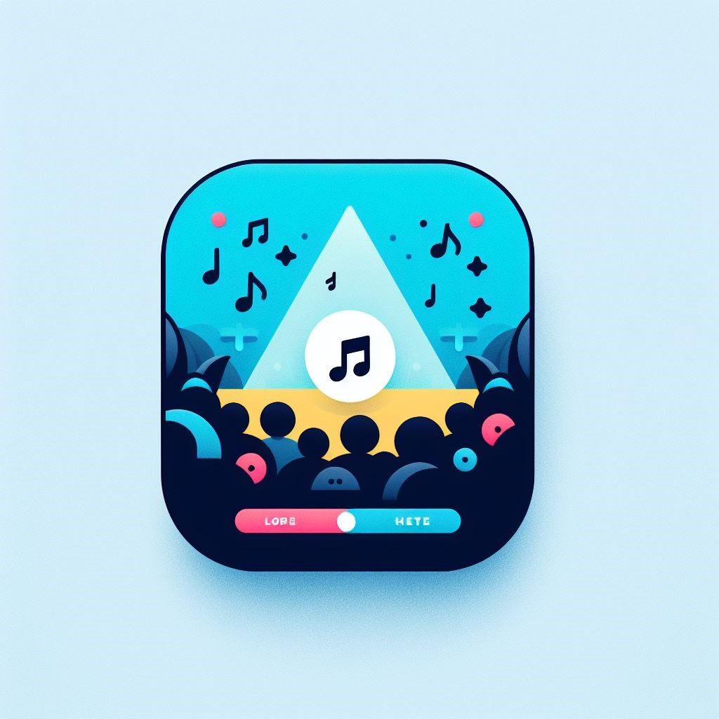
GigGuide
By Patrick Hession

Slide 2

What is it?
App to help you ensure you don’t miss concerts by artists you love.
Spotify Account integration
Tailored Suggestions
Community focused

Slide 3
Research
Researching Spotify and Ticketmaster API uses
React Native for an app that works on all platforms
Switching from Microsoft Project to Jira
MongoDB
Coding courses and example app to feel confident with new language
.
Getting opinions on prototype UI designs before finalising.
Push Notifications: FCM or APNs?

Slide 4
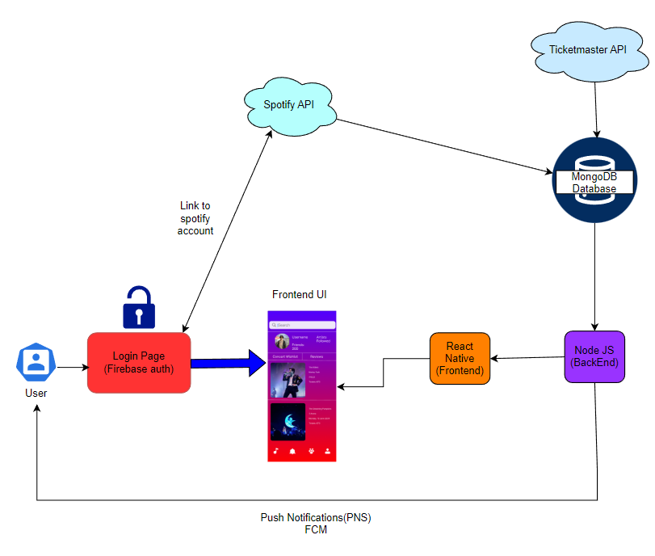
Architecture Diagram

Slide 5
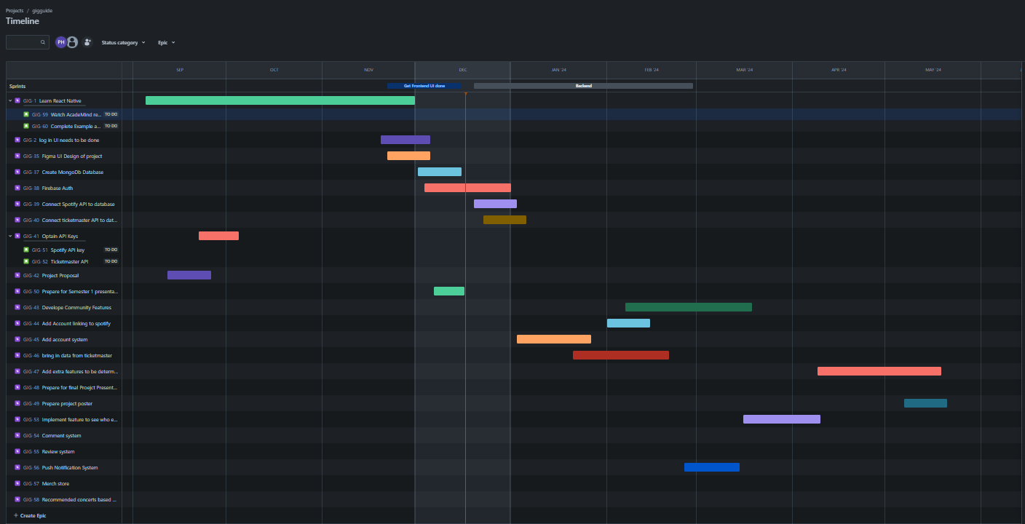
Organisation
Kept Teams logs up to date with progress
Used Jira heavily to plan and adjust timeline as problems arose
Logged standups to reflect and see progress.
Dedicated research time

Slide 6
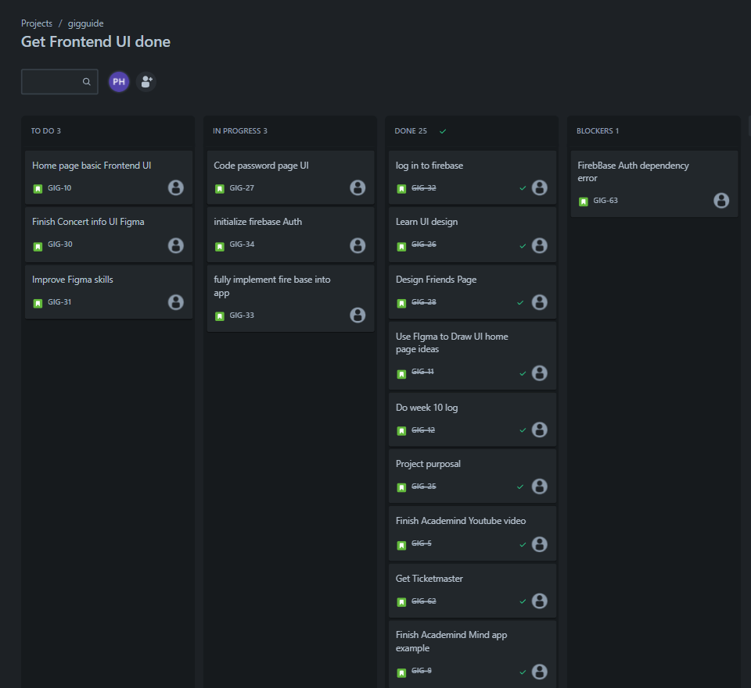
Agile Board

Slide 7
Initiative & Engagement
Got valuable feedback from lecturers and peers for improvements and ideas
Engaged in standup meetings with fellow students
Microsoft Team Logs
Jira project management

Slide 8
Thanks For Listening!

