Slide 1

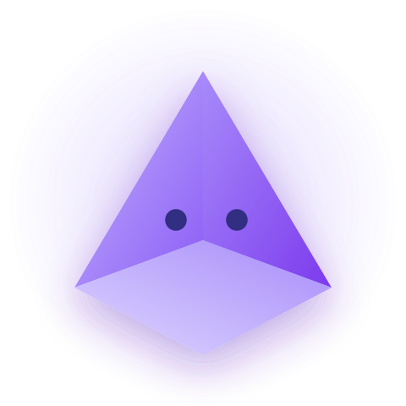

PrismLearning.AI
Not a chatbot. Lumi drives your document itself.
Built with AMD Instinct GPUs x Fireworks AI
PrismLearning.AI Pitch Deck
Built for the AMD Developer Hackathon 2026.

Slide 2







Passive reading is dead.
Cognitive Load
Passive Dumping
Hallucination Risks
Flat PDFs create a dense wall of unabsorbable text, quickly exhausting student retention capacities and focus spans.
Standard AI chatbots simply hand over answers without guidance, short-circuiting critical thinking and conceptual learning.
Unconstrained LLMs easily pull students completely out of the core curriculum by generating unsupported factual errors.
PrismLearning.AI | Problem
02

Slide 3
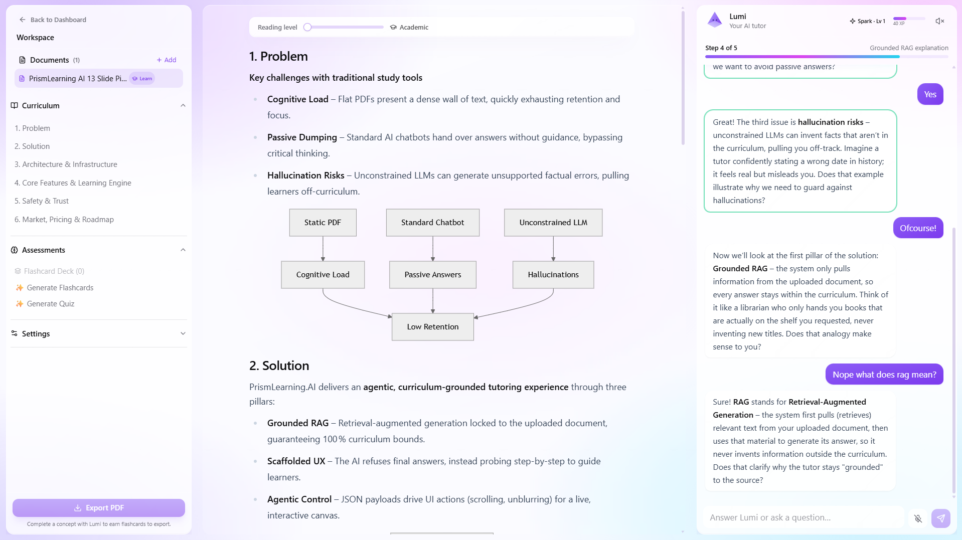
Lumi Drives the Document — Not the Chat
Not a chatbot. Not a flashcard app.
Grounded RAG: A pristine pipeline strictly locked within the uploaded document bounds to maintain 100% curriculum bounds.
Scaffolded UX: The AI refuses to give final answers, strategically probing and guiding the student step-by-step to answers.
Agentic Control: Every reply is JSON that drives the UI — scroll, highlight, unlock, gamify. Never just chat.
PrismLearning.AI | Solution
03

Slide 4




Why We Win
AGENTIC / ACTIVE INTERFACE
GENERIC KNOWLEDGE
CURRICULUM GROUNDED
PASSIVE TOOL
PrismLearning.AI | Competitive Landscape
04

Slide 5




The Engineering Stack
Frontend
State Engine
Backend
Data & Auth
Next.js 14, Tailwind CSS, and Framer Motion for sleek glassmorphic transitions.
Zustand state engine catches JSON payloads for instant, low-latency DOM manipulation.
Python FastAPI & Pydantic designed for highly performant text extraction from documents.
Supabase PostgreSQL with Clerk auth; uploads stay in memory only, never stored.
01
02
03
04
PrismLearning.AI | Architecture
05

Slide 6


Powered by Fireworks AI & AMD
Traditional Cloud APIs
Fireworks AI on AMD Instinct™
High latency ruins real-time agentic interaction.
Blazing fast Tokens-Per-Second output capacity.
Prohibitively expensive inference costs limit growth.
Sub-second UI mutation latency for live updates.
Breaks immersion of a fluid, live conversational tutor.
Serverless scaling on AMD Instinct™ GPUs, low cost.
One architecture, three models — gpt-oss-120b for tutoring, Gemma 3 27B for flashcards, Gemma 4 for Enterprise, all served on AMD Instinct™ GPUs.
PrismLearning.AI | Infrastructure Choice
06

Slide 7




The Active Learning Canvas
Fog of War
Walkie-Talkie
Printable Decks
The core text remains locked behind frosted glass, unblurring section-by-section as student mastery is proven.
Low-latency, vocal interaction driven securely by the Web Speech API for natural conversation.
Instantly compiles smart micro-quizzes into cleanly formatted PDF flashcard cutouts for physical study.
PrismLearning.AI | Core Features
07

Slide 8
Beyond Flashcards: The Learning Engine
Confidence
Boss Battles
Mastery Decay
Before revealing a quiz answer, students self-rate their confidence — feedback then flags over- or under-confidence.
Mastering a chapter unlocks a themed, timed practice exam that proves the material actually stuck.
Flashcards resurface on a spaced-repetition schedule; mastery quietly decays until reviewed again.
PrismLearning.AI | The Learning Engine
08

Slide 9






Built for Academic Integrity
Data Sovereignty
Anti-Cheat Guardrails
Hallucination-Free
Zero-retention data framework. Uploaded curriculum assets are fully discarded post-session and never used for base training.
The Agentic Tutor is hard-prompted to never write essays, output source copy blocks, or hand over final homework answers directly.
Strict structural system prompts constrain the model to instruct solely from parameters defined in your syllabus.
PrismLearning.AI | Safety & Trust
09

Slide 10


A Scalable SaaS Engine
MOST POPULAR
Free Tier
Pro Tier
Campus Tier
Basic exploration
Designed for power students
Institutional standard
Free
$10/mo
B2B
Advanced UI limits unlocked
Ingest standard PDFs
Unlimited syllabus uploads
Dedicated Gemma 4 on AMD Instinct™
Core active tutor chat
Full Walkie-Talkie voice tutor
Teacher Analytics dashboards
Tapping into the $340 Billion global EdTech market.
10

Slide 11

The Future of PrismLearning
MVP Launch
Shared Acrylic Spaces
Enterprise LMS Hooks
Fireworks AI multi-model tutor shipped — gamified, adaptive, and grounded in the source document.
Collaborative multi-student workspaces built for peer-to-peer interactive study.
Direct system hooks into Canvas/Blackboard, powered by dedicated Gemma 4 on AMD Instinct™ GPUs.
PrismLearning.AI | Strategic Roadmap
11

Slide 12


Enough talking.
Let’s step inside the Prism.
PrismLearning.AI Live Demo Session
[Switching to Live Agentic Demo...]

Slide 13


The Visionaries Behind PrismLearning
We are looking for seed-stage feedback and beta testers to break our Agentic Engine.
patrickilagan.dev@gmail.com
John Patrick Ilagan - Student Founder & Full-Stack Architect
“Built out of personal necessity because
current study tools are fundamentally broken."
Scan to try the beta. Built for the Developer Hackathon 2026.
13

