Slide 1
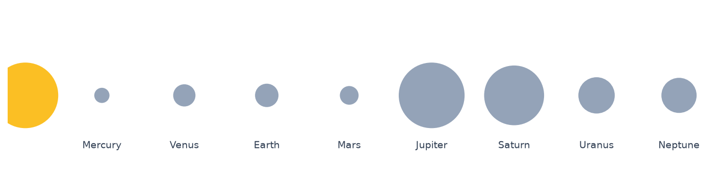
Astronomy: Our Solar System
An Introductory Survey of the Eight Planets

Slide 2
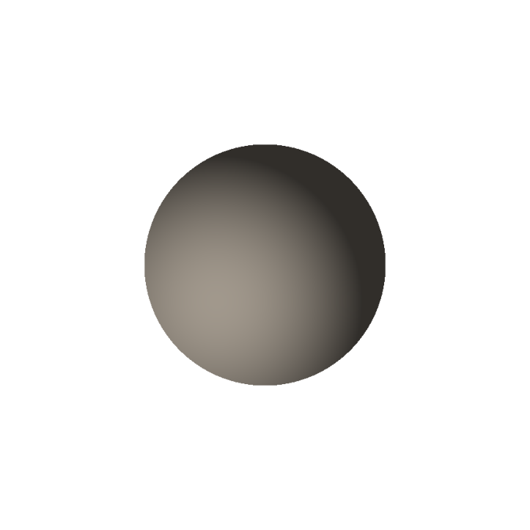

Mercury & Venus — The Inner Rocky Worlds
Mercury is the smallest planet and closest to the Sun, with almost no atmosphere and extreme temperature swings between day and night.
Venus is similar in size to Earth but has a thick, toxic atmosphere of carbon dioxide that traps heat, making it the hottest planet in the solar system despite being farther from the Sun than Mercury.

Slide 3
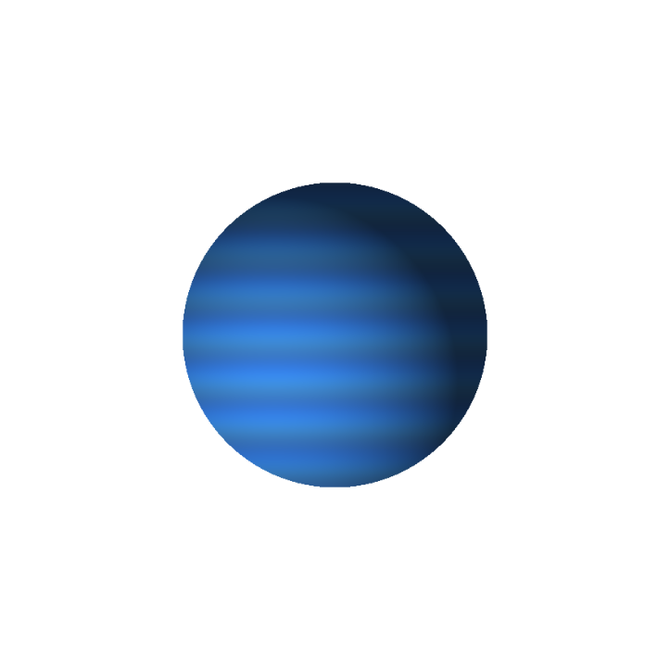
Earth — The Blue Planet
Earth is the only known planet to support life, thanks to liquid water, a protective atmosphere, and a moderate distance from the Sun known as the habitable zone.
Earth's axial tilt of about 23.5 degrees is responsible for the seasons, and its single large moon stabilizes that tilt over long timescales.

Slide 4

Mars — The Red Planet
Mars gets its reddish color from iron oxide (rust) covering its surface. It has the largest volcano in the solar system, Olympus Mons, and a canyon system, Valles Marineris, that dwarfs the Grand Canyon.
Evidence of ancient riverbeds and polar ice caps suggests Mars once had liquid water on its surface, making it a major target in the search for past microbial life.

Slide 5

Jupiter — King of the Planets
Jupiter is the largest planet in the solar system — more than twice as massive as all other planets combined. It is a gas giant with no solid surface, dominated by swirling bands of clouds.
Its Great Red Spot is a giant storm that has raged for at least 350 years, large enough to swallow Earth several times over.

Slide 6
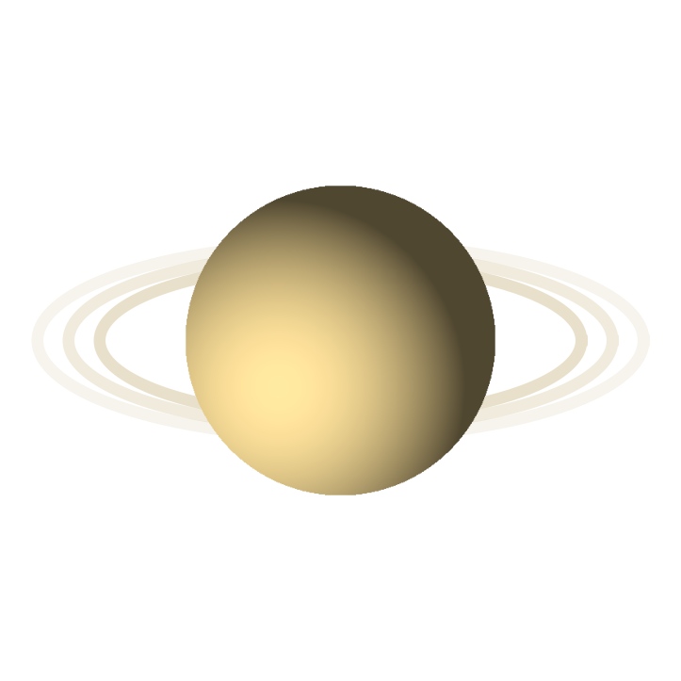
Saturn — The Ringed Jewel
Saturn is best known for its spectacular ring system, made almost entirely of ice particles ranging from tiny grains to house-sized chunks, held in place by the gravity of its many moons.
Like Jupiter, Saturn is a gas giant made mostly of hydrogen and helium, and it is so much less dense than water that it would theoretically float in a large enough ocean.

Slide 7


Uranus & Neptune — The Ice Giants
Uranus is unique for rotating almost completely on its side, likely the result of an ancient collision. Its pale blue-green color comes from methane in its atmosphere absorbing red light.
Neptune, the most distant planet, has the fastest winds in the solar system, reaching over 1,200 miles per hour, and was the first planet located through mathematical prediction rather than direct observation.

Slide 8
Recap: The Eight Planets in Order
1. Mercury — smallest, closest to the Sun
2. Venus — hottest, thick toxic atmosphere
3. Earth — only known planet with life
4. Mars — the Red Planet, evidence of ancient water
5. Jupiter — largest planet, Great Red Spot
6. Saturn — spectacular ring system
7. Uranus — rotates on its side
8. Neptune — fastest winds, most distant

