Slide 1


Clamor Web Chat Application
Patrick Cannell
Chat Application with Server Implementation

Slide 2
https://thawing-hamlet-65909.herokuapp.com
Hosted on Heroku cloud
Pre-created users on paper
Registration supported
Go ahead and chat!

Slide 3
Past, Present, and Future Pt. 1
I. Started May 20 - C, C++ - Basic OOP & algorithms - Basic Design Patterns
II. First 2 Weeks - SQL, HTML (Michael) - C# (Matt) - Angular/JS (Igor) - Colliers (Kaushik)
III. Real Job Starts - Got Pratik as manager - Agile Scrum Runs - 3-week crash course - 2-week chat app
IV. Crash Course Phase - Scrum runs fall apart - Tutorials not enough - Didn't know IIS - Moved on to Chat App
Pratik’s 3-Week Crash Course
Basics: Web apps, windows apps, HTML, XML, Windows Forms, Job Scheduling
Databases: SQL, noSQL, Big Data, Blob
Javascript: Angular, JQuery, React
APIs: ….
Architecture: Generalized architecture components like Login and Error Handling
CSS: Styles, Bootstrap, mobile

Slide 4
Patrick’s 3-Week Crash Course Schedule

Slide 5
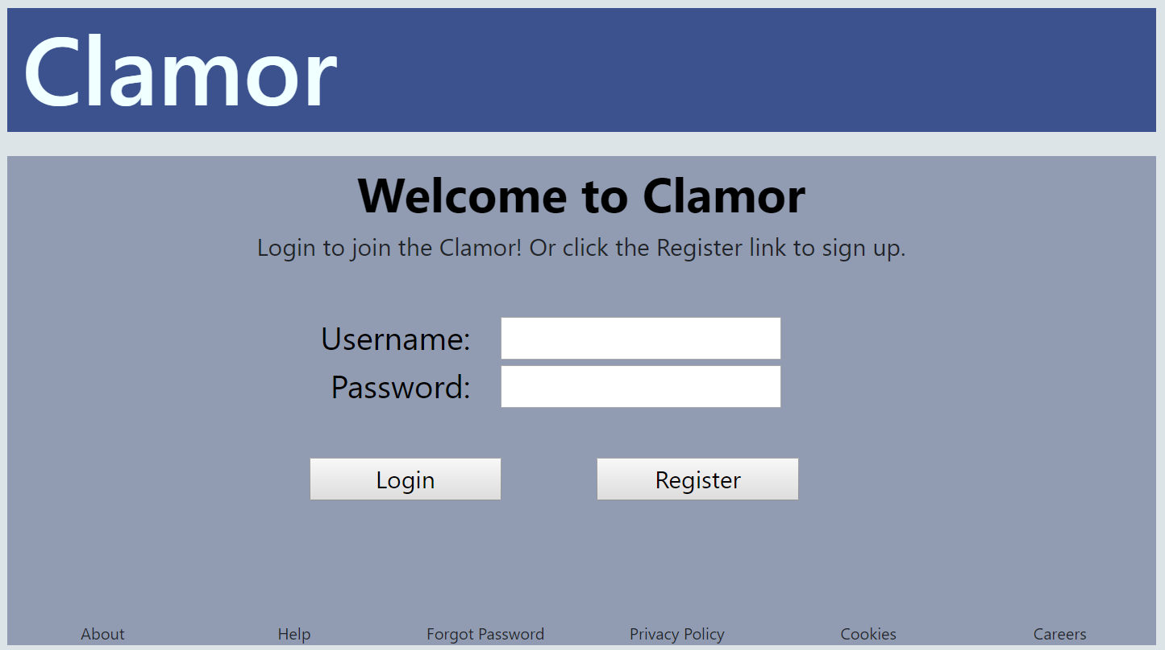
Past, Present, and Future Pt. 2
Chat Application Requirements
Support user creation
Logon
Who is online
Send Messages
Maintain History of Messages
Update immediately
V. Begin Chat App - HTTP Programming - Client/Server - Wrote server infrastructure - Avoided APIs
V. Deploy on Cloud - Heroku Cloud Hosting - Production Environment - New DB - Config environment vars
VI. Current State of Affairs - Would use Frameworks/APIs - Have XP to know where to look - Goal: Rapid development - Mini side projects to gain skills
(TCP/web sockets)

Slide 6




Wrote code for server infrastructure (node.js)
Deep(er) understanding of client/server model
Asynchronous callback handling
Implemented sessions (I think)
Basic DB queries (C R U D)
Direct DOM manipulations
BOOTSTRAP for UI
CSS class and IDs visual representation of sessions
Socket.io API for broadcast
5 MB of space
60 second connection timeout
3600 queries per hour

Slide 7
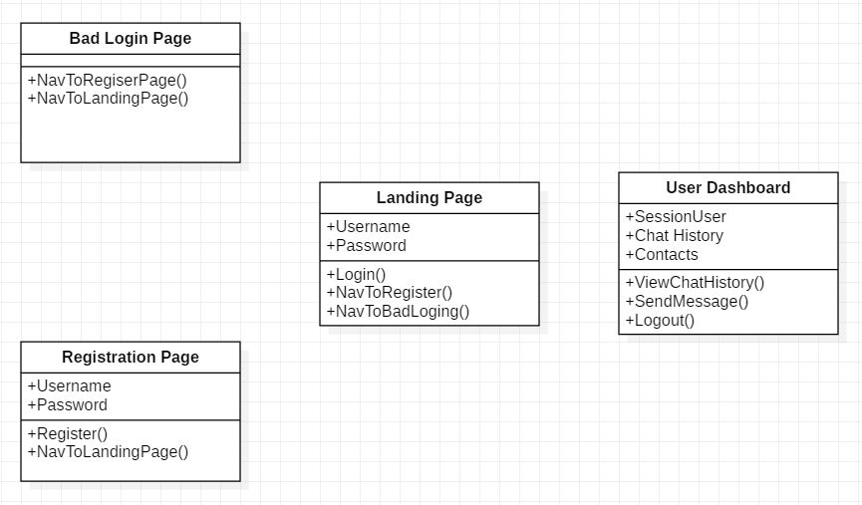

End-User Experience and Interactions
Enter App
Automatically update chat history when new message is posted
Indicate when other users online

Slide 8
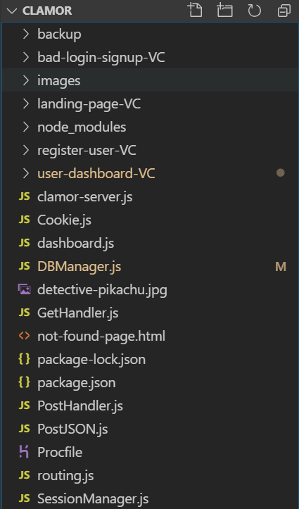
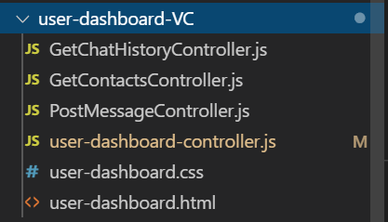
Software Architecture
Imitated Microsoft’s MVC tutorials → used VC because data models were simple
User Data Model = { username: ____ , password: ____ }
Message Data Model = { sender_username: ____, receiver_username: ____, content: ____ }
View-Controllers
Server Side “Use Case” Controllers
Server Classes
Client Side UI and dynamic webpage controller

Slide 9
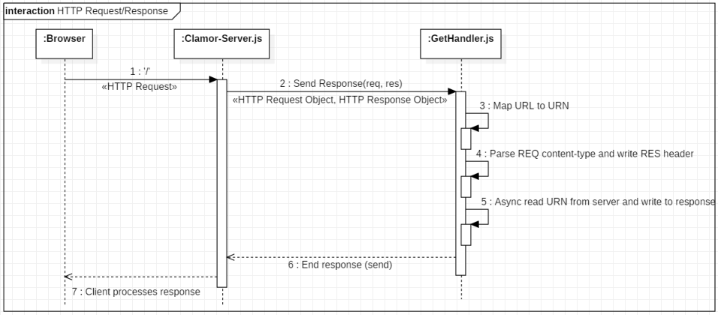
Anatomy of an HTTP Request

Slide 10
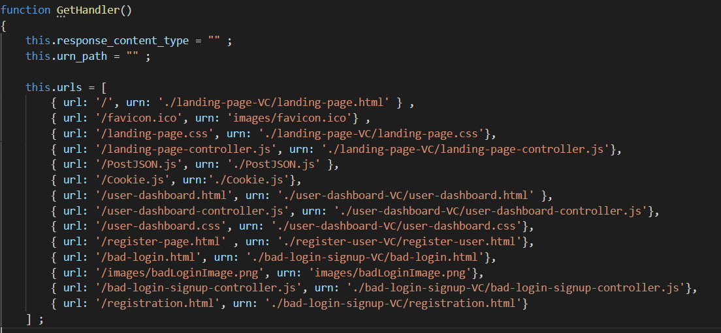
GET HTTP Request Routing Table
3: Map Request URL to a URN on the server

Slide 11
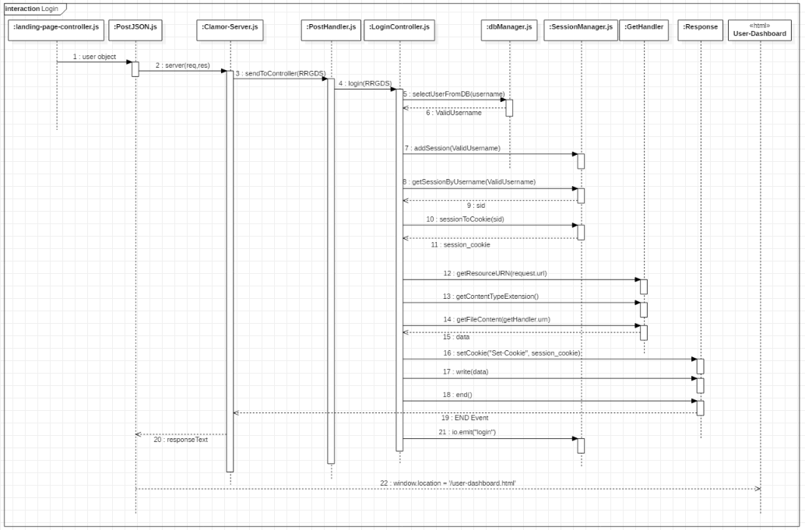
Login Use Case

Slide 12
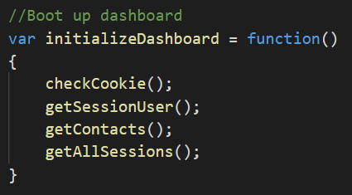
User Dashboard Initialization
If no sid (session id) was generated, take the user back to the landing page.
Setup up a custom dashboard for the user that just logged in (session_user)
The cookie only stores the sid, so the username must be retrieved from the server using the sid
The session user can talk to any other user who is registered with clamor.
Get all other users and put in a table
The SessionManager stores an array of “sessions”. A session is an object containing a username and sid pair.
Get the sessions array. Then, for every contact with a session object, turn the offline dot to green (online)

Slide 13
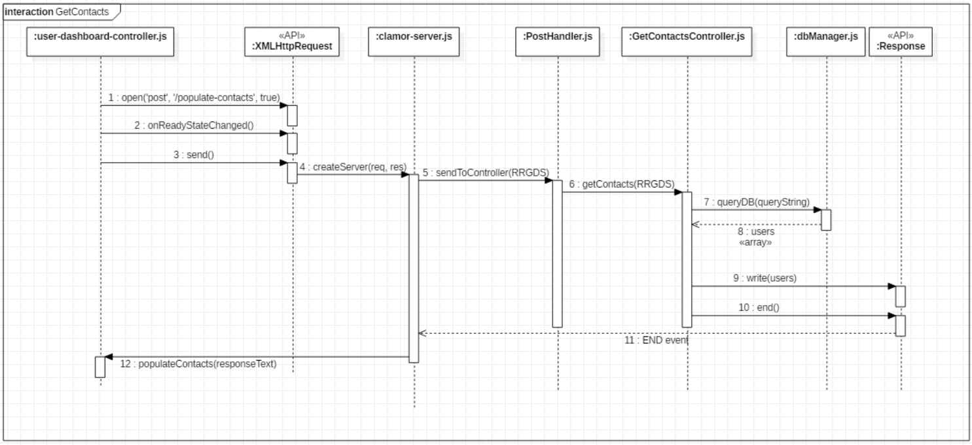
Get Contacts Sequence Diagram

Slide 14
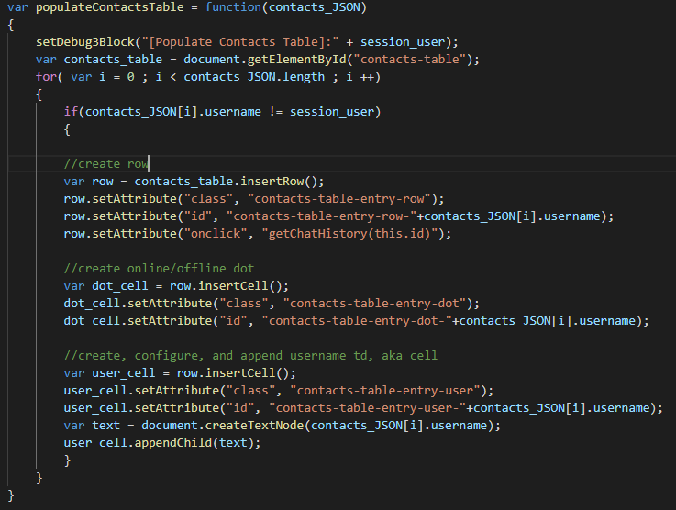
Populate Contacts Container
<table class = "contacts-table-class" id="contacts-table">
<tr id="contacts-entry-row-USERNAME1">
<tr id="contacts-entry-user-USERNAME1">
<tr id="contacts-entry-dot-USERNAME1">
Text Node w Text = USERNAME1
<tr id="contacts-entry-row-USERNAME2">
<tr id="contacts-entry-dot-USERNAME2">
<tr id="contacts-entry-user-USERNAME2">
Text Node w Text = USERNAME2
.
.
.
.
.
.
<tr id="contacts-entry-row-USERNAMEx">
<tr id="contacts-entry-dot-USERNAMEx">
<tr id="contacts-entry-user-USERNAMEx">
Text Node w Text = USERNAMEx

Slide 15
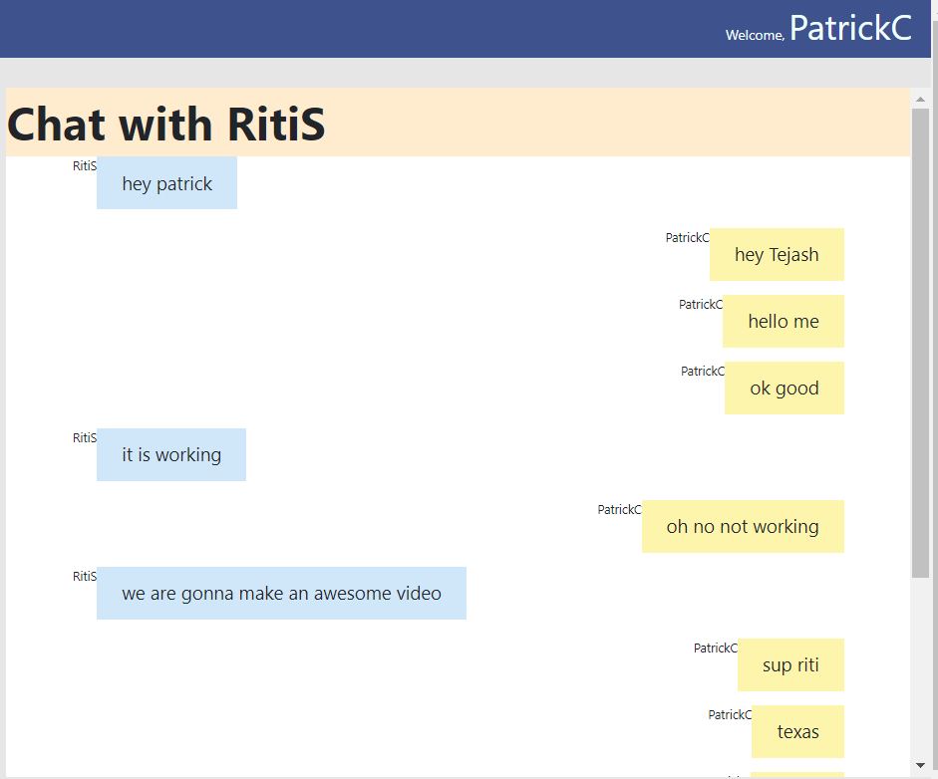
View Chat History
The client/server exchange (UML diagram) and populating the chat history container is very similar to the contacts table
Click row in Contacts container, get receiver username from Row Id
If current other user is not the same as the username from Row ID, remove current messages and download new message history
Message data model = { sender, receiver, content}
DB query = SELECT * FROM messages where
{sender: session_user, receiver: other_user} OR
{sender: other_user, receiver: session_user}
4. Chat container implemented w <div> not table elements

Slide 16
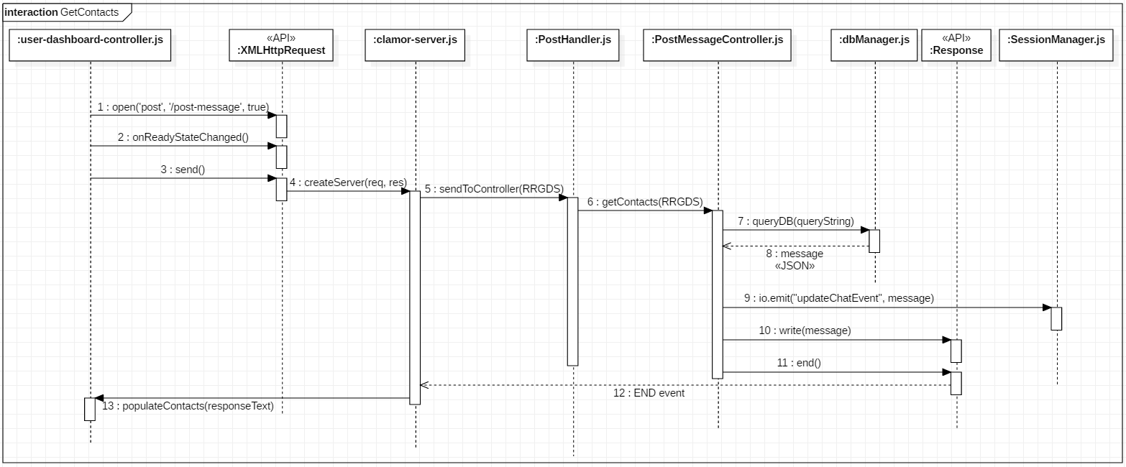
Send Message: Sequence Diagram
Message = { sender_username: PatrickC, receiver_username: RitiS, content: Hello, world! }
Socket.io API enables BROADCAST, which is used to implement instant notifications

Slide 17

Send Message: Broadcast
Socket.io creates for custom EventListener and EventEmitters using a socket object
When the message is inserted into DB, the SessionManager emits a message event
Server instigates communication (not usual client-server request/response)
Clamor-Server.js
SessionManager.js
MichaelV
[Opera]
Socket.io
Request
BROADCAST
Client 4
Response
RitiS
[Edge]
PatrickC
[Chrome]
TanmayaB
[Firefox]
Client 3
Client 1
Client 2
*The session user for each client is the person who logged in

Slide 18
Deploy On Heroku Cloud
New database connection
ClearDB Heroku Add-On
Poll connection to prevent timeout
In future, include DB connection as environment variable
Created Procfile to set main entry point
Create package.json file that pointed to package-lock.json

Slide 19
fin
Q/A

