Slide 1
Netzwerk Architekturen

Slide 2
Simons ANN
Params
S₀
R₂
Y
v
x_{nb}
1D GRE data
without air and CSF
8 GE from ?? to ??
Delta GE
Concat
Fully connected
N=10
Act = tanh
Fully connected
N = 5
Act = Linear params
QSM
Loss Function:
Levenberg-Markqward

Slide 3
2D Fully Conv Simple
Params
GRE data
without air and CSF
16 GE from 3 to 48
Delta GE = 3 ms
SE at 40 ms
Conv2D
1: S₀
Conv2D
1: R₂
Concat
Conv2D
Conv2D
Conv2D
1: Y
Conv2D
1: v
QSM
Conv2D
1: x_{nb}
Activation:
linear or double ReLU
Kernel Size 3
Stride 1
Dilation 1
Activation tanh
Padding Same
Conv2D
N_Filters
Loss Function:
Mean Absolute Error
or MSE

Slide 4
2D Fully Conv Separate QSM+qBOLD
Params
GRE data
without air and CSF
16 GE from 3 to 48
Delta GE = 3 ms
SE at 40 ms
Conv2D
1: S₀
Conv2D
Conv2D
Conv2D
1: R₂
Concat
Conv2D
Conv2D
Conv2D
1: Y
Conv2D
1: v
QSM
Conv2D
Conv2D
Conv2D
1: x_{nb}
Activation:
linear or double ReLU
Kernel Size 3
Stride 1
Dilation 1
Activation tanh
Padding Same
Conv2D
N_Filters
Loss Function:
Mean Absolute Error
or MSE

Slide 5
Simple Segmentation 2D
Types
Conv2D
3
Tissue
CSF
Air
GRE data
with air and CSF
16 GE from 3 to 48
Delta GE = 3 ms
SE at 40 ms
Segmentation
Conv2D
8
Conv2D
16
Conv2D
32
Kernel Size 3
Stride 1
Dilation 1
Activation tanh
Padding Same
Conv2D
N_filters
Loss Function:
SparseCategoricalCrossentropy

Slide 6
Model with Segmentation
Segmentation (Tissue, CSF, Air)
Params
Conv2D
8
Conv2D
16
Conv2D
32
Conv2D
3
GRE data
with air and CSF
16 GE from 3 to 48
Delta GE = 3 ms
SE at 40 ms
Conv2D
S₀
qBOLD
Conv2D
R₂
Conv2D
16
Conv2D
32
Conv2D
48
Combination
Concat
Conv2D
Y
Conv2D
32
Conv2D
64
Conv2D
128
Conv2D
v
QSM Map
QSM
Conv2D
16
Conv2D
32
Conv2D
x_{nb}
Kernel Size 3
Stride 1
Dilation 1
Activation tanh
Padding Same
Conv2D
N_filters
Loss Function:
Mean Absolute Error

Slide 7
Model with Segmentation Alternative
GRE data
with air and CSF
16 GE from 3 to 48
Delta GE = 3 ms
SE at 40 ms
qBOLD
Conv2D
16
Conv2D
32
Conv2D
48
Params
Conv2D
S₀
Conv2D
R₂
Segmentation (Tissue, CSF, Air)
Combination
Conv2D
8
Conv2D
16
Conv2D
32
Conv2D
3
Conv2D
Y
Concat
Conv2D
32
Conv2D
64
Conv2D
128
Conv2D
v
QSM
QSM Map
Conv2D
16
Conv2D
32
Conv2D
x_{nb}
Kernel Size 3
Stride 1
Dilation 1
Activation tanh
Padding Same
Conv2D
N_filters
Loss Function:
Mean Absolute Error

Slide 8
Enforcing Physics

Slide 9
Calculate v
Params
GRE data
with air and CSF
16 GE from 3 to 48
Delta GE = 3 ms
SE at 40 ms
Conv2D
S₀
Conv2D
R₂
ANN
Conv2D
Y
Conv2D
v
Comparison
only v
or
all 5 Params
Conv2D
x_{nb}
Concat
Conv2D
?
Conv2D
?
QSM Map
Lambda
Calculate v

Slide 10
Calculate QSM+qBOLD
Params
GRE data
with air and CSF
16 GE from 3 to 48
Delta GE = 3 ms
SE at 40 ms
Conv2D
S₀
Lambda
qBOLD 2D
Conv2D
R₂
Training on real data possible
ANN
Conv2D
Y
Conv2D
v
QSM Map
Lambda
QSM 2D
Conv2D
x_{nb}

Slide 11
Calculate QSM+qBOLD Grid Search
Expand each voxel to a grid
Lambda
qBOLD 2D
Params
Params
Conv2D
S₀
GRE data
with air and CSF
16 GE from 3 to 48
Delta GE = 3 ms
SE at 40 ms
Reshape to 1D
voxelwise
S₀
Conv2D
S₀
Conv2D
R₂
Conv2D
R₂
Reshape to 1D
voxelwise
R₂
Combination
Concat
Conv2D
Y
Conv2D
Y
Reshape to 1D
voxelwise
Grad Y
Conv2D
32
Conv2D
64
Conv2D
128
ANN
Conv2D
v
Conv2D
v
Reshape to 1D
voxelwise
Grad
v
Use Stride size and no padding to reduce 2D back to 1D with optimal value for each voxel
Pooling for less memory?
QSM Map
Conv2D
x_{nb}
Conv2D
x_{nb}
Reshape to 1D
voxelwise
x_{nb}
Lambda
QSM 2D
Tensor gets very very big

Slide 12
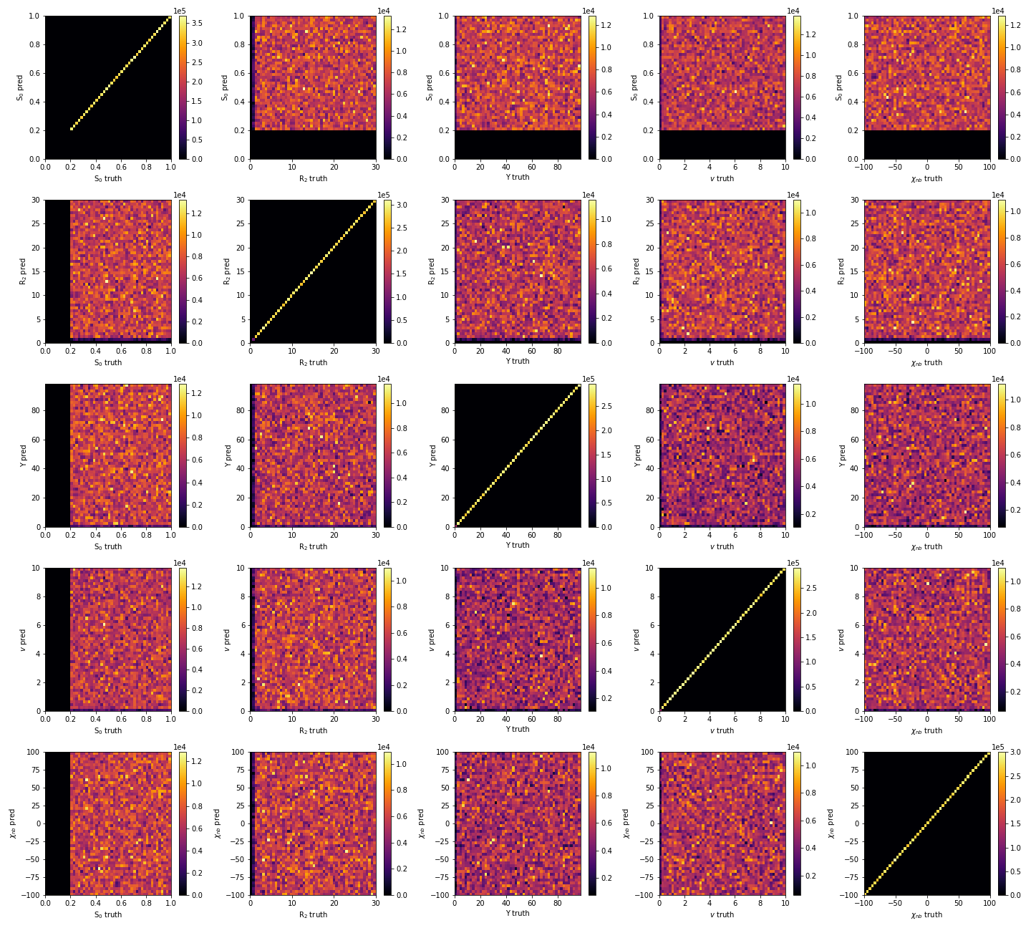
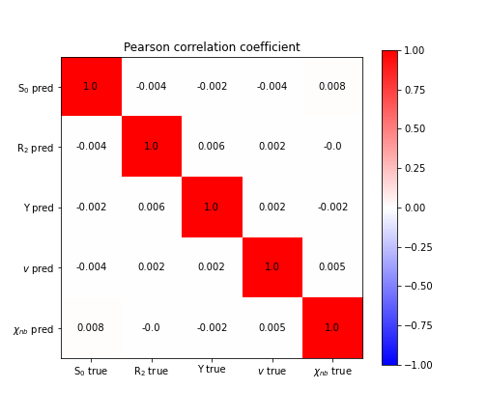
Testing Models and Visualizing Results

Slide 13
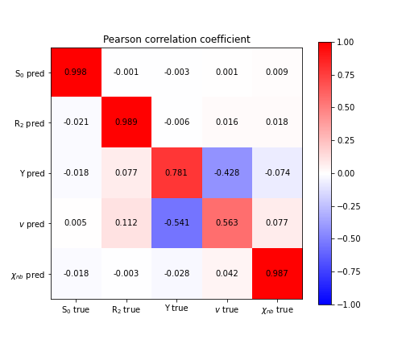
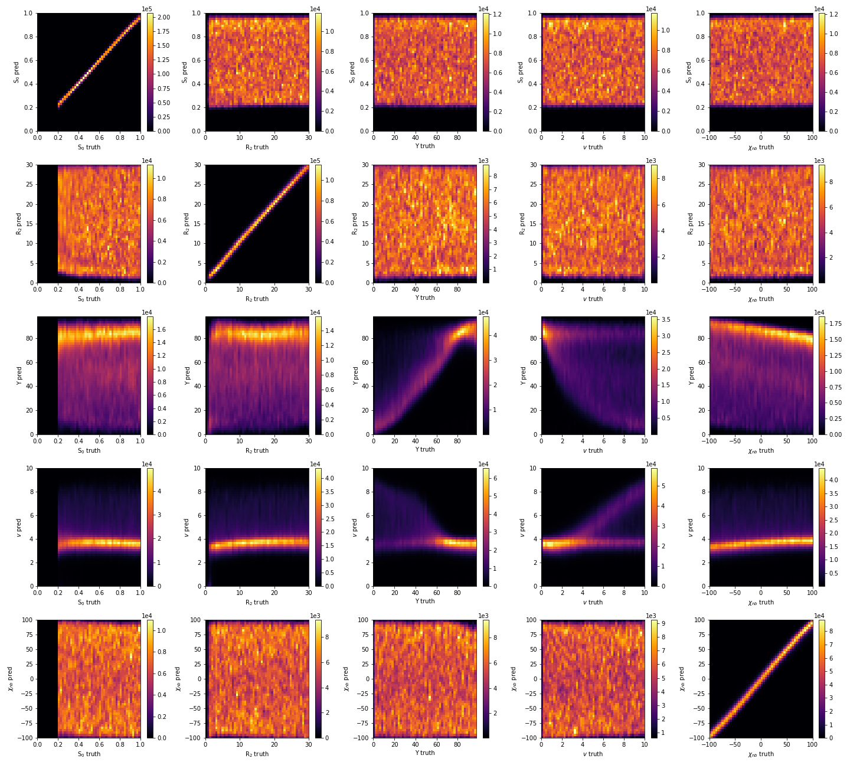
Testing Models and Visualizing Results

