Slide 1
跑步聊天室

Slide 2
dependencies
TECH
REACT
REDUX
Windowing
DND
TypeScript
Style
ANT DESIGN
SCSS

Slide 3
feature
外觀
效能
傳送訊息

Slide 4
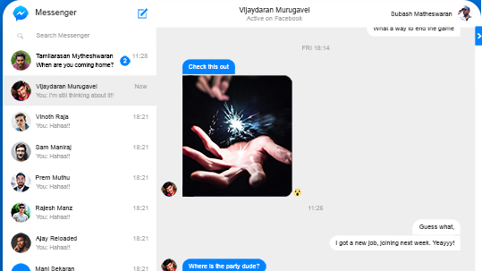
View

Slide 5
Structure
Main
SideBar
Header
ChatroomList
Chatroom
Header
SearchBar
MessageList
InputForm

Slide 6
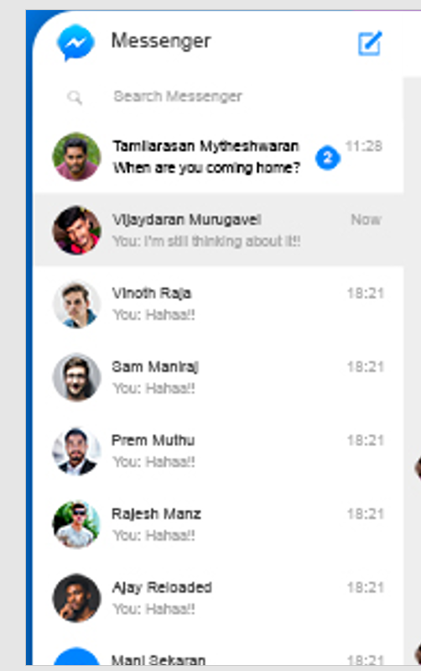
SideBar
HeaderBar
SearchBar
ChatList

Slide 7

HeaderBar
Icon
App name
New chat

Slide 8

SearchBar
icon
Input

Slide 9
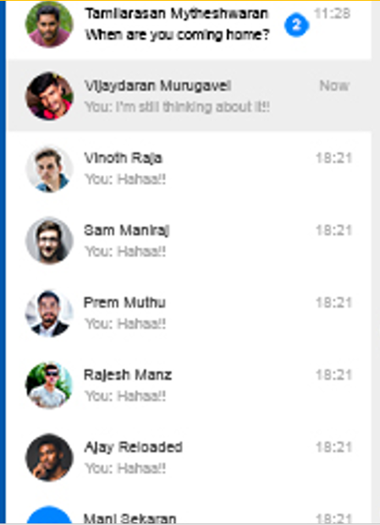

Chat list
ChatItem
Img
name
LastestText
time

Slide 10
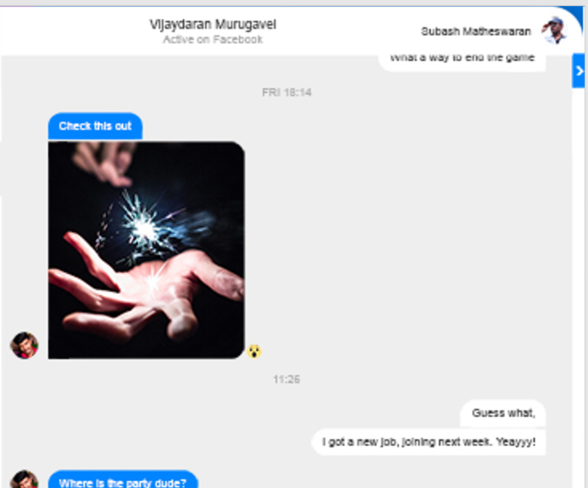
ChatScreen
CurrentTarget
Dialogue

Slide 11
CurrentTarget
Name
Active on Facebook?
Subash?
img

Slide 12
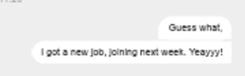

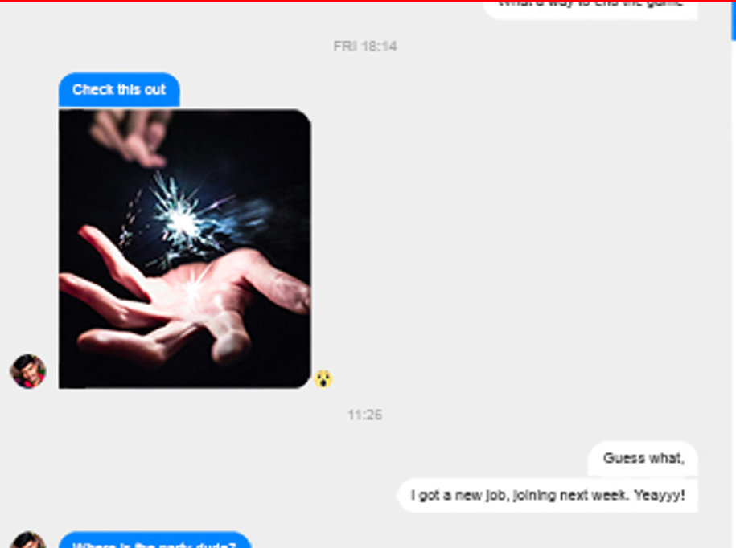
Dialogue
LocalUser
RemoteUser
AvatorImg
Text

