Slide 1


A Mobile Traffic Predictor Enhanced by Neighboring Transportation Data (MTP-NT)
Programa de Pós-Graduação em Ciência da Computação
Patrick Luiz de Araújo
Defesa de dissertação de mestrado em ??/??/????

Slide 2
Contents
Introduction
Related Work
Preliminaries on data collection for MTP-NT
Framework structure and fundamentation
Experimental results
Final considerations and future work

Slide 3
Data per month, per smartphone in 2028
Introduction
5 billion
5G subscribers in 2028
19 GB/month
100 exabytes
Data per quarter in 2028
Fonte: Ericsson Mobility Report, November 2022

Slide 4
Introduction
To
New 5G networks will count on
Allocate the maximum amount of users
Core Network (CN) based on Virtual Network Functions (VNF) over a Network Function Virtualization (NFV)² topology
Cloud and edge computing³
Use Machine Learning (ML) and other predictive tools
Optimize network operability
Reach 5G QoS/QoE metrics¹
1ms latency
low energy consumption
High coverage
Intelligent caching in network edge
Cloud computing optimization
[1] AGIWAL, M.; ROY, A.; SAXENA, N. Next generation 5g wireless networks: A comprehensive survey. IEEE Communications Surveys Tutorials, v. 18, n. 3, p. 1617–1655, 2016.
[2] Sun, Y. et al. Application of machine learning in wireless networks: Key techniques and open issues. IEEE Communications Surveys Tutorials, v. 21, n. 4, p. 3072–3108, 2019.
[3] ALAWE, I. et al. Improving traffic forecasting for 5g core network scalability: A machine learning approach. IEEE Network, v. 32, n. 6, p. 42–49, 2018.
Notes:
NFV: topologia usando cloud e/ou edge
Estruturas com a capacidade que necessitam, economizando recursos
Vai passar a ter gerenciamento de rede unificado

Slide 5
Introduction
AI models advantages
Limitants
Enough data?
Pertinent information?
Response time
Return Over Investiment – ROI
Rely on historical data¹²³
Can be less complex than conventional approaches⁴
Robust patterns and best overall performance⁵
[1] Wang, X. et al. Spatio-temporal analysis and prediction of cellular traffic in metropolis. In: 2017 IEEE 25th International Conference on Network Protocols (ICNP). [S.l.: s.n.], 2017. p. 1–10
[2] Wang, J. et al. Spatiotemporal modeling and prediction in cellular networks: A big data enabled deep learning approach. In: IEEE INFOCOM 2017 - IEEE Conference on Computer Communications. [S.l.: s.n.], 2017. p. 1–9.
[3] CHEN, X. et al. Analyzing and modeling spatio-temporal dependence of cellular traffic at city scale. In: 2015 IEEE International Conference on Communications (ICC). [S.l.: s.n.], 2015. p. 3585–3591.
[4] SUN, H. et al. Learning to optimize: Training deep neural networks for wireless resource management. In: 2017 IEEE 18th International Workshop on Signal Processing Advances in Wireless Communications (SPAWC). [S.l.: s.n.], 2017. p. 1–6.
[5] Sun, Y. et al. Application of machine learning in wireless networks: Key techniques and open issues. IEEE Communications Surveys Tutorials, v. 21, n. 4, p. 3072–3108, 2019.
Notes:
Modelos de IA
Dependem de dados históricos
Menos complexos: implementação de um alocador de potência menos complexo que o Weighted Minimum Mean-Square Error (WMMSE)

Slide 6
tl;dr
Enough Data
Innovation
Compatible responsiveness
Performance
Notes:
Estes são os desafios a atentar-se em uma implementação de ML em 5G

Slide 7
Mobile Traffic Predictor Enhanced by Neighboring Transportation Data MTP-NT
City of Milan Dataset¹
Scalable public transport and neighboring data
Open source
Lightweight, adaptable and highly performant
State-of-art performance
Network usage
Geolocalized tweets
Weather
Electricity
News
[1] Barlacchi, G. et al. A multi-source dataset of urban life in the city of milan and the province of trentino. Sci Data 2, 2015.
Notes:
Dados
GDPR: politica de dados robusta
Dados de 1/nov/2013 até 31/dez/2013
Inovação
Uso pioneiro de dados de transporte público
Dados e modelagem abertas
Leve
Escalável através do volume de dados ingeridos
Vários volumes validados
Performático
Performance
Mas também oportunidade
80% das torres carregam 20% do tráfego;
50% carregam 5%;
0,35% carregam 50% de todo o volume

Slide 8
Contents
Introduction
Related Work
Preliminaries on data collection for MTP-NT
Framework structure and fundamentation
Experimental results
Final considerations and future work

Slide 9
Metrics and mathematical characteristics of network usage
Related work
Characterization
Prediction
Mathematical models to predict network traffic

Slide 10
Regions of the city grouped based on network usage patterns¹ Composition of trimodal distributions to describe the network traffic² Sand temporal distribution of the network traffic results into extremely insufficient utilization of network resources² Traffic was concentrated in some regions (city center) and peak hours³
Related work - Characterization
[1] Xu, F. et al. Understanding mobile traffic patterns of large scale cellular towers in urban environment. IEEE/ACM Transactions on Networking, v. 25, n. 2, p. 1147–1161, 2017.
[2] WANG, H. et al. Characterizing the spatio-temporal inhomogeneity of mobile traffic in large-scale cellular data networks. In: Proceedings of the 7th International Workshop on Hot Topics in Planet-Scale MObile Computing and
Online Social NeTworking. New York, NY, USA: Association for Computing
Machinery, 2015. (HOTPOST ’15), p. 19–24. ISBN 9781450335171. Disponível em: <https://doi.org/10.1145/2757513.2757518>.
[3] Gotzner, U.; Rathgeber, R. Spatial traffic distribution in cellular networks. In: VTC
’98. 48th IEEE Vehicular Technology Conference. Pathway to Global Wireless
Revolution (Cat. No.98CH36151). [S.l.: s.n.], 1998. v. 3, p. 1994–1998 vol.3.
Notes:
Em (1)
Regiões da cidade são agrupadas com base no seu padrão de uso
Padrão de uso evidenciam a natureza organizacional da cidade
Indicando correlação e causualidade

Slide 11
Related work - Prediction
Pure Time Series Function (TSF) and Non-TSF problem¹
1989
1991
2017
2021
AutoRegressive Moving Average (ARIMA) and Neural Network model training with Simulated Annealing (SA)⁷
In-tower and inter-tower traffic analysis through a Graph Neural Network (GNN)⁶
Recurrent Neural Network and usage of global + local autoencoders⁵
MLP to network traffic forecasting⁴
[1] BOUTABA, R. et al. A comprehensive survey on machine learning for networking: evolution, applications and research opportunities. Journal of Internet Services and Applications, Springer, v. 9, n. 1, p. 1–99, 2018.
[2] CYBENKO, G. Approximation by superpositions of a sigmoidal function. Mathematics of control, signals and systems, Springer, v. 2, n. 4, p. 303–314, 1989.[3] Funahashi, 1989
[4] HORNIK, K. Approximation capabilities of multilayer feedforward networks. Neural networks, Elsevier, v. 4, n. 2, p. 251–257, 1991.[5] Wang, 2017a
[6] Wang, X. et al. Spatio-temporal analysis and prediction of cellular traffic in metropolis. In: 2017 IEEE 25th International Conference on Network Protocols (ICNP). [S.l.: s.n.], 2017. p. 1–10.
[7] YANG, H. et al. A network traffic forecasting method based on sa optimized arima–bp neural network. Computer Networks, v. 193, p. 108102, 2021. ISSN 1389-1286. Disponível em: <https://www.sciencedirect.com/science/article/pii/ S1389128621001821>.
Single Layer Perceptron (SLP) to traffic perdiction³
Multi Layer Perceptrion (MLP) to traffic perdiction²

Slide 12
2844 Base Stations (BSs) in Suzhou 500m²x 500m² Uses the neighborhood concept LSTM Cells paired with Global and Local Autoencoders
Related work – Wang 2017a
Source: Wang, 2017a

Slide 13
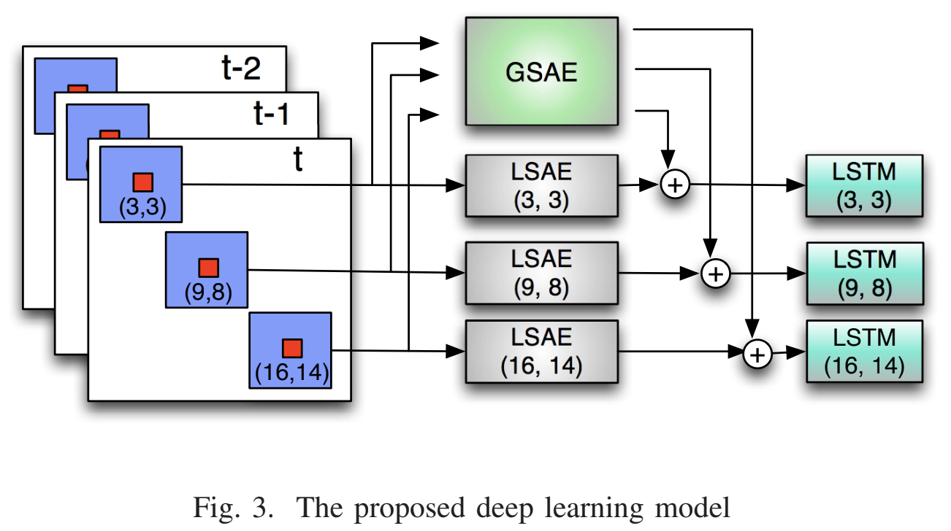
Related work – Wang 2017a
Source: Wang, 2017a

Slide 14
5929 Base Stations (BSs), 1.5 million users In-tower and inter-tower traffic Temporal correlations between physically distant towers Graph Neural Network (GNN) architecture
Related work – Wang 2017b
Source: Wang, 2017b
Notes:
Correlações causadas por modais de transporte cada vez mais eficientes

Slide 15
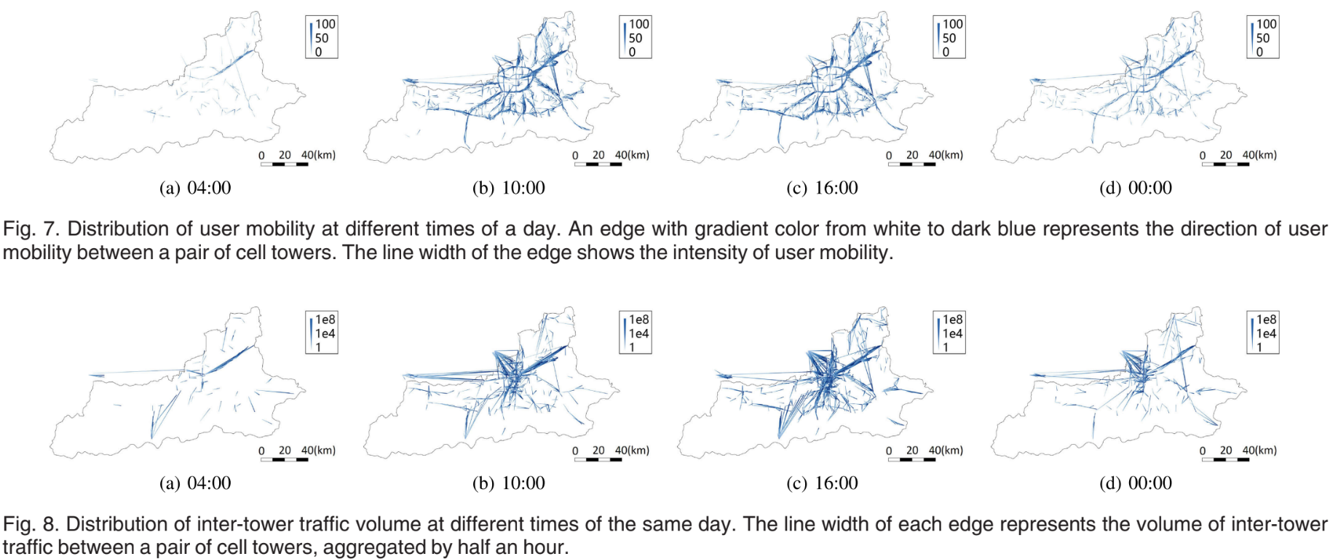
Related work – Wang 2017b
Source: Wang, 2017b
Notes:
Correlações causadas por modais de transporte cada vez mais eficientes

Slide 16
Related work – Summary
Ref. | Method | Dataset availability | Source code available
(Wang et al., 2017a) | Autoencoders | X | X
(Wang et al., 2017b) | Graph Neural Networks | X | X
(Sciancalepore et al., 2017) | Holt Winters | No information | X
(ALAWE et al., 2018) | Deep Learning | X | X
(YANG et al., 2021) | ARIMA and Neural Network | ✓ | X
Notes:
Cada um considera métodos de modelagem diferentes
De qualquer forma, o custo computacional tende a ser maior com técnicas mais complexas

Slide 17
Related work – Summary
Ref. | LSTM | Time series | Grid arrange | Neighborhood concept | Spatial modelling | Residual/aperiodic events | Network traffic consumption characterization
Wang et al., 2015 |  |  |  |  |  |  | ✓
Wang et al., 2017a | ✓ |  | ✓ | ✓ | ✓
Wang et al., 2017b |  | ✓ |  | ✓ | ✓ | ✓
YANG et al., 2021 |  | ✓
Gotzner; Rathgeber, 1998 |  |  |  |  |  |  | ✓
BOUTABA et al., 2018 |  |  |  |  |  |  | ✓
Notes:
Cada um considera métodos de modelagem diferentes
De qualquer forma, o custo computacional tende a ser maior com técnicas mais complexas

Slide 18
Contents
Introduction
Related Work
Preliminaries on data collection for MTP-NT
Preliminaries
The predictive model in the 5G infrastructure
Data Flow
Dataset used in this work
Mathematical formalization
Framework structure and fundamentation
Experimental results
Final considerations and future work

Slide 19
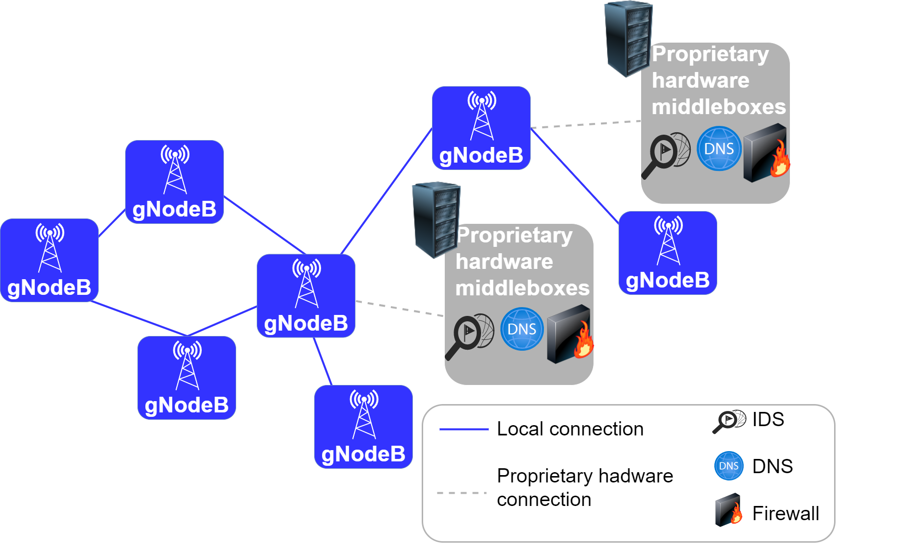
Preliminaries on data Collection for MTP-NT – The predictive model in the 5G Infrastructure
Source: the author
Notes:
Serviços baseados em hardware proprietário, tais como:
IDS
Proxy
Criptografia
Monitoramento de rede
Desvantagens
Ciclo de aquisição -> treinamento -> deploy custosos e rápidos
Sistema estático
Não escalável
Dependente do fornecedor
Padrões fechados

Slide 20


Hardware middleboxes become software functions Rely on dedicated hardware and/or cloud
Preliminaries on data Collection for MTP-NT – The predictive model in the 5G Infrastructure
Network Function Virtualization (NFV)
Notes:
Serviços baseados em hardware proprietário, tais como:
IDS
Proxy
Criptografia
Monitoramento de rede
Desvantagens
Ciclo de aquisição -> treinamento -> deploy custosos e rápidos
Sistema estático
Não escalável

Slide 21
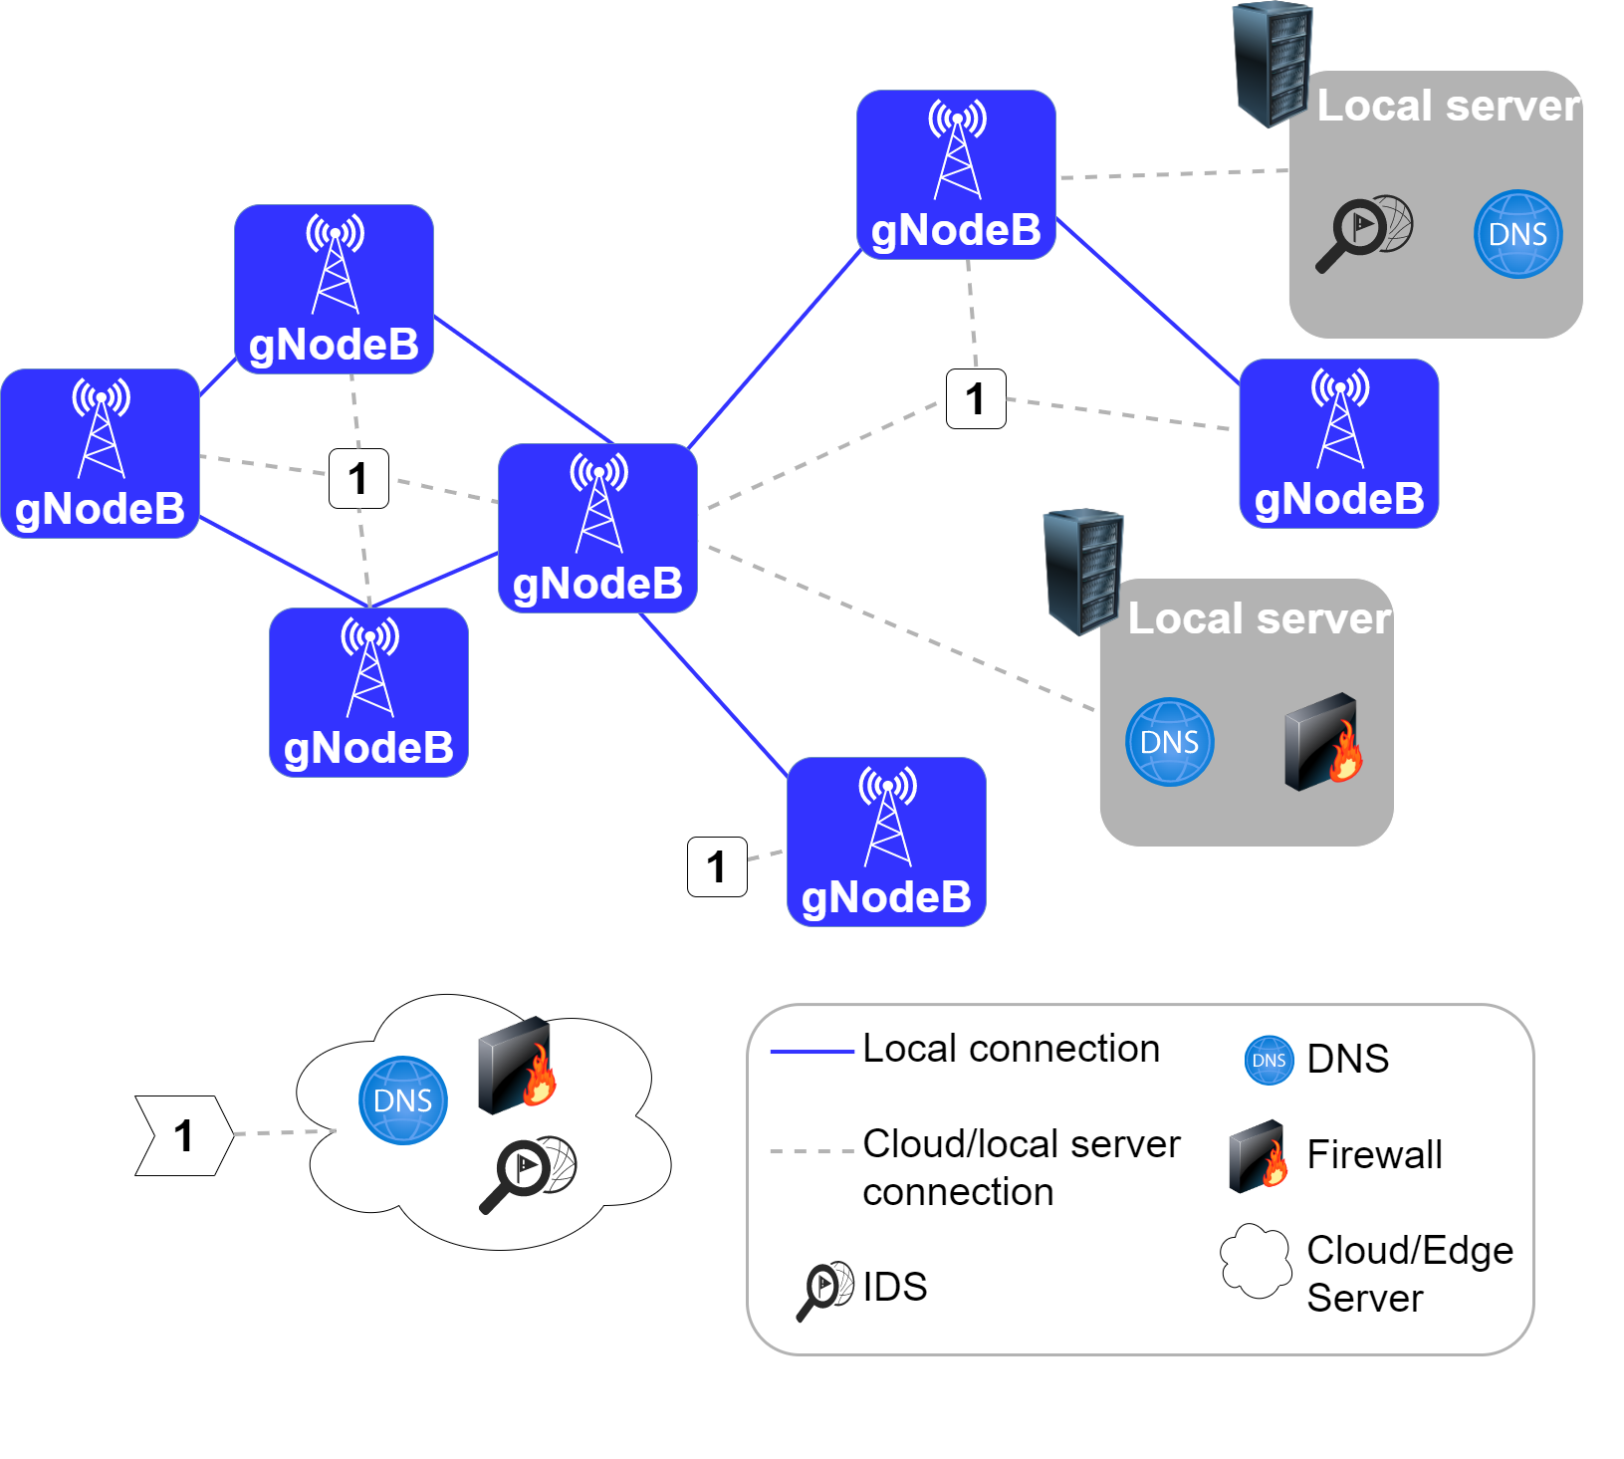
Preliminaries on data Collection for MTP-NT – The predictive model in the 5G Infrastructure
Source: the author
Notes:
Nessa nova infraestrutura, um novo recurso passa a ser valioso: os recursos computacionais
Orquestrador
Encontra o melhor arranjo com base em métricas
Network Traffic Monitoring and Analysis (NTMA)
VNF
Previsão de tráfego de rede

Slide 22
Main advantages according to European Telecommunications Standards (ETSI)¹
Preliminaries on data Collection for MTP-NT – The predictive model in the 5G Infrastructure
NFV as a service²
Virtualization of Core Network (CN) and Base Stations (BSs)³
Virtualization of home environment⁴
Virtualization of CDNs^{5,6}
[1] ETSI
[2] Rankothge
[3] Basta
[4] Bronstein
[5] Manglini
[6] Kim, Lee
Notes:
Alguns pontos de atenção
- Latêcia geral de uma cadeia de middleboxes

Slide 23
Network Traffic Monitoring and Analysis Also a NFV Problems
Preliminaries on data Collection for MTP-NT – The predictive model in the 5G Infrastructure
Network usage
Orchestrator
NTMA
Problems
Volume
Velocity
Volume
Velocity
Notes:
Nessa nova infraestrutura, um novo recurso passa a ser valioso: os recursos computacionais
Orquestrador
Encontra o melhor arranjo com base em métricas
Network Traffic Monitoring and Analysis (NTMA)
VNF
Previsão de tráfego de rede

Slide 24
How does it flow? How to store? Is there a open standard?
Preliminaries on data Collection for MTP-NT – The predictive model in the 5G Infrastructure
Network usage
Orchestrator
NTMA
Notes:
Nessa nova infraestrutura, um novo recurso passa a ser valioso: os recursos computacionais
Orquestrador
Encontra o melhor arranjo com base em métricas
Network Traffic Monitoring and Analysis (NTMA)
VNF
Previsão de tráfego de rede

Slide 25
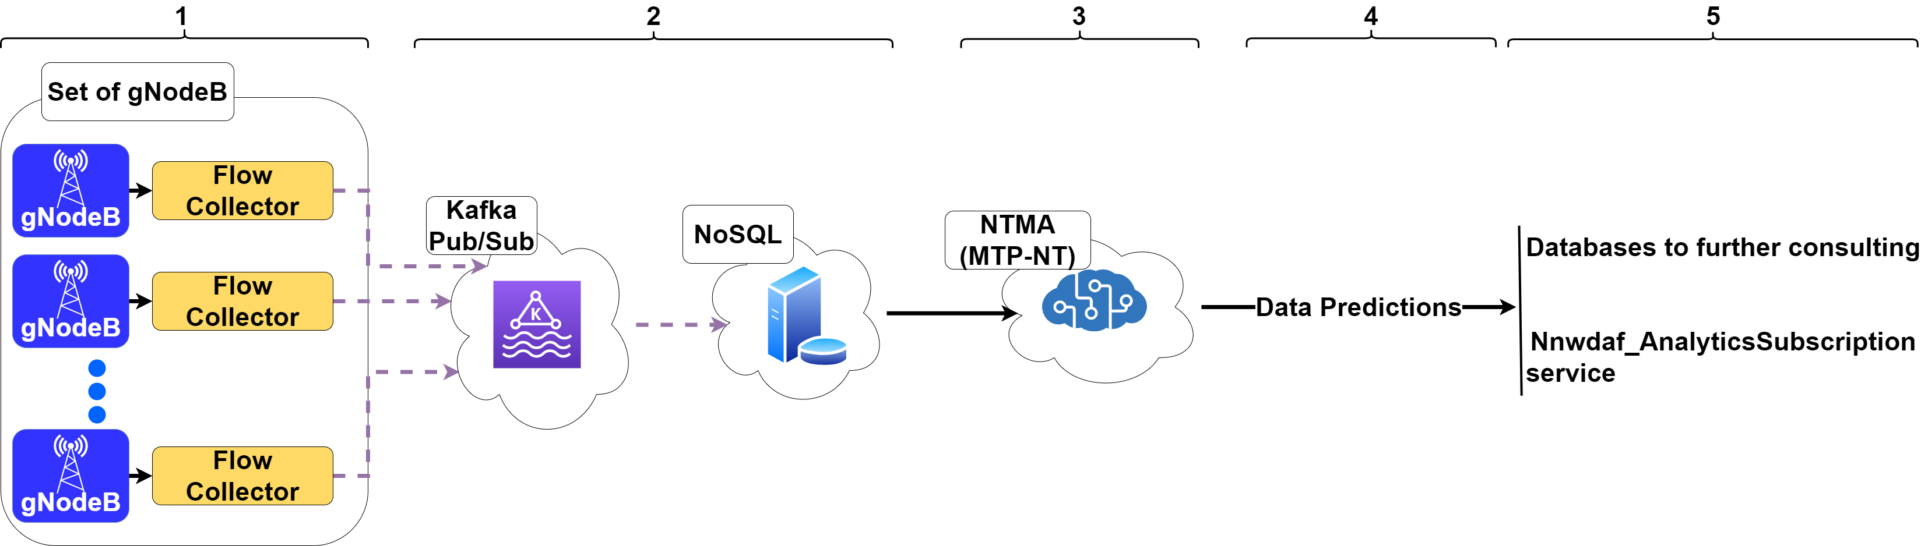
Flow collectors/Network exporters and collectors Radio Access Network (RAN) layer Network Data Analytics Function (NWDAF)¹
Preliminaries on data Collection for MTP-NT – Data flow
[1] 3GPP, 2022
Notes:
NWDAF é uma interface padrão do 5G
Pode se comunicar com a camada Policy Control Function (PCF)
PCF: camada de gestão de políticas de fatiamento
Podem se comunicar por uma interface N23
Também pode se comunicar com uma função Network Slice Selection Function (NSSF)
Pode se comunicar por uma interface N34

Slide 26
NoSQL¹² Less performance penalties with large datasets Popular open source solutions
Preliminaries on data Collection for MTP-NT – Data flow
[1] Han 2011
[2] D Alconzo 2019a
Notes:
Armazenado para análises futuras

Slide 27
The data is pulled by the MTP-NT, which can be seen as a NTMA
Preliminaries on data Collection for MTP-NT – Data flow
[1] 3GPP, 2022

Slide 28
Preliminaries on data Collection for MTP-NT – Data flow
Notes:
Bases para registro das predições
Nnwdaf_AnalyticsSubscription service
- Serviço Publisher-subscriber
- Uso interno no core 5G

Slide 29
Preliminaries on data Collection for MTP-NT – Data flow
Notes:
Alguns pontos de atenção
- Latêcia geral de uma cadeia de middleboxes

Slide 30
Database to Milan and Trento from November 1st to December 31st of 2013¹
Preliminaries on data Collection for MTP-NT – Dataset used in this work
Grid (Telecom Italia)
Social Pulse (Spazio Dati, DEIB)
Telecommunications (Telecom Italia)
Precipitations (Metereotrentino, ARPA)
Weather (ARPA)
Electricity (SET Distribuizione SPA)
News (Citynews)
[1] Barlacchi
Notes:
Nem todas as bases de dados foram exploradas
Escolheu-se a cidade de Milão

Slide 31
Telecommunications dataset from Milan
Preliminaries on data Collection for MTP-NT – Dataset used in this work
10,000 zonal regions in a 100x100 regular grid
Each regions is a square of 0.06km²
One log at every 10 minutes in every region
Call Detail Records (CDRs)
Notes:
Os grids são regulares apesar da cobertura das torres não ser
- Anonimização dos dados que será explorada mais adiante

Slide 32

Anonymization of data
Preliminaries on data Collection for MTP-NT – Dataset used in this work
GDPR compliant
Protects the real infrastructure capabilities
Each parameter $f$ is multiplied by a anonymization constant $k_{f}$
Notes:
De acordo com a GDPR: não possibilita rastreamento de um único usuário
Também mantém reservado a capacidade real da infraestrutura da Telecom Italia

Slide 33
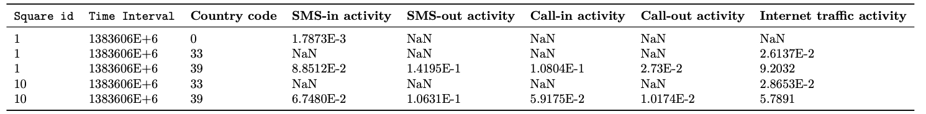
Preliminaries on data Collection for MTP-NT – Dataset used in this work
Notes:
De acordo com a GDPR: não possibilita rastreamento de um único usuário
Também mantém reservado a capacidade real da infraestrutura da Telecom Italia

Slide 34
Preliminaries on data Collection for MTP-NT – Dataset used in this work
Notes:
De acordo com a GDPR: não possibilita rastreamento de um único usuário
Também mantém reservado a capacidade real da infraestrutura da Telecom Italia

Slide 35
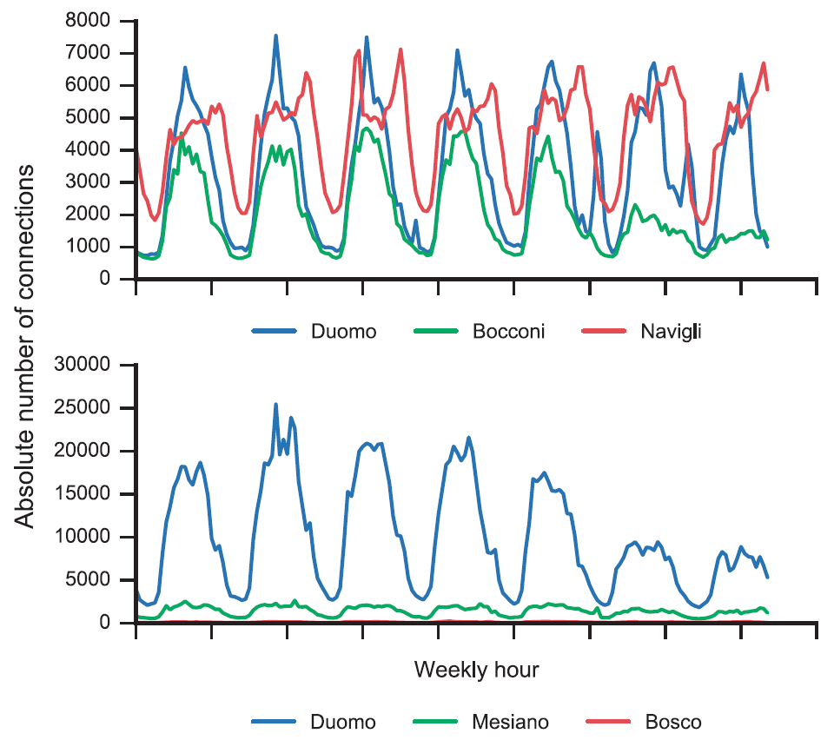
Preliminaries on data Collection for MTP-NT – Dataset used in this work
Source: Barlacchi
Notes:
Gráfico superior
Cada região tem seu padrão de tráfego
Bocconi: universidade; redução do tráfego aos finais de semana
Duomo e Navigli: tráfego mais intenso, majoritariamente de regiões turísticas
Navigli: bairro turístico com grande tráfego no período noturno
Gráfico inferior
- Bosco fica quase imperceptível por ser menos movimentado

Slide 36
Sudden changes in network usage can make predictions inaccurate¹ Despite changes, patterns can be identified and models could be developed² Traffic “hubs” can be a good source of information to traffic prediction^{3,4}
Preliminaries on data Collection for MTP-NT – Dataset used in this work
[1] D’Alconzo, 2019b
[2] Pirozmand, 2014
[3] Wang 2015
[4] Wang 2017b
Notes:
Sudden changes:
Rede pode ter um comportamento irregular
Fundamentalmente, em redes móveis, estamos falando do comportamento humano
Traffic “hubs”:
Pessoas se deslocam em transporte público
Transporte cada vez mais eficiente
Cria correlações entre regiões fisicamente distantes

Slide 37
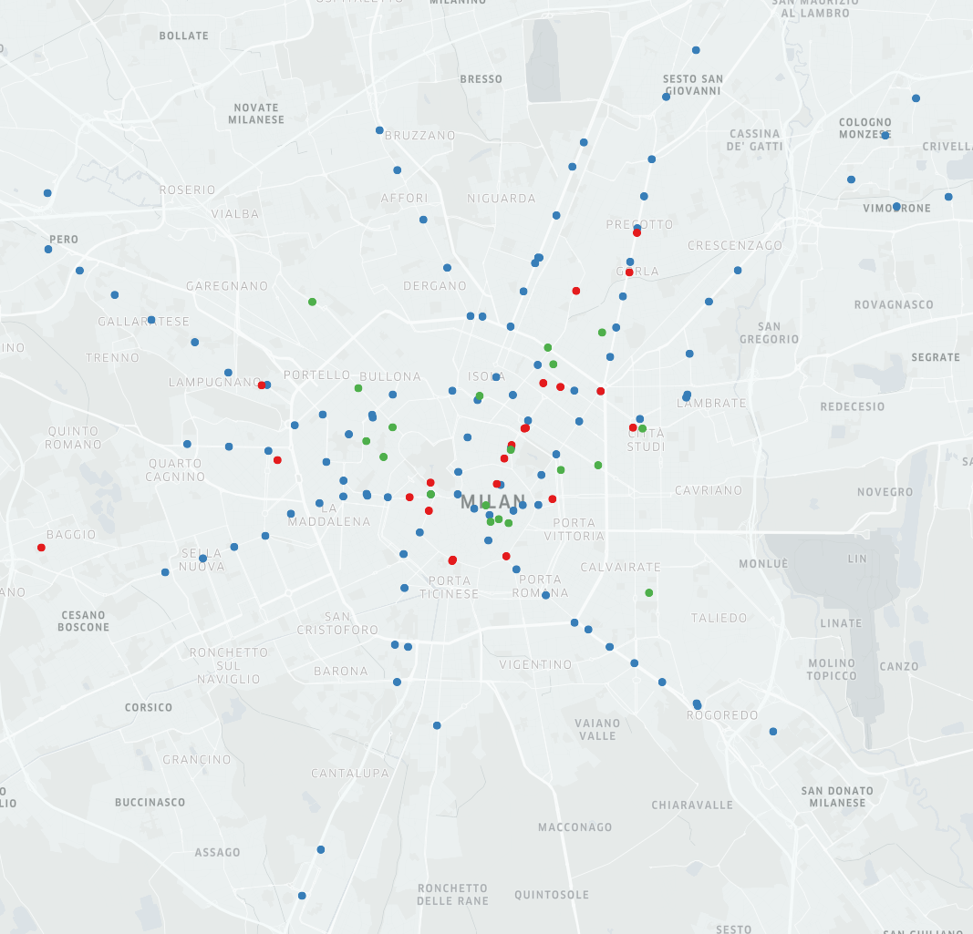
Preliminaries on data Collection for MTP-NT – Dataset used in this work
Source: the author
Notes:
Azul: metro
Verde: bonde
Vermelho: ônibus
Dados coletados com a API do Google Maps

Slide 38



10,000 regions 1 CDR sample for each 10 minutes, from November 1st to December 31st of 2013. Total: 8928 traffic samples for each region
Preliminaries on data Collection for MTP-NT – Mathematical formalization
Region $m,n$ for $m,n$ between 0 and 99
$$x^{m,n}(t)$$
Time period $t$ between $13832604E+5$ to $13886166E+45$

Slide 39

Moore neighborhood
Preliminaries on data Collection for MTP-NT – Mathematical formalization
$$\left|m−m’\right| ≤d, \left|n−n’\right|≤d$$
For a region $x^{m,n}$ the group of neighbors $N$ within a degree $d$ of distance is the group ${N\left(x^{m,n}\right)}_{d}$
$${N\left(x^{m,n}\right)}_{d}=\left\{x^{m,n}|\left|m−m’\right| ≤d, \left|n−n’\right|≤d ∀m, n, m’, n’ ∈\left\{0,1,…,99\right\}\right\}$$

Slide 40
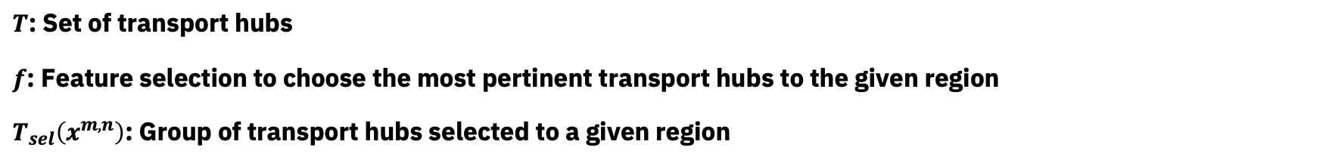
$T$: Set of transport hubs $f$: Feature selection to choose the most pertinent transport hubs to the given region $T_{sel}\left(x^{m,n}\right)$: Group of transport hubs selected to a given region
Preliminaries on data Collection for MTP-NT – Mathematical formalization
$$T_{sel}\left(x^{m,n}\right)=\left\{x^{m’,n’}|f_{sel}\left(x^{m,n}\left(t\right),x^{m’,n’}(t)\right)∀x^{m’,n’}∈T\right\}$$

Slide 41
Contents
Introduction
Related Work
Preliminaries on data collection for MTP-NT
Framework structure and fundamentation
Mathematical formalization
Overview of the framework architecture
Experimental results
Final considerations and future work

Slide 42
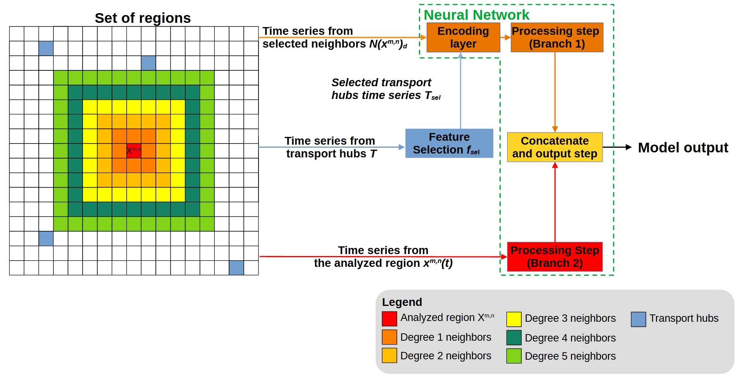
Framework structure and fundamentation – Mathematical formalization
Notes:
Branch 1
Input data from the selected neighbords
Selected time series transport hubs

Slide 43
Framework structure and fundamentation – Mathematical formalization
Notes:
Branch 2
Vizinhos selecionados com base na distância de Moore
Séries temporais dos hubs de transporte selecionados
Algumas técnicas de seleção de variáveis foram testadas
A melhor seleção foi o uso dos 20 hubs mais próximos

Slide 44
Framework structure and fundamentation – Mathematical formalization

Slide 45
Thanks!
A Mobile Traffic Predictor Enhanced by Neighboring Transportation Data (MTP-NT)
Patrick Luiz de Araújo
patrick@ufu.br
Prof. Dr. Rafael Pasquini
rafael.pasquini@ufu.br
Prof. Dr. Murillo Guimarães Carneiro
mgcarneiro@ufu.br

