Slide 1
Linux Administration Final Presentation
Patrick Morley

Slide 2
Weekly Accomplishments
Week Ending 10/26
Accomplishment: Figured out how to set up wifi network on my raspberry pi CentOS server
Accomplishment: Figured out how to extend root partition on my CentOS server to create more space so I could finish installing my programs
Challenge: Having difficulty creating script for network dump
Week Ending 11/02
Accomplishment: Completed all of continued set up for my Ubuntu server
Challenge: Having difficulty installing Fail2Ban, cowsay and fortune
Week Ending 11/09
Accomplishment: Completed script for network dump on my Ubuntu server
Challenge: Researching iptables and firewalls, a lot of information
Week Ending 11/16
Accomplishment: Completed script for network dump on my CentOS server
Accomplishment: Completed continued set up for my CentOS server
Accomplishment: Revised Getting your systems set up, SetUp documentation, and uploaded all revised and completed work to github

Slide 3
More Weekly Accomplishments
Challenge: Figured out how to SSH into my raspberry pi from my laptop at home, but still having trouble accessing it from a different location.
Week Ending 11/23
Accomplishment: Completed my Pecha Kucha presentation for Internship program
Challenge: Started having problems with my raspberry pi not updating and downloading
Week Ending 11/30
Accomplishment: Completed Splunk Fundamentals I
Challenge: Catching up on reading and working on firewalls
Week Ending 12/07
Accomplishment: Completed User Management/Uploaded to github
Accomplishment: Completed Firewalls/Uploaded to github
Challenge: Completing remaining assignments and final presentation
Week Ending 12/14
Accomplishment: Completed final presentation/Uploaded to github
Accomplishment: Learned a lot in this class. Became more comfortable with scripting, Linux and servers
Challenge: Finished all reading but couldn’t finish all assignments

Slide 4
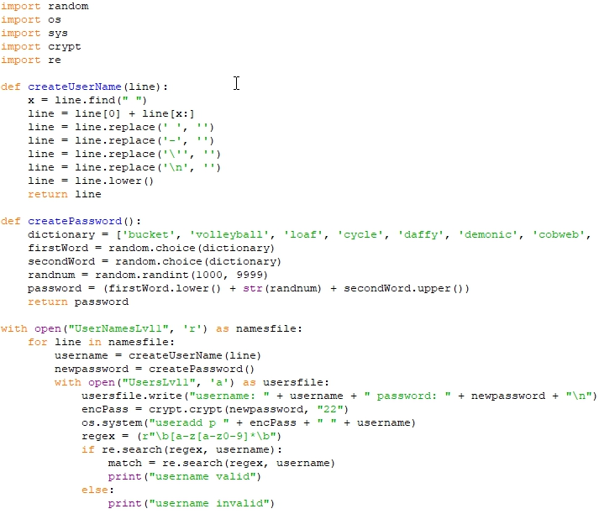

Slide 5
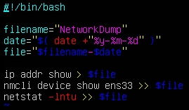
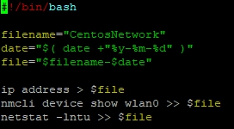
Network Dump Scripts

Slide 6
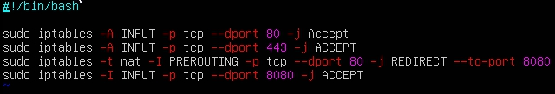
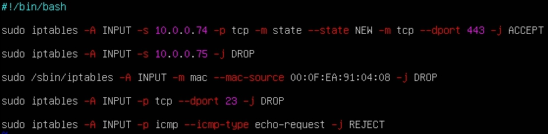
Firewall Rules

Slide 7
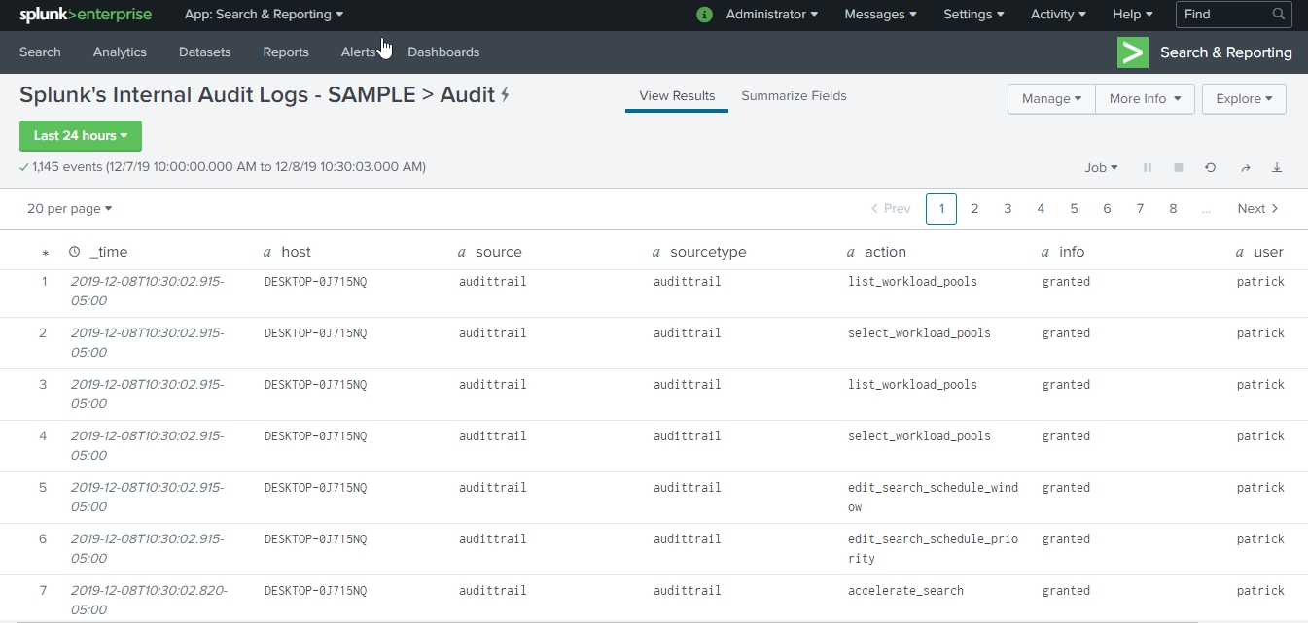

Slide 8
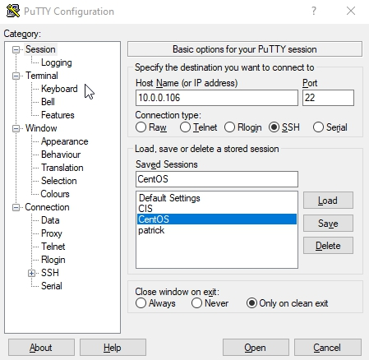
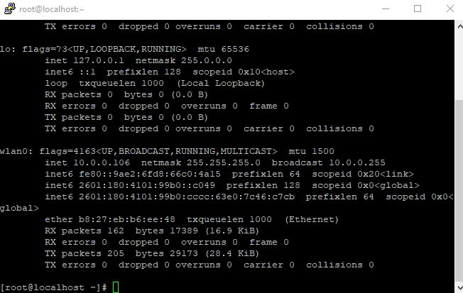
SSH Into CentOS Server

Slide 9
Sites Cited
https://www.digitalocean.com/community/tutorials/iptables-essentials-common-firewall-rules-and-commands
https://www.crybit.com/how-to-save-current-iptables-rules/
https://www.thegeekstuff.com/2011/03/iptables-inbound-and-outbound-rules/
https://www.digitalocean.com/community/tutorials/iptables-essentials-common-firewall-rules-and-commands
https://support.rackspace.com/how-to/best-practices-for-firewall-rules-configuration/
https://downloads.mysql.com/docs/mysql-port-reference-en.pdf
https://vitux.com/how-to-block-allow-ping-using-iptables-in-ubuntu/
https://phoenixnap.com/kb/how-to-enable-ssh-centos-7
https://itsfoss.com/ssh-into-raspberry/
https://www.raspberrypi.org/documentation/remote-access/ssh/
https://unix.stackexchange.com/questions/370318/how-to-connect-to-wifi-in-centos-7clino-gui
https://www.networkworld.com/article/3262045/checking-your-network-connections-on-linux.html
http://www.linuxandubuntu.com/home/10-essential-linux-network-commands
https://www.cyberciti.biz/tips/iptables-mac-address-filtering.html
https://unix.stackexchange.com/questions/207697/how-to-block-telnet-using-iptables-command

Slide 10
PatrickMorley.github.io
The End

