Slide 1
Linux Administration Midterm Presentation
By Patrick Morley

Slide 2
Weekly Accomplishments
Week Ending 9/7
Accomplishment: Set up Ubuntu server on my laptop through Vmware
Accomplishment: Got started on user creation code using python
Challenge: Having trouble getting CentOS server on my raspberry pi 3 b+
Week Ending 9/14
Accomplishment: Helped more than 20 people at the library help desk solve problems they were having with printing, BB, excel, access, word and powerpoint.
Accomplishment: Learning how to navigate through my Ubuntu server, and completed the in-class assignment of finding where the different directories were located ( i.e. /etc, /bin)
Accomplishment: Created groups in my Ubuntu server
Challenge: Having trouble finishing the code for adding users to groups
Challenge: Still having trouble figuring out how to install CentOS on raspberry pi
Week Ending 9/21
Accomplishment: Finally got my CentOS server up and running on my raspberry pi
Accomplishment: Helped at least 25 people at the help desk
Accomplishment: Checked 30+ computers for printer errors and created a report for printer troubleshooting
Accomplishment: Figured out the regex for my user creation script
Challenge: Must research Sed and Awk commands

Slide 3
More Weekly Accomplishments
Week Ending 9/28
Accomplishment: Finally turned in my setup documentation and screenshots for Getting your systems set up part 1
Accomplishment: Figured out how to use WinSCP to transfer files from my host computer to my Vmware server
Challenge: Having some issues with the Sed command
Week Ending 10/05
Accomplishment: Completed Grep assignment
Accomplishment: Figured out the problem with my Sed command (there was a blank line in between each name)
Challenge: Researching Awk command
Week Ending 10/12
Accomplishment: Completed Sed and Awk assignment and enjoyed learning about them
Accomplishment: Continuing to build my servers and write the documentation
Challenge: Having a really hard time with the user script
Week Ending 10/19
Accomplishment: Helped a student over the phone with a powerpoint presentation while working the library help desk
Accomplishment: Did all the updates and install programs and worked with repositories on my Ubuntu server
Accomplishment: Almost finished documentation and midterm presentation
Challenge: Decided to change from using python to bash scripting for creating user script
Challenge: Having some trouble setting up security boot

Slide 4
Server Setup
Installed Ubuntu on VMware
Installed CentOS on Raspberry Pi
Maintained Documentation
Took many screenshots
Used WinSCP to transfer files to my Vmware
Googled Everything!

Slide 5
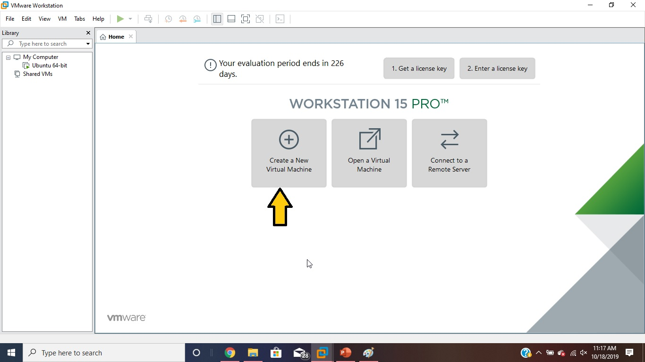
Creating a New Virtual Machine

Slide 6
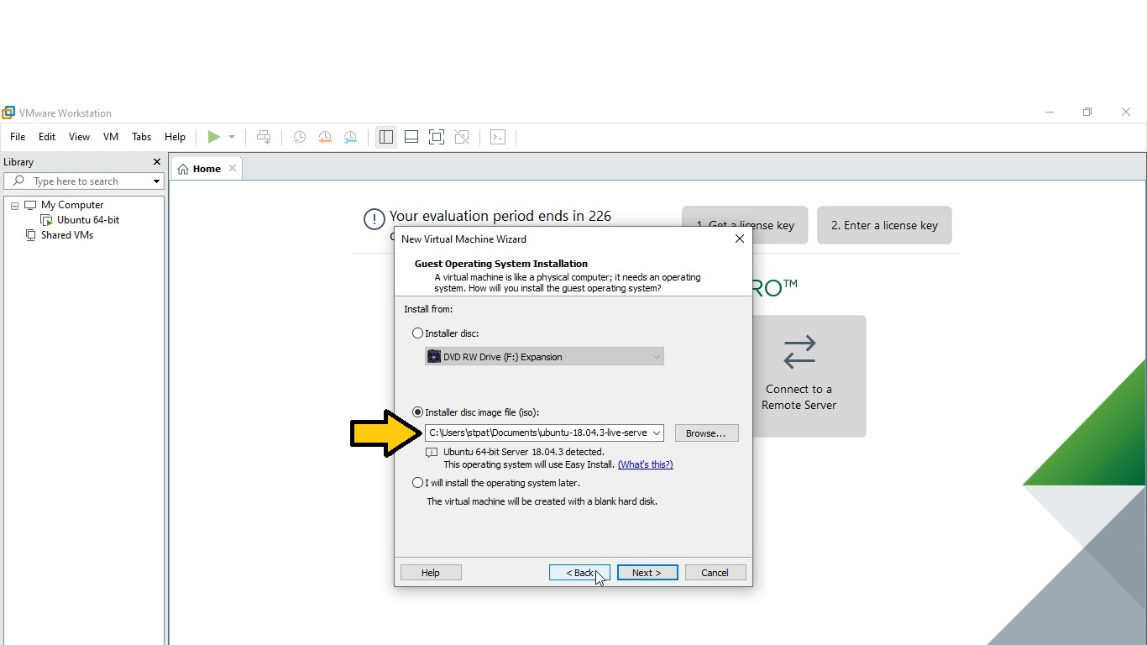
Select the Correct Server

Slide 7
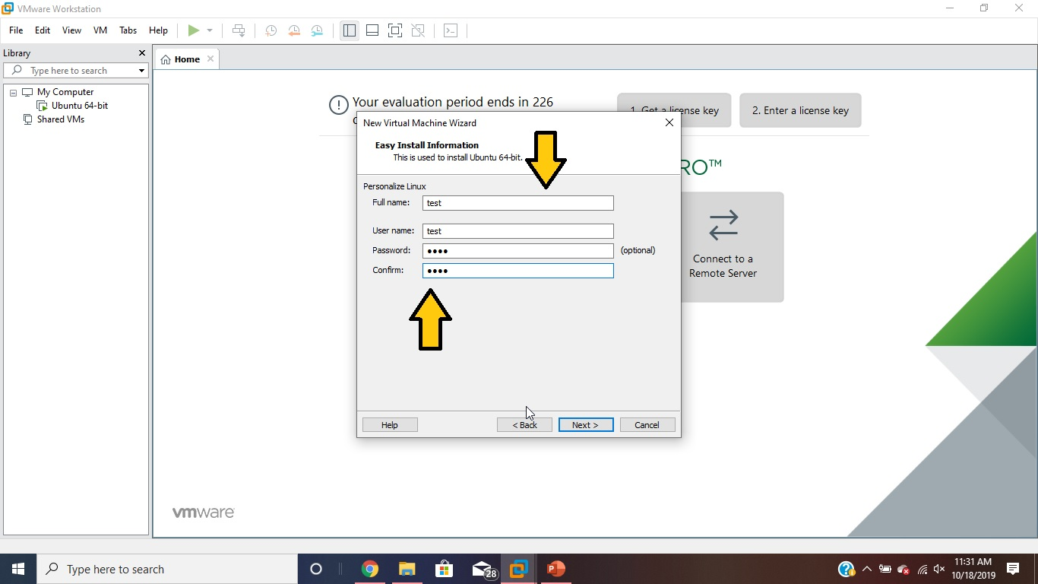
Enter Username and Password

Slide 8
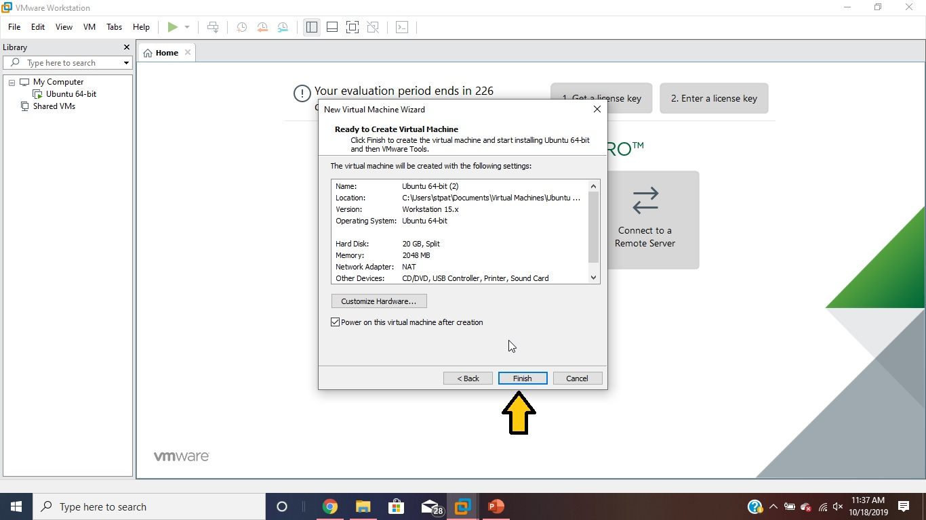
Follow all Prompts and Click Finish

Slide 9
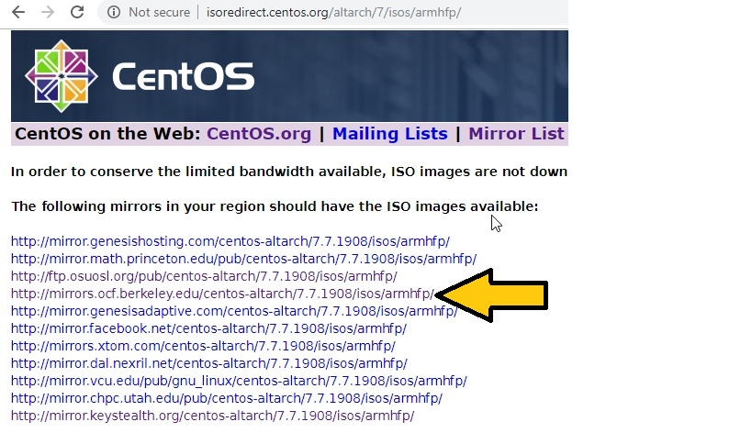
http://isoredirect.centos.org/altarch/7/isos/armhfp/

Slide 10
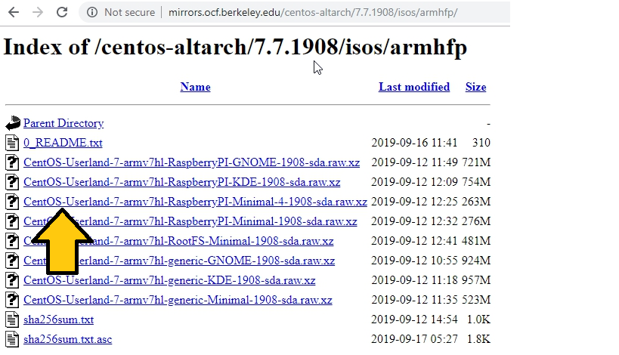
Select iso for raspberry pi without GUI

Slide 11
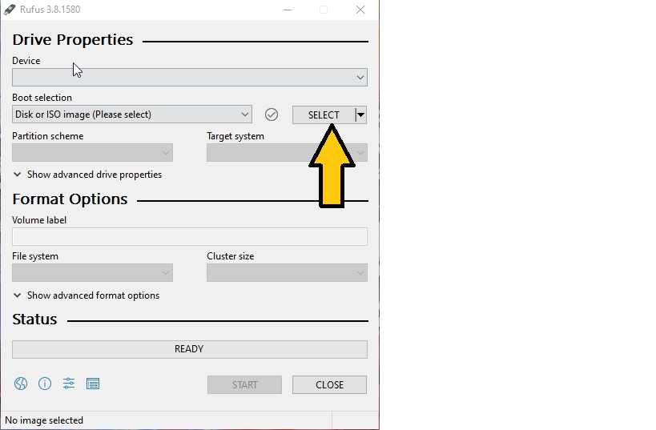
Open Rufus/Click select dropdown

Slide 12
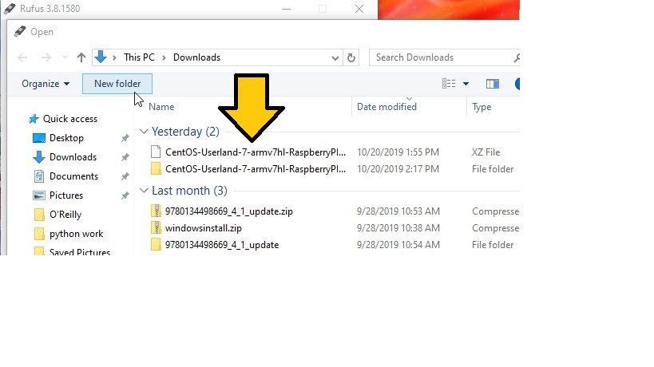
Select zipped CentOS Raspberry pi iso

Slide 13
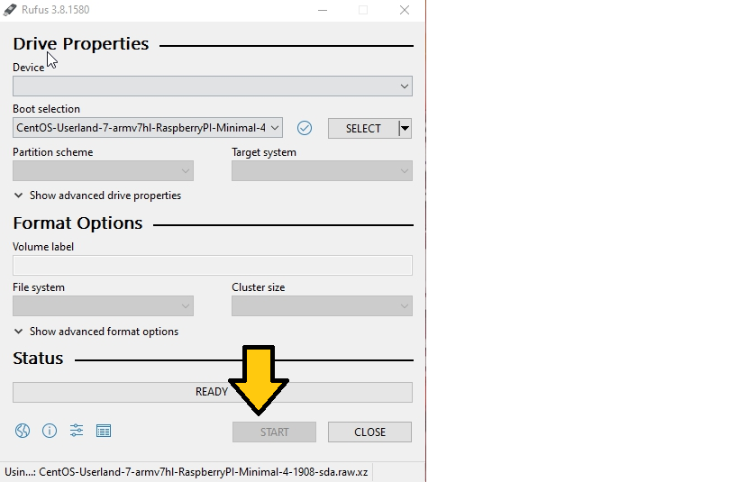
Start the process (Must have SD card or USB plugged in)

Slide 14
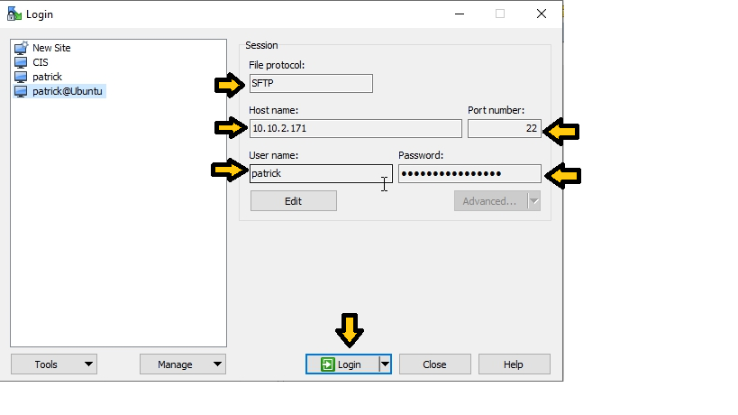
WinSCP Login

Slide 15
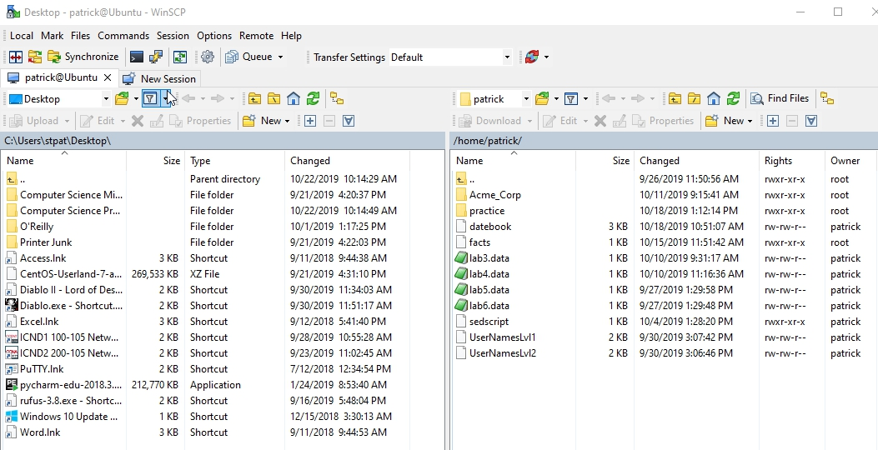
Transfer files from host computer to server

Slide 16
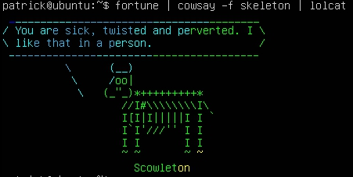
Fortune | cowsay –f skeleton | lolcat

Slide 17
Connect to wifi from raspberry pi
Chkconfig NetworkManager on
Service NetworkManager start
Nmtui
Follow the steps in the network manager text user interface to find and connect to your wifi

Slide 18
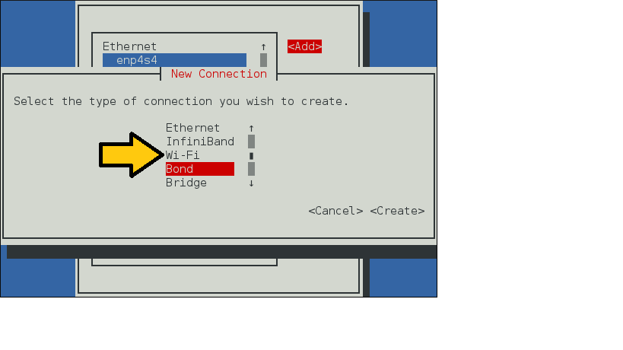
Select wifi

Slide 19
Expanding root partition
Yum install parted
Parted (start program)
Print (check partitions)
Resizepart, 3, 25000 (25GB)
Reboot
Fdisk /dev/mmcblk0, p (shows the partition was made larger)
Resize2fs /dev/mmcblk0p3 (expands the root file system)
E2fsck –f /dev/mmcblk0p3 (checks for errors)
Df –h (shows the root file system has now been made larger)

Slide 20
Cited Sites
Helped with CentOS
Helped with Ubuntu
https://www.tecmint.com/parted-command-to-create-resize-rescue-linux-disk-partitions/
https://gohgarry.wordpress.com/2017/10/29/expand-root-filesystem-using-cli-parted-reize2fs/
https://rharmonson.github.io/cos7instpi.html
https://unix.stackexchange.com/questions/370318/how-to-connect-to-wifi-in-centos-7clino-gui
https://o7planning.org/en/11299/installing-ubuntu-server-on-vmware
https://winscp.net/eng/docs/guide_connect
https://linoxide.com/linux-how-to/linux-fun-terminal-crazy-output/

Slide 21
PatrickMorley.github.io
The End

