Slide 1
LAUNDROMAT
SYSTEM
DOCUMENTATION
CREATED BY: Patrick Musaza
DATE: January-2026
Simple Format

Slide 2
Use Case Diagram
SDLC Document
Actors and core interactions for Smart Laundromat

Slide 3
ACTORS
Use Cases
Place Laundry Order
Select Wash Type (Hot / Cold)
Make Payment (Cash, Mobile Money, Card)
Print EBM Receipt
Customer (Walk-In)
Place & Track Delivery Order
Register for Loyalty
Switch Language
Staff (Employee)
Delivery Agent
Manage Prices & Promotions
Manage Machines & Users
Generate Reports
Monitor System
Accountant
Admin
Sync Offline Invoices
Configure Settings

Slide 4
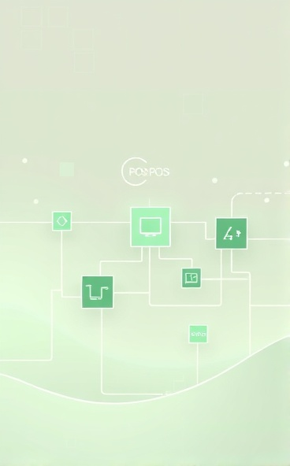
System Architecture
SDLC Document
System Components
Includes POS, Edge Server, IoT Devices, Receipt Printer, Cloud Backend, and Management Portal.

Slide 5
SDLC Document
Network
APIs
Router
RS 485 Gateway
Transaction Services
EBM Integration
LOCAL WORKSTATION
Hardware
Desktop App
Touchscreen Display
Receipt Printer
Customer Display
Touchscreen UI
Virtual Keyboard
Receipt Printer Controller
Local PostgreSQL
Offline Database
CLOUD INFRASTRUCTURE
MANAGEMENT PORTAL
(WEB)
RRA EBM Server
Production
Sandbox
UPS
BACKUP
Touchscreen Display
Receipt Printer
Customer Display
Cloud PostgreSQL
Master Database

Slide 6
Database Schema
SDLC Document
Tables to include:
Customers
Orders
OrderItems
Payments
Invoices
Machines
Users
Promotions
SyncQueue
Database Structure
Overview of database schema including SQLite and PostgreSQL with key tables.
To be detailed later

Slide 7
Class Diagram
SDLC Document
Classes
Include
Key classes include Customer, Order, OrderItem, Payment, Invoice, Machine, User, Role, Promotion, EBMService, IoTService, SyncManager.
Focus on attributes, methods, and relationships such as association and aggregation.

Slide 8
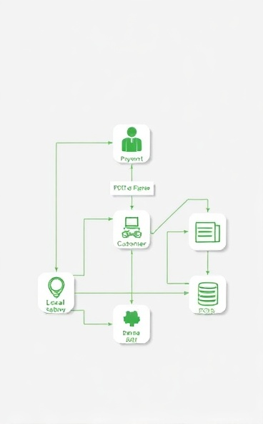
Data Flow Diagram
SDLC Document
Data Flow
Customer interacts with POS, which connects to various systems including Payment Gateway and Local Database.
Flow:
  Customer → POS
  POS → Payment Gateway
  POS → EBM System
  POS → Receipt Printer
  POS → Local Database
  Local Database → Cloud Backend

Slide 9
Sequence Diagram
SDLC Document
Customer interacts with POS, which connects to various systems including Payment Gateway and Local Database.

Slide 10
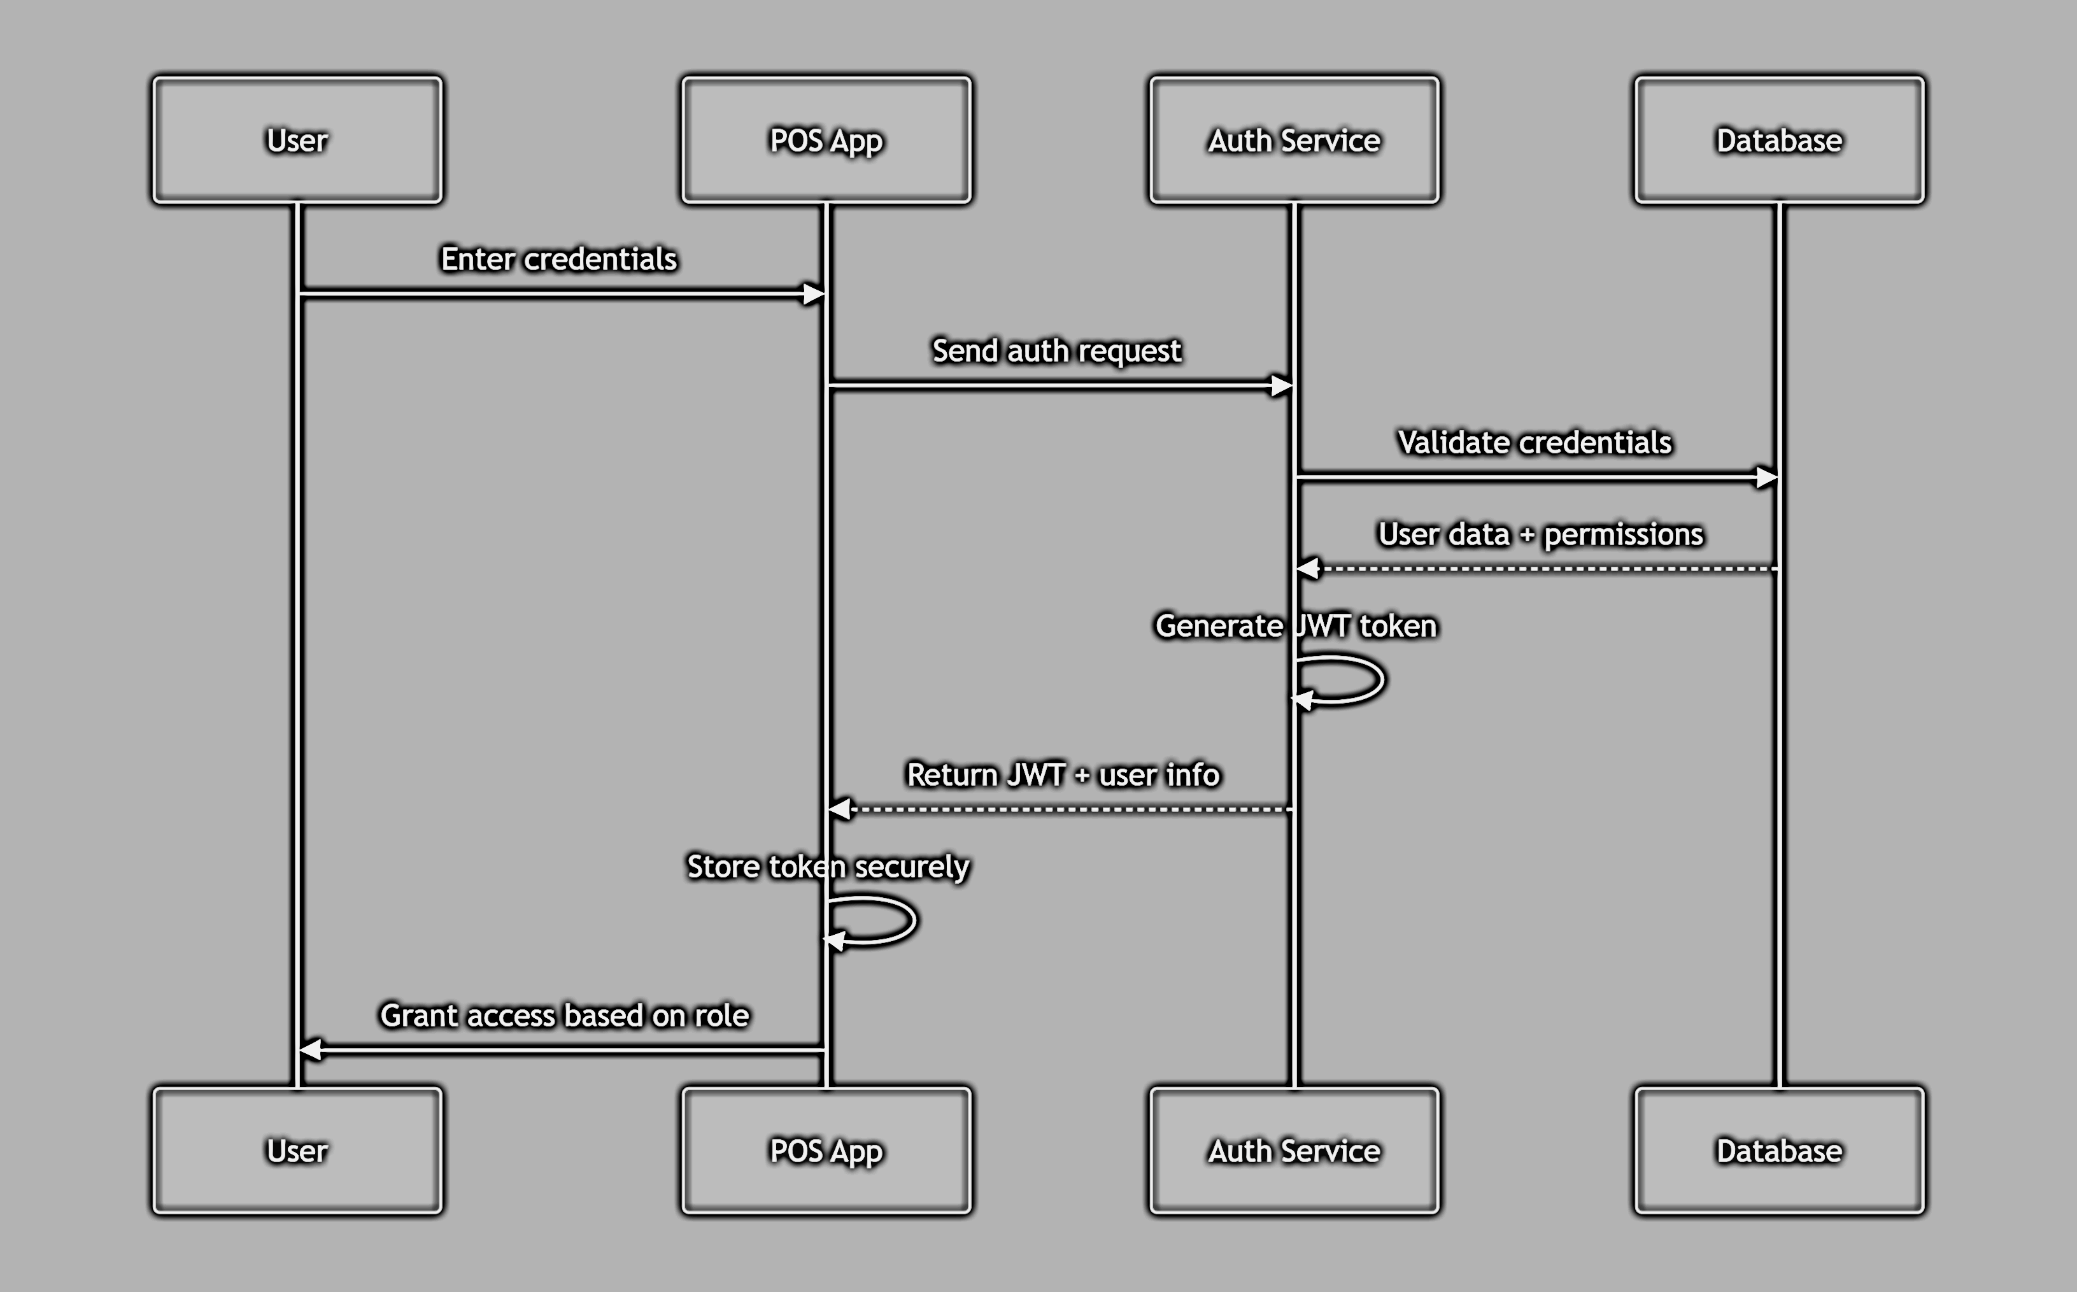
1
SDLC Document

Slide 11
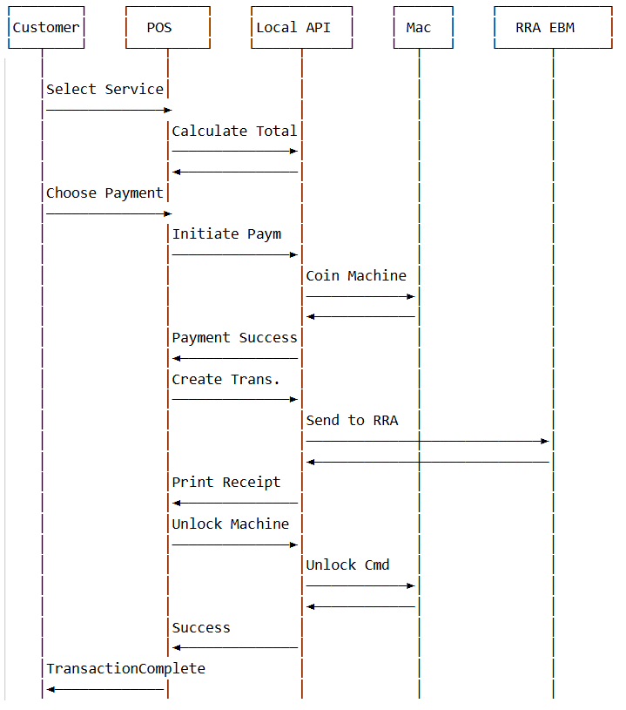
2

Slide 12
Activity Diagram
Start
SDLC Document
Select Service
Choose Water
Hot
End
Laundry Order Flow
Add Iron
Cold
Start Machine
Payment
Print Receipt
Generate Invoice

Slide 13
100-Day Timeline
Gantt Chart
Days 1–10
11–20
21–45
30–60
50–70
65–80
Requirements & Analysis
Architecture & UI Design
POS Development
Backend & Web Admin
IoT Integration
EBM Integration
Initial phase focusing on gathering requirements and analyzing project needs.
Designing the system architecture and user interface.
Development of the Point-of-Sale system.
Building backend systems and web administration tools.
Integrating Internet of Things components.
Integrating RRA Electronic Billing Machine systems.

