Slide 1

Recommender Systems for Electronic Commerce
By Patrick Nohra

Slide 2
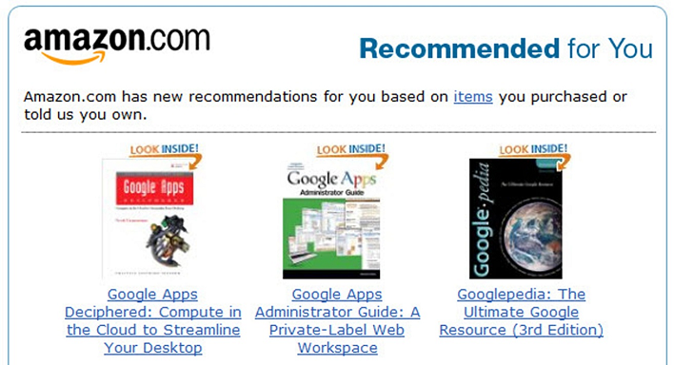

Slide 3
Approaches
Popularity based model
Collaborative Filtering
Model-Based collaborative filtering
Memory-Based Collaborative filtering

Slide 4
Popularity Based Models
Follows the trend.
Employs items that are currently popular.

Slide 5
Collaborative Filtering
techniques are designed to fill in the gaps in a user-item association matrix
predicts how someone would evaluate an item based on prior item evaluations from like people.

Slide 6
Model-Based CF
Model-based CF technique builds model by using existing relationships of users and items and learns the model to predict accurately.
Popular model-based techniques: Singular Value Decomposition (SVD), Matrix Factorization (MF), clustering, Bayesian networks etc.

Slide 7

Memory-Based CF
Finds a group of users with similar tastes by using similarity measures such as Pearson correlation, adjusted cosine similarities etc.
Then recommends items based on the choices of the similar users.

Slide 8
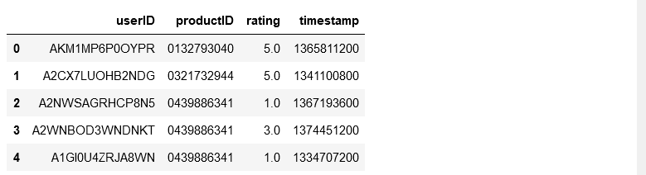
Dataset: Amazon Reviews Dataset

Slide 9
Amazon Reviews Dataset
Due to the limitations of this project, we had to drop the timestamp column and restrict our dataset to 50,000 observations only

Slide 10


Language
Python or R?

Slide 11
Libraries
Numpy
Pandas
Seaborn
Sklearn
Surprise

Slide 12
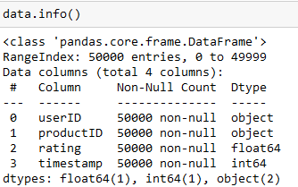
Data Preprocessing
The data we have already met all the preprocessing criterion.
There isn’t any null value that we have to deal with, and all the columns are formatted as we need them.

Slide 13
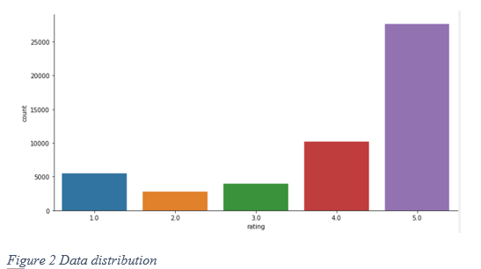
Analyzing the Dataset

Slide 14
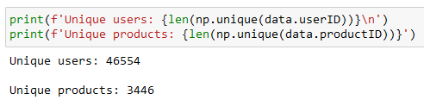
Analyzing the dataset (Contd...)

Slide 15
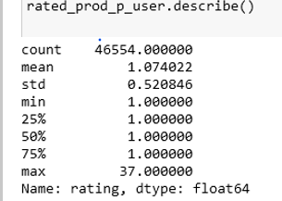
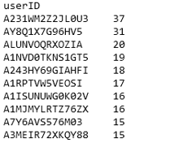
Analyzing the dataset (Contd...)

Slide 16
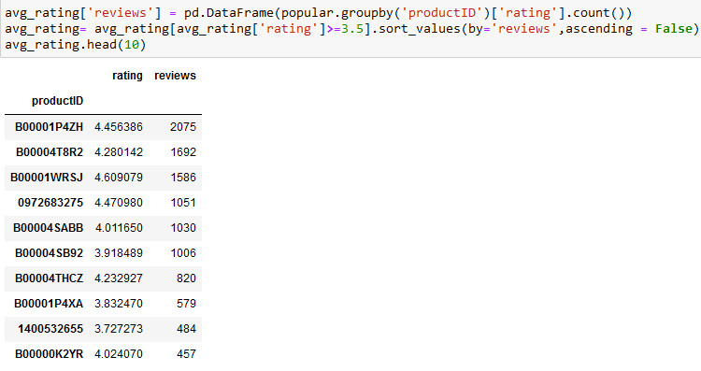

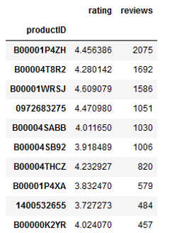
Popularity Based Recommendation

Slide 17
Memory-Based Collaborative Filtering
Split the data into training and testing (75% and 25% respectively)
1
Use KNN with means with Pearson baseline similarity measure.
2
Train the model
3
Test the model
4
Evaluate the model using RMSE
5

Slide 18


Prediction
[Prediction(uid='A2XNOB1T796Y6B', iid='1400532655', r_ui=4.0, est=4.123157620946766)

Slide 19
Model Based Collaborative filtering.

Slide 20

Singular Value Decomposition (SVD)
Dimensionality reduction technique
SVD is a matrix factorization technique, which reduces the number of features of a dataset by reducing the space dimension

Slide 21
Thank you

