Slide 1


26/10/23
By LifeSync

Slide 2
Project Overview
Roles
Class – SD3a:
Robert Nugent – Team Lead/ Front-end Developer
Patrick Orjieh – Back-end Developer/ Database Management
Conor McGinn – UI Designer/ Lead Tester
Hannah Mc Elroy – Hardware Manager/ Front-end Developer

Slide 3
Project Overview
Project Overview
Wearable Wristband
Air Quality Monitor
Connectivity with mobile app
Designed for people with late-stage asthma
Made to avoid possible asthma attacks
Environmental Triggers

Slide 4
Project Overview
Concept & Use Case
Main UDP Principle: Equitable use
Persona: Michael, the middle school teacher
Preconditions: Charges wristband, connected to app
Scenario: → Wears wristband
→ Real-time air quality monitoring
→Change of LED colour
→ Reacts to environmental changes
→ Makes informed decision

Slide 5
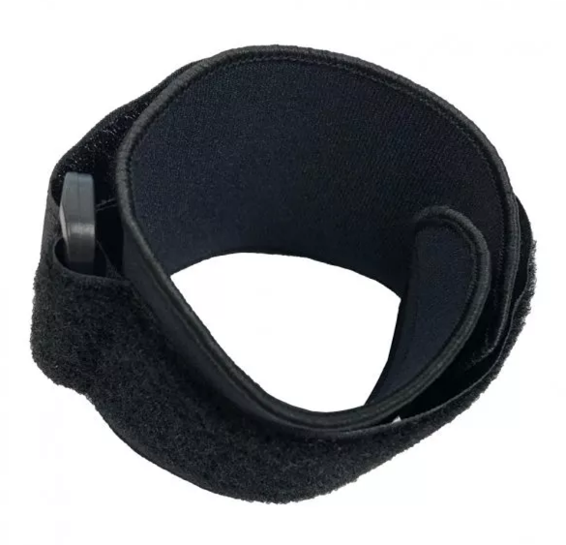
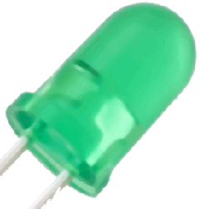
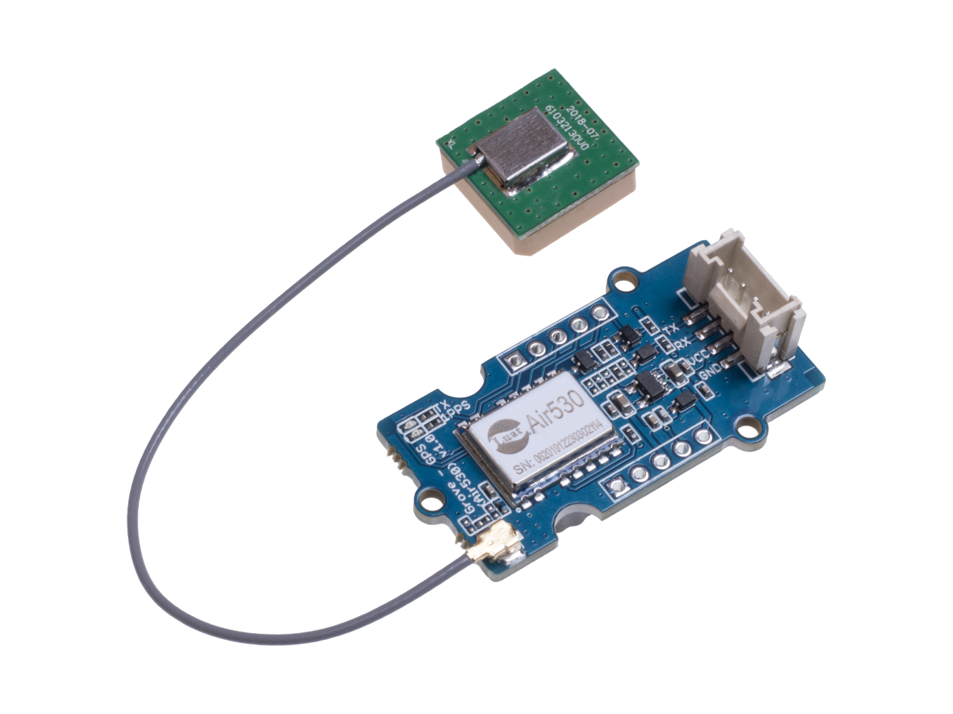
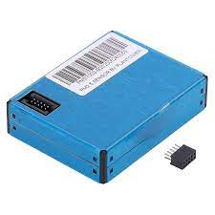
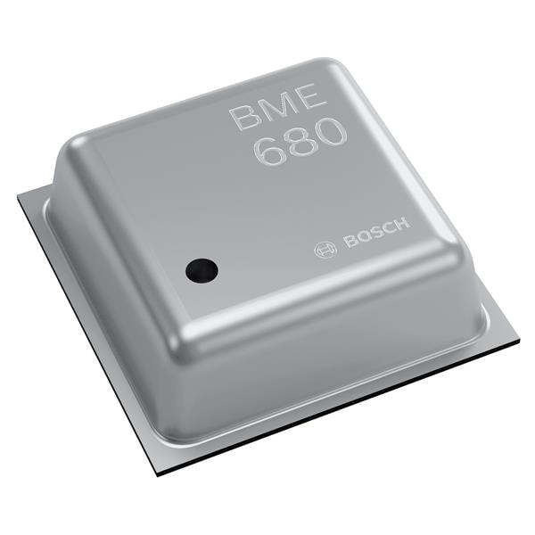
Project Overview
Hardware
Velcro Wristband
Sensors
LED
PM Sensor (PMS7003)
Gas Sensor Array (BME680)
GPS Sensor (Grove)

Slide 6
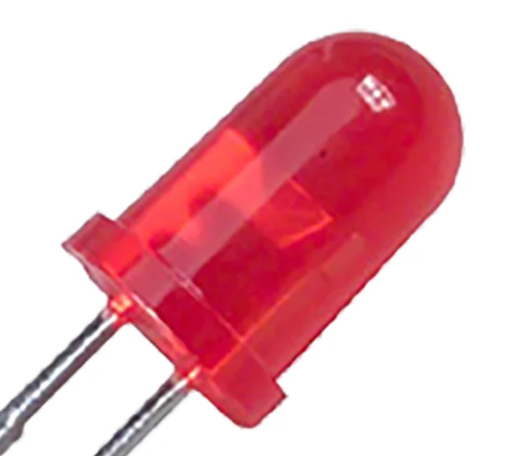
Project Overview
Scenarios
Scenario: Michael takes his students outside for an outdoor lesson and feels a vibration on his wrist.

Slide 7
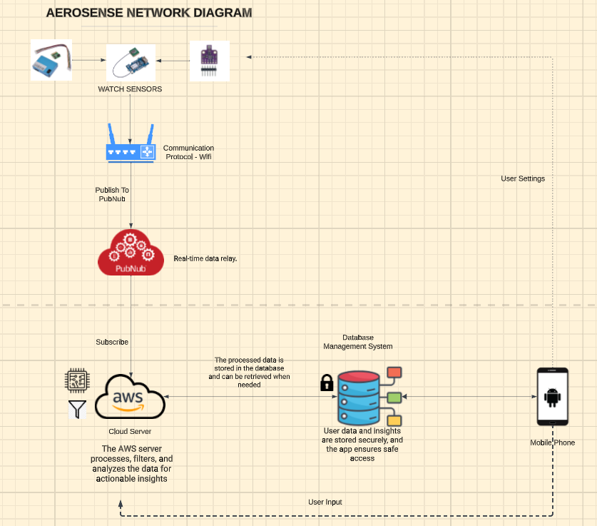
Project Overview
Flowchart

Slide 8
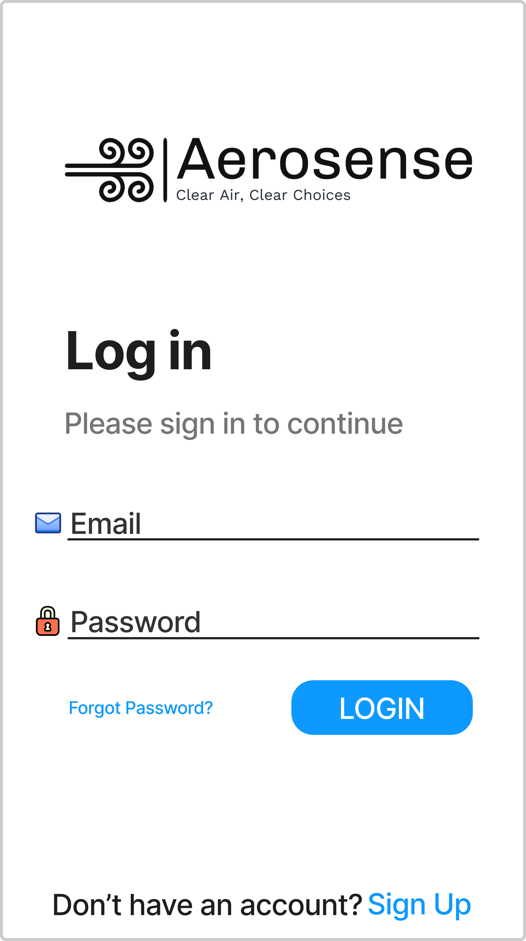
Project Overview
Scenarios
Scenario: Michael wishes to access his AeroSense app to view the current air quality stats.

Slide 9
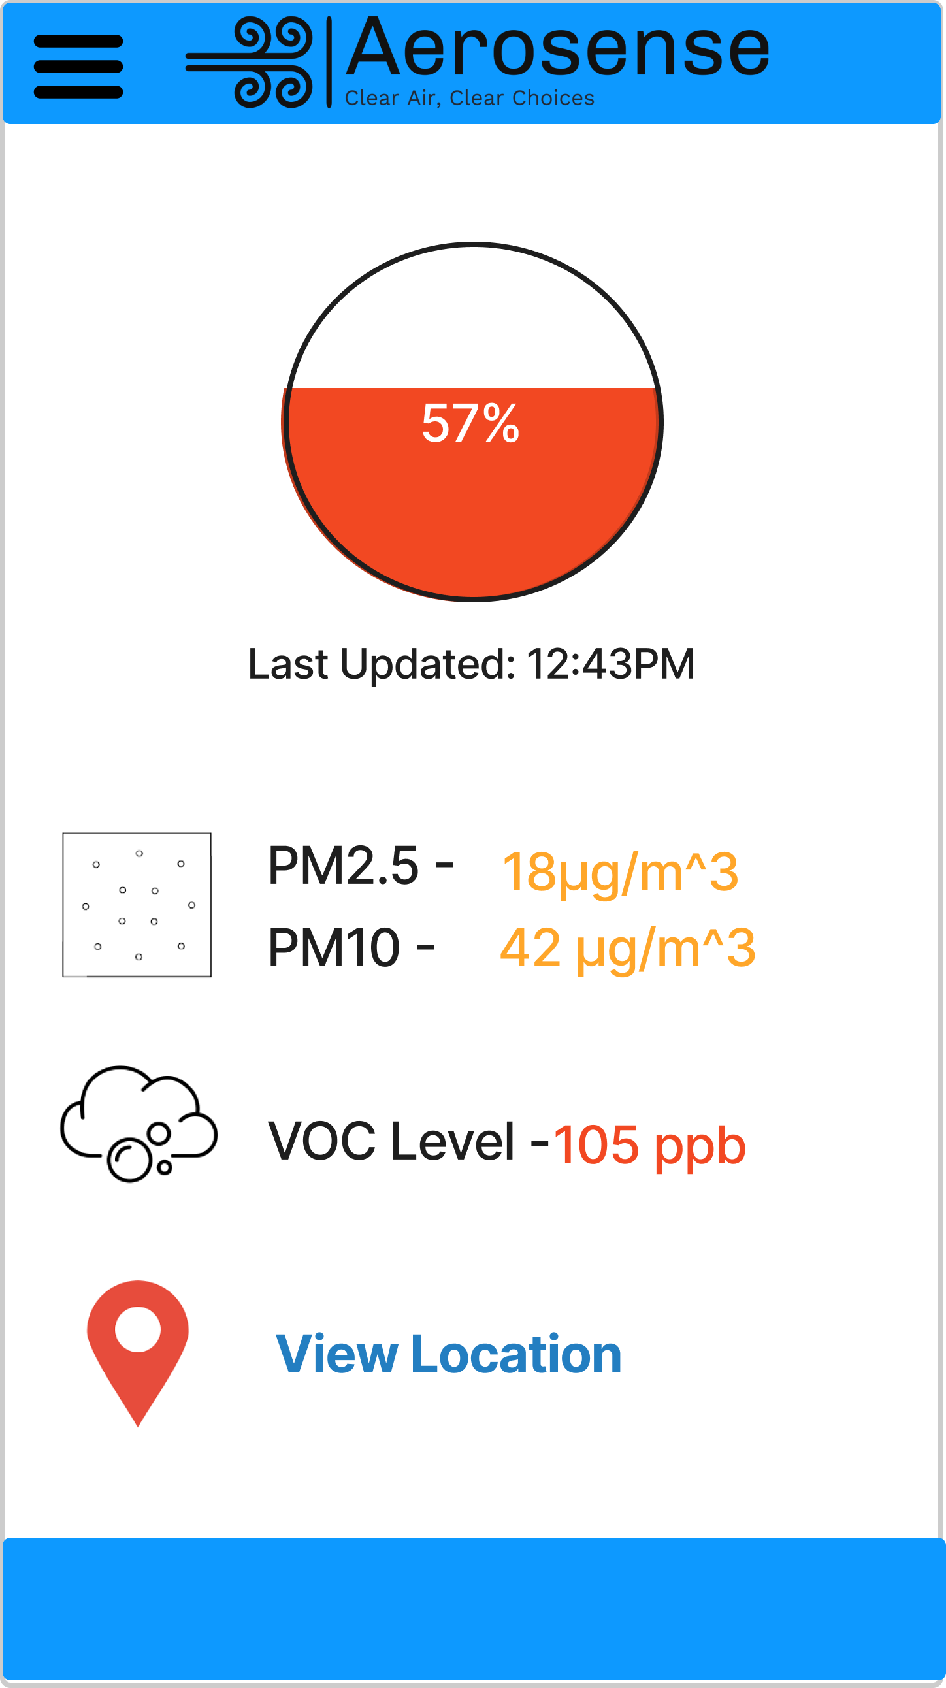
Project Overview
Scenarios
Scenario: Michael has now gained access to his stats and wants to view more detail about the current bad deteriorating air quality.

Slide 10
Project Overview
Key Interactions with the System
Accessing stats page via received notification
Reviewing current air quality in their surrounding area
Viewing bad air quality areas near their current location
Reviewing average air quality over a period of time

Slide 11
Project Overview
MoSCoW Rules
Must have: Air quality monitoring using sensors, clear alerts, app connectivity, notifications
Should have: GPS integration, user-friendly design, low battery notification, review air quality over time
Could have: Monthly reports, integration with other health apps, community sharing features
Would like to have: User guides for band and app, Integration with daily planner apps

Slide 12
Project Overview
Security and Privacy
Sensitive data
Data Encryption
User authentication
Data Access Control

Slide 13
Thanks for Listening!

