Slide 1

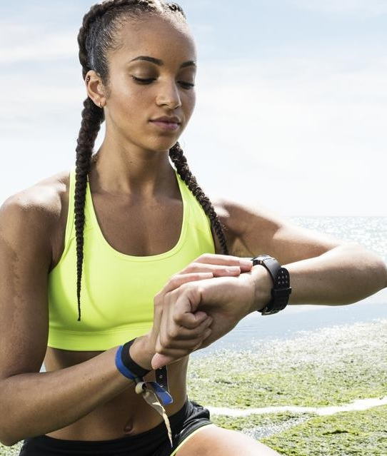

Optiband
By LifeSync

Slide 2
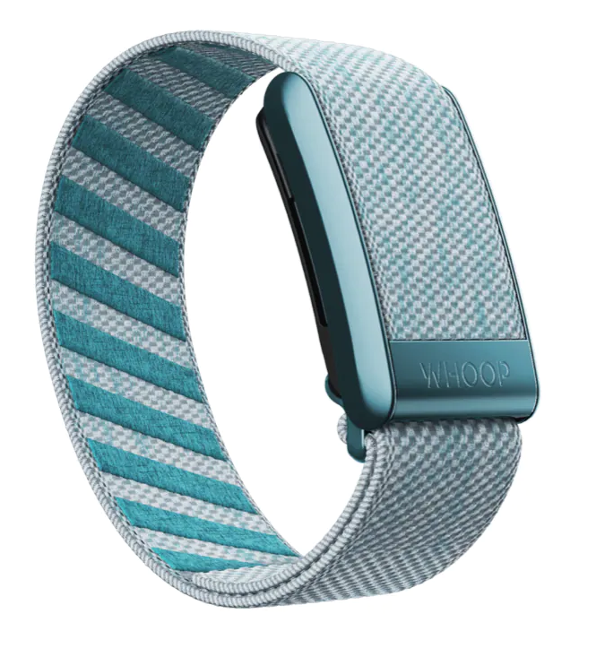
Project Scope
Develop a wearable fitness tracker
Aid in achievement of optimal exercise
Monitor user stats to provide guidance
Avoidance of overexertion
For teenagers/young adults new to the gym

Slide 3
Hardware Overview
Insert Hardware info here

Slide 4
Functional & Non-functional Requirements
Functional:
Heart rate and Oxygen Saturation monitoring
User Data Input
Real-Time Feedback
Workout Duration Timer
Connectivity with Mobile App
Non-Functional:
Usability
Battery Life
Durability & build
Data security & privacy
Responsiveness

Slide 5
U/T/S/E Analysis – Average user
User – Some gym experience, uses technology regularly
Task – engage in effective workouts without over exhaustion
System – Valuable workout assistant & safety device
Environment – Local gym, distractions: other gym-goers

Slide 6
System Conceptual model design
Hardware Components – Sensors, Bluetooth module, Battery
Software Components – Mobile App, Account Management, Data Storage, Notifications
User Experience – UI Design, User Feedback

Slide 7
Thanks for listening!

