Slide 1
ENSF 592 Final Project
Authors: Patrick Pickard, Joshua Posyluzny
Presentation Date: August 13, 2020

Slide 2
Project Topics
Area of Interest
Grid The City
Master DataFrame
Data Visualization
Conclusion

Slide 3
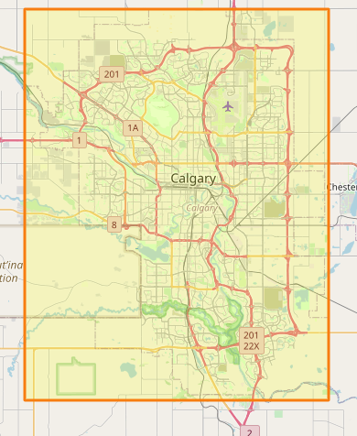

Area of Interest
The goal of this project is to analyze various traffic data inside the following orange square section, which defines the maximum boundaries of the city of Calgary, and attempt to draw correlations between the data and the number of incidents that occurred inside this area in 2018.

Slide 4
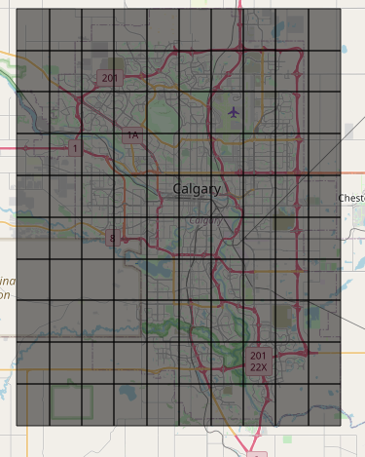
Grid The City
The city grid was built using the pd.cut function from Pandas to build 10 equal size bins for both latitude and longitude using the max and min of each. The bins were then used to create the grid breakdown inside the DataFrame and the GeoJson file that was used to generate the Choropleth maps.

Slide 5
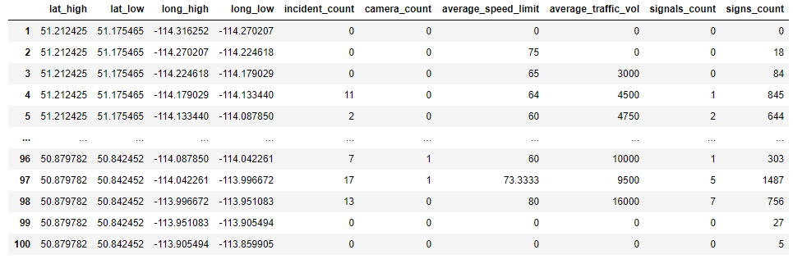
Master DataFrame
Our Master DataFrame is organized as follows:
Index refers to the grid number. Grids start at the top left of the map, and go left to right, up to down
lat_high, lat_low, long_high, and long_low define the boundaries of each grid
Data for the remaining columns/features are found using loops to traverse the cleaned data to find how many of each feature occur in each grid, and the counts/averages for each feature are displayed for the grid

Slide 6
Data Visualization
The following slides will show visualization for the analyzed data in the forms of maps and plots

Slide 7
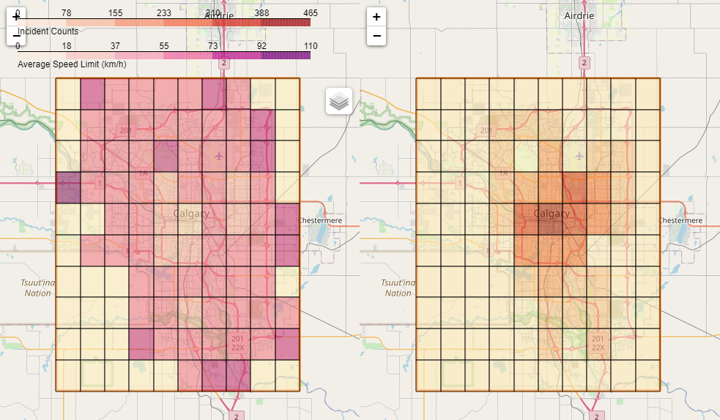
Traffic Incidents vs Average Speed Limits
These data show the lowest correlation.

Slide 8
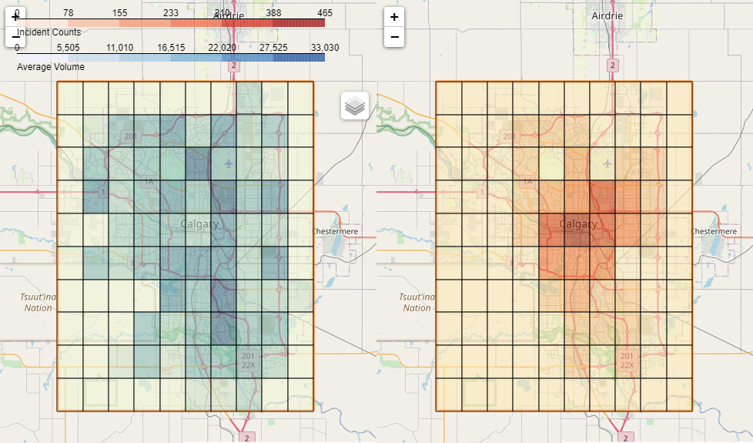
Traffic Incidents vs Average Traffic Volume
These data show very strong correlation.

Slide 9
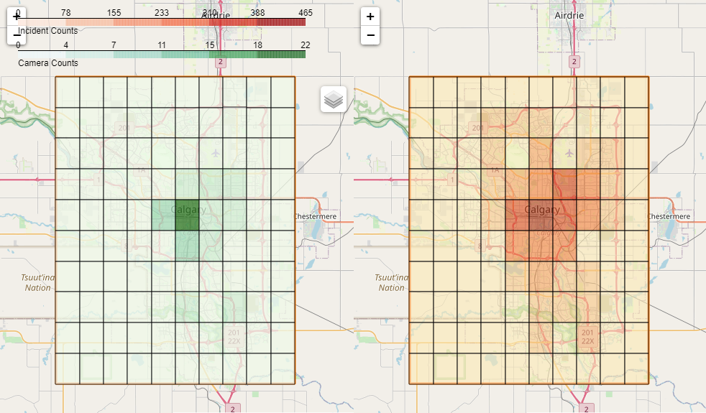
Traffic Incidents vs Traffic Cameras
These data show very strong correlation.

Slide 10
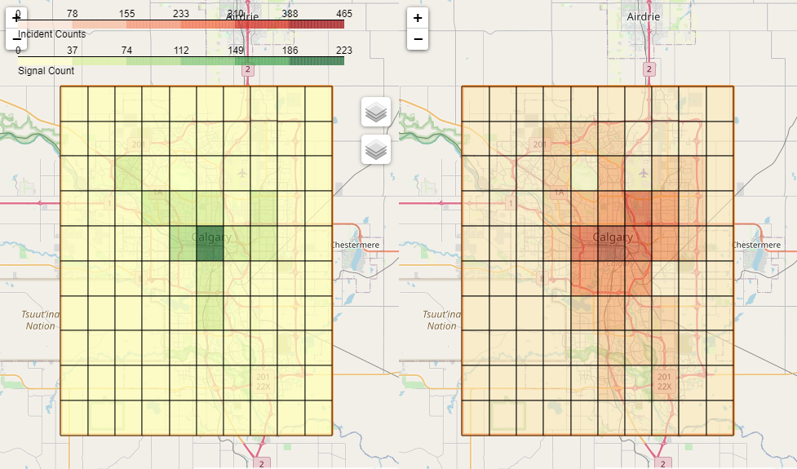
Traffic Incidents vs Traffic Signals
These data show the strongest correlation.

Slide 11
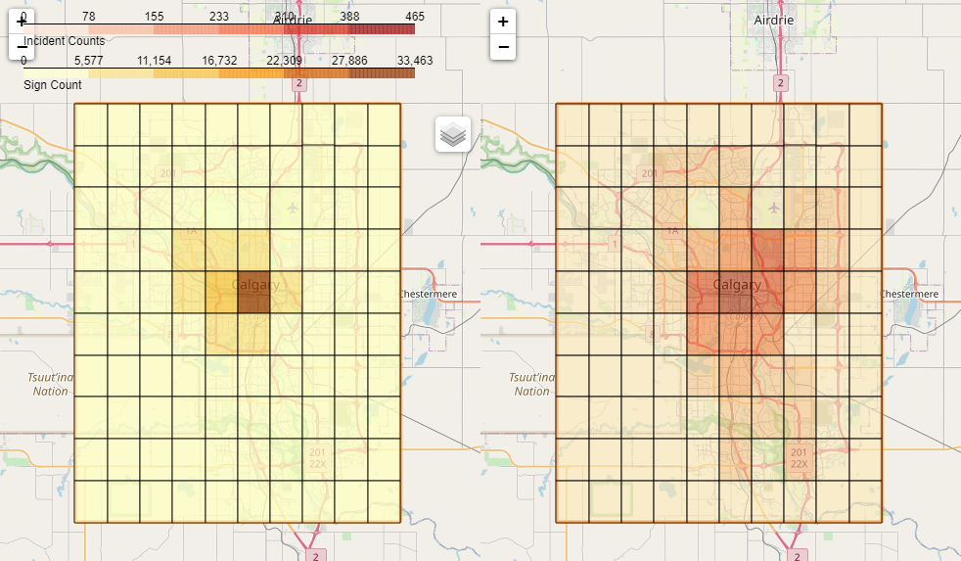
Traffic Incidents vs Traffic Signs
These data show very strong correlation.

