Slide 1
Building Cloud Native Applications using Spring Cloud

Slide 2
Agenda
Spring Cloud Background
Spring Cloud in Action
Spring Cloud Kubernetes
Questions?
Notes:
Where it came from?
Why you would use it?
Why its important?
How can it help you?
Some live coding?
Spring Cloud Kubernetes
Questions

Slide 3

Survey Time
Notes:
Who is already familiar with Spring Framework? Spring Boot? Raise your hands!
Who has already heard of Spring Cloud or played some time with it?
Who is an expert in Spring Cloud? You shouldnt be here -> Go to a different sessions maybe?

Slide 4
Why Spring Cloud?
In general, cloud native apps are a good thing, just not easy
Follow the Spring Boot model of providing useful defaults for Cloud Native apps with the ability to easy configure them
Cloud Agnostic
Notes:
It’s easier said than its done
Add dependencies to Maven, put some annotations in there, maybe define some properties and there you go with your shiny cloud native service

Slide 5
Spring Cloud Components
Configuration
Service Discovery
Circuit Breakers
Routing and Messaging
API Gateway
Tracing
Consumer Driven Contracts
Notes:
Let‘s take a look at the core components, or some core components that make up the spring cloud ecosystem
Spring Cloud Config Server and Client for centralized Configuration
Service Discovery needed in any Cloud environment -> dynamic nature of the cloud makes it more complicated to find the bunch of services you deployed some time earlier
Circuit Breakers help to cope with failure, they help to isolate service failures from each other, preventing cascading failure
Somehow your services need to communicate with each other. Having a way to communicate is quite important
API Gateway can be quite important depending on the environment. It is the entry point to your service landscape, handling routing, filtering, load shedding etc.
Observability is quite at the uprising of attention in cloud environments. It is quite important to trace the messages through your service landscape.
Spring Cloud Contract to verify your inter-service communication

Slide 6

However, the list goes on …
Spring Cloud Bus
Spring Cloud Open Service Broker
Spring Cloud Cluster
Spring Cloud Data Flow
Spring Cloud Stream
Spring Cloud Task
…
Notes:
The number of projects is still growing, I‘m not going to talk about all, I am only talking about the ones that I think are important for beginners and people gravitate towards to just get started.

Slide 7
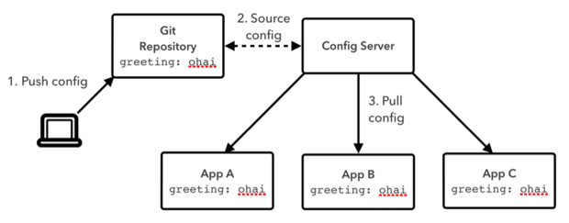
Configuration
We want to remove the configuration out of the application to a centralized store across all environments
Possible to use Git, SVN, filesystem, JDBC etc.
Config clients retrieve the configuration from the server at startup
Can be notified of changes and process changes in a refresh event
https://docs.pivotal.io/spring-cloud-services/1-5/common/config-server/index.html
Notes:
Who hasn’t stumbled across these nasty applications, having configuration properties hardcoded in some Java classes, or set in some shell install scripts, or configuration determined at build time, bundled with the resulting package?
Suddenly configuration is invalid, changes without any trace or imagine the following situation:
You have to change a single property and suddenly you have to change the file, code or whatever, build a JAR and run through the whole build and deployment pipeline.
With Spring Cloud it is possible to remove the configuration out of the application following a more centralized approach.
The configuration can be stored in Git (most common way) or in SVN, the filesystem, can be fetched using JDBC or any other custom approach.
With that comes versioning, traceability and overall increased transparency and flexibility.
When changing the configuration the Config Server reloads the configuration (e.g. udpates its local Git repository). Then you can either restart the application effected, or the Config server notifies the affected applications, depending on your environment.
https://spring.io/blog/2015/01/13/configuring-it-all-out-or-12-factor-app-style-configuration-with-spring

Slide 8
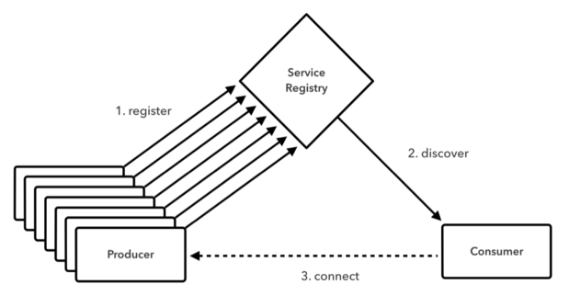
Service Discovery
With the dynamic nature of any cloud native application, depending on things like URLs can be problematic
Service Discovery allows applications to easily discover the routes to the services it needs to use
Netflix Eureka
Zookeeper
Consul
Kubernetes
https://docs.pivotal.io/spring-cloud-services/1-2/service-registry/
Notes:
In cloud environments, the number of apps deployed, and their location can change from hour to hour, day to day, so its very dynamic. Suddenly you have the problem that you cannot hardcode URLs anymore.
You need a more dynamic and flexible approach, maybe also considering the health of a service ( Maybe it would be a good idea to know if a service is up or down before talking with it?). Service Discovery therefore allows applications to easily discover applications using the concept of „logical service names“
A couple of different backends are supported, like Eureka, Zookeeper, Consul, or directly trust the capabilities of your Kubernetes Cluster (more on that later)

Slide 9
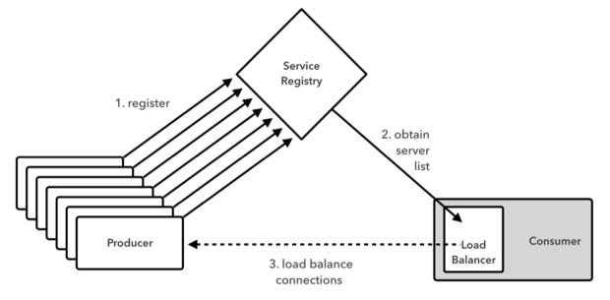
Routing and Messaging
Your cloud native app will be composed of many microservices so communication will be critical
Spring Cloud supports communication via HTTP requests or via messaging
Routing and Load Balancing:
Netflix Ribbon and Open Feign
Messaging
RabbitMQ or Kafka
https://www.javaworld.com/article/2927920/cloud-computing/build-self-healing-distributed-systems-with-spring-cloud.html
Notes:
Sooner or later you will end with just more than one service. So you will need a way how these services will communicate. This can be over HTTP and REST or some type of asynchronous messaging protocol as well.
Your application will talk to the service registry service, and figure out where is the service that I wanna make a request to located and use some form of routing and messaging to do this request.
Supported out of the box e.g. is Netflix Ribbon and Open Feign or RabbitMQ or Kafka for asynchronous messaging.
With this comes the ability of client side load balancing. The app can make decisions based on metrics, based on latency or whatever you need.
If you ask yourself why there is Netflix in there, Netflix is not only a video streaming platform, but also open sourced half of the stuff they built a couple of years ago, like Hystrix, Eureka, Ribbon, Zuul, etc.

Slide 10
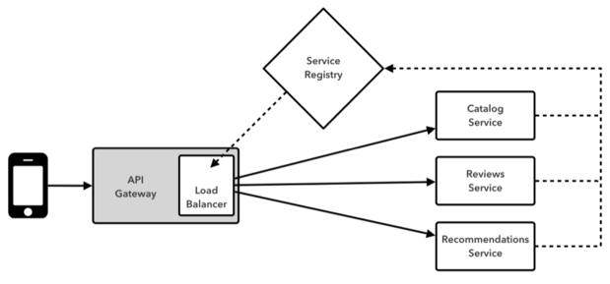
API Gateway
API Gateways allow you to route API requests (internal or external) to the correct service
Netflix Zuul
Spring Cloud Gateway
https://www.javaworld.com/article/2927920/cloud-computing/build-self-healing-distributed-systems-with-spring-cloud.html
Notes:
You want to have some gateway in between to insulate your services that make up your cloud native application and that‘s because, again, the number of services, type of services, the services themselves that you have today, can be quite different tomorrow.
Image you have a service, which becomes so large, your have to split it into smaller pieces. Clients which needed one API request before, now need two or more requests. Or you are migrating a monolith slice by slice, service by service. Without an API Gateway to abstract away these interna, you can run in a lot of troubles here.
Here you basically have the choice of Netflix Zuul, which leverages Ribbon, Service Discovery and so one, which we talked about a second ago.
Since last year there is also a new kid on the block: Spring Cloud Gateway. Both Zuul 2.0 and Spring Cloud Gateway are completely written in an asynchronous and reactive way, with all pros and cons. The only difference is: Netflix took so long with releasing Zuul 2.0 Spring decided to make their own Gateway

Slide 11
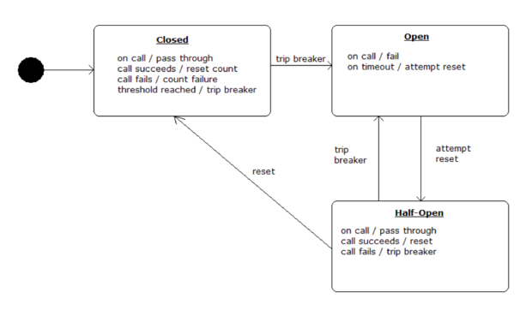
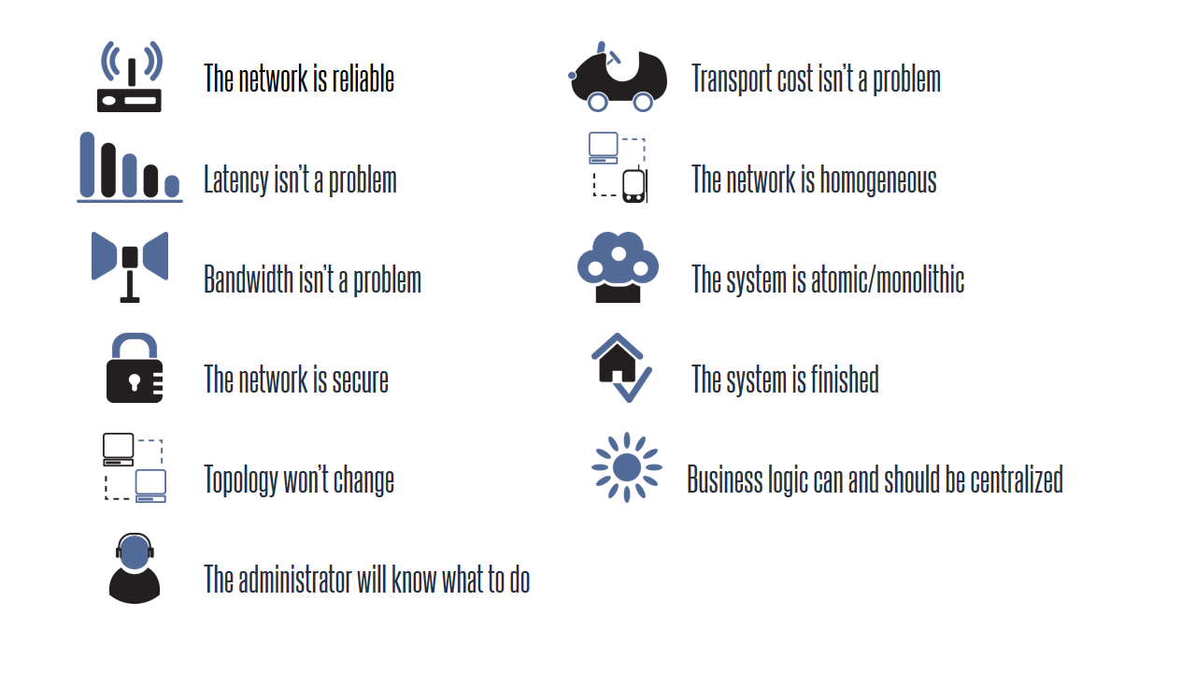
Circuit Breakers
Failure is inevitable, but your user’s don’t need to know
Circuit breakers can help an application function in the face of failure
Netflix Hystrix
Resilience4J
https://www.planetgeek.ch/wp-content/uploads/2014/03/Slide5.png
https://www.javaworld.com/article/2927920/cloud-computing/build-self-healing-distributed-systems-with-spring-cloud.html
Notes:
Failures can happen, but you typically don‘t want your users to notice
Circuit breakers can help to cope with this. Imagine sending an API request, to another service, database or whatever. If this request fails, and it will sooner or later, you don't want your users to see nasty Stacktraces or anything.
If now the request times out, or blows in our face, the circuit trips. Which avoids sending massive loads of requests to already overloaded services, but instead maybe returning the last good cache data that we had.
Then periodically, we let some requests go through, to kind of test to see if something’s actually working again.

Slide 12
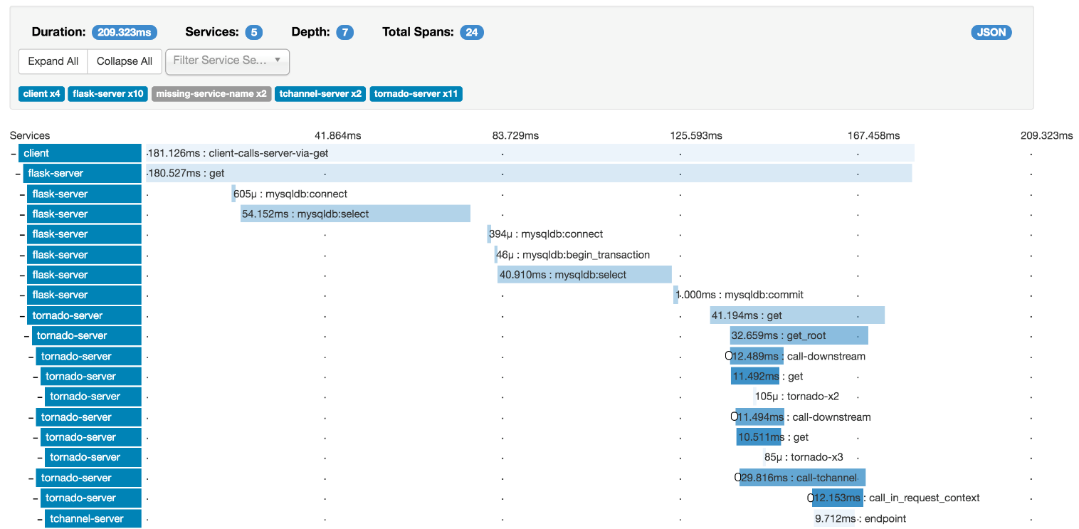
Tracing
A single request to get data from your application may result in an exponentially larger number of requests to various microservices
Tracing these requests through the application is critical when debugging issues
Spring Cloud Sleuth
Zipkin
In-Memory
Cassandra
ElasticSearch
https://zipkin.io/
Notes:
You mostly have a number of microservices, talking to each other, and of course you want to see what's going on there, especially when stuff goes wrong.
Basically you have a bunch of requests now, inside your service landscape, how are you going to find out which belong together?
This is where Spring Cloud Sleuth comes in, it instruments the most common libraries, like Feign, Hystrix, RxJava and basically every incoming and outgoing HTTP request of your Spring application, and adds correlation ids to every request.
The information can then be visualized using Zipkin, where you can search an filter for requests and services, analyze errors and latency issues

Slide 13
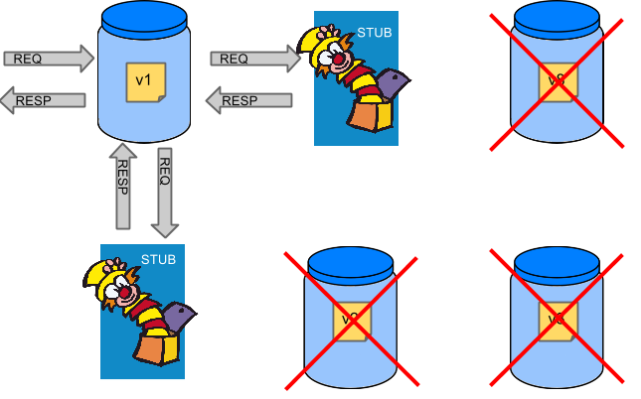
Consumer Driven Contracts
Testing your microservices all at once, is not possible in larger environments
Mocking and testing in isolation becomes necessary
Spring Cloud Contract
https://raw.githubusercontent.com/spring-cloud/spring-cloud-contract/1.0.x/docs/src/main/asciidoc/images/Stubs1.png
Notes:
As I already said, you will end up with a lot of services sooner or later, with a lot of communication in between. If you now want to test your whole system (remember, its always a good idea to check if your system as a whole is even working!),
You have to start every single service and then run your test scenarios.
As you might image, this is easier said than done, it is slow, it is expensive, it is complex and it is extremely hard to debug.
Another way to do it, is to mock the other services, which is faster, and easier to reason about.
And here is where Spring Cloud Contract comes to the rescue. It allows us to define contracts (imagine: if I send you this, I expect this response from you), which then allows for automatic creation of stubs and tests based on this contracts.

Slide 14

Coding…

Slide 15
https://github.com/PatrickRi/EMerge

Slide 16
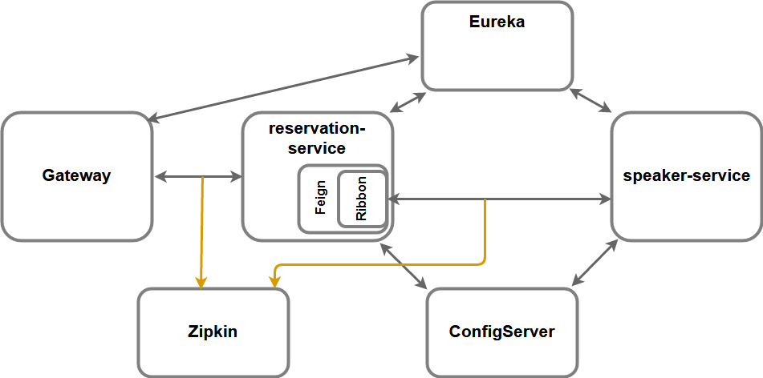

Slide 17
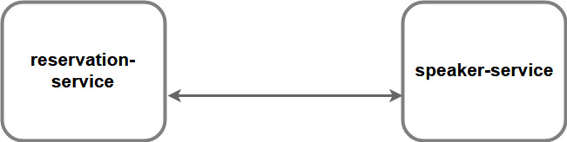

Slide 19
Spring Cloud Kubernetes
Spring Cloud | Spring Cloud Kubernetes
DiscoveryClient (Eureka, Consul, ...) | DiscoveryClient (DNS, Eureka, Consul, ...)
Spring Cloud Config | Spring Cloud Config, ConfigMap, Secrets, gitcontroller
Ribbon | Ribbon, or integrated load balancing
Hystrix | Hystrix
… | …

Slide 20


