Slide 1
Predicting the direction of the DAX by using indicators

Slide 2
Table of Contents
1
2
3
4
5
6
Objective
Data Collection
Data Cleaning
Processing
Model Training and Validation
Results

Slide 3
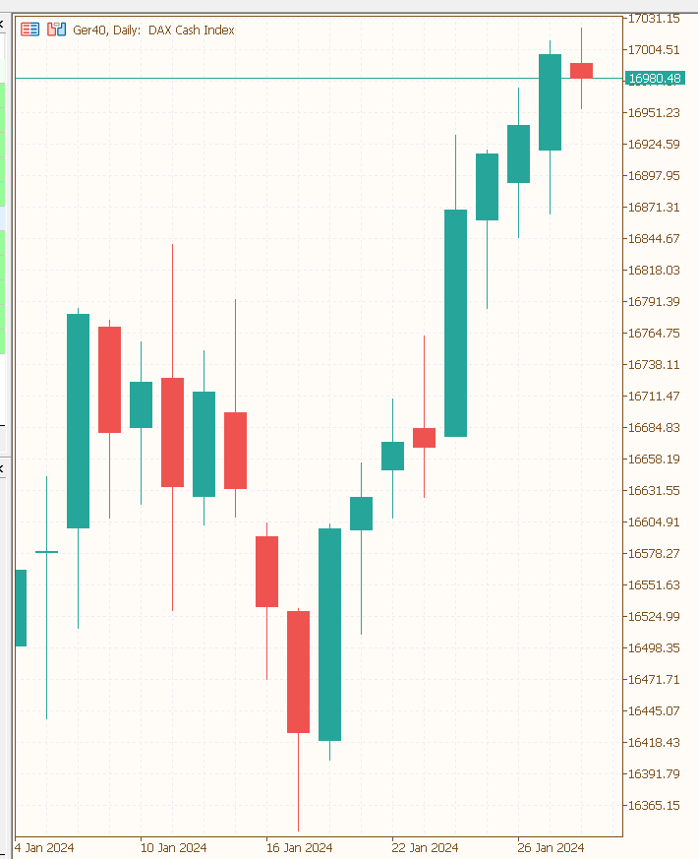
How does the data of a stock market look?
Objective
Collection
Cleaning
Processing
Modelling
Results
The typical representation of market prices is the candlestick chart
Each candle represents a period (in this example, one day)
Each candle contains four prices (open, high, low, close)
The direction can be defined by the difference between the close and open prices
When the difference is positive, the direction is upward; when the difference is negative, the direction is downward
high
close
open
low

Slide 4
How is the DAX calculated?
Objective
Collection
Cleaning
Processing
Modelling
Results
The DAX is calculated from the price of the 30 largest German companies
The price development of individual companies is generally influenced by supply and demand
There are many different factors that influence the market behaviors
Fundamental Data
Economic News
Technical Market Analysis
Profit
Revenue
Reports
Pattern
Indicators

Slide 5
Data Collection
Objective
Collection
Cleaning
Processing
Modelling
Results
I have collected data from 1987 to the present by using the yfinance library
The data includes open, high, low, close (OHLC) prices and the volume of the market
The target variable is the direction, calculated by the difference between close-price and open-price
As input variables, I have calculated multiple indicators across different timeframes

Slide 6
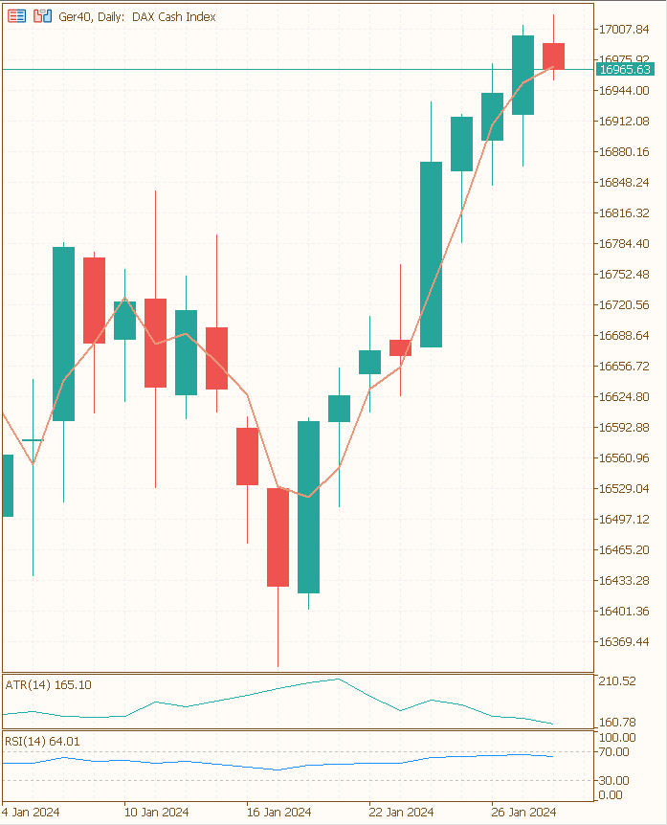
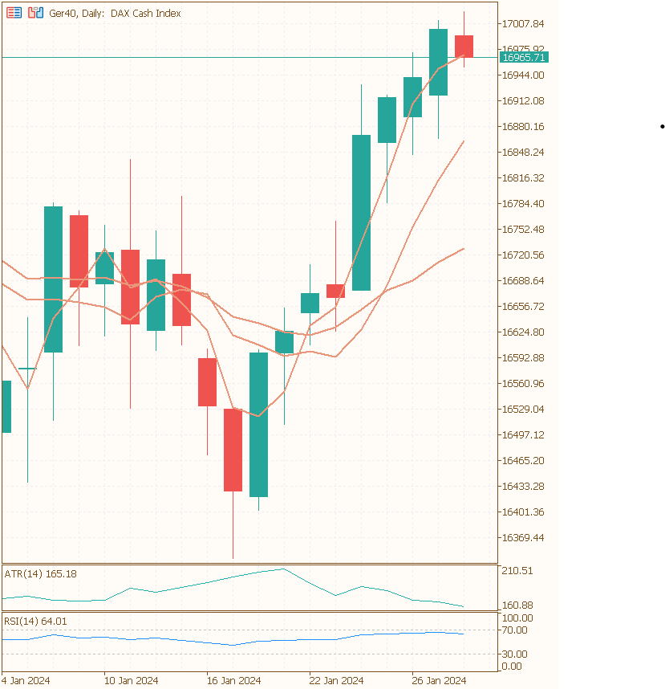
Indicators
Objective
Collection
Cleaning
Processing
Modelling
Results
Use 10 different types of indicators
Simple Moving Average
Relative Strength Index
Average True Range
Bollinger Bands
Each indicator was calculated for three different time periods
For each indicator that returns a market price, i created a categorical column
1 if the price is above the indicator price
0 if the price is lover then the indicator price

Slide 7
Data Cleaning
Objective
Collection
Cleaning
Processing
Modelling
Results
Before 2000 there are missing Values for the volume of the market
started from 2000
By computing an Indicator with a timeperiod of 14 day, the first 13 rows has missing values
I dropped the first 13 days

Slide 8
Time Dependency
Objective
Collection
Cleaning
Processing
Modelling
Results
 | open | low | high | close | moving average | direction
01.01.2024 | 5975 | 6048 | 5974 | 6048 | 6050 | Up
02.01.2024 | 6043 | 6058 | 6015 | 6032 | 6042 | Down
03.01.2024 | 6032 | 6047 | 5997 | 6034 | 6040 | Up
Notes:
In the table you can see an example for three observations. You can see the open, low, high and close price.
Also an example of an indicator and the direction calculated out of the close and the open price.
Because of the time dependency I need to ensure that each observation only includes informations from the past otherwise my model will not perform under realistic circumstances. So it allways will perform much better as in reality because it has information about the future.
I hope I can make this more clear with the following example:
An Indicator is an aggregated calculation with the past prices AND the current prices. Therefore i have set an offset to every indicator so that the calculation starts from the day before. Otherwise the Observation will have information from the future.
After calculating each indicator I also dropped every OLHC-price because it also contains information about the future and i was left with 60 different indicators and the direction.
If I would let these Informations in, the Model would already have all Information needed to calculate the direction.

Slide 9
Feature Selection
Objective
Collection
Cleaning
Processing
Modelling
Results
Varianace Threshold to drop features with a variance less then 0.02
Correlation Matrix to identify multicorrelarity with a threshold = 0.99
End up with 43 features
Transforming, Scaling and Sampling
Power Transformer
Min Max Scaler for X
My target is allready in a range between 0 and 1
Class Imbalance: Train-Set = 0.045 Test-Set = 0.044 -> So I did not use any sampling method

Slide 10
X-y Split
Objective
Collection
Cleaning
Processing
Modelling
Results
Data-Set
90 %
10 %
Data-Set
Validation-Set
70 %
20 %
Train-Set
Test-Set

Slide 11
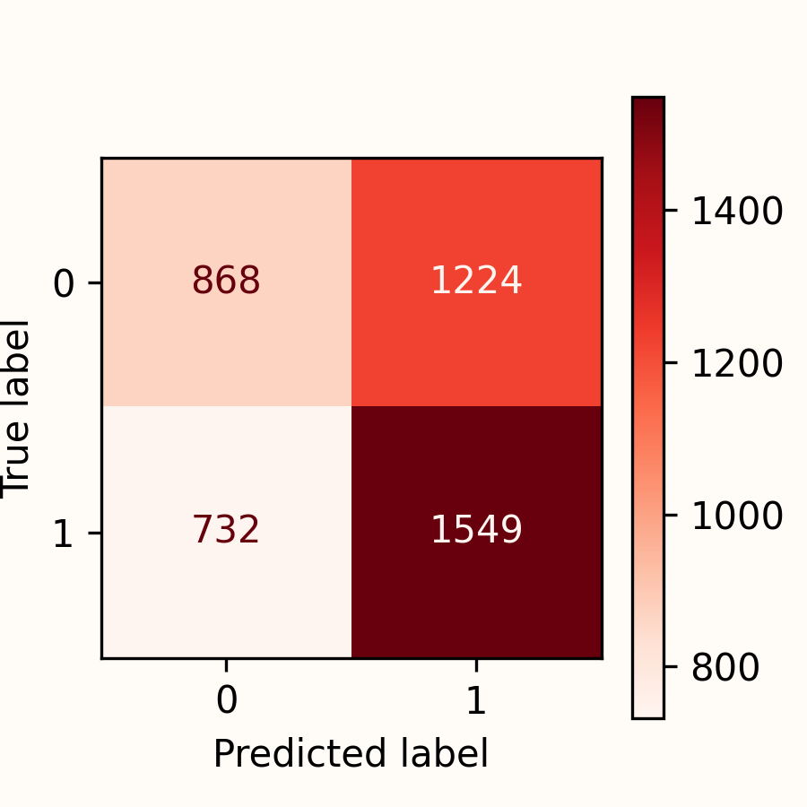
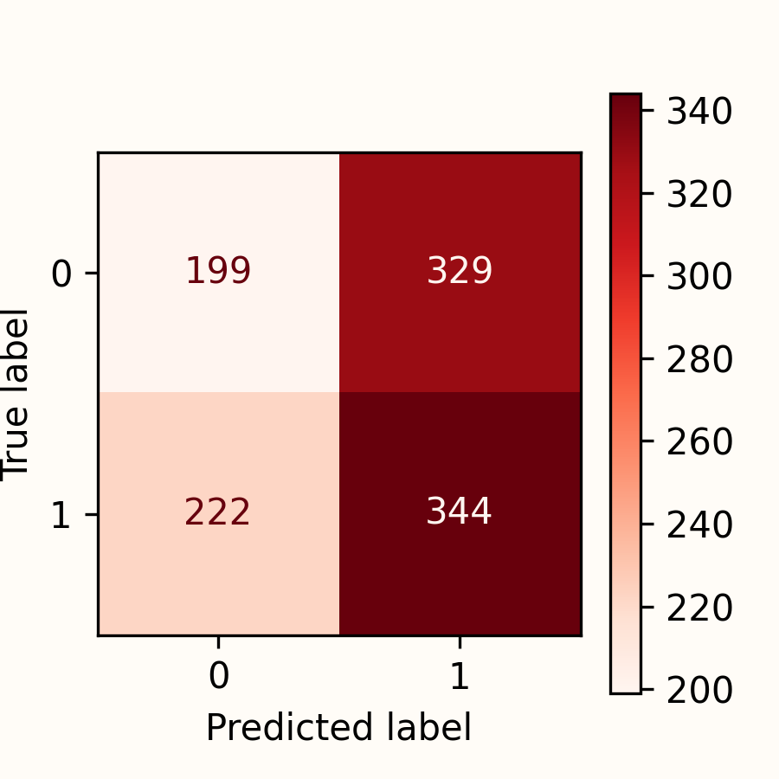
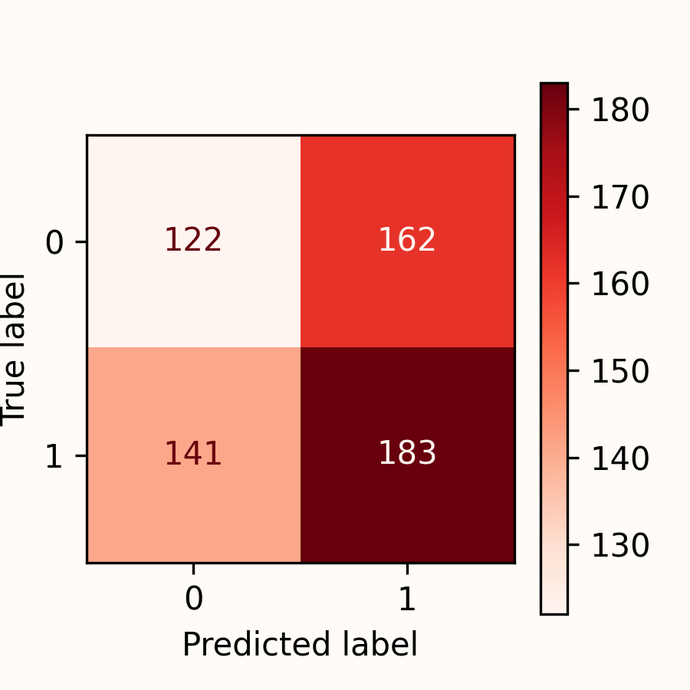
Logistic - Regression
Objective
Collection
Cleaning
Processing
Modelling
Results
Train-Set
Test-Set
Validation-Set
Accuracy |  | 0.552 |  | 0.496 |  | 0.501
Kappa |  | 0.094 |  | -0.015 |  | 0.005

Slide 12
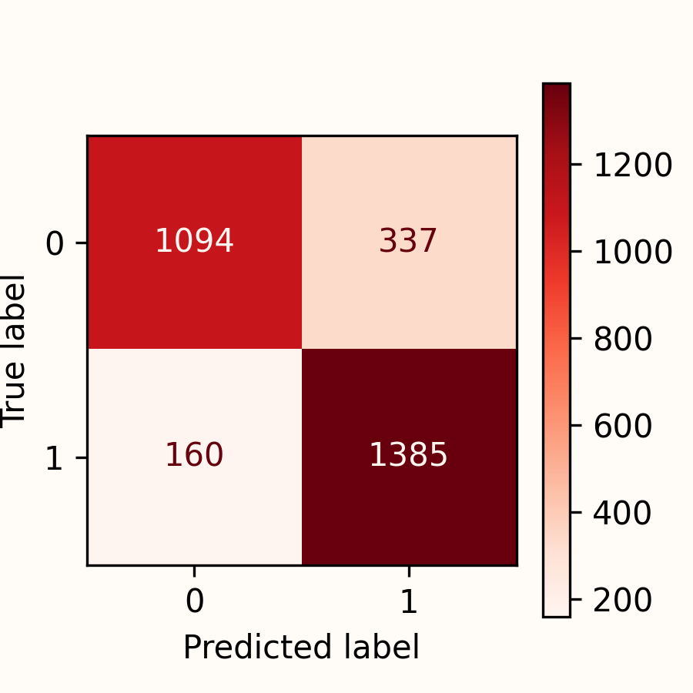
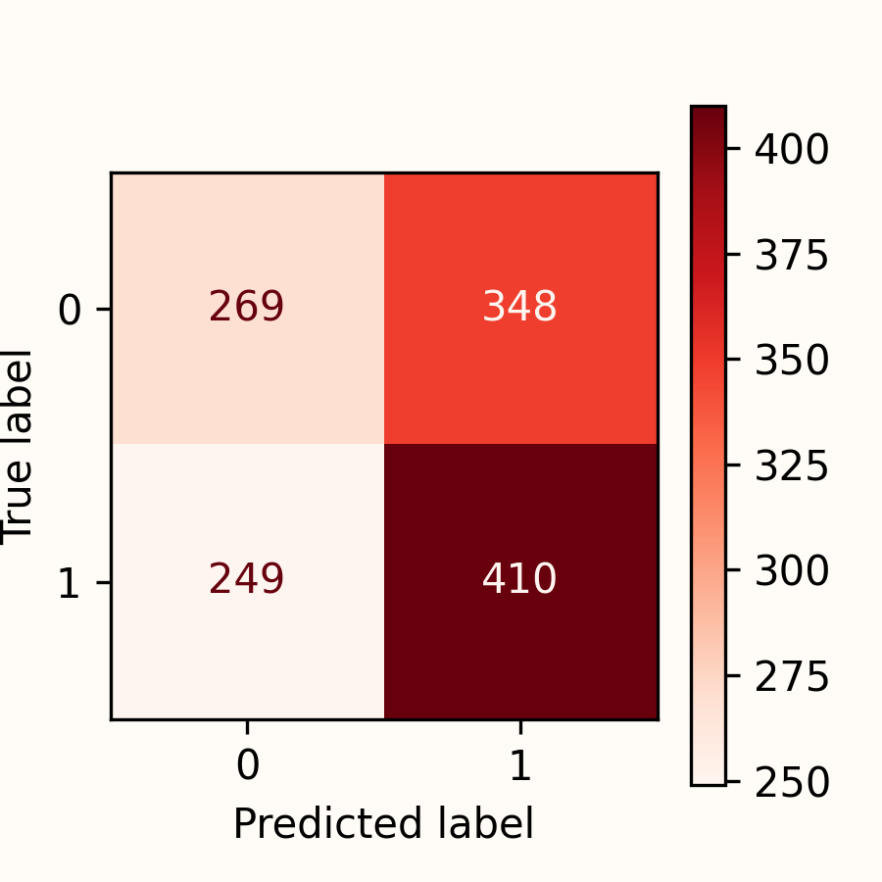
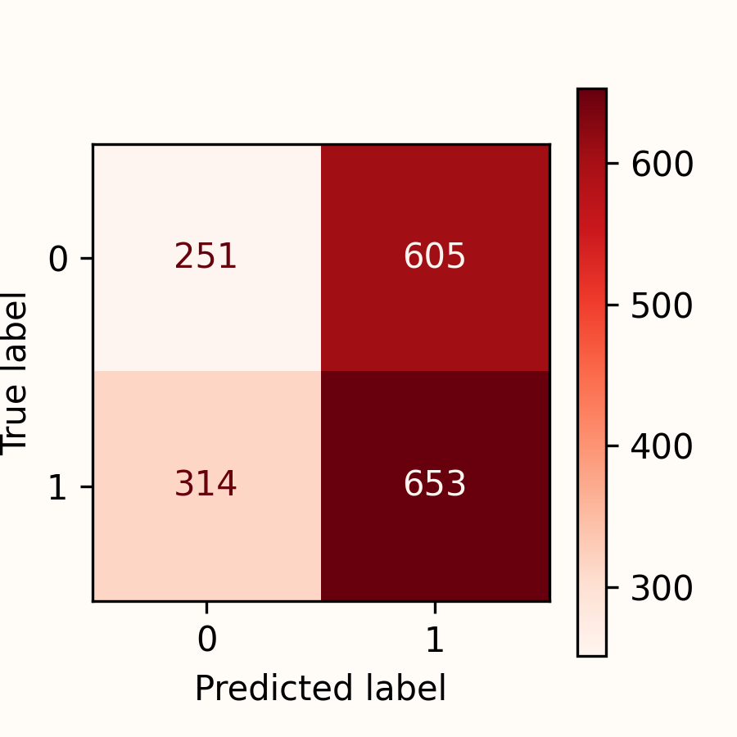
Random Forest with GridSearchCV
Objective
Collection
Cleaning
Processing
Modelling
Results
Train-Set
Test-Set
Validation-Set
Accuracy |  | 0.833 |  | 0.532 |  | 0.495
Kappa |  | 0.664 |  | 0.058 |  | -0.032

Slide 13
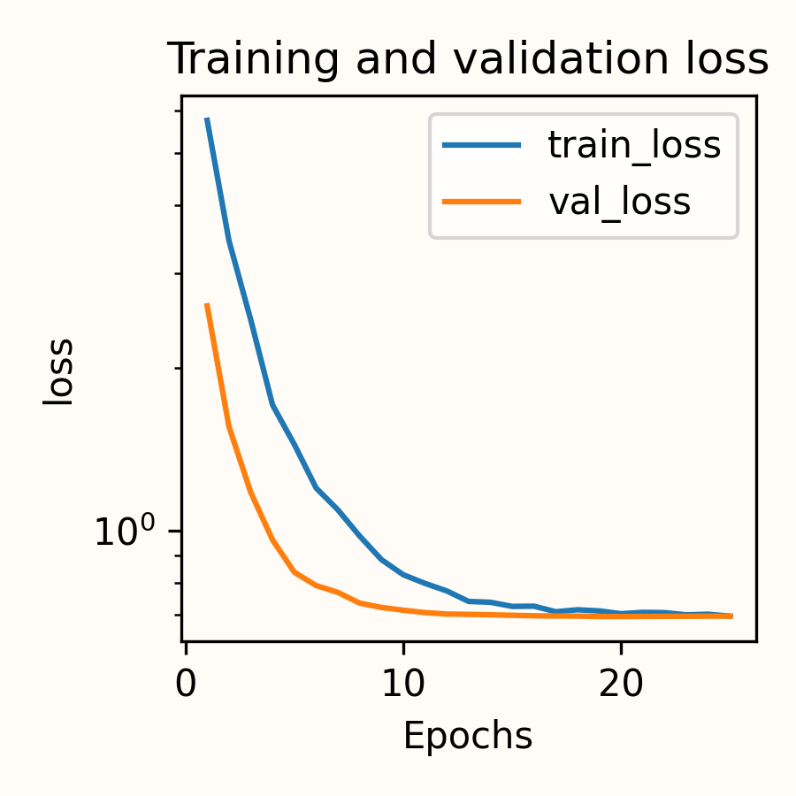
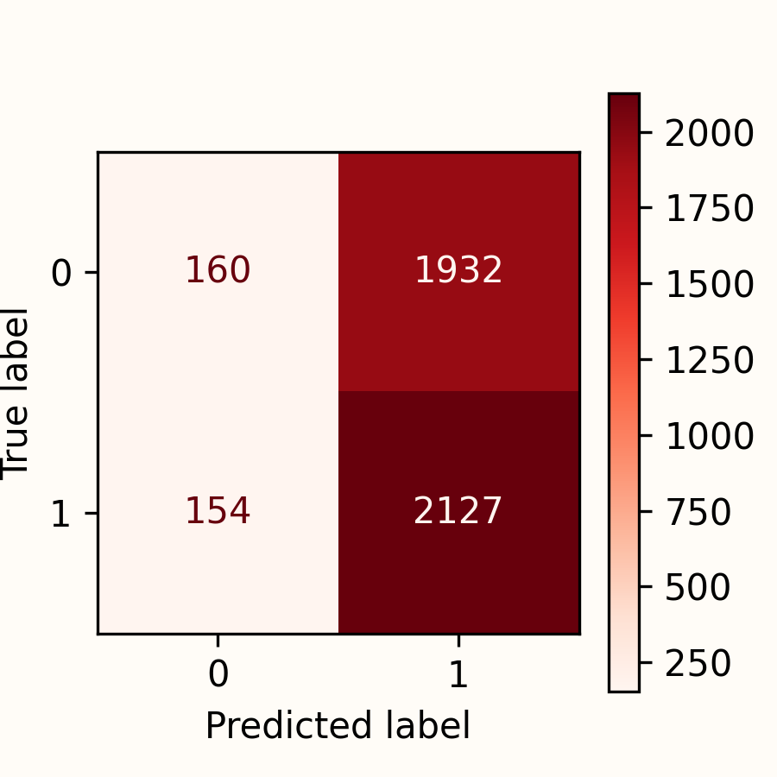
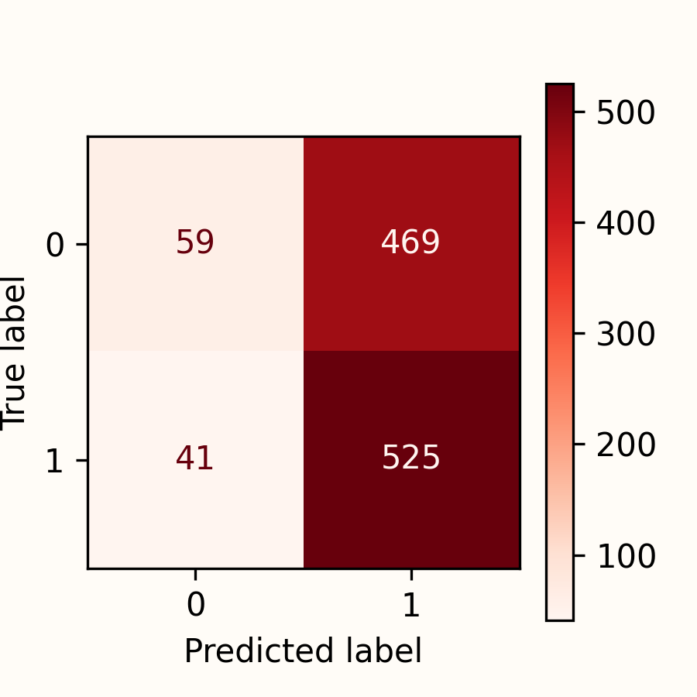
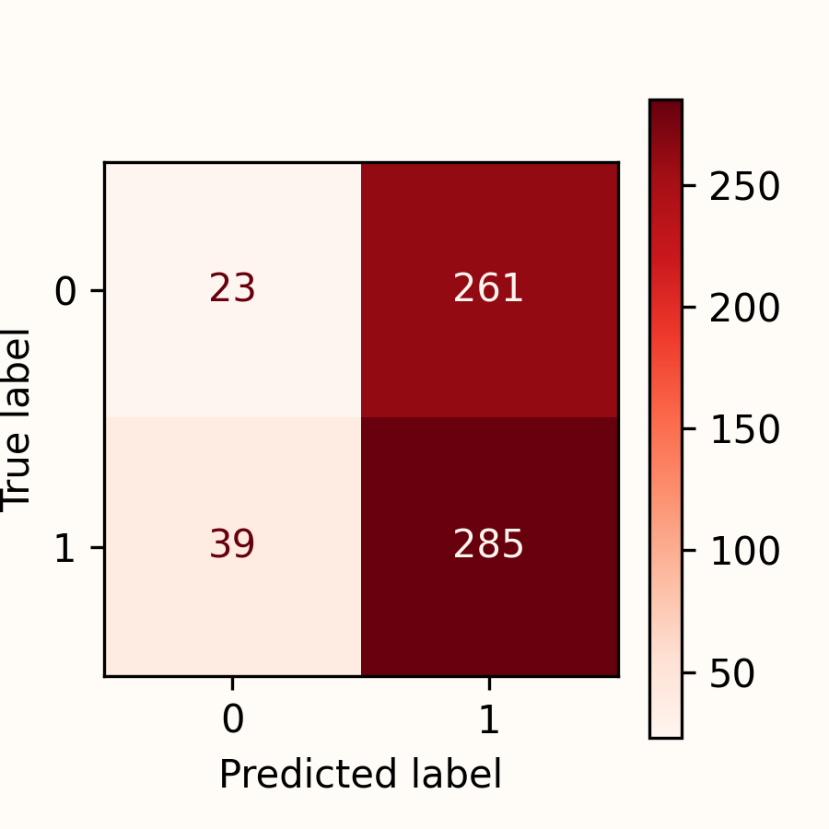
Neural Network
Objective
Collection
Cleaning
Processing
Modelling
Results
Train-Set
Test-Set
Validation-Set
Accuracy |  | 0.553 |  | 0.533 |  | 0.506
Kappa |  | 0.009 |  | 0.040 |  | -0.041

Slide 14
Final Results
Validation Set | Accuracy | F1 | Recall | Precission | Kappa
Logistic Regression | 0.502 | 0.547 | 0.565 | 0.530 | -0.006
Random Forest | 0.498 | 0.593 | 0.685 | 0.522 | -0.030
Neural Network | 0.506 | 0.655 | 0.879 | 0.522 | -0.041
The performance of all models is realy bad -> they are not practical for actual use
Financial markets are known for their unpredictability and constant changes
The performance of a model heavely relies on the input
Next Steps: Is there an improvement, if I add features from different sources like more pattern related indicators and fundamental data from the companies?

Slide 15
Thank you for your attention!
- Better trust a goldfish then my model! -

