Slide 1
Predicting the direction the Stock Market

Slide 2


Slide 3
Inhalt
Objective
Collection
Data Cleaning
Missing values
Computing indicators
Exploration
Processing
Model training
Model validation
Results

Slide 4
Objective
Pridicting the direction of a Stock Market
Wie entsteht der Preis?
Nur technische Analyse keine Wirtschaftsdaten Fundamentaldaten

Slide 5
Collection

Slide 6
Data Cleaning

Slide 7
Exploration

Slide 8
Processing

Slide 9
Model training

Slide 10
Model validation

Slide 11
Results

Slide 13
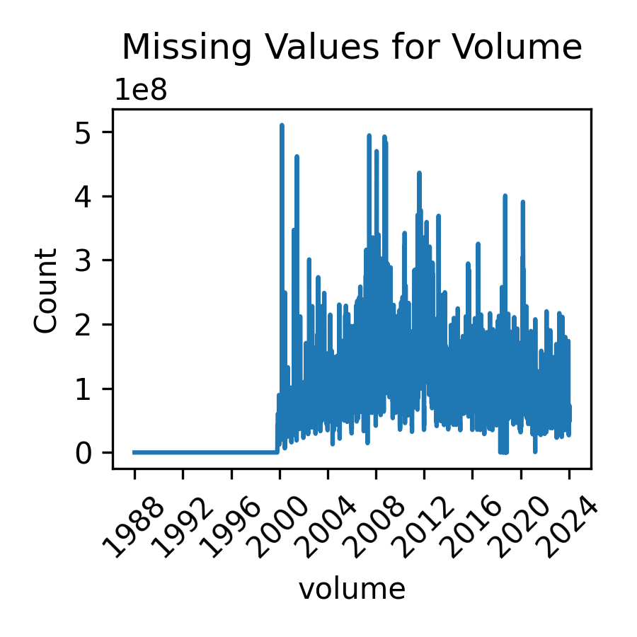
Cleaning
Missing values for volume before year 2000

Slide 14
Technical Analyis

Slide 15
Workflow
Model sprecification
Fitting
Prediction
Evaluation

Slide 16
Time dependent observations
Univariate data
Repeated obeservations over time from a single variable or kind of measurement
Multivariate data
Repeated observations over time from multiple related variables or kinds of measurements
Panel data
Repeated obseravations over time on multiple independen experimenttal units from one or more related variables or kinds of measurements

Slide 17
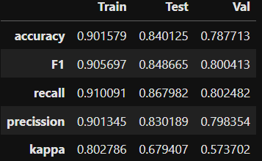
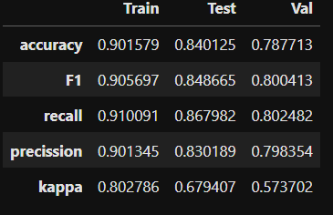
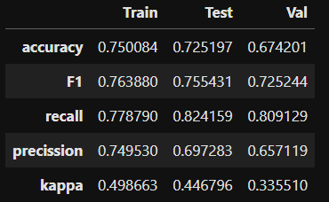
Error Metrics
LR with pos
Pos as numeric with transfrom/scaling
LR with pos
Pos as categroical without transform/scaling
Different indicator lenght parameters (bigger)

Slide 18
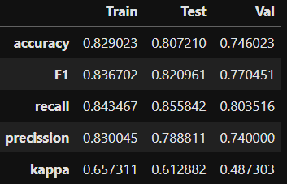
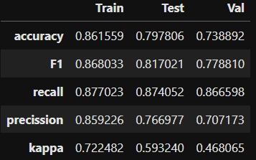
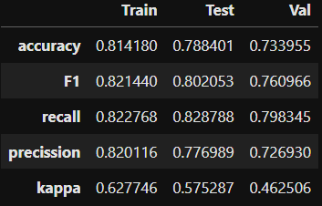
Offset
l_low = 3
l_mid = 7
l_high = 14
offset = 0
Richtige variante
l_low = 3
l_mid = 7
l_high = 14
offset = 1
l_low = 3
l_mid = 7
l_high = 14
offset = -1

